Slide 1
Chapter 1: Introduction

Slide 2
Objectives
To describe the basic organization of computer systems
To provide a grand tour of the major components of operating systems
To give an overview of the many types of computing environments
To explore several open-source operating systems

Slide 3
What is an Operating System?
An operating system(OS) is a program that manages a computer’s hardware:
provides a basis for application programs and
acts as an intermediary between the user and the computer hardware.
Operating system goals:
Execute user programs and make solving user problems easier.
Make the computer system convenient to use.
Use the computer hardware in an efficient manner.

Slide 4
Computer System Structure
A computer system can be divided into four components (Figure 1.1):
Hardware
provides basic computing resources such as CPU, memory, I/O devices
OS
Controls and coordinates use of hardware among various applications and users
Application programs
such as word processors, compilers, web browsers, database systems, video games
Users
People, other computers

Slide 5
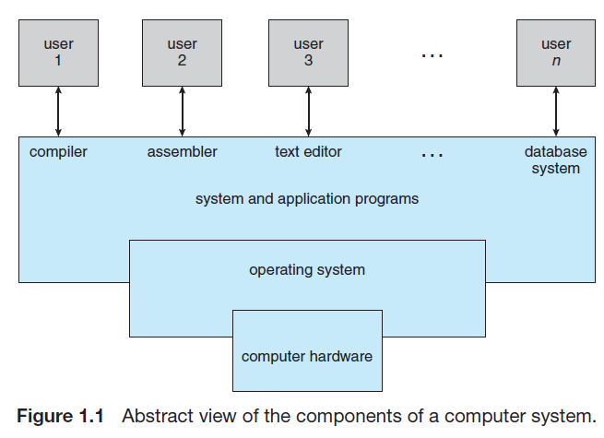

Slide 6
What Operating Systems Do
To understand an operating system’s role, we need to explore the OS from following viewpoints:
user and
the system.

Slide 7
User View
The user’s view of the computer varies according to the system usage.
When considering a personal computer (PC) system:
The OS is designed mostly for ease of use, with some attention paid to performance and none paid to resource utilization
how various hardware and software resources are shared.
Such systems are optimized for the single-user experience rather than the requirements of multiple users.

Slide 8
User View
In other cases such as a mainframe or a minicomputer system:
various users are accessing the same computer through other terminals.
These users share resources and exchange information.
The OS in such cases is designed to maximize resource utilization
to assure that all available CPU time, memory, and I/O are used efficiently and that no individual user takes more than his or her fair share.

Slide 9
System View
From the computer’s point of view, an OS is a resource allocator.
A computer system has many resources that may be required to solve problems such as:
CPU time, memory space, file-storage space, I/O devices, and so on.
The OS acts as the manager of these resources.
Facing numerous and conflicting requests for resources;
the OS must decide how to allocate those resources to specific programs and
users so that it can make the computer system efficiently and fairly.

Slide 10
Defining Operating Systems
Operating systems are essential because they solve the problem of creating a usable computing system.
The fundamental goal of computer systems is to execute user programs and to make solving user problems easier.
The common functions of controlling and allocating resources (such as memory, I/O, etc) are brought together into one piece of software which is called the operating system (OS).

Slide 11
Defining Operating Systems
The OS is a program that running at all times on a computer—usually called the kernel.
Along with the kernel, there are two other types of programs in a computer system:
System programs: Associated with the OS but are not necessarily part of the kernel, and
Application programs: Include all programs not associated with the OS.

Slide 12
Defining Operating Systems
Mobile operating systems often include not only a core kernel but also middleware
Middleware is a set of software frameworks that provide additional services to application developers.
The mobile OS features a core kernel along with middleware together supports databases, multimedia, and graphics.

Slide 13
Computer-System Operation
A general-purpose computer system consists of one or more CPUs and a number of device controllers connected through a common bus that provides access to a shared memory (shown in Figure 1.2).
Each device controller is in charge of a specific type of device (for example, disk drives, audio devices, or video displays).
The CPU and the device controllers can execute in parallel, competing for memory cycles.
To ensure orderly access to the shared memory, a memory controller synchronizes the memory access during a program execution.

Slide 14
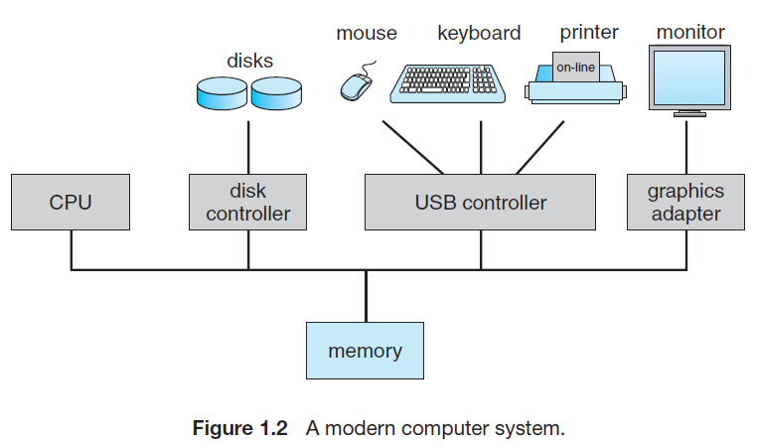

Slide 15
Computer-System Operation
For a computer to start running it needs to be powered up or rebooted—it needs to have an initial program to run.
This initial program (or bootstrap program), tends to be simple:
The initial program is stored within the computer hardware in read-only memory (ROM) or electrically erasable programmable read-only memory (EEPROM), known by the term firmware.
It is loaded into the main memory for execution.
It initializes all aspects of the system, from CPU registers to device controllers to memory contents.
The bootstrap program must know how to load the OS and how to start executing the system.

Slide 16
Computer-System Operation
Once the kernel (a part of the OS which is running all the time) is loaded and executing, it can start providing services to the computer system and its user:
some services are provided outside of the kernel, by system programs that are loaded into memory at boot time.
The occurrence of an event in a computer system is usually signaled by an interrupt from either the hardware or the software.

Slide 17
Computer-System Operation
Hardware may trigger an interrupt at any time by sending a signal to the CPU, usually by way of the system bus.
Software may trigger an interrupt by executing a special operation called a system call (also called a monitor call).
When the CPU is interrupted, it stops what it is doing and immediately transfers execution to a fixed location.
The fixed location usually contains the starting address of the new service routine for the interrupt.
The interrupt service routine executes; on completion, the CPU resumes the interrupted computation.

Slide 18
Computer-System Operation
Interrupts are an important part of a computer architecture.
Each computer design has its own interrupt mechanism, but several functions are common.
The interrupt must transfer control to the appropriate interrupt service routine (ISR).
The routine, in turn, would call the interrupt-specific handler.

Slide 19
Storage Structure
During a program execution, the CPU can load instructions only from memory, so any programs to run must be stored there:
General-purpose computers run most of their programs from re-writable memory, called main memory (also called random-access memory, or RAM).
Main memory commonly is implemented in a semiconductor technology called dynamic random-access memory (DRAM).

Slide 20
Storage Structure
Computers use other forms of memory as well.
We have already seen that, read-only memory (ROM) and electrically erasable programmable read-only memory, (EEPROM):
ROM cannot be changed, only static programs, such as the bootstrap program described earlier, are stored there.
EEPROM can be changed but cannot be changed frequently and so contains mostly static programs.
For example, smart phones have EEPROM to store their factory-installed programs.

Slide 21
Storage Structure
All forms of memory provide an array of bytes.
Each byte has its own address.
Interaction is achieved through a sequence of load or store instructions to specific memory addresses:
load instruction moves a byte or word from main memory to an internal register within the CPU,
store instruction moves the content of a register to main memory.
Aside from explicit loads and stores, the CPU automatically loads instructions from main memory for execution.

Slide 22
Storage Structure
We need to understand how a sequence of main memory addresses are generated by the running program.
Before execution, the user program stays in the form of .exe file (on a disk folder) and it must be loaded into the main memory for execution.
Direct loading the .exe file into memory is not possible due to the following two reasons:
Main memory is usually too small to store all needed programs and data permanently.
Main memory is a volatile storage device that loses its contents when power is turned off
Thus, most computer systems provide secondary storage as an extension of main memory.
.

Slide 23
Storage Structure
The most common secondary-storage device is a Hard disk, which provides storage for both programs and data.
Most programs (system and application) are stored on a disk until they are loaded into memory.
Many programs then use the disk as both the source and the destination of their processing.
The main differences among the various storage systems lie in speed, cost, size, and volatility.
The wide variety of storage systems can be organized in a hierarchy (Figure 1.4) according to speed and cost.

Slide 24
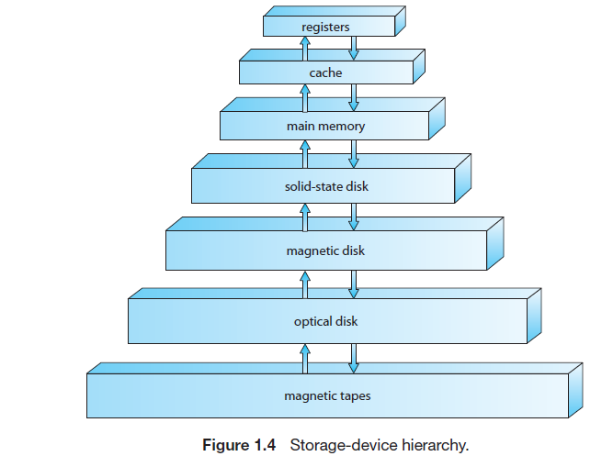
Storage Structure

Slide 25
I/O Structure
A large portion of OS code is dedicated to managing I/O devices.
Device controllers that are connected to specific type of devices through a common bus.
The device controller is responsible for moving the data between the peripheral devices that it controls and its local buffer storage.
Operating systems have device drivers (device controlling SW) for each device controller.
This device driver understands the device controller and provides the rest of the OS with a uniform interface to the device.

Slide 26
Computer-System Architecture
A computer system can be organized in a number of different ways based on the number of processors used:
Single-Processor System
Multiprocessor System
Clustered System

Slide 27
Single-Processor Systems
On a single processor system, there is one capable of executing a general-purpose instruction set (instructions from user process)
Almost all single CPU systems have other special-purpose Processors as well:
such as disk, keyboard, and graphics controllers, or I/O processors that move data rapidly among the components of the system.
All of these special-purpose Processors run a limited instruction set and do not run user processes (program).
For example, a disk-controller processor receives a sequence of requests from the CPU based on the scheduling algorithm.

Slide 28
Multiprocessor Systems
Now a days multiprocessor systems (or multi-core systems) have begun to dominate the computing.
Such systems have two or more Processors
sharing the computer bus and sometimes the clock, memory, and peripheral devices.
multiple processors have appeared on mobile devices such as smart phones and tablet computers.
Multiprocessor systems have three main advantages:
Increased throughput: Get more work done in less time.
Economy of scale: Multiprocessor systems can cost less because they can share peripherals, mass storage, and power supplies.
Increased reliability: If functions can be distributed properly, then the failure of one Processor will not halt the system, instead only slow it down.

Slide 29
Multiprocessor Systems
The multiprocessor systems in use today are of two types:
Asymmetric multiprocessing (AMP):
in which each processor is assigned a specific task.
A master processor controls the system; the other processors either look to the boss for instruction or have predefined tasks.
Symmetric multiprocessing (SMP):
in which each processor performs all tasks within the OS.
SMP means that all processors are peers; no master–worker relationship exists between processors.
sharing the system bus and sometimes the clock, memory, and peripheral devices.

Slide 30
Multiprogramming
In multiprogramming, the OS keeps several jobs in main memory simultaneously for a single CPU (Figure 1.9).
Since the main memory is too small to accommodate all jobs, the jobs are kept initially on the disk in the job pool.
This pool act as a job queue for all processes awaiting allocation of main memory.
There must be enough memory to hold the OS (here the OS is called resident monitor) and one user program.
Multiprogramming increases CPU utilization by organizing jobs so that the CPU always has one to execute.

Slide 31
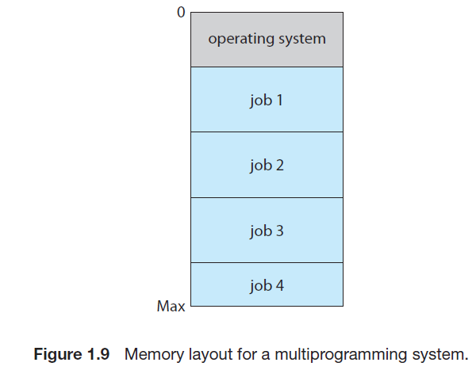
Multiprogramming

Slide 32
Multi-programming
When one job needs to wait for I/O, the processor can switch to the other job which is not waiting for I/O
This approach is called multiprogramming or multitasking
When one job needs to wait for I/O, the processor can switch to the other job, which is likely not waiting for I/O.

Slide 33
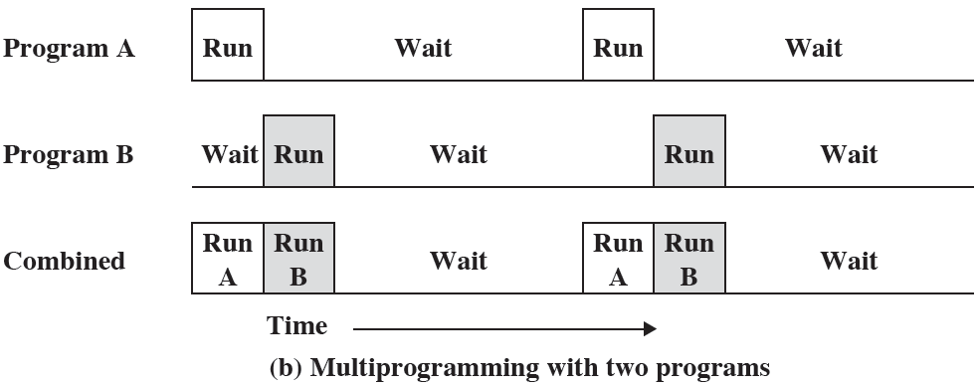
Multi-programming

Slide 34
Time sharing
Time sharing is a logical extension of multiprogramming.
In time-sharing systems, the single CPU executes multiple jobs by switching among them, but the switches occur so frequently that the users can interact with each program while it is running.
As the system switches rapidly from one user to the next, each user is given the impression that the entire computer system is dedicated to his use, even though it is being shared among many users.

Slide 35
Job Scheduling
Time sharing and multiprogramming require that several jobs be kept simultaneously in main memory.
If several jobs are ready to be brought into memory, and if there is not enough room for all of them, then the system keeps some of them in a job pool (or job queue) in a disk memory.
Making this decision involves job scheduling, which we discuss in Chapter 6.
If several jobs are ready to run at the same time, the system must choose which job will run first by CPU.

Slide 36
Operating-System Operations
Modern operating systems are interrupt driven systems.
If there are no processes to execute, no I/O devices to service, and no users to whom to respond, an OS will sit quietly, waiting for something to happen.
Events are almost always signaled by the occurrence of an interrupt or a trap or a system call.
The system call is a software-generated interrupt caused either by an error (for example, division by zero or invalid memory access) or by a specific request from a user program that an OS service be performed.
An interrupt service routine is an OS-predefined program which will deal with the interrupt.

Slide 37
Dual-Mode and Multimode Operation
In order to ensure the proper execution of the OS, it is to distinguish between the execution of operating-system code and user defined code.
Based on these, we need two separate modes of operation:
user mode and
kernel mode
A bit, called the mode bit, is added to the HW of the computer to indicate the current mode:
kernel mode (0) or user mode (1).

Slide 38
Dual-Mode and Multimode Operation
With the mode bit, we can distinguish between a task that is executed either in User mode or in Kernel mode:
User mode: When the computer system is executing on behalf of a user application, the system is in user mode.
Kernel mode: when a user application requests a service from the OS (via a system call), the system must transition from user to kernel mode to fulfill the request.
The mode transition of OS is shown in Figure 1.10.

Slide 39
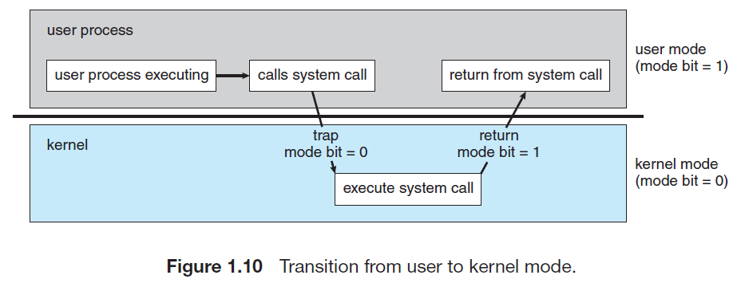
Dual-Mode and Multimode Operation

Slide 40
Dual-Mode and Multimode Operation
At system boot time, the system is in kernel mode.
The OS is then loaded into main memory and starts user applications in user mode.
Whenever a trap or system call occurs, the HW switches from user mode to kernel mode as shown in Figure 1.10
Thus, whenever the operating system gains control of the computer, it is in kernel mode.
The system always switches to user mode (by setting the mode bit to 1) before passing control to a user program.

Slide 41
Dual-Mode and Multimode Operation
The dual mode of operation provides us with the means for protecting the OS by designating some of the machine instructions called privileged instructions.
The hardware allows privileged instructions to be executed only in kernel mode.
If an attempt is made to execute a privileged instruction in user mode, the hardware does not execute the instruction but treats it as illegal and traps it to the OS.

Slide 42
System Call
System calls provide the means for a user program to ask the OS to perform tasks reserved for the OS on the user program’s behalf.
A system call is invoked in a variety of ways, depending on the functionality provided by the underlying processor.
It is the method used by a process to request action by the OS.
A system call usually takes the form of a trap to a specific location in the interrupt vector.
The system-call service routine is a part of the OS.
The kernel examines the interrupting instruction to determine what system call has to be occurred.

Slide 43
Process Management
A program in execution, is called a process.
A compiler is a process.
A word-processing program being run by an individual user on a PC is a process.
A system task, such as sending output to a printer, can also be a process (or at least part of one).
A process needs certain resources—including CPU time, memory, files, and I/O devices—to accomplish its task.
These resources are either given to the process when it is created or while it is running.
When the process terminates, the OS will reclaim any reusable resources.

Slide 44
Process Management
The CPU executes one instruction at a time form the process (it can be called a thread) one after another, until the process completes.
A single-threaded process has one program counter specifying the next instruction to execute.
Thus, although two processes may be associated with the same program, they are considered two separate execution sequences.
A multithreaded process has multiple program counters, each pointing to the next instruction to execute for a given thread.

Slide 45
Process Management
A system consists of a collection of processes, some of which are OS processes (running- OS code) and the rest of which are user processes.
All these processes can potentially execute concurrently—by multiplexing on a single CPU.
The OS is responsible for the following activities in connection with process management:
• Scheduling processes and threads on the CPU.
• Creating and deleting both user and system processes.
• Suspending and resuming processes.
• Providing mechanisms for process synchronization.
• Providing mechanisms for process communication.

Slide 46
Memory Management
The main memory is central to the operation of a computer system (von Neumann architecture).
Main memory is a large array of bytes, each byte has its own address.
Main memory is a repository of quickly accessible data shared by the CPU and I/O devices.
The main memory is only the large storage device that the CPU is able to address and access directly.
The CPU reads instructions from main memory during the instruction-fetch cycle and both reads and writes data from main memory during the data-fetch cycle.
The data which is stored on disk must be transferred to main memory by CPU-generated I/O calls.

Slide 47
Memory Management
For a program to be executed, it must be mapped from disk address to main memory address (or absolute addresses ) and then loaded into main memory.
As the program executes, the CPU accesses program instructions and data from memory by these absolute addresses.
Eventually, the program terminates, its memory space is declared available, and the next program can be loaded and executed.

Slide 48
Memory Management
To improve both the utilization of the CPU and the performance of the computer system, a need for memory management is important:
Many different memory management schemes are used.
The OS is responsible for the following activities as part of memory management:
• Keeping track of which parts of memory are currently being used and who is using them.
• Deciding which processes (or parts of processes) and data to move into and out of memory.
• Allocating and de-allocating memory space as needed.

Slide 49
File-System Management
The OS abstracts from the physical properties of its storage devices to define a logical storage unit, is the file unit.
The OS maps files onto physical media and accesses these files via the storage devices.
The OS is responsible for the following activities in connection with file management:
Creating and deleting files.
Creating and deleting directories to organize files.
Supporting primitives for manipulating files and directories.
Mapping files onto secondary storage.
Backing up files on stable (nonvolatile) storage media.

Slide 50
Mass-Storage Management
The OS is responsible for the following activities in connection with disk management:
Free-space management
Storage allocation
Disk scheduling

Slide 51
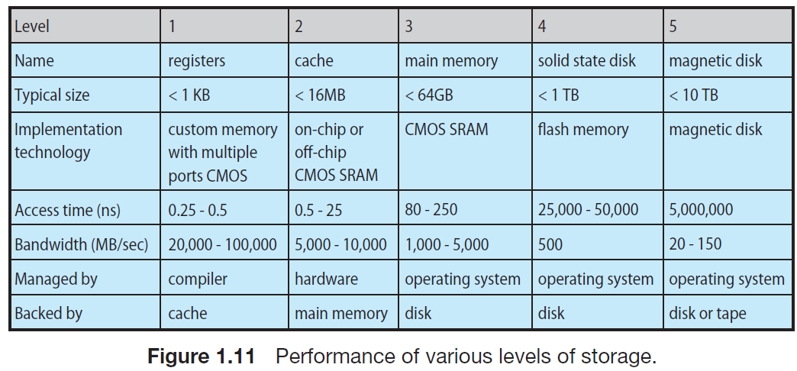
Storage Management

Slide 52
I/O Systems
One of the purposes of an OS is to hide the peculiarities of specific hardware devices from the user.
For example, in UNIX, the peculiarities of I/O devices are hidden from the bulk of the OS itself by the I/O subsystem.
The I/O subsystem of the OS consists of several components:
A memory-management component that includes buffering, caching, and spooling
A general device-driver interface
Drivers for specific hardware devices

Slide 53
Practice Exercises
What are the three main purposes of an operating system?
What is the main difficulty that a programmer must overcome in writing an operating system for a real-time environment?
In a multiprogramming and time-sharing environment, several users share the system simultaneously. This situation can result in various security problems.
a. What are two such problems?
b. Can we ensure the same degree of security in a time-shared
machine as in a dedicated machine? Explain your answer.
What is the purpose of interrupts? How does an interrupt differ from a trap? Can traps be generated intentionally by a user program? If so, for what purpose?
Define the following: multiprogramming, multitasking, and multiprocessing
Distinguish the terms: interrupt, trap (system call), and mode bit.

Slide 54
End of Chapter 1

