Slide 1
Chapter 4: Threads

Slide 2
Chapter 4: Threads
Overview
Multicore Programming
Multithreading Models
Thread Libraries
Implicit Threading
Threading Issues
Operating System Examples

Slide 3
Objectives
To introduce the notion of a thread—a fundamental unit of CPU utilization that forms the basis of multithreaded computer systems
To explore several strategies that provide implicit threading
To examine issues related to multithreaded programming
To cover operating system support for threads in Windows and Linux

Slide 4
Motivation
A thread is a basic unit of CPU utilization; it comprises a thread ID, a program counter, a register set, and a stack.
  Most modern applications are multithreaded
  Thread that run within an application shares with other threads belonging to the same process
Process creation is heavy-weight while thread creation is light-weight
  A traditional process has a single thread of control.
    If a process has multiple threads of control, it can perform more than one task at a time.
  Figure 4.1 illustrates the difference between a traditional single-threaded process and a multithreaded process.

Slide 5
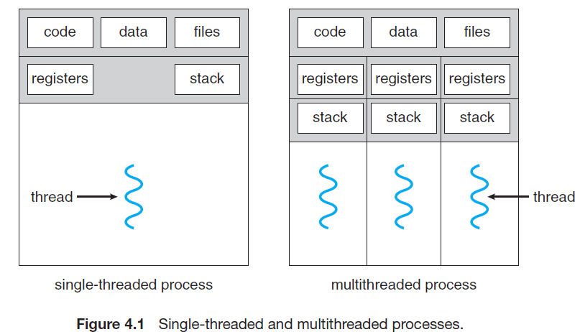
Motivation

Slide 6
Motivation
Most software applications that run on modern computers are multithreaded;
  An application typically is implemented as a separate process with several threads of control.
    For example, a web browser might have one thread display images or text while another thread retrieves data from the network.
Applications designed to leverage processing capabilities on multicore systems.
  Such applications can perform several CPU-intensive tasks in parallel across the multiple computing cores.

Slide 7
Motivation
It is generally more efficient to use one process that contains multiple threads;
  If the web-server process is multithreaded, the server will create a separate thread that listens for client requests.
  When a request is made, rather than creating another process, the server creates a new thread to service the request and resume listening for additional requests.
    This is illustrated in Figure 4.2.
Threads also play a vital role in remote procedure call (RPC) systems.

Slide 8
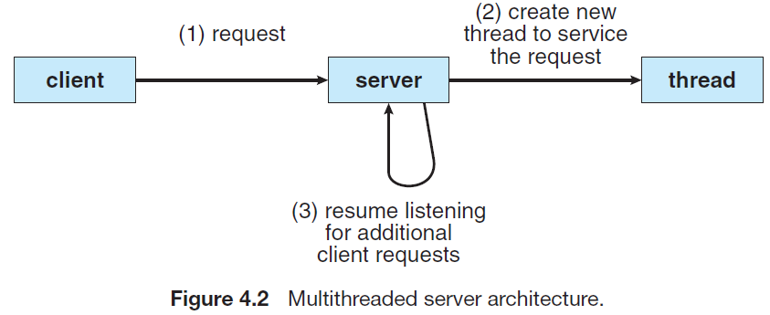
Motivation

Slide 9
Motivation
Most OS kernels are now multithreaded.
Several threads operate in the kernel, and each thread performs a specific task, such as managing devices, managing memory, interrupt handling, etc.
  For example,
    Solaris has a set of threads in the kernel specifically for interrupt handling;
    Linux uses a kernel thread for managing the amount of free memory in the system.
    Windows has many threads for supporting its various functions

Slide 10
Benefits of Multithreaded Programming
The benefits of multithreaded programming can be broken down into four major categories:
  Responsiveness: Multithreading an interactive application allow a program to continue running even if part of it is blocked or is performing a lengthy operation, thereby increasing responsiveness to the user.
    This quality is especially useful in designing user interfaces.
  Resource sharing: Processes can only share resources through techniques such as shared memory and message passing.
    The benefit of sharing code and data is that it allows an application to have several different threads of activity within the same address space (memory location).

Slide 11
Benefits of Multithreaded Programming
  Economy: Allocating memory and resources for process creation is costly.
    it is more economical to create and context-switch threads.
  Scalability: The benefits of multithreading can be even greater in a multiprocessor architecture, where threads may be running in parallel on different processing cores.
    A single-threaded process can run on only one processor, regardless how many are available.

Slide 12
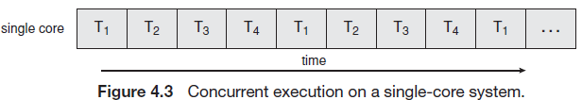
Multicore Programming
A more recent trend in system design is to place multiple computing cores on a single chip.
Each core appears as a separate processor to the OS and call these multi-core or multiprocessor systems.
  Multithreaded programming provides a mechanism for more efficient use of these multiple cores.
  Consider an application with four threads on a system with a Single Processor, concurrency (happening at the same time) merely means that the execution of the threads will be interleaved over time (see Figure 4.3), because the single processing core is capable of executing only one thread at a time.

Slide 13
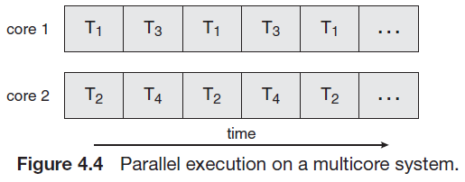
Multi-core Programming
On a system with multiple cores, concurrency means that the threads can run in parallel, because the system can assign a separate thread to each core ( see Figure 4.4).

Slide 14
Parallelism and Concurrency
A system is parallel if it can perform more than one task simultaneously.
A concurrent system supports more than one task by allowing all the tasks to make progress.
  Thus, it is possible to have concurrency without parallelism.
In a single core system, the CPU schedulers were designed to provide the illusion of parallelism by rapidly switching between processes in the system, thereby allowing each process to make progress.
  Such processes were running concurrently, but not in parallel.

Slide 15
Concurrent Processes (Cont.)
Concurrent processes are often non-deterministic, which means it is not possible to tell, by looking at the process, what will happen when it executes
  Consider two threads A and B and a1 and b1 are the events of A and B respectively:
  Thread A: a1 print “yes” Thread B: b1 print “no”
Because the two threads run concurrently, the order of execution depends on the scheduler
  During any given run of this program, the output might be “yes no” or “no yes”

Slide 16
Concurrent Processes (Cont.)
When concurrent processes (or threads) interact through a shared variable
  may cause the integrity of the variable to be violated, if the variable access is not coordinated
  Ex. Of integrity violations are:
    The variable does not record all changes
    A process may read inconsistent values
    The final value of the variable may be inconsistent
Concurrent writes
  Consider, x is a shared variable accessed by two writes
  Thread A Thread B
  What value of x gets printed? What is the final value of x ?
  What is the execution path of events of threads A and B?
a1: x = 5
a2: print x
b1: x = 7

Slide 17
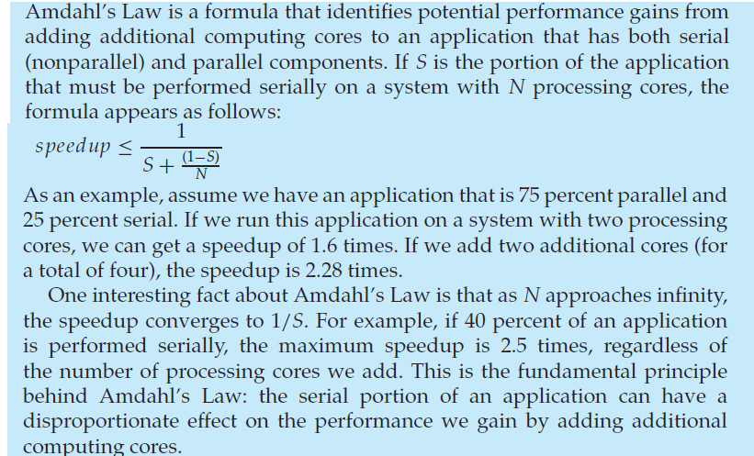
Amdahl’s Law

Slide 18
Types of Parallelism
In general, there are two types of parallelism:
  data parallelism and
  task parallelism.

Slide 19
Data parallelism
Data parallelism focuses on distributing the data across multiple cores and performing the same operation on each core.
  For example, summing the contents of an array of size N.
  On a single-core system, one thread would simply sum the elements [0] . . . [N − 1].
  On a dual-core system, however, thread A, running on core0, could sum the elements [0] . . . [N/2 − 1] while thread B, running on core1 could sum the elements [N/2] . . . [N − 1].
    These two threads would be running in parallel on separate computing cores.

Slide 20
Task parallelism
Task parallelism involves distributing tasks (or threads) across multiple cores:
  Each thread is performing a unique operation.
  Different threads may be operating on the same data, or on different data.
  An example of task parallelism might involve two threads, each performing a unique statistical operation on the array of elements.
  The threads (tasks) again are operating in parallel on separate computing cores, but each is performing a unique operation.
Data parallelism involves the distribution of data across multiple cores and task parallelism on the distribution of tasks across multiple cores.

Slide 21
Multithreading Models
However, support for threads may be provided either at the user level, for user threads, or by the kernel, for kernel threads.
  User threads are supported above the kernel and are managed without kernel support,
  whereas kernel threads are supported and managed directly by the OS.
Virtually all contemporary operating systems—including Windows, Linux, Mac OS X, and Solaris—support kernel threads.

Slide 22
Multithreading Models
There is a relationship exists between user threads and kernel threads.
There are three ways of mapping the user threads to kernel thread for thread execution:
  many-to-one model
  one-to-one model
  many-to-many model

Slide 23
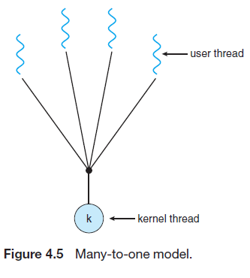
Many-to-one Model
The many-to-one model (Figure 4.5) maps many user threads to one kernel thread.
Thread management is done by the thread library in user space, so it is efficient.
The entire process will block if a thread makes a blocking system call.
only one thread can access the kernel at a time, multiple threads are unable to run in parallel on multicore systems.
For example, Green threads—a thread library available for Solaris systems and adopted in early versions of Java—used the many-to-one model.

Slide 24
One-to-one Model
The one-to-one model (Figure 4.6) maps each user thread to individual kernel thread.
  It provides more concurrency than the many-to-one model by allowing another thread to run when a thread makes a blocking system call.
  It allows multiple threads to run in parallel on multicore system (greater concurrency).
  The only drawback to this model is that creating a user thread requires creating the corresponding kernel thread:
    because the overhead of creating kernel threads can burden the performance of an application.
  Linux, along with the family of Windows, implement the one-to-one model.

Slide 25
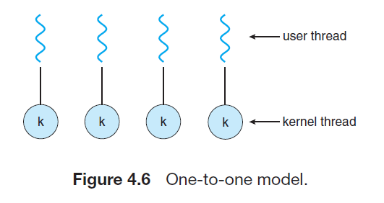
One-to-One Model

Slide 26
Many-to-Many Model
The many-to-many model (Figure 4.7) multiplexes many user threads to a smaller or equal number of kernel threads.
  The number of kernel threads may be specific to either a particular application (an application may be allocated more kernel threads on a multiprocessor than on a single processor).
  The many-to-one model allows the developer to create as many user threads.
  It does not result in true concurrency, because the kernel can schedule only one thread at a time.
  Developers can create as many user threads as necessary, and the corresponding kernel threads can run in parallel on a multiprocessor.

Slide 27
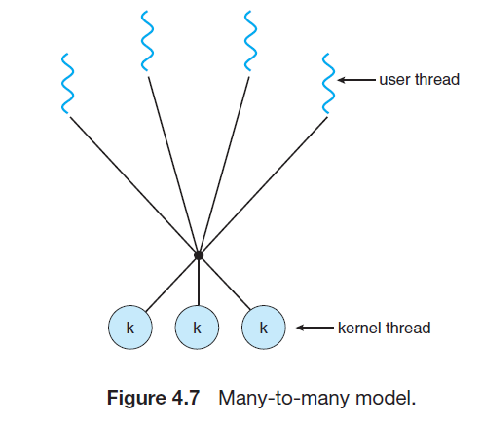
Many-to-Many Model

Slide 28
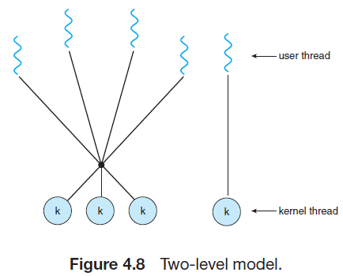
Two-level Model
One variation on the many-to-many model still multiplexes many user level threads to a smaller or equal number of kernel threads but also allows a user-level thread to be bound to a kernel thread.
This variation is sometimes referred to as the two-level model (Figure 4.8). The Solaris supported the two-level model in versions older than Solaris 9.
However, beginning with Solaris 9, this system uses the one-to-one model.

Slide 29
Java Threads
Threads are the fundamental model of program execution in a Java program.
All Java programs comprise at least a single thread of control—even a simple Java program consisting of only a main() method runs as a single thread in the JVM.
Java threads are available on any system that provides a JVM including Windows, Linux, and Mac OS X.
The Java thread API is available for Android applications.
There are two techniques for creating threads in a Java program.
  One approach is to create a new class that is derived from the Thread class and to override its run() method.
  A more commonly used—technique is to define a class that implements the Runnable interface.

Slide 30
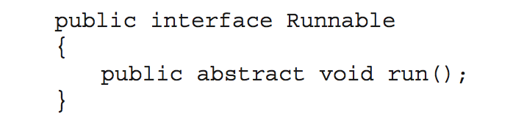
Java Threads
Java threads are managed by the JVM
Typically implemented using the threads model provided by underlying OS
Java threads may be created by:
  Extending Thread class
  Implementing the Runnable interface

Slide 31
Threading Issues
Semantics of fork() and exec() system calls
Signal handling
  Synchronous and asynchronous
Thread cancellation of target thread
  Asynchronous or deferred (delayed)
Thread-local storage
Scheduler Activations

Slide 32
Semantics of fork() and exec()
Does fork()duplicate only the calling thread or all threads?
  Some UNIXs have two versions of fork
exec() usually works as normal – replace the running process including all threads

Slide 33
Signal Handling
Signals are used in UNIX systems to notify a process that a particular event has occurred.
A signal handler is used to process signals
  Signal is generated by particular event
  Signal is delivered to a process
  Signal is handled by one of two signal handlers:
    default
    user-defined
Every signal has default handler that kernel runs when handling signal
  User-defined signal handler can override default
  For single-threaded, signal delivered to process

Slide 34
Signal Handling (Cont.)
Where should a signal be delivered for multi-threaded?
  Deliver the signal to the thread to which the signal applies
  Deliver the signal to every thread in the process
  Deliver the signal to certain threads in the process
  Assign a specific thread to receive all signals for the process

Slide 35
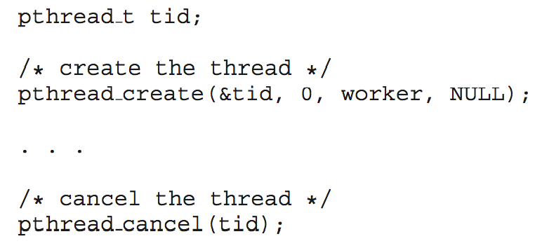
Thread Cancellation
Terminating a thread before it has finished
Thread to be canceled is called a target thread
Two general approaches:
  Asynchronous cancellation terminates the target thread immediately
  Deferred cancellation allows the target thread to periodically check if it should be cancelled
Pthread code to create and cancel a thread:

Slide 36
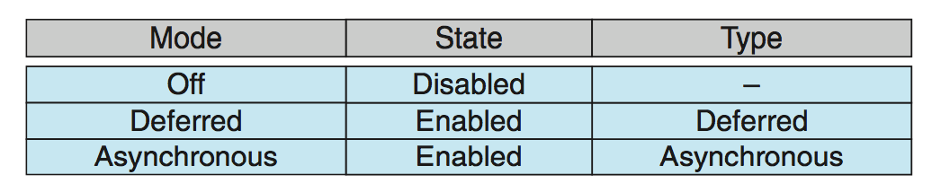
Thread Cancellation (Cont.)
Invoking thread cancellation requests cancellation, but actual cancellation depends on thread state
If thread has cancellation disabled, cancellation remains pending until thread enables it
Default type is deferred
  Cancellation only occurs when thread reaches cancellation point
    I.e. pthread_testcancel()
    Then cleanup handler is invoked
On Linux systems, thread cancellation is handled through signals

Slide 37
Thread-Local Storage
Thread-local storage (TLS) allows each thread to have its own copy of data
Useful when you do not have control over the thread creation process (i.e., when using a thread pool)
Different from local variables
  Local variables visible only during single function invocation
  TLS visible across function invocations
Similar to static data
  TLS is unique to each thread

Slide 38
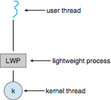
Scheduler Activations
Both M:M and Two-level models require communication to maintain the appropriate number of kernel threads allocated to the application
Typically use an intermediate data structure between user and kernel threads – lightweight process (LWP)
  Appears to be a virtual processor on which process can schedule user thread to run
  Each LWP attached to kernel thread
  How many LWPs to create?
Scheduler activations provide upcalls - a communication mechanism from the kernel to the upcall handler in the thread library
This communication allows an application to maintain the correct number kernel threads

Slide 39
Windows Threads
Windows implements the Windows API – primary API for Win 98, Win NT, Win 2000, Win XP, and Win 7
Implements the one-to-one mapping
Each thread contains
  A thread id
  Register set representing state of processor
  Separate user and kernel stacks for when thread runs in user mode or kernel mode
  Private data storage area used by run-time libraries and dynamic link libraries (DLLs)
The register set, stacks, and private storage area are known as the context of the thread

Slide 40
Windows Threads (Cont.)
The primary data structures of a thread include:
  ETHREAD (Executive Thread Block) – includes pointer to process to which thread belongs and to KTHREAD, in kernel space
  KTHREAD (Kernel Thread Block) – scheduling and synchronization info, kernel-mode stack, pointer to TEB, in kernel space
  TEB (Thread Environment Block) – thread id, user-mode stack, thread-local storage, in user space

Slide 41
Windows Threads Data Structures

Slide 42
Linux Threads
Linux refers to them as tasks rather than threads
Thread creation is done through clone() system call
clone() allows a child task to share the address space of the parent task (process)
  Flags control behavior
struct task_struct points to process data structures (shared or unique)

Slide 43
Exercises
What are two differences between user-level threads and kernel-level threads? Under what circumstances is one type better than the other?
Can a multithreaded solution using multiple user-level threads achieve better performance on a multiprocessor system than on a single processor system? Explain.
Is it possible to have concurrency but not parallelism? Explain.
Using Amdahl’s Law, calculate the speedup gain of an application that has a 60 percent parallel component for (a) two processing cores and (b) four processing cores.

Slide 44
End of Chapter 4

