Slide 1
Chapter 5: Process Synchronization

Slide 2
Chapter 5: Process Synchronization
Background
The Critical-Section Problem
Peterson’s Solution
Synchronization Hardware
Mutex Locks
Semaphores
Classic Problems of Synchronization
Synchronization Examples
Alternative Approaches

Slide 3
Objectives
To present the concept of process synchronization.
To introduce the critical-section (CS) problem, whose solutions can be used to ensure the consistency of shared data
To present both software and hardware solutions of the critical-section problem
To examine several classical process-synchronization problems
To explore several tools that are used to solve process synchronization problems

Slide 4
Background
Processes can execute concurrently
May be interrupted at any time, partially completing execution
Concurrent access to shared data may result in data inconsistency
Maintaining data consistency requires mechanisms to ensure the orderly execution of cooperating processes
Illustration of the problem: Suppose that we wanted to provide a solution to the consumer-producer problem that fills all the buffers.
an integer counter that keeps track of the number of full buffers.
Initially, counter is set to 0. It is incremented by the producer after it produces a new buffer location and is decremented by the consumer after it consumes a buffer.

Slide 5
Producer
while (true) { /* produce an item in next produced */
while (counter == BUFFER_SIZE) ;
/* do nothing */
buffer[in] = next_produced;
in = (in + 1) % BUFFER_SIZE;
counter++;
}

Slide 6
Consumer
while (true) {
while (counter == 0)
; /* do nothing */
next_consumed = buffer[out];
out = (out + 1) % BUFFER_SIZE;
counter--;
/* consume the item in next consumed */
}

Slide 7
Race Condition
counter++ could be implemented as register1 = counter register1 = register1 + 1 counter = register1
counter-- could be implemented as register2 = counter register2 = register2 - 1 counter = register2

Slide 8
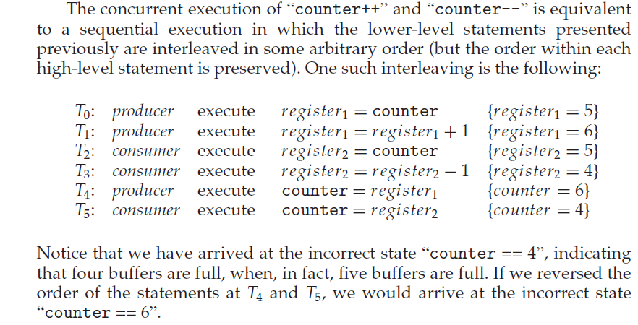
Race Condition

Slide 9
Producer-Consumer Problem: Race condition
We would arrive at this incorrect state because we allowed both processes to manipulate the variable counter concurrently.
A situation like this, where several processes access and manipulate the same data concurrently and the outcome of the execution depends on the particular order in which the access takes place, is called a race condition.
To guard against the race condition we need to ensure that only one process at a time can be manipulating the variable counter.

Slide 10
Principles of Concurrency-Race condition
Suppose that two processes P1 and P2 share the global variable a. At some point in its execution, P1 updates a to the value 1, and at some point in its execution, P2 updates a to the value 2. Thus, the two tasks are in a race to write variable a.
In this example, the process that updates last determines the final value of a.
Consider two processes, P3 and P4, that share global variables b and c, with initial values b = 1 and c = 2. At some point in its execution, P3 executes b = b + c and at some point in its execution, P4 executes c = b + c.
The final values of the two variables depend on the order in which the two processes execute their assignments.
If P3 executes its assignment first, then b = 3 and c = 5.
If P4 executes its assignment first, then b = 4 and c = 3.

Slide 11
Critical Section (CS)
A critical section (CS) is a code segment in a process in which a shared resource is allowed to access:
Only one process can execute its CS at any one time
When no process is executing in its CS, any process that requests entry to its CS must be permitted without delay
When two or more processes compete to enter their respective CSs, the selection cannot be postponed indefinitely
No process can prevent any other process from entering its CS indefinitely
Every process should be given a fair chance to access the shared resource through CS

Slide 12
CS Problem
Consider system of n processes {p₀, p₁, … p_{n-1}}
Each process has CS segment
Process may be changing common variables, updating table, writing file, etc
When one process in CS, no other may be in its CS
Each process must ask permission to enter CS in entry section, may follow critical section with exit section, then remainder section.
The general structure of a typical process Pi is shown in Figure 5.1.
No two processes are executing in their critical sections at the same time.

Slide 13
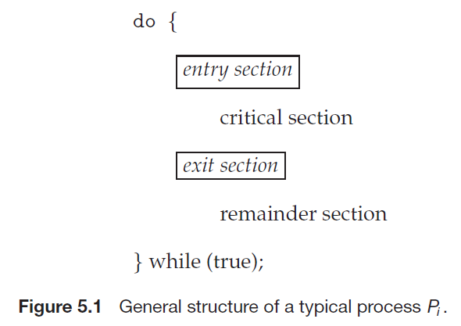
CS
General structure of process P_{i}

Slide 14
Solution to CS Problem
1. Mutual Exclusion - If process P_{i} is executing in its critical section (CS), then no other processes can be executing in their critical sections
2. Progress - If no process is executing in its CS and there exist some processes that wish to enter their CS, then the selection of the processes that will enter the CS next cannot be postponed indefinitely
3. Bounded Waiting - A bound must exist on the number of times that other processes are allowed to enter their critical sections after a process has made a request to enter its critical section and before that request is granted
Assume that each process executes at a nonzero speed
No assumption concerning relative speed of the n processes

Slide 15
CS Handling in OS
Two approaches depending on if kernel is preemptive or non- preemptive
Preemptive – allows preemption of process when running in kernel mode
Preemptive kernels are especially difficult to design for SMP architectures, since in these environments it is possible for two kernel-mode processes to run simultaneously on different processors.
Non-preemptive – runs until exits kernel mode, blocks, or voluntarily yields CPU
Essentially free of race conditions in kernel mode, as only one process is active in the kernel at a time.

Slide 16
Critical-Section Handling in OS
Why, then, would anyone favor a preemptive kernel over a non-preemptive one?
A preemptive kernel may be less risk that a kernel-mode process can run for an arbitrarily long period before relinquishing it by the processor.
A preemptive kernel is more suitable for real-time programming, as it will allow a real-time process to preempt a process currently running in the kernel.

Slide 17
Critical-Section Problem: Peterson’s Solution
Peterson’s solution to CS problem is restricted to two processes that alternate execution between their critical sections and remainder sections.
The processes are numbered P_{i} and P_{j} (where i = 0 and j = 1)
Figure 5.2 The structure of process in Peterson’s solution.
int turn;
The integer variable turn indicates whose turn it is to enter its CS.
if turn == i, then process Pi is allowed to execute in its CS
boolean flag[2];
A size two array is used to indicate if a process is ready to enter its CS.
For example, if flag[i] is true, this value indicates that Pi i is ready to enter its critical section.

Slide 18
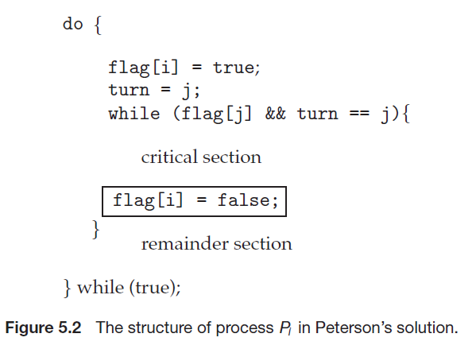
Critical-Section Problem: Peterson’s Solution

Slide 19
Critical-Section Problem: Peterson’s Solution
Each P_{i} enters its CS only if either (flag[j] == false ) or
(turn == P_{i} ), where P_{i} = 0
If (flag[i] == flag[j] == true), then it imply that P_{i} and P_{j} could not have successfully executed their while statements at about the same time, since the value of turn can be either 0 or 1 but cannot be both. So this situation is not valid!
If (flag[j] == true and turn == P_{j}), and this condition will cause P_{j} is in its critical section, where P_{j} = 1
If P_{j} is not ready to enter its CS, then (flag[j] == false), and P_{i} can enter its CS.
Mutual exclusion is preserved
P_{i} enters CS only if: either flag[j] = false or turn = i
Simulation
Code in C++

Slide 20
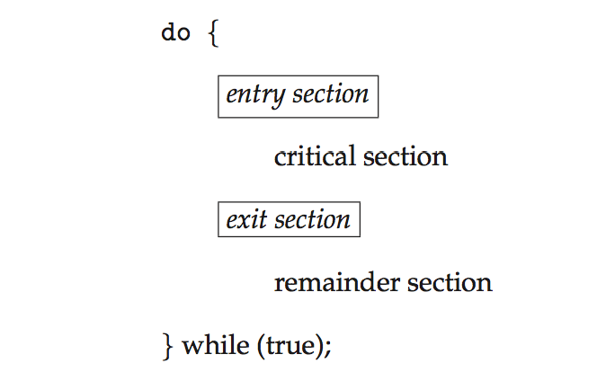
Critical Section
General structure of process P_{i}

Slide 21
Solution to CS: mutual exclusion locks
OS designers build software tools to solve CS problem, simplest is mutex lock (called mutual exclusion lock) to protect critical regions and thus prevent race conditions.
That is, a process must acquire the lock before entering a CS; it releases the lock when it exits the CS.
Protect a CS by first acquire() a lock then release() the lock;
do {
acquire lock
critical section
release lock
remainder section
} while (TRUE);

Slide 22
Mutex Locks

Slide 23
Disadvantage of Mutex Locks
The main disadvantage of mutex lock is that it requires busy waiting (spinlock)
Spinlock means processors continuously execute the atomic instruction to check for the status of the shared variable
It wastes processor cycles and consumes network bandwidth
While a process is in its CS, any other process that tries to enter its CS must loop continuously in the call to acquire().
Calls to acquire() and release() must be atomic
But this solution requires busy waiting
This lock therefore called a spinlock

Slide 24
Atomic hardware instructions for Critical Section
Atomic HW instructions for CS through mutex are:
Test-and-Set () instruction
Compare-and-Swap() Instruction

Slide 25
Atomic hardware instructions for Critical Section (mutex)
Test-and-Set () instruction
“Test” the requested process is sanctioned to enter CS by checking a memory location or a Boolean variable
If yes (the memory location match), then “Set” the selected process for CS
The Test-and -Set() instruction can be defined as shown in Figure 5.3.
If the machine supports the test and set() instruction, then we can implement mutex by declaring a boolean variable lock, initialized to false.

Slide 26
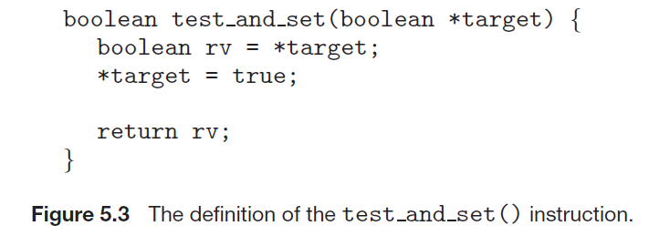
test and set() instruction
Executed atomically
Returns the original value of passed parameter
Set the new value of passed parameter to “TRUE”.
Executed atomically
Returns the original value of passed parameter *target and set it as true

Slide 27
compare_and_swap Instruction
int compare _and_swap(int *value, int
expected, int new_value)
{
int temp = *value;
if (*value == expected)
*value = new_value;
return temp;
}
Executed atomically
Returns the original value of passed parameter “*value” – a shared variable
If *value and expected are same, then assigns new_value to *value and return *value. That is, the swap takes place only under this condition.

Slide 28
Semaphores
Mutex locks, are generally considered the simplest of process synchronization tools.
A semaphore is a more robust synchronization tool that provides more sophisticated ways (than Mutex locks) for process synchronization.
A semaphore S is an integer variable that, apart from initialization, is accessed only through two standard atomic operations:
wait()
signal()

Slide 29
Semaphores
The wait() operation was originally termed P (“to test”).
The definition of wait() is as follows:
P(S) or wait(S): send a wait to waiting processes until the S access operation (S = S - 1)by the current process(s) has been completed.
The signal() was originally called V (“to increment ”).
The definition of signal() is as follows:
V(S) or signal(S): Signal a waiting process if the previous process has been released all S by incrementing (S = S + 1)it.

Slide 30
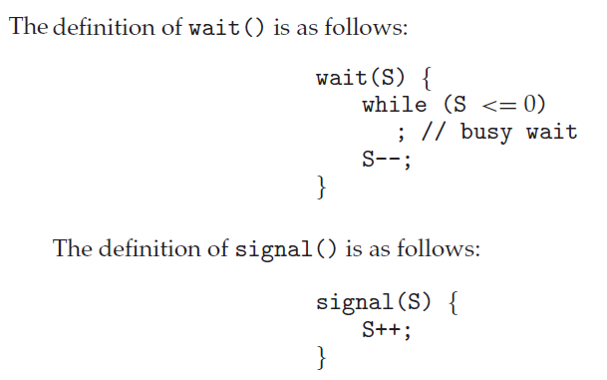
Semaphores

Slide 31
Semaphores
P(S)
Semaphore S; // initialize resource size S
{
while (S > 0) ; // wait until resource accessed
S = S - 1; // resource access
}
V(S)
Semaphore S; // initialize resource size S
{
S = S+1; // free resources by processes
}
Init(S, v) // initialize S with v values before a new request
Semaphore S; // initialize resource size S
Int v;
{
S = v;
}

Slide 32
Semaphores
All modifications to the integer value of the semaphore in the wait() and signal() operations must be executed indivisibly.
That is, when one process modifies the semaphore value, no other process can simultaneously modify that same semaphore value.
In addition, in the case of wait(S), the testing of the integer value of S (S ≤ 0), as well as its possible modification (S--), must be executed without interruption.

Slide 33
Semaphore Usage
Operating systems often distinguish between counting and binary semaphores.
The value of a counting semaphore can range over an unrestricted domain.
The value of a binary semaphore can range only between 0 and 1.
Thus, binary semaphores behave similarly to mutex locks.
on systems that do not provide mutex locks, binary semaphores can be used instead for providing mutual exclusion.

Slide 34
Semaphores
Use semaphores to solve synchronization problems: For example, consider two concurrently running processes:
P1 with a statement S1 and P2 with a statement S2. Suppose we require that S2 be executed only after S1 has completed.
We can implement this scheme readily by letting P1 and P2 share a common semaphore synch, initialized with its size.
In process P1, we insert the statement
S1;
wait(synch); // P1 using semaphore synch (P1
in CS) and P2 should wait
In process P2, we insert the statements:
signal(synch); // Signal to P2 indicates P1 has
completed its semaphore synch
(means, its CS).

Slide 35
Semaphores
Possibly the simplest use for a semaphore is signaling
Means that one thread sends a signal to another thread to indicate that something has happened
Signaling makes it possible to guarantee that one thread will run CS before another thread
Assume that semaphore s with initial value 0 (no resource available), and that Threads A and B have shared access to it
Thread-A Thread-B
At time t1, ThreadA in CS and ThreadB in waiting state
At time t2, ThreadA frees s and ThreadB gets s (in its CS)
The semaphore guarantees that Thread-A has completed a1 before Thread-B begins b1
t1. statement a1 (in CS)
t2. s.signal()
t1. s.wait()
t2. statement b1 (in CS)

Slide 36
Semaphores - Puzzle
Thread A Thread B
Given this code we want to guarantee that a1 happens before b2 and b1 happens before a2
(Hint: use semaphores as like the previous example. Don’t forget to specify the names and initial values of your semaphores)
1 statement a1
2 Statement a2
1 Statement b1
2 Statement b2

Slide 37
Semaphores – Puzzle Answer
Thread A Thread B
t1: a1(in CS)
t2: a1.signal
t3: a2.wait
t4: a2 (in CS)
t5: a2.signal
t1: b1.wait
t2: b1(in CS)
t3: b1.signal
t4: b2.wait
t5: b2 (in CS)

Slide 38
Semaphores
Advantages
Semaphores impose deliberate constraints that help programmers to avoid errors
Solutions using semaphores are often clean and organized
Semaphore can be implemented efficiently on many systems, so solutions that use semaphores are portable and usually efficient

Slide 39
Semaphores
Drawbacks
A process that uses a semaphore has to know which other processes use the semaphore (or waiting for semaphore)
the semaphore operations of all interacting processes have to be coordinated
Semaphore operations must be carefully positioned in a process
The omission of a P or V operation may result in deadlock or inconsistencies
Programs with semaphores extremely hard to verify for their correctness

Slide 40
Deadlock and Starvation
Deadlock – two or more processes are waiting indefinitely for an event that can be caused by only one of the waiting processes
Let S and Q be two semaphores initialized to 1
P₀ P₁
wait(S); wait(Q);
wait(Q); wait(S);
... ...
signal(S); signal(Q);
signal(Q); signal(S);
Suppose that P0 executes wait(S) and then P1 executes wait(Q). When P0 executes wait(Q), it must wait until P1 executes signal(Q).
Similarly, when P1 executes wait(S), it must wait until P0 executes signal(S). Since these signal() operations cannot be executed, P0 and P1 are deadlocked.

Slide 41
Deadlock and Starvation
Starvation – indefinite blocking
A process may never be removed from the semaphore queue in which it is suspended
Priority Inversion – Scheduling problem when lower-priority process holds a lock needed by higher-priority process
Solved via priority-inheritance protocol

Slide 42
Classical Problems of Synchronization
Classical problems used to test newly-proposed synchronization schemes
Bounded-Buffer Problem
Readers and Writers Problem
Dining-Philosophers Problem

Slide 43
Bounded-Buffer Problem
n buffers, each can hold one item
Semaphore mutex initialized to the value 1
Semaphore full initialized to the value 0
Semaphore empty initialized to the value n

Slide 44
The Producer-Consumer - Semaphore
The structure of the producer process
do {
... /* produce an item in next_produced */
...
wait(empty);
wait(mutex);
... /* add next produced to the buffer */
...
signal(mutex);
signal(full);
} while (true);

Slide 45
The Producer-Consumer - Semaphore
The structure of the consumer process
Do {
wait(full);
wait(mutex);
... /* remove an item from buffer to next_consumed */
...
signal(mutex);
signal(empty);
... /* consume the item in next consumed */
... } while (true);

Slide 46
The Producer-Consumer - Semaphore
The structure of the producer process
do {
// produce an item
wait (empty); // consumer should wait because buffer is empty
wait (mutex); // consumer wait, mutex semaphore is with producer add the item to the buffer; // fill buffer (CS)
signal (mutex); // signal to consumer that ‘mutex’ is free and get it
signal (full); // signal to consumer that buffer is full
} while (TRUE);
The structure of the consumer process
do {
wait (full); // producer wait because buffer is full
wait (mutex); // producer wait ‘mutex’ is with consumer
remove an item from buffer; // consume buffer (CS)
signal (mutex); // signal to producer that mutex is free and get it
signal (empty); // signal to producer that buffer is empty
} while (TRUE);

Slide 47
The Producer-Consumer problem
In multithreaded programs there is often a division of labor between processes (or threads)
And some processes are producers and some are consumers
Producers create items of some kind and add them to a data structure (buffer);
Consumers remove (consume) the items from buffer and process them

Slide 48
Producer-Consumer Problem
There are several synchronization constraints that we need to enforce to make this producer-consumer system work correctly
Producer processes (or threads) supplies/produce messages
Consumer processes ( or threads) consume messages
Both processes (asynchronous in nature) share a common buffer
conditional synchronization as well as mutual exclusion needed:
No consumer can access the buffer when it is empty and no producer can access the buffer when it is full
If a consumer process (or thread) arrives while the buffer is empty, it blocks until a producer adds a new item into it

Slide 49
Producer-Consumer Problem
Event-driven programs are a good example:
Whenever and event occurs, a producer thread creates an event object and adds it to the event buffer
Concurrently, consumer threads take events out of the buffer and execute them
In this case, the consumers are called “event handlers”

Slide 50
Readers-Writers Problem
Here a data set is shared among a number of concurrent processes
Readers – only read the data set; they do not perform any updates
Writers – can both read and write
Problem – allow multiple readers to read at the same time and only one single writer can access the shared data at the same time.
Several variations of how readers and writers are considered – all involve some form of priorities
Shared Data
Data set
Semaphore rw_mutex initialized to 1
Semaphore mutex initialized to 1
Integer read_count initialized to 0

Slide 51
Readers-Writers Problem (Cont.)
The structure of a writer process
do { wait(rw_mutex);
... /* writing is performed */
...
signal(rw_mutex);
} while (true);

Slide 52
Readers-Writers Problem (Cont.)
The structure of a reader process
do { // first finding readers using ‘mutex’ wait(mutex); // reader gets ‘mutex’ means a writer waits read_count++; // check no.of readers if (read_count == 1) //if at least one reader
wait(rw_mutex); // then writer waits
signal(mutex); // else signal mutex to write(no readers)
... /* reading is performed */
...
wait(mutex); // Still reading is going on (means writer waits) read count--; // reading by readers one by one if (read_count == 0) // if no more readers
signal(rw_mutex); // signal ‘rw_mutex’ to writers to synch
signal(mutex); // signal ‘mutex’ to synchronized writers
} while (true);

Slide 53
The Dining Philosophers (cont.)
Five philosophers are sitting in a circle, attempting to eat spaghetti with the help of forks
Each philosopher has a bowl of spaghetti but there are only five forks (forks are placed between left and right of each philosopher) to share among them
But both forks are needed at a time to consume spaghetti
A philosopher alternates between two phases:
Thinking and eating
In the thinking mode, a philosopher does not hold a fork
When hungry, a philosopher attempts to pick up both forks on left and right sides
A philosopher can start eating only after obtaining both forks
Once start eating the forks are not relinquished until the eating phase is over

Slide 54
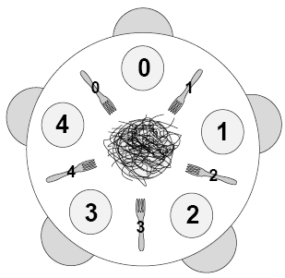
The Dining Philosophers (cont.)
Note that no two neighboring philosophers can eat simultaneously
In order to find any solution, the act of picking up a fork by a philosopher must be a critical section
The solution should be a deadlock free one, in which no philosopher starves

Slide 55
The Dining Philosophers (cont.)
Five philosophers, who represent interacting threads, come to the table and execute the following loop:
while true
think()
get_forks()
eat()
put_forks()
The program should satisfy the following constraints:
1. Only one philosopher can hold a fork at a time.
2. It must be impossible for a deadlock to occur.
3. It must be impossible for a philosopher to starve waiting for a fork.
4. It must be possible for more that one philosopher to eat at the same time.

Slide 56
Windows Synchronization
Windows uses interrupt masks to protect access to global resources on uniprocessor systems.
Uses spinlocks on multiprocessor systems
Spinlocking-thread will never be preempted
Also provides dispatcher objects user-land which may act as mutexes, semaphores, events, and timers
Events
An event acts much like a condition variable
Timers notify one or more thread when time expired
Dispatcher objects either signaled-state (object available) or non-signaled state (thread will block)

Slide 57
Linux Synchronization
Linux:
Prior to kernel Version 2.6, disables interrupts to implement short critical sections
Version 2.6 and later, fully preemptive
Linux provides:
Semaphores
atomic integers
spinlocks
reader-writer versions of both
On single CPU system, spinlocks replaced by enabling and disabling kernel preemption.

Slide 58
#include <cstdlib>
#include <iostream>
#include <string>
#include <time.h>
#include<windows.h>
using namespace std;
void delay()
{ time_t start_time, cur_time;
time(&start_time);
do{ time(&cur_time);}
while((cur_time - start_time) < 2.5); // 2.5 ms delay
}
int main(int argc, char *argv[])
{
bool flag[2]= {false, false};
int turn;
int count = 1;
int bount = 1;
string turnVal;
do{
system("CLS");
srand (time(NULL));
int ran = rand() % 2; // generate 0 = i or 1 = j
flag[ran] = true;// i == true
turn = ran; //j = 1
while(flag[ran] && turn == ran)// while both flag and turn are same then
{
cout << "\n\n";
for (int i = 0; i < 2; i++)
{ if (i == 0 && flag[i] == 1) {cout << " flag[Pi] = true " ;}
else if(i == 0 && flag[i] == 0){cout << " flag[Pi] = false " ;}
else if(i == 1 && flag[i] == 1){cout << " flag[Pj] = true ";}
else {cout << " flag[Pj] = false ";}}//for ends
if(turn == 0)turnVal = " Pi ( value is 0) ";
else turnVal = " Pj (value is 1) ";
cout << " turn = " << turnVal << endl;
if(ran == 0) // print the equivalent process critical status
{ if (count == 1)
{Beep(1568, 300); //cout << '\a';// window beep
count = 0;}
cout << "\n =============================================\n";
cout << " \n Process Pi is in its Critical Section (CS).\n";
cout << "\n =============================================\n" ;
bount = 1;}
else { if(bount == 1){
Beep(1275, 400); //cout << '\a';// window beep
bount = 0;}
cout << "\n =============================================\n";
cout << " \n Process Pj is in its Critical Section (CS).\n";
cout << "\n =============================================\n" ;
count = 1;
}
flag[ran] = false; // clear the flag status for next process
delay();// call 2 ms delay
}
}while(true);
system("PAUSE");
return EXIT_SUCCESS;
}
BACK

Slide 59
End of Chapter 5

