Slide 1
Chapter 6: CPU Scheduling

Slide 2
Chapter 6: CPU Scheduling
Basic Concepts
Scheduling Criteria
Scheduling Algorithms
Thread Scheduling
Multiple-Processor Scheduling
Real-Time CPU Scheduling
Operating Systems Examples
Algorithm Evaluation

Slide 3
Objectives
To introduce CPU scheduling, which is the basis for multi-programmed operating systems, by switching the CPU among processes, the OS can make the computer more productive.
To describe various CPU-scheduling algorithms
To discuss evaluation criteria for selecting a CPU-scheduling algorithm for a particular system
To examine the scheduling algorithms of several operating systems

Slide 4
Basic Concepts
In a single-processor system, only one process can run at a time. Others must wait until the CPU is free.
The objective of multiprogramming is to have some process running at all times, to maximize CPU utilization.
The idea is relatively simple:
  A process is executed until it must wait for the completion of some I/O request.
One process has to wait, the OS takes the CPU away from that process and gives the CPU to another waiting process. This pattern continues is multiprogramming.
  This pattern continues.
  Every time one process has to wait, another process can take over use of the CPU.

Slide 5
Basic Concepts
Scheduling of this kind is a fundamental OS function.
Almost all computer resources are scheduled before use.
The CPU is, of course, one of the primary computer resources.
Thus, CPU scheduling is central to an OS design.

Slide 6
CPU–I/O Burst
The success of CPU scheduling depends on the following observed properties of processes:
  A process execution consists of
    (1) a cycle of CPU execution and
    (2) I/O wait.
  Processes alternate between these two states.
  Process execution begins with a CPU burst (means CPU involvement).
Process execution begins with a CPU burst. That is followed by an I/O burst, which is followed by another CPU burst, then another I/O burst, and so on.
Eventually, the final CPU burst ends with a system request to terminate execution (Figure 6.1).

Slide 7
CPU–I/O Burst Figure 6.1
Maximum CPU utilization obtained with multiprogramming
CPU–I/O Burst Cycle – Process execution consists of a cycle of CPU execution and I/O wait
CPU burst followed by I/O burst
CPU burst distribution is of main concern

Slide 8
CPU–I/O Burst
The durations of CPU bursts have been measured extensively.
  Although a CPU burst vary from process to process and from computer to computer, it tends to have a frequency curve similar to that shown in Figure 6.2.
The curve is generally characterized as exponential or hyper-exponential, with a large number of short CPU bursts and a small number of long CPU bursts.
  An I/O-bound program typically has many short CPU bursts.
  A CPU-bound program might have a few long CPU bursts.
  This distribution can be important in the selection of an appropriate CPU-scheduling algorithm.

Slide 9
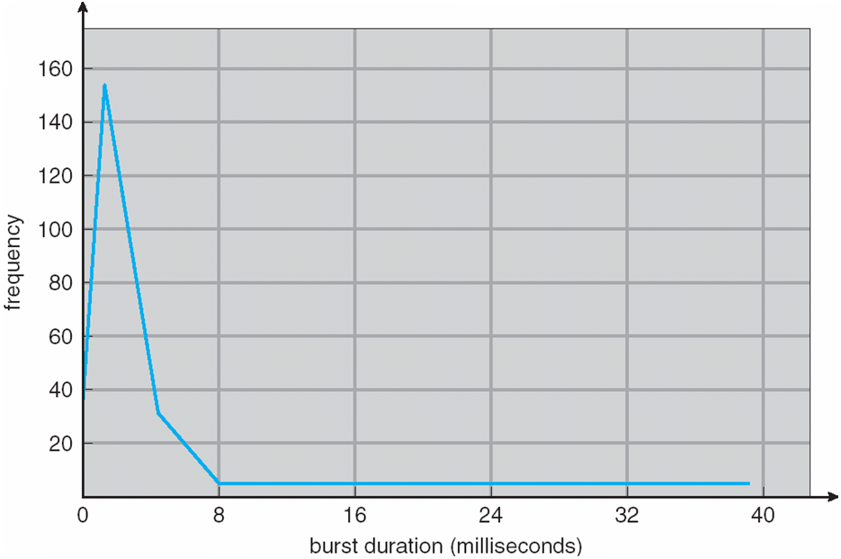
Histogram of CPU-burst Times Figure 6.2
Figure 6.2.

Slide 10
CPU Scheduler
Whenever the CPU becomes idle (not working), the OS must select one of the processes in the ready queue to be executed.
The selection process is carried out by a short-term scheduler or CPU scheduler.
The short-term scheduler selects from among the processes in ready queue, and allocates the CPU to one of them
  The scheduler selects a process from the ready queue (processes in memory) that are ready to execute and allocates the CPU to that process.

Slide 11
CPU Scheduler
Short-term scheduler selects the processes in ready queue, and then allocates the CPU to one of them
  the ready queue is not necessarily a first-in, first-out (FIFO) queue
CPU scheduling decisions may take place when a process:
  1. Switches from running state to waiting state (result of an I/O request)
  2. Switches from running state to ready state (when an interrupt occurs)
  3. Switches from waiting state to ready state (at completion of I/O)
  4. Terminates
Scheduling under 1 and 4 is non-preemptive, there is no choice in terms of scheduling.
This scheduling method was used by Microsoft Windows 3.x.

Slide 12
CPU Scheduler
All other scheduling is preemptive, There is a choice, however, for situations 2 and 3.
  Consider access to shared data
  Consider preemption while in kernel mode
  Consider interrupts occurring during crucial OS activities
preemptive scheduling can result in race conditions when data are shared among several processes:
  Consider the case of two processes that share data. While one process is updating the data, it is preempted so that the second process can run. The second process then tries to read the data, which are in an inconsistent state.
Preemption also affects the design of the OS kernel. During the processing of a system call, the kernel maybe busy with an activity on behalf of a process. Such activities may involve changing important kernel data (for instance, I/O queues).

Slide 13
CPU Scheduler
Windows 95 introduced preemptive scheduling, and all subsequent versions of Windows operating systems have used preemptive scheduling.
The Mac OS X for the Macintosh also uses preemptive scheduling.

Slide 14
Dispatcher
The dispatcher module gives control of the CPU to the process selected by the short-term scheduler and this involves the following:
  switching context
  switching to user mode
  jumping to the proper location in the user program to restart that program
Dispatch latency – time it takes for the dispatcher to stop one process and start another process running

Slide 15
Scheduling Criteria
Many criteria have been suggested for comparing CPU-scheduling algorithms. The criteria include the following:
CPU utilization – keep the CPU as busy as possible (can range from 0 to 100 percent).
Throughput – # of processes that complete their execution per time unit.
Turnaround time – amount of time to execute a particular process (is the sum of the clock periods spent waiting to get into memory, waiting in the ready queue, executing on the CPU, and doing I/O).
Waiting time – amount of time a process has been waiting in the ready queue
Response time – amount of time it takes from when a request was submitted until the first response is produced–is the time it takes to start responding.

Slide 16
Scheduling Algorithm Optimization Criteria
The following are the optimization criteria of a CPU scheduling algorithm:
  Max. CPU utilization
  Max. throughput
  Min. turnaround time
  Min. waiting time
  Min. response time

Slide 17
Scheduling Algorithms
CPU scheduling deals with the problem of deciding which of the processes in the ready queue is to be allocated the CPU.
There are many different CPU-scheduling algorithms. This section describes the following:
  First-Come, First-Served Scheduling (FCFS)
  Shortest-Job-First Scheduling (SJFS)
  Priority Scheduling (PS)
  Round-Robin Scheduling (RR)
  Multilevel Queue Scheduling (MLQ)
  Multilevel Feedback Queue Scheduling (MLFQ)
  Thread Scheduling (TS)

Slide 18
First- Come, First-Served (FCFS) Scheduling
Consider the following set of processes that arrive at time 0,with the length of the CPU burst given in milliseconds (ms):
Process Burst Time(ms)
P₁ 24
P₂ 3
P₃ 3
Suppose that the processes arrive in the order: P₁ , P₂ , P₃
The Gantt Chart for the schedule is:
Waiting time for P₁ = 0; P₂ = 24; P₃ = 27
Average waiting time: (0 + 24 + 27)/3 = 17 ms

Slide 19
FCFS Scheduling (Cont.)
Suppose that the processes arrive in the order:
P₂ , P₃ , P₁
The Gantt chart for the schedule is:
Waiting time for P₁ = 6; P₂ = 0; P₃ = 3
Average waiting time: (6 + 0 + 3)/3 = 3 ms
Much better than previous case
Convoy effect - short process behind long process (in previous case)
  Consider one CPU-bound and many I/O-bound processes
  This effect results in lower CPU and device utilization

Slide 20
FCFS Scheduling (Cont.)
The FCFS scheduling algorithm is a non-preemptive one.
Once the CPU has been allocated to a process, that process keeps the CPU until it releases the CPU, either by terminating or by requesting I/O.
The FCFS algorithm is thus particularly troublesome for time-sharing systems.

Slide 21
Shortest-Job-First (SJF) Scheduling
In the SJF algorithm each process is associated with the length of its next CPU burst
  Use these lengths to schedule the process with the shortest time
SJF is optimal – it gives minimum average waiting time for a given set of processes
  The difficulty is knowing the length of the next CPU request
  Could ask the user

Slide 22
Example of SJF
Consider the following set of processes (in the ready queue) with the length of the CPU burst given in milliseconds:
Process Burst Time (ms)
P₁ 6
P₂ 8
P₃ 7
P₄ 3
SJF scheduling chart
Waiting time for P₄ = 0; P₁ = 3; P₃ = 9; P₂ = 16
Average waiting time = (3 + 16 + 9 + 0) / 4 = 28/4 = 7 ms

Slide 23
Determining Length of Next CPU Burst
The real difficulty with the SJF algorithm is knowing the length of the next CPU request.
  It can only estimate the length – should be similar to the previous one
  Then pick process with shortest predicted next CPU burst
Can be done by using the length of previous CPU bursts, using exponential averaging
Commonly, α set to ½
A Preemptive SJF algorithm is called shortest-remaining-time-first (SRTF)
A non-preemptive SJF algorithm will allow the currently running process to finish its CPU burst.

Slide 24
Prediction of the Length of the Next CPU Burst

Slide 25
Shortest-remaining-time-first
A Preemptive version SJF is called shortest-remaining-time-first (SRTF) algorithm
Now we add the concepts of varying arrival times and preemption to the analysis
ProcessA ri Arrival TimeT Burst Time (ms)
P₁ 0 8
P₂ 1 4
P₃ 2 9
P₄ 3 5
Preemptive SJF Gantt Chart
Average waiting time = [(10-1)+(1-1)+(17-2)+5-3)]/4 = 26/4 = 6.5 ms

Slide 26
Shortest-remaining-time-first
Process P1 is started at time 0, since it is the only process in the queue. Process P2 arrives at time 1. The remaining time for process P1 (7 ms) is larger than the time required by process P2 (4 ms), so process P1 is preempted, and process P2 is scheduled. The average waiting time for this example is
[(10 − 1) + (1 − 1) + (17 − 2) + (5 − 3)]/4 = 26/4 = 6.5 ms.
P1 = final-start – initial start = 10 -1 = 9 ms
P2 = start – arrival = 1-1 = 0 ms
P3 = start – arrival = 17-2 = 15 ms
P4 = start – arrival = 5-3 = 2 ms
Total time /4 = ( 9 + 0 + 15 + 2)/4 = 26/4 = 6.5 ms
Non-preemptive SJF scheduling would result in an average waiting time of 7.75 ms

Slide 27
Priority Scheduling
A priority number (integer) is associated with each process
The CPU is allocated to the process with the highest priority (smallest integer represents highest priority)
  Preemptive
  Non-preemptive
Equal-priority processes are scheduled in FCFS order
SJF is priority scheduling where priority is the inverse of predicted next CPU burst time
Problem ≡ Starvation – low priority processes may never execute
Solution is Aging – as time progresses increase the priority of the process

Slide 28
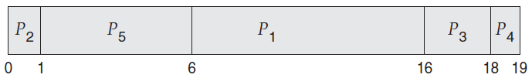
Example of Priority Scheduling
Consider the following set of processes, assumed to have arrived at time 0 in the order P1, P2, · · ·, P5, with the length of the CPU burst given in ms:
ProcessA arri Burst Time (ms)T Priority
P₁ 10 3
P₂ 1 1
P₃ 2 4
P₄ 1 5
P₅ 5 2
Priority scheduling Gantt Chart
Average waiting time = (0 + 1 + 6 + 16 + 18)/5 = 8.2 ms

Slide 29
Round Robin (RR) Scheduling
The round-robin (RR) scheduling algorithm is designed especially for timesharing systems. It is similar to FCFS scheduling, but preemption is added to enable the system to switch between processes.
Each process gets a small unit of CPU time (time quantum q), usually 10-100 milliseconds. After this time has elapsed, the process is preempted and added to the end of the ready queue.
  The ready queue is treated as a circular queue
If there are n processes in the ready queue and the time quantum is q, then each process gets 1/n of the CPU time in chunks of at most q time units at once. No process waits more than (n-1)q time units.
Timer interrupts every quantum to schedule next process
Performance
  q large ⇒ FIFO
  q small ⇒ q must be large with respect to context switch, otherwise overhead is too high

Slide 30
Round Robin (RR) Scheduling
The ready queue is treated as a circular queue. The CPU scheduler goes around the ready queue, allocating the CPU to each process for a time interval of up to 1 time quantum.
New processes are added to the tail of the ready queue. The CPU scheduler picks the first process from the ready queue, sets a timer to interrupt after 1 time quantum, and dispatches the process.
If the process have a CPU burst of less than 1 time quantum, then the process itself will release the CPU voluntarily. The scheduler will then proceed to the next process in the ready queue.
If the CPU burst of the currently running process is longer than 1 time quantum, the timer will go off and will cause an interrupt to the operating system.
  A context switch will be executed, and the process will be put at the tail of the ready queue. The CPU scheduler will then select the next process in the ready queue.

Slide 31
Example of RR with Time Quantum = 4
Consider the following set of processes that arrive at time 0, with the length of the CPU burst given in ms (and the time quantum is 4 ms):
Process Burst Time (ms)
P₁ 24
P₂ 3
P₃ 3
The Gantt chart is:
Let’s calculate the average waiting time for this schedule. P1 waits for 6 ms (10 - 4), P2 waits for 4 ms, and P3 waits for 7ms
Thus, the average waiting time is (6+4+7)/3 = 17/3 = 5.66ms

Slide 32
Example of RR with Time Quantum = 4
If we use a time quantum of 4 milliseconds, then process P1 gets the first 4 ms.
Since it requires another 20 milliseconds, it is preempted after the first time quantum, and the CPU is given to the next process in the queue, process P2. Process P2 does not need 4 milliseconds, so it quits before its time quantum expires.
The CPU is then given to the next process, process P3. Once each process has received 1 time quantum, the CPU is returned to process P1 for an additional time quantum.
Typically, higher average turnaround than SJF, but better response
The time quantum, q should be large compared to context switch time
  q usually 10ms to 100ms, context switch < 10 μsec

Slide 33
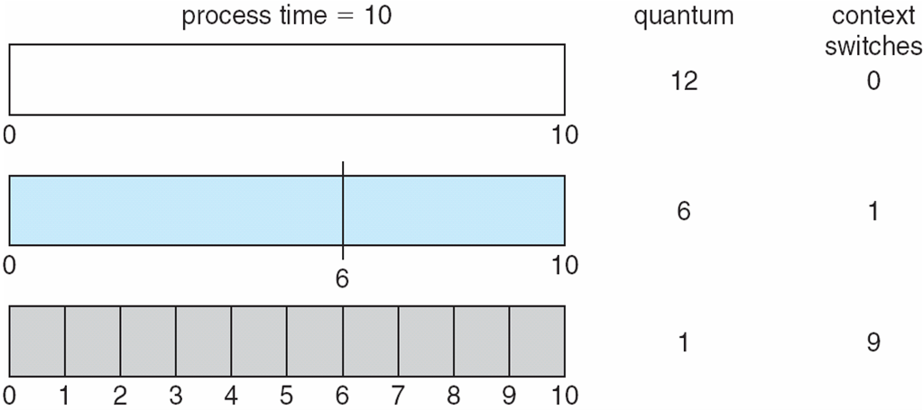
Time Quantum and Context Switch Time

Slide 34
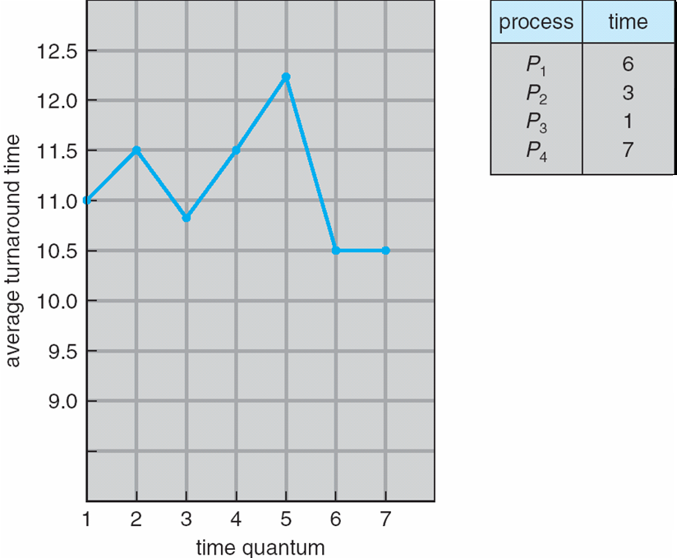
Turnaround Time Varies With The Time Quantum
80% of CPU bursts should be shorter than q

Slide 35
Multilevel Queue
The Ready queue is partitioned into separate queues, eg:
  foreground (interactive) processes
  background (batch) processes
foreground processes may have higher priority (externally defined) over background processes.
Each queue has its own scheduling algorithm:
  foreground – RR
  background – FCFS
Scheduling must be done between the queues:
  Fixed priority scheduling; (i.e., serve all from foreground then from background). Possibility of starvation.
  Time slice – each queue gets a certain amount of CPU time which it can schedule amongst its processes; i.e., 80% to foreground in RR
  20% to background in FCFS

Slide 36
Multilevel Queue Scheduling
A multilevel queue scheduling algorithm partitions the ready queue into several separate queues (Figure 6.6).
The processes are permanently assigned to one queue, generally based on some property of the process, such as memory size, process priority, or process type.
Each queue has its own scheduling algorithm. For example, separate queues might be used for foreground and background processes.
The foreground queue might be scheduled by an RR algorithm, while the background queue is scheduled by an FCFS algorithm.
The foreground queue may have absolute priority over the background queue.

Slide 37
Multilevel Queue Scheduling
Let’s look at an example of a multilevel queue scheduling algorithm with five queues, listed below in their order of priority:
  1. System processes
  2. Interactive processes
  3. Interactive editing processes
  4. Batch processes
  5. Student processes
Each queue has absolute priority over lower-priority queues.
No process in the batch queue, for example, could run unless the queues for system processes, interactive processes, and interactive editing processes were all empty.
If an interactive editing process entered the ready queue while a batch process was running, the batch process would be preempted.

Slide 38
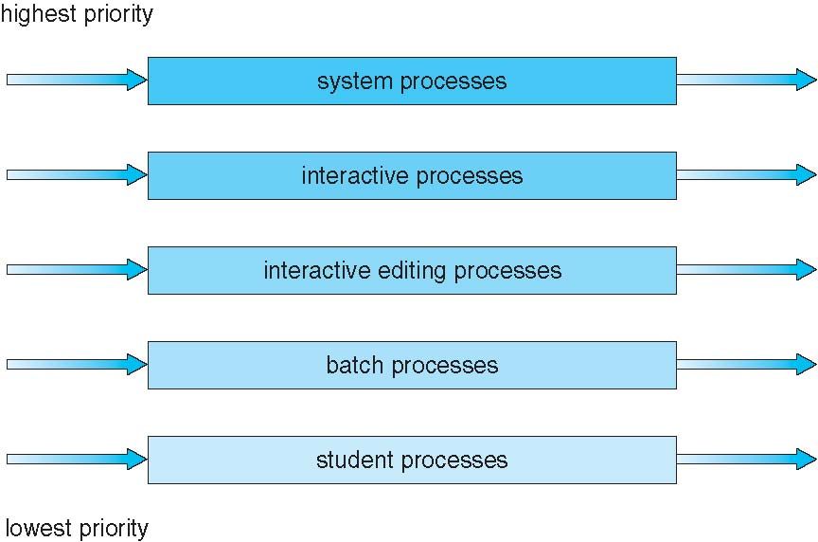
Multilevel Queue Scheduling
Figure 6.6 Multilevel queue scheduling.

Slide 39
Thread Scheduling
We have seen the distinction between user-level and kernel-level threads
As per operating systems the kernel-level threads—not processes—that are being scheduled by the operating system.
User-level threads are managed by a thread library, and the kernel is unaware of them. To run on a CPU, user-level threads must ultimately be mapped to an associated kernel-level thread, although this mapping may be indirect and may use a lightweight process (LWP).
Thread library schedules user-level threads to run on LWP
  Known as process-contention scope (PCS) since scheduling competition is within the process
  Typically done via priority set by programmer
Kernel thread scheduled onto available CPU is system-contention scope (SCS) – competition among all threads in system

Slide 40
Thread Scheduling
When we say the thread library schedules user threads onto available LWPs, we do not mean that the threads are actually running on a CPU.
That would require the OS to schedule the kernel thread onto a physical CPU. To decide which kernel-level thread to schedule onto a CPU, the kernel uses system-contention scope (SCS).
Typically, process-contention scope (PCS) is done according to priority—the scheduler selects the runnable thread with the highest priority to run.
User-level thread priorities are set by the programmer and are not adjusted by the thread library, although some thread libraries may allow the programmer to change the priority of a thread.
It is important to note that PCS will typically preempt the thread currently running in favor of a higher-priority thread.

Slide 41
Multiple-Processor Scheduling
CPU scheduling more complex when multiple CPUs are available
Multi-core system: Homogeneous processors within a multiprocessor
Asymmetric multiprocessing – only one processor (master) accesses the system data structures, alleviating the need for data sharing
Symmetric multiprocessing (SMP) – each processor is self-scheduling, all processes in common ready queue, or each has its own private queue of ready processes
  Currently, most common
Processor affinity (liking) – process has affinity for processor on which it is currently running
  soft affinity
  hard affinity
  Variations including processor sets

Slide 42
NUMA and CPU Scheduling
Note that memory-placement algorithms can also consider affinity (NUMA → Non Uniform Memory Access)

Slide 43
Multiple-Processor Scheduling – Load Balancing
If SMP, need to keep all CPUs loaded for efficiency
Load balancing attempts to keep workload evenly distributed
Push migration – periodic task checks load on each processor, and if found pushes task from overloaded CPU to other CPUs
Pull migration – idle processors pulls waiting task from busy processor

Slide 44
Multicore Processors
Recent trend to place multiple processor cores on same physical chip
Faster and consumes less power
Multiple threads per core also growing
  Takes advantage of memory stall to make progress on another thread while memory retrieve happens

Slide 45
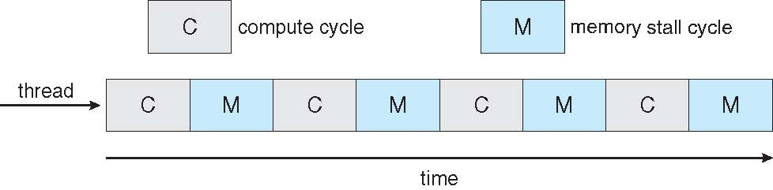

Multithreaded Multicore System

Slide 46
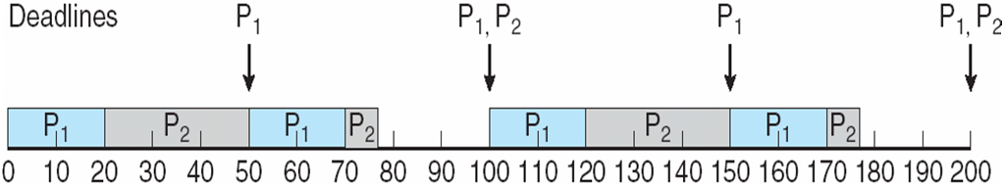
Rate Montonic Scheduling
A priority is assigned based on the inverse of its period
Shorter periods = higher priority;
Longer periods = lower priority
P₁ is assigned a higher priority than P₂.

Slide 47
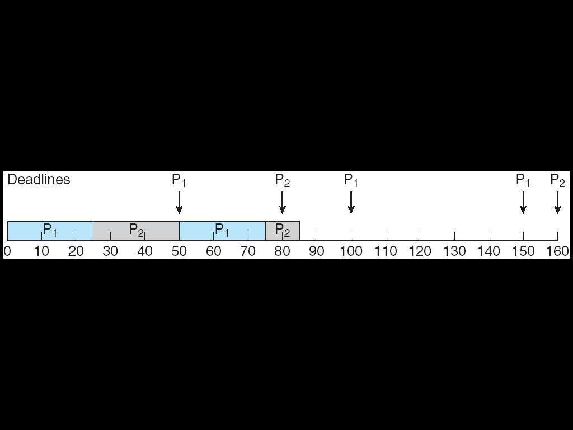
Missed Deadlines with Rate Monotonic Scheduling

Slide 48
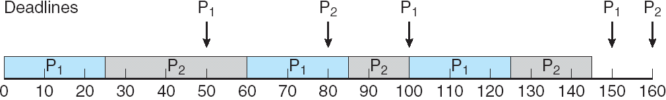
Earliest Deadline First Scheduling (EDF)
Priorities are assigned according to deadlines:
the earlier the deadline, the higher the priority;
the later the deadline, the lower the priority

Slide 49
Scheduling in Operating Systems
Linux scheduling
Windows scheduling
Solaris scheduling

Slide 50
Linux Scheduling Through Version 2.5
Prior to kernel version 2.5, ran variation of standard UNIX scheduling algorithm
Version 2.5 moved to constant order O(1) scheduling time
  Preemptive, priority based
  Two priority ranges: time-sharing and real-time
  Real-time range from 0 to 99 and nice value from 100 to 140
  Map into global priority with numerically lower values indicating higher priority
  Higher priority gets larger q
  Task run-able as long as time left in time slice (active)
  If no time left (expired), not run-able until all other tasks use their slices
  All run-able tasks tracked in per-CPU runqueue data structure
    Two priority arrays (active, expired)
    Tasks indexed by priority
    When no more active, arrays are exchanged
  Worked well, but poor response times for interactive processes

Slide 51
Linux Scheduling in Version 2.6.23 +
Completely Fair Scheduler (CFS)
Scheduling classes
  Each has specific priority
  Scheduler picks highest priority task in highest scheduling class
  Rather than quantum based on fixed time allotments, based on proportion of CPU time
  2 scheduling classes included, others can be added: default and real-time
Quantum calculated based on nice value from -20 to +19
  Lower value is higher priority
  Calculates target latency – interval of time during which task should run at least once
  Target latency can increase if say number of active tasks increases
CFS scheduler maintains per task virtual run time in variable vruntime
  Associated with decay factor based on priority of task – lower priority is higher decay rate and Normal default priority yields virtual run time = actual run time
To decide next task to run, scheduler picks task with lowest virtual run time

Slide 52
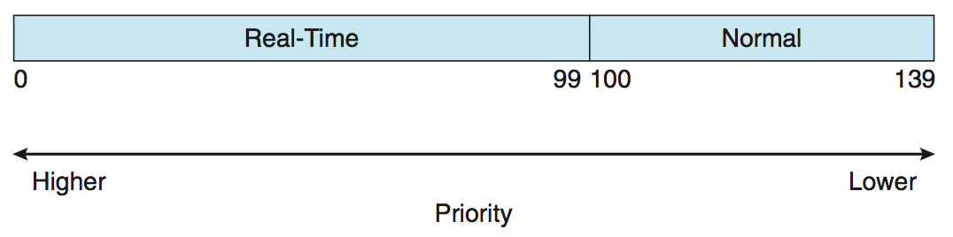
Linux Scheduling (Cont.)
Real-time scheduling according to POSIX.1b
  Real-time tasks have static priorities
Real-time plus normal map into global priority scheme
Nice value of -20 maps to global priority 100
Nice value of +19 maps to priority 139

Slide 53
Windows Scheduling
Windows uses priority-based preemptive scheduling
Highest-priority thread runs next
Dispatcher is scheduler
Thread runs until (1) blocks, (2) uses time slice, (3) preempted by higher-priority thread
Real-time threads can preempt non-real-time
32-level priority scheme
Variable class is 1-15, real-time class is 16-31
Priority 0 is memory-management thread
Queue for each priority
If no run-able thread, runs idle thread

Slide 54
Windows Priority Classes
Win32 API identifies several priority classes to which a process can belong
  REALTIME_PRIORITY_CLASS, HIGH_PRIORITY_CLASS, ABOVE_NORMAL_PRIORITY_CLASS,NORMAL_PRIORITY_CLASS, BELOW_NORMAL_PRIORITY_CLASS, IDLE_PRIORITY_CLASS
  All are variable except REALTIME
A thread within a given priority class has a relative priority
  TIME_CRITICAL, HIGHEST, ABOVE_NORMAL, NORMAL, BELOW_NORMAL, LOWEST, IDLE
Priority class and relative priority combine to give numeric priority
Base priority is NORMAL within the class
If quantum expires, priority lowered, but never below base

Slide 55
Windows Priority Classes (Cont.)
If wait occurs, priority boosted depending on what was waited for
Foreground window given 3x priority boost
Windows 7 added user-mode scheduling (UMS)
  Applications create and manage threads independent of kernel
  For large number of threads, much more efficient
  UMS schedulers come from programming language libraries like C++ Concurrent Runtime (ConcRT) framework

Slide 56
Windows Priorities

Slide 57
Solaris
Priority-based scheduling
Six classes available
  Time sharing (default) (TS)
  Interactive (IA)
  Real time (RT)
  System (SYS)
  Fair Share (FSS)
  Fixed priority (FP)
Given thread can be in one class at a time
Each class has its own scheduling algorithm
Time sharing is multi-level feedback queue
  Loadable table configurable by sys.admin

Slide 58
Solaris Dispatch Table

Slide 59
Solaris Scheduling

Slide 60
Solaris Scheduling (Cont.)
Scheduler converts class-specific priorities into a per-thread global priority
  Thread with highest priority runs next
  Runs until (1) blocks, (2) uses time slice, (3) preempted by higher-priority thread
  Multiple threads at same priority selected via RR

Slide 61
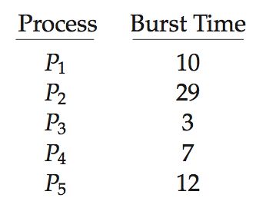
Algorithm Evaluation
How to select CPU-scheduling algorithm for an OS?
Determine criteria, then evaluate algorithms
Deterministic modeling
  Type of analytic evaluation
  Takes a particular predetermined workload and defines the performance of each algorithm for that workload
Consider 5 processes arriving at time 0:

Slide 62
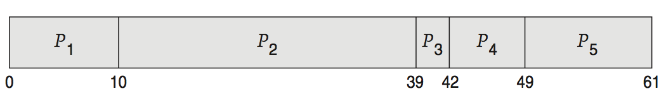
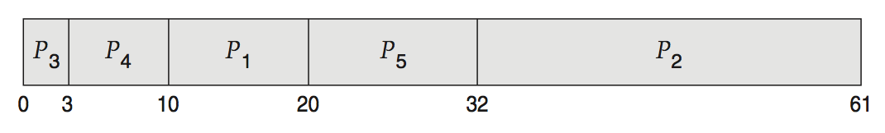
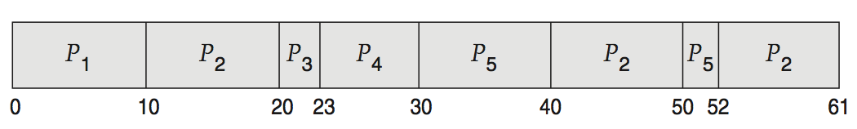
Deterministic Evaluation
For each algorithm, calculate minimum average waiting time
Simple and fast, but requires exact numbers for input, applies only to those inputs
  FCS is 28ms:
  Non-preemptive SFJ is 13ms:
  RR is 23ms:

Slide 63
Queueing Models
Describes the arrival of processes, and CPU and I/O bursts probabilistically
  Commonly exponential, and described by mean
  Computes average throughput, utilization, waiting time, etc
Computer system described as network of servers, each with queue of waiting processes
  Knowing arrival rates and service rates
  Computes utilization, average queue length, average wait time, etc

Slide 64
Little’s Formula
n = average queue length
W = average waiting time in queue
λ = average arrival rate into queue
Little’s law – in steady state, processes leaving queue must equal processes arriving, thus:
n = λ x W
  Valid for any scheduling algorithm and arrival distribution
For example, if on average 7 processes arrive per second, and normally 14 processes in queue, then average wait time per process = 2 seconds

Slide 65
Simulations
Queueing models limited
Simulations more accurate
  Programmed model of computer system
  Clock is a variable
  Gather statistics indicating algorithm performance
  Data to drive simulation gathered via
    Random number generator according to probabilities
    Distributions defined mathematically or empirically
    Trace tapes record sequences of real events in real systems

Slide 66
Evaluation of CPU Schedulers by Simulation

Slide 67
Implementation
Even simulations have limited accuracy
Just implement new scheduler and test in real systems
  High cost, high risk
  Environments vary
Most flexible schedulers can be modified per-site or per-system
Or APIs to modify priorities
But again environments vary

Slide 68
End of Chapter 6

