Slide 1
I/O System management

Slide 2
Agenda
Overview
I/O Hardware
Application I/O Interface
Kernel I/O Subsystem
Transforming I/O Requests to Hardware Operations
Performance

Slide 3
Objectives
Explore the structure of an operating system’s I/O subsystem
Discuss the principles of I/O hardware and its complexity
Provide details of the performance aspects of I/O hardware and software

Slide 4
Overview
The control of I/O devices connected to the computer is a major concern of OS designers.
  Because I/O devices vary so widely in their function and speed (consider a mouse, a hard disk, or a optical disc), so different methods are needed to control them.
Such methods form the I/O subsystem of the kernel, which separates the rest of the kernel from the complexities of managing I/O devices.
I/O-device technology exhibits two conflicting trends:
  increasing standardization of SW and HW interfaces.
  increasingly broad variety of I/O devices.

Slide 5
Overview
Data behavior and structure of new I/O devices are so and hence it is a challenge to incorporate them into an OS.
The basic I/O hardware elements such as ports, buses, and device controllers, accommodate a wide variety of I/O devices.
To encapsulate the details of different I/O devices, the kernel of an OS is structured to use device-driver modules.
The device drivers present a uniform device access interface to the I/O subsystem of the kernel:
  Based on system calls generated by each I/O device driver, the OS provides standard interface between the device and the application.

Slide 6
Overview
I/O management is a major section of an OS design and it should handle the following:
  I/O operation of the device
  I/O devices vary greatly
  Various methods to control them
  Performance management
  New types of devices frequent
  Present uniform device-access interface to I/O subsystem
Ports, busses, device controllers connect to various devices
Device drivers encapsulate each device in details

Slide 7
I/O Hardware
Computers operate with a variety of I/O devices such as:
  Storage: disk, Flash drive, etc.
  Transmission: network, Bluetooth, etc.
  Human-interface: keyboard, mouse, display, audio in and out, etc.
Signals from I/O devices interface with a computer through:
  Port – connection point for device, for ex. USB, HDMI, etc.
  Bus – group of signal conduction cables, operate based on daisy chain or shared direct access
    PCI bus connects fast devices to processor-memory system
    Expansion bus- connects relatively slow devices such as keyboard, serial ports, etc
    SCSI - bus that supports hard disks

Slide 8
I/O Hardware
An I/O device controller (or a host adapter) is a collection of electronics that can operate a port, a bus, or a device.
For example, a serial-port controller (or a USB port controller) is a single chip (or portion of a chip) in the computer that controls the signals on the serial port.
A typical PC (personal Computer) bus structure appears in Figure 13.1.

Slide 9
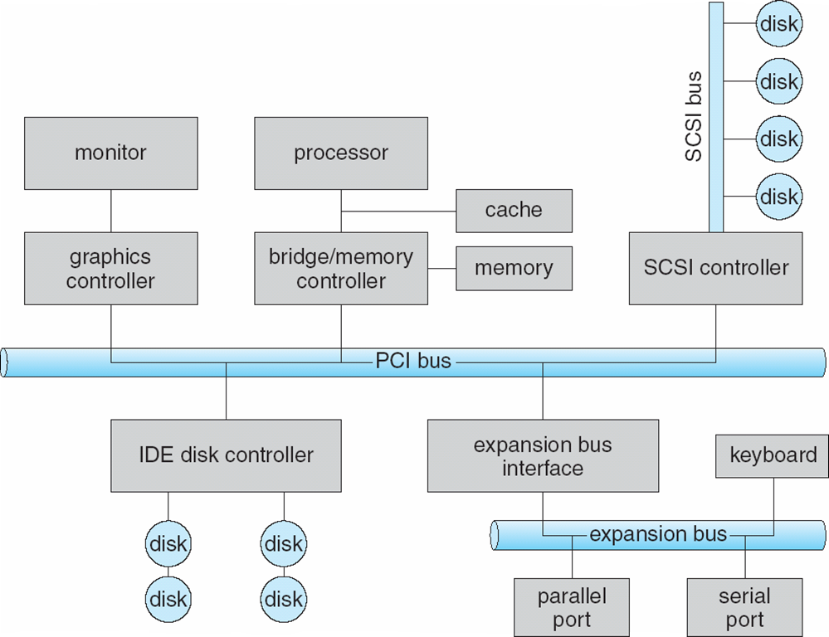
A Typical PC Bus Structure
Figure 13.1 A typical PC bus structure.

Slide 10
I/O Hardware
The SCSI bus controller has a complex protocol and is often implemented as a separate circuit board (or a host adapter).
How can the CPU give commands and data to an I/O controller to accomplish a data transfer?
  The controller has one or more registers for handling data and control signals.
  The CPU communicates with the controller by reading the control register for putting the I/O command and finding the status of the device and then writing a bit patterns into the data register for an I/O write
    This communication is through the use of I/O instructions that specify the transfer of a byte or word to an I/O port address.
  The I/O instruction triggers bus lines to select the proper devices and to move bits into or out of a device register.

Slide 11
I/O Hardware
The device controller can support memory-mapped I/O operation:
  In this case, the device-control registers are mapped into the memory address space of the system.
Some times, the CPU executes direct I/O instructions for I/O operations by reading or writing the device-control registers and transfer data from/to I/O devices.
Some systems use both I/O instructions and memory-mapped techniques for I/O device support.
Figure 3.2 shows the usual I/O port addresses for PCs (personal computes).

Slide 12
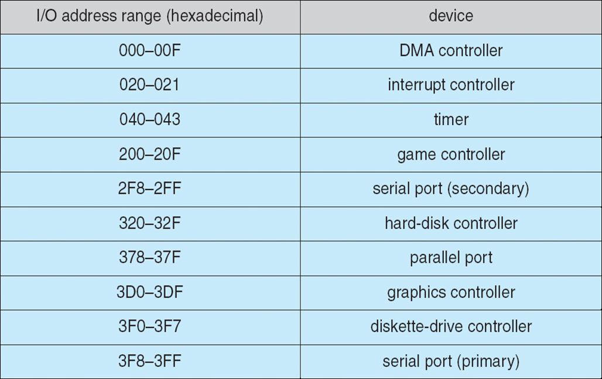
Device I/O Port Locations on PCs (partial)
Figure 13.2 Device I/O port locations on PCs (partial).

Slide 13
I/O Hardware -Summary
I/O devices usually have registers where device drivers place commands, addresses, and data to write, or read data from registers after command execution
  data-in register, data-out register, status register, control register
  Typically 1-4 bytes, or FIFO buffer
Devices have addresses, used by
  Direct I/O instructions
  Memory-mapped I/O

Slide 14
I/O Registers
An I/O port typically consists of four registers, called the status, control, data-in, and data-out registers:
  The data-in register is read by the host to get input.
  The data-out register is written by the host to send output.
  The status register contains bits that can be read by the host.
    These bits indicate status states, such as whether the current command has completed, whether a byte is available to be read from the data-in register, and whether a device error has occurred.
  The control register can be written by the host to start a command or to change the mode of a device.
    For instance, a certain bit in the control register of a serial port chooses between full-duplex and half-duplex communication, another bit enables parity checking, etc.

Slide 15
Polling
The I/O controller indicates its device state through the busy bit in the status register.
The controller sets (1) the busy bit when device is busy and clears (0) the busy bit when it is ready to accept the command.

Slide 16
I/O Polling
Assume a host system perform an I/O write to a device through a port coordinates with its I/O controller as follows:
  1. Read the busy bit from status register of the I/O controller until it is 0 (0 = ready) is called I/O polling.
  2. If it is ready, then host sets the write bit in the command register and writes a byte into the I/O controller’s data-out register.
  3. Then the host sets the command-ready bit.
  4. When the I/O controller notices that the command-ready bit is set, it sets the busy bit to indicate a write operation.
  5. Then controller reads the command register and sees the write command from the host.
  6. It reads the data-out register to get the byte and does the I/O write to the device.
  7. Controller clears busy bit, error bit, command-ready bit when the I/O transfer is done
  .

Slide 17
Polling
The I/O polling operation is indicated in step1:
  the host is busy-waiting or polling: it is in a loop, reading the status register over and over until the busy bit becomes clear.
In many computer architectures, three CPU-instruction cycles are sufficient to poll an external device:
  read a device status register,
  extract its status bit, and
  branch if not zero.

Slide 18
Interrupts
Clearly, the basic polling operation is efficient.
But polling becomes inefficient when an I/O controller is repeatedly waiting for the ready status of its I/O device: wasting CPU’s useful processing time.
In such instances, it may be more efficient to arrange for the HW controller to notify the CPU when the device becomes ready for service rather than the CPU to poll repeatedly for the device by itself.
The HW mechanism that enables a device to notify the CPU when it is ready is called an interrupt.

Slide 19
Interrupts
The basic interrupt mechanism works as follows:
  The CPU hardware has an input pin (or line) called the interrupt-request line (IRQ-line) that the CPU senses its signal after executing every instruction.
  When the CPU detects that an I/O controller has asserted (1) a signal on the IRQ-line, the CPU performs a state save operation and jumps to a interrupt-handler routine (IHR) instructions which are stored at a fixed address in the OS memory.
    The IHR of each device is provided by the OS.
  The IHR determines the cause of the interrupt and performs the necessary processing;
    CPU executes the instructions of IHR and then restore the system state for resuming the interrupted process.

Slide 20
Interrupts
The device controller raises an interrupt by asserting the IRQ- line of the CPU and then the CPU catches the interrupt and dispatches it to the IHR of the OS, and the handler clears the interrupt by servicing the device.
Figure 13.3 summarizes the interrupt-driven I/O cycle.
Interrupt management function of the OS is important:
  because even a single-user system manages hundreds of interrupts per second and the server systems handle hundreds of thousands interrupts per second.

Slide 21
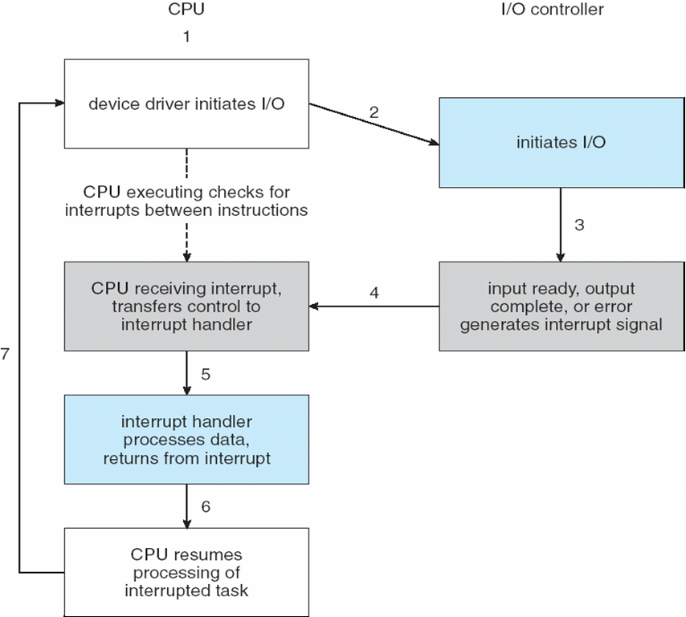
Interrupt-Driven I/O Cycle
Figure 13.3 Interrupt-driven I/O cycle.

Slide 22
Interrupts
The basic interrupt mechanism enables the CPU to respond to an asynchronous event, as when a device controller becomes ready for service.
In a modern OS:
  We need an efficient way to dispatch to the proper interrupt handler for a device without wasting time for polling all the device controllers to find the source.
  We need multilevel interrupts, so that the OS can distinguish between high- and low-priority interrupts.
In modern computer hardware, these three features are provided by the CPU and by the interrupt-controller hardware.

Slide 23
Interrupts
Most modern CPUs have two interrupt request (IRQ) lines:
  Non-maskable interrupt: which is reserved for events such as unrecoverable memory errors.
  Maskable interrupt: it can be turned off by the CPU before the execution of critical instruction sequences that must not be interrupted.
The maskable interrupt is used by device controllers to request service.

Slide 24
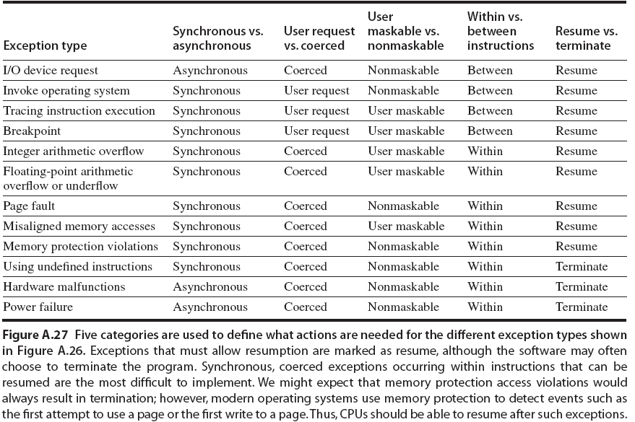

Slide 25
Interrupts
The interrupt mechanism accepts an address—a number that selects a specific interrupt-handling routine.
In most architectures, this address is an offset in a table called the interrupt vector.
Interrupt vector contains the memory addresses of specialized interrupt handlers for various I/O devices.
The purpose of a vectored interrupt mechanism is to search all possible sources of interrupts to determine which one needs service.

Slide 26
Interrupts
Figure 13.4 illustrates the design of the interrupt vector for the Intel Pentium processor.
  The events from 0 to 31, which are nonmaskable, are used to signal various error conditions.
  The events from 32 to 255, which are maskable, are used for purposes such as device-generated interrupts.

Slide 27
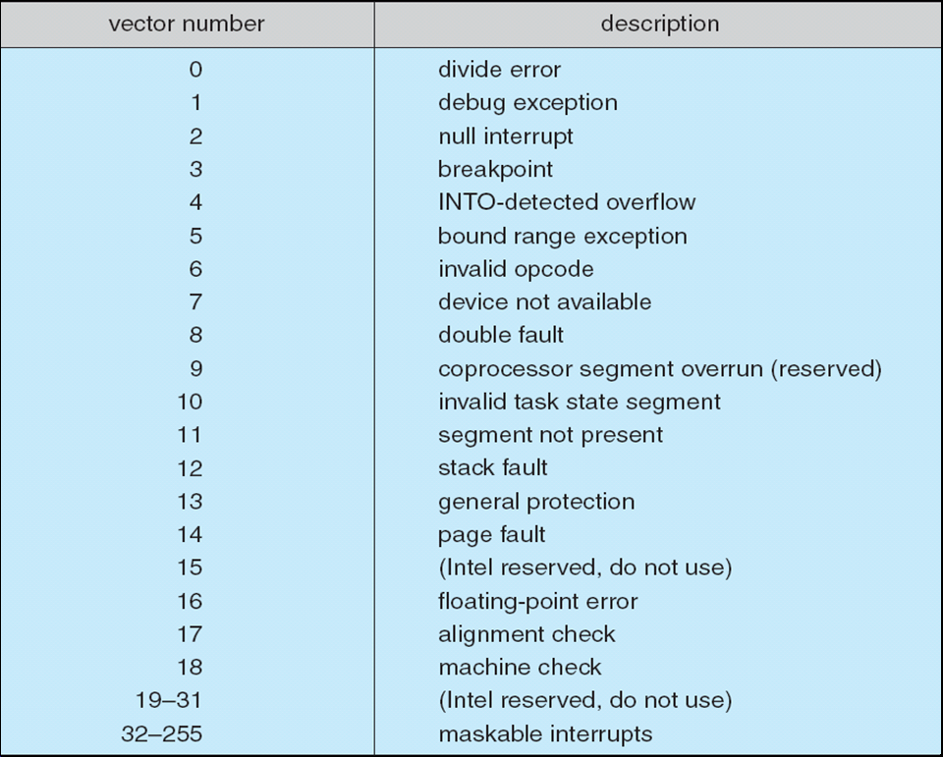
Interrupts
Figure 13.4 Intel Pentium processor event-vector table.

Slide 28
Interrupts
The interrupt mechanism also implements a system of interrupt priority levels.
These levels enable the CPU to defer the handling of low-priority interrupts without masking (hiding) all interrupts
  it possible to preempt a low-priority interrupt for a high priority interrupt.
The interrupt mechanism is also used to handle a wide variety of exceptions;
  such as dividing by 0, accessing a protected memory address, or attempting to execute a privileged instruction from user mode.

Slide 29
Page Fault
An OS has an efficient HW and SW mechanism that saves processor state and then calls a privileged routine in the kernel during an I/O interrupt.
Many operating systems use the interrupt mechanism for virtual memory paging.
A page fault is an exception that results an IHR.
  This interrupt suspends the current process and jumps to the page-fault handler in the kernel.
This handler saves the state of the interrupted process, moves the process to the wait queue, performs page-cache management, schedules an I/O operation to fetch the page from the disk (VM), schedules another process to resume execution of the process.

Slide 30
System Calls
Another example of kernel interrupt is the implementation of system calls.
System call procedure:
  A user program uses library calls to issue system calls.
    The library routines check the arguments given by the application, build a data structure to convey the arguments to the kernel, and then execute a special instruction called a trap.
  This system call instruction has an operand that identifies the desired kernel service.
    When a process executes the trap instruction, the interrupt hardware saves the state of the user code, switches to kernel mode, and dispatches to the kernel routine that implements the requested service.

Slide 31
Direct Memory Access
For a large data transfer device such as a hard disk, it is wasteful to use the processor to watch status bits time to time for transferring data in the form one byte at a time — this type of I/O transaction is called programmed I/O (PIO) operation.
Many computers avoid burdening the CPU with PIO (PIO supports only one byte transfer at a time) for large data transfer.
Now a day’s large data transfer operations (such as USB transfer) happen in a computer system through a special-purpose I/O controller called a direct-memory-access controller (DMA controller) .

Slide 32
Direct Memory Access
To initiate a DMA transfer (assume an I/O write operation), the host computer generates a DMA command block, consists of:
    a pointer to the source of a transfer,
    a pointer to the destination of the transfer, and
    a count of the number of bytes to be transferred.
Prior to a DMA operation, the CPU sends DMA command block to the DMA controller, then goes on with other work.
Then the DMA controller proceeds to operate the memory bus directly, by placing memory addresses of the data locations on the bus to perform data transfer without the help of the CPU.
  A DMA controller is a standard component in all modern computers, including smart phones.

Slide 33
Direct Memory Access
Pairing between the DMA controller and the device controller is performed via the two control signal of the CPU called DMA-request (DRQ) and DMA-acknowledge (DACK).
  First, the DMA controller collects status of its I/O device and sends it to the CPU as DRQ for initiating a data transfer.
  If the CPU is willing to accept the DRQ from the DMA controller, it sends a DACK signal back to the DMA controller.
  It causes the DMA controller to seize (called cycle stealing ) the system bus (address bus, data bus, and control bus) from the CPU and places the desired memory address on the address bus for data transfer between the memory and the I/O device meantime the DMA controller cancels the DRQ signal.
When the entire transfer is finished, the DMA controller interrupts the CPU .The whole process is depicted in Figure 13.5.

Slide 34
Six Step Process to Perform DMA Transfer
Figure 13.5 Steps in a DMA transfer.

Slide 35
Application I/O Interface
This section discusses the structuring techniques and interfaces for the OS that enable I/O devices to be treated in a standard and uniform way.
How an application can open a file on a disk without knowing what kind of disk it is and how new disks and other devices can be added to a computer without disruption of the OS?
Figure 13.6 illustrates how the I/O-related portions of the kernel are structured in software layers (device-driver layer):
  The purpose of the device-driver layer is to hide the differences among device controllers from the I/O subsystem of the kernel.
  Making the I/O subsystem independent of the HW simplifies the job of the OS developer.

Slide 36
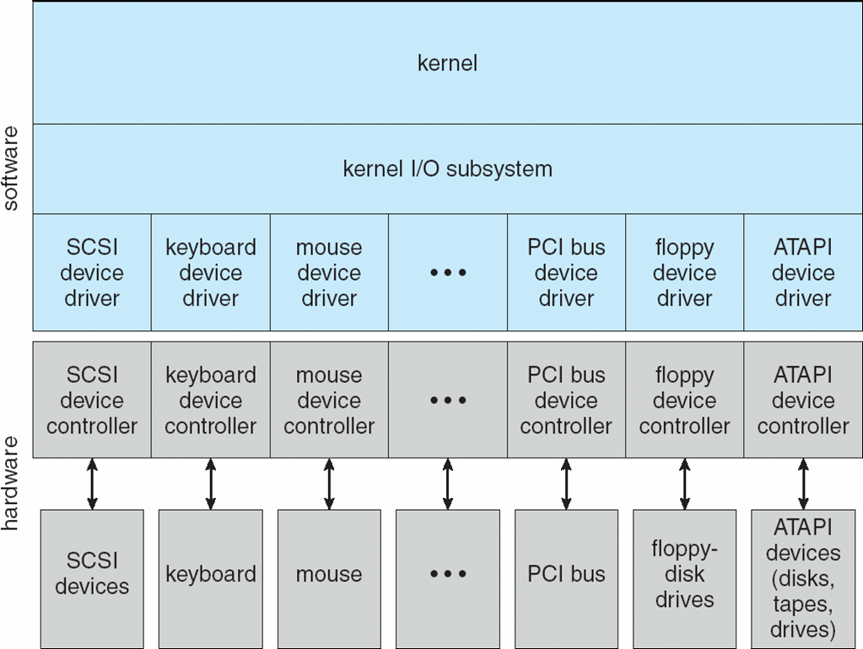
Application I/O Interface
Figure 13.6 A kernel I/O structure.

Slide 37
Application I/O Interface
For device-hardware manufacturers, each type of OS has its own standards for the device-driver interface.
  A given device may ship with multiple device drivers—for instance, drivers for Windows, Linux, AIX, and Mac OS X.
Devices vary on many dimensions, as illustrated in Figure 13.7:
  Character-stream or block: Character-stream is byte by byte transfer and a block has many bytes
  Sequential or random-access: In sequential access, data transfer is in fixed order
  Synchronous or asynchronous (or both): if the data transfer is synchronous with the system clock cycle, then it is synchronous else not
  Sharable or dedicated : A sharable device can be used concurrently by several processes or threads; a dedicated device cannot.
  Speed of operation: from a few bytes per sec to a few gigabytes per sec
  read-write, read only, or write only: perform input-output, or support only one data transfer direction (either read or write).

Slide 38
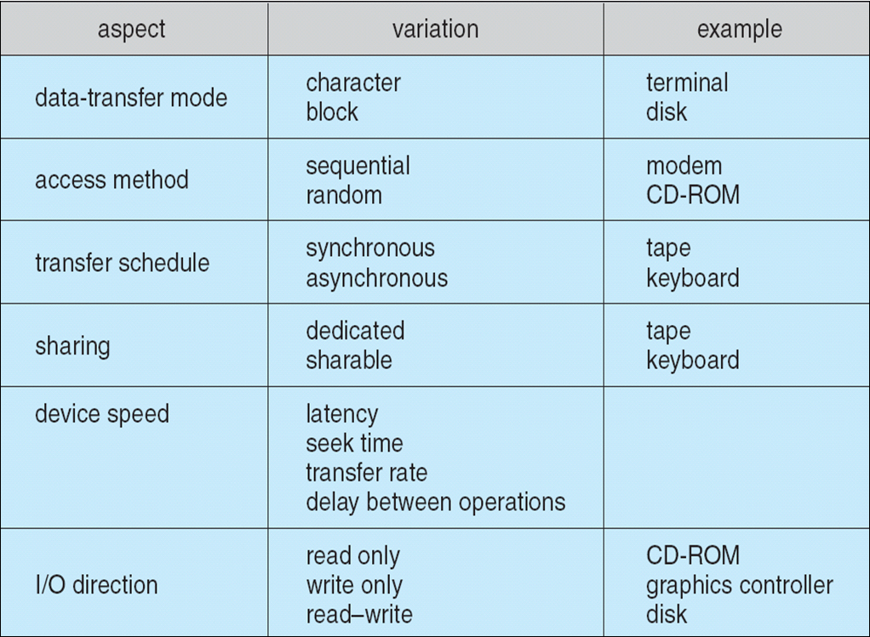
Characteristics of I/O Devices
Figure 13.7 Characteristics of I/O devices.

Slide 39
Characteristics of I/O Devices
Broadly I/O devices can be grouped by the OS into:
  Block device- Hard Disk, Optical Disk, etc
  Character I/O (Stream)- Keyboard, etc
  Memory-mapped file access- DMA devices such as disk, etc
  Network sockets- client-server accesses

Slide 40
Blocking and Nonblocking System Call I/O Interface
System-call interface relates to the choice between blocking I/O and non-blocking I/O.
Blocking I/O system call:
  When an application issues a blocking system call, the execution of the application is suspended.
  The application is moved from the operating system’s run queue to a wait queue.
  After the system call completes, the application is moved back to the run queue, where it is eligible to resume execution.
  When it resumes execution, it will receive the values returned by the system call.
Nevertheless, most operating systems use blocking system calls for the application interface, because blocking application implementation is easier than non-blocking system calls.

Slide 41
Blocking and Nonblocking System Call I/O Interface
Non-blocking I/O system calls:
  Some operating systems provide nonblocking I/O system calls and some user-level processes need nonblocking I/O.
  A nonblocking call does not halt the execution of the application for an extended time.
  Instead, it returns quickly, with a return value that indicates how many bytes were transferred.
  One example is a user interface that receives keyboard and mouse input while processing and displaying data on the screen.

Slide 42
Vectored I/O
Some operating systems provide another major variation of I/O via their applications interfaces.
A vectored I/O allows one system call to perform multiple I/O operations involving multiple locations.
For example, the UNIXreadv system call accepts a vector of multiple buffers and either reads from a source to that vector or writes from that vector to a destination.
Multiple separate buffers can have their contents transferred via one system call, avoiding context-switching and system-call overhead.
Advantage:
  Without vectored I/O, the data might first need to be transferred to a larger buffer in the right order and then transmitted, which is inefficient.

Slide 43
Kernel I/O Subsystem
Kernels provide many services related to I/O operations. This services are collectively called a kernel I/O subsystem:
The kernels I/O subsystem has the following services:
  scheduling,
  buffering,
  caching,
  spooling,
  device reservation, and
  Error handling
These are provided by the kernel’s I/O subsystem and build on the hardware and device driver infrastructure.
The I/O subsystem is also responsible for protecting itself from errant processes and malicious users.

Slide 44
Kernel I/O Subsystem
Scheduling
  Some I/O request ordering via per-device queue
  Some OSs try fairness
  Some implement Quality Of Service (i.e. IPQOS)
Buffering - store data in memory while transferring between devices
  To cope with device speed mismatch
  To cope with device transfer size mismatch
  To maintain “copy semantics”
  Double buffering – two copies of the data
    Kernel and user
    Varying sizes
    Full / being processed and not-full / being used
    Copy-on-write can be used for efficiency in some cases

Slide 45
Kernel I/O Subsystem
Caching - faster device holding copy of data
  Always just a copy
  Key to performance
  Sometimes combined with buffering
Spooling - hold output for a device
  If device can serve only one request at a time
  i.e., Printing
Device reservation - provides exclusive access to a device
  System calls for allocation and de-allocation
  Watch out for deadlock

Slide 46
Kernel I/O Subsystem- Scheduling
I/O Scheduling: to schedule a set of I/O requests means to determine a good order in which to execute them.
I/O Scheduling can improve overall system performance by sharing devices fairly among processes, and hence reduce the average waiting time for I/O to complete.
  Suppose that a disk arm is near the beginning of a disk and that three applications issue blocking read calls to that disk.
    Application1 requests a block near the end of the disk,
    application2 requests one block near the beginning, and
    application3 requests one block in the middle of the disk.
  The OS can reduce the distance that the disk arm travels by serving the applications in the order 2, 3, and 1.
  Rearranging the order of service in this way is the essence of I/O scheduling.

Slide 47
Kernel I/O Subsystem Summary
In summary, the I/O subsystem coordinates an extensive collection of services that are available to applications and to other parts of the kernel. The I/O subsystem supervises these procedures:
  Management of the name space for files and devices
  Access control to files and devices
  Operation control (for example, a modem cannot seek())
  File-system space allocation
  Device allocation
  Buffering, caching, and spooling
  I/O scheduling
  Device-status monitoring, error handling, and failure recovery
  Device-driver configuration and initialization

Slide 48
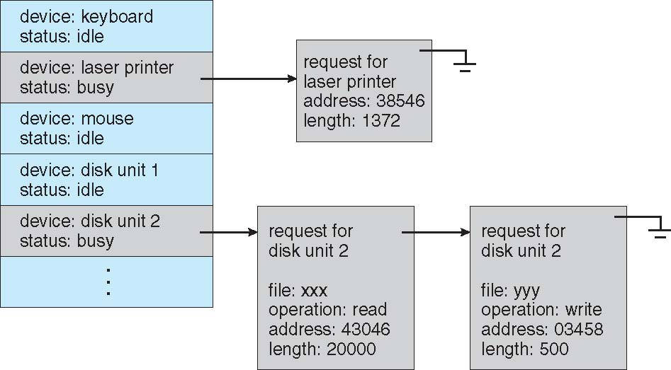
Device-status Table

Slide 49
Error Handling
OS can recover from device unavailable, transient failures (write failure)
  Retry a read or write, for example
  Some systems more advanced – Solaris FMA, AIX
    Track error frequencies, stop using device with increasing frequency of retry-able errors
Most return an error number or code when I/O request fails
System error logs hold problem reports

Slide 50
I/O Protection
User process may accidentally or purposefully attempt to disrupt normal operation via illegal I/O instructions
  All I/O instructions defined to be privileged
  I/O must be performed via system calls
    Memory-mapped and I/O port memory locations must be protected too

Slide 51
Use of a System Call to Perform I/O

Slide 52
Power Management
Not strictly domain of I/O, but much is I/O related
Computers and devices use electricity, generate heat, frequently require cooling
OSs can help manage and improve use
  Cloud computing environments move virtual machines between servers
    Can end up evacuating whole systems and shutting them down
Mobile computing has power management as first class OS aspect

Slide 53
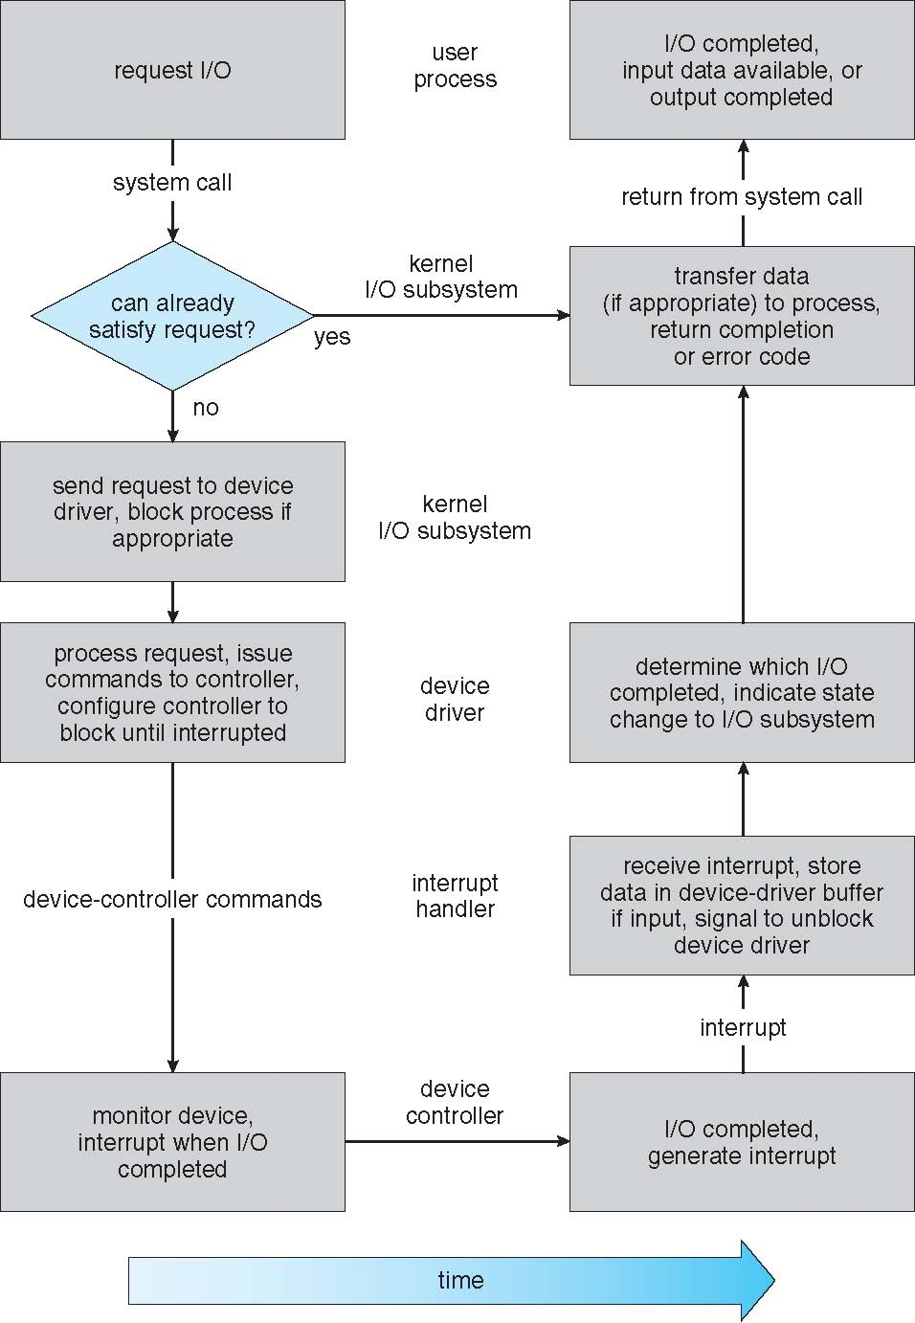
Life Cycle of An I/O Request

Slide 54
Improving I/O Performance
We can employ several principles to improve the efficiency of I/O interface:
  Reduce the number of context switches.
  Reduce the number of data copying in memory while passing between device and application.
  Reduce the frequency of interrupts by using large transfers, smart controllers, and polling.
  Use DMA I/O interface large data transfer.
  Use smarter hardware for I/O controller.
  Balance CPU, memory subsystem, bus, and I/O performance, for higher throughput.
  Move user-mode processes to kernel threads

