Slide 1
Chapter 2: Operating-System Structures

Slide 2
Chapter 2: Operating-System Structures
Operating System Services
User Operating System Interface
System Calls
Types of System Calls
System Programs
Operating System Design and Implementation
Operating System Structure
Operating System Debugging
Operating System Generation
System Boot

Slide 3
Objectives
To describe the services an OS provides to users, processes, and other systems.
To discuss the various ways of structuring an OS.
To explain how operating systems are installed and customized and how they boot.

Slide 4
Operating System Services
Operating systems provide an environment for execution of programs and services to programs and users.
The major OS services that helpful to the user are:
  User interface - Almost all operating systems have a user interface (UI).
    Command-Line (CLI), Graphics User Interface (GUI), and Batch
  Program execution - The system must be able to load a program into memory and to run that program, end execution, either normally or abnormally (indicating error).
  I/O operations - A running program may require I/O, which may involve a file or an I/O device.

Slide 5
Operating System Services (Cont.)
  File-system manipulation - Programs need to read and write files and directories, create and delete them, search them, list file Information, permission management.
  Communications – Processes may exchange information, on the same computer or between computers over a network
  Error detection – OS needs to be constantly aware of possible errors
    Errors may occur in the CPU and memory hardware, in I/O devices, and in user program
    For each type of error, OS should take the appropriate action to ensure correct and consistent computing
    Debugging facilities can greatly enhance the user’s and programmer’s abilities to efficiently use the system.

Slide 6
Operating System Services (Cont.)
  Resource allocation - When multiple users or multiple jobs running concurrently, resources must be allocated to each of them
    Many types of resources - CPU cycles, main memory, file storage, I/O devices, etc.
  Accounting - To keep track of which users use how much and what kinds of computer resources, etc.
  Protection and security - The owners of information stored in a multiuser or networked computer system controls the use of that information;
    concurrent processes should not interfere with each other.
    Protection involves ensuring that all access to system resources is controlled.
    Security of the system from outsiders requires user authentication, including I/O devices from invalid access attempts

Slide 7
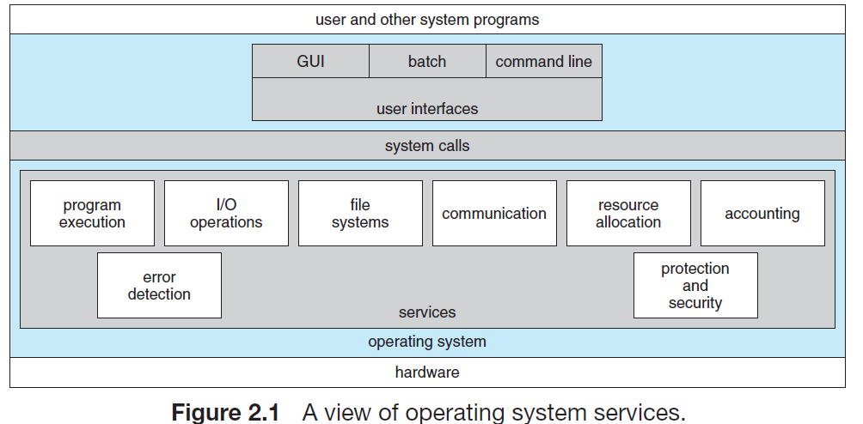
A View of Operating System Services
Figure 2.1 shows one view of the various operating-system services
and how they interrelate.

Slide 8
User and Operating-System Interface
Two fundamental user-OS interface approaches are:
  A command-line or command interpreter interface
    that allows users to directly enter commands to be performed by the operating system.
    For example command line by DOS, Linux, etc
  A graphical user interface (GUI)
    For example Windows

Slide 9
Command Interpreters
The main function of the command line is to get and execute the given user-specified command.
  Many of the commands given at this level manipulate files:
    create, delete, list, print, copy, execute, and so on.
  The MS-DOS and UNIX shells operate in this way.
These commands can be implemented in two general ways:
  One approach is the command interpreter or command line itself contains the code to execute the command.
    For example, a command to delete a file may cause the command interpreter to jump to a section of its code that sets up the parameters and makes the appropriate system call.

Slide 10
Command Interpreters
  An alternative approach—used by UNIX—implements most commands through system programs.
    In this case, the command interpreter does not understand the command in any way; it merely uses the command to identify a file to be loaded into memory and executed (without a system call).
    Thus, the UNIX command to delete a file: rm file.txt

Slide 11
Graphical User Interface (GUI)
In GUI, instead of entering commands directly via a command-line interface, users employ a mouse-based window and-menu system characterized by a desktop metaphor:
  The user moves the mouse to position its pointer on images, or icons, on the screen (the desktop) that represent programs, files, directories, and system functions.
  The first GUI appeared on the Xerox Alto computer in 1973.
  However, GUI became more widespread with the advent of Apple Macintosh computers in the 1980s.
  Microsoft’s first version of Windows—Version 1.0—was based on the addition of a GUI interface to the MS-DOS.

Slide 12
Choice of Interface
The choice of whether to use a command-line or GUI interface is mostly one of personal preference.
  If a frequent task requires a set of command-line steps, those steps can be recorded into a file, and that file can be run just like a program- shell programming.
  This program is not compiled into executable code but rather is interpreted by the command-line interface.
These shell scripts are very common on systems that are command-line oriented, such as UNIX and Linux.
Most Windows users are happy to use the Windows GUI environment.
  .

Slide 13
System Calls (1)
System calls provide an interface to the services made available by an OS.
Let us see how system calls are used:
  Assume a simple program to read data from one file and copy them to another file (the output file is not existing)
  The first name the input and the output files:
    One approach is for the program to ask the user for the names.
    In an interactive system, this approach will require a sequence of system calls, first to write a prompting message on the screen and then to read names from the keyboard.
  Once the two file names have been obtained, the program must open the input file and create the output file.

Slide 14
System Calls (2)
  Each of these operations requires another system call.
    Possible error conditions for each operation can require additional system calls.
      If there is no file of that name or the file is protected against access.
      In these cases, the program prints an error message on the console and then terminates.
  When both files are set up, a loop statement that reads from the input file (a system call) and writes to the output file (another system call).
  Finally, after the entire file is copied, the program may close both files (another system call), write a message to the console or window (one more system call), and finally terminate normally (the final system call). This system-call sequence is shown in Figure 2.5.

Slide 15
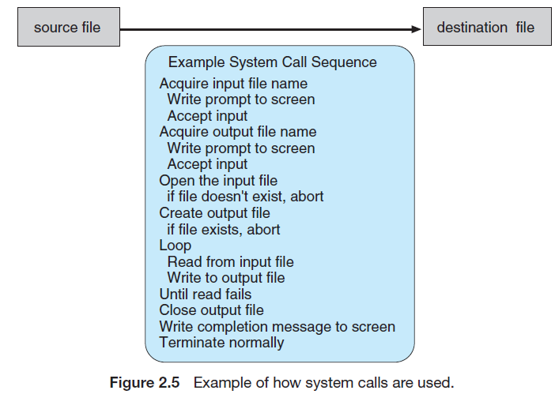
System Calls (3)

Slide 16
System Calls (4)
For most programming languages, there is a run-time support system (a set of functions built into libraries included with a compiler) provides a system-call interface that serves system calls:
  The system-call interface intercepts function calls in the API (Application Programming Interface) and invokes the necessary system calls within the OS.
  The most common APIs are the Windows API for Windows systems, the POSIX API for UNIX, Linux, and Mac OSX systems, and the Java API for the Java virtual machine (JVM) and Android OS.
    Typically, a number is associated with each system call, and the system-call interface maintains a table indexed according to these numbers.

Slide 17
System Calls (5)
The caller (a user program) needs only obey the API and understand what the OS will do as a result of the execution of that system call.
  Most of the details of the OS interface are hidden from the programmer by the API and are managed by the run-time support library.
The relationship between an API, the system-call interface, and the OS is shown in Figure 2.6.
  which illustrates how the OS handles a user application invoking the open() system call.

Slide 18
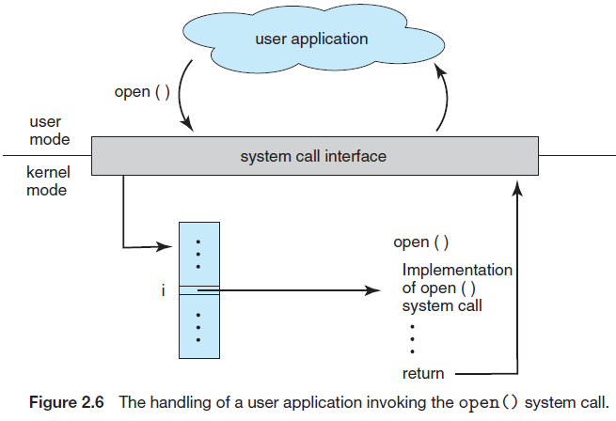
System Calls (6)

Slide 19
System Calls (7)
Three general methods used to pass parameters to the OS during a system call are:
  The simplest approach is to pass the parameters in registers (Figure 2.7).
    This is the approach taken by Linux and Solaris.
  In other cases, the parameters also can be placed, or pushed, onto the stack by the program and popped off the stack by the OS.

Slide 20
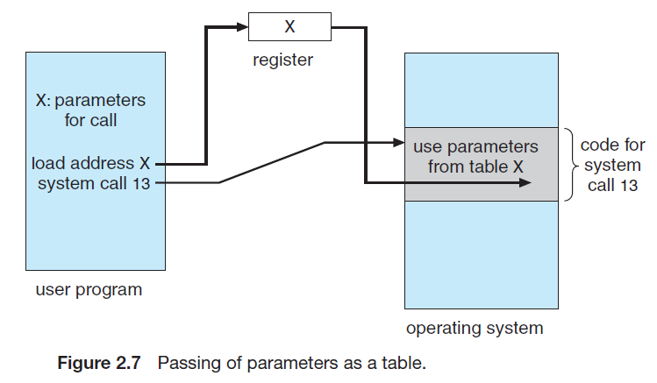
System Calls (8)

Slide 21
Types of System Calls
System calls can be grouped roughly into six major categories:
  process
  control
  file manipulation
  device manipulation
  information maintenance
  communication
  protection

Slide 22
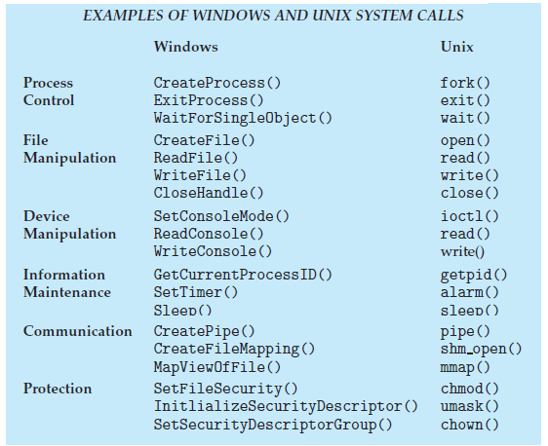
Types of System Calls

Slide 23
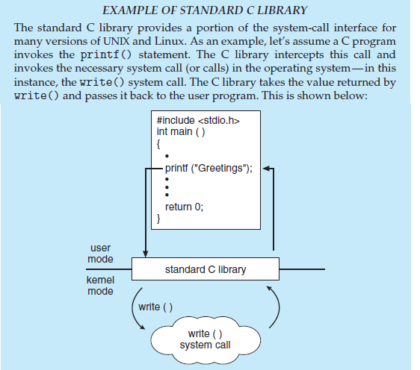
process, control – System Calls (1)

Slide 24
process, control – System Calls (2)
In a computer system, it is quite often, two or more processes may share data.
To ensure the integrity of the data being shared, an OS often provide system calls allowing a process to lock shared data.
  Then, no other process can access the data until the lock is released.
Typically, such system calls include acquire lock() and release lock().

Slide 25
process, control – System Calls (3)
The MS-DOS is an example of a single-tasking system.
It has a command interpreter that is invoked when the computer is started (Figure 2.9(a)).
  Because MS-DOS is single-tasking, it uses a simple method to run a program and does not create a new process.
It loads the program into main memory, writing over most of itself to give the program as much memory as possible (Figure 2.9(b)).

Slide 26
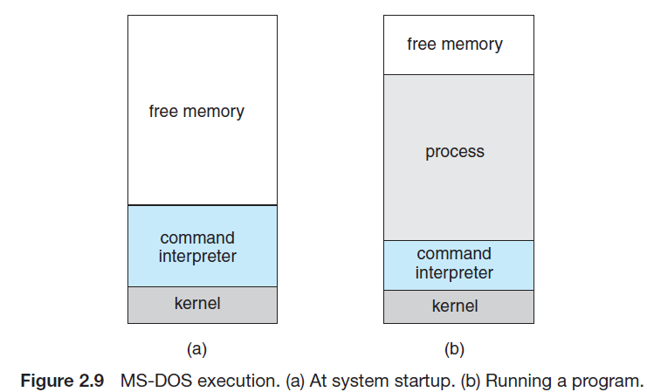
process, control – System Calls (4)

Slide 27
process, control – System Calls (5)
Next, it sets the instruction pointer (also called a program counter) to the first instruction of the program.
The program then runs, and either an error causes a trap, or the program executes a system call to terminate.

Slide 28
process, control – System Calls (8)
FreeBSD OS (derived from Berkeley UNIX) is an example of a multitasking operating system.
  When a user logs on to the system, the shell of the user’s choice is run.
  This shell is similar to the MS-DOS shell in that it accepts commands and executes programs that the user requests.
  However, since FreeBSD is a multitasking system, the command interpreter may continue running while another program is executed (Figure 2.10).

Slide 29
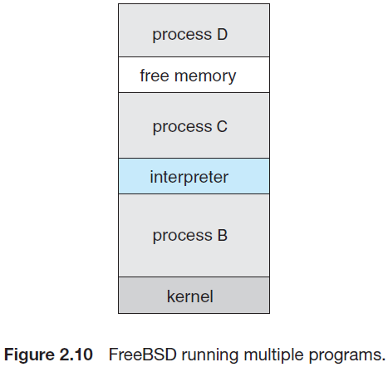
process, control – System Calls (9)

Slide 30
File Management – System Calls
Several system calls dealing with files:
  We first need to be able to create() file.
  Once the file is created, we need to open() it and to use it.
  We may also read(), write(), or reposition() (rewind or skip to the end of the file, for example).
  Finally, we need to close() the file, indicating that we are no longer using it.
  Later can delete() the selected file.

Slide 31
Device Management – System Calls
A process may need several resources to execute—main memory, disk drives, access to files, and so on.
  If the resources are available, they can be granted, and control can be returned to the user process.
  Otherwise, the process will have to wait (called blocked) until resources are available.
A system with multiple users may require us to first request() a device, to ensure exclusive use of it.
After we are finished with the device, we release() it.

Slide 32
Information Maintenance
Many system calls exist simply for the purpose of transferring information between the user program and the OS:
  For example, most systems have a system call to return the current time() and date().
  Other system calls may return information about the system, such as the number of current users, the version number of the OS, the amount of free memory or disk space, and so on.

Slide 33
Communication
There are two common models of inter-process communication:
  the message passing model and
  the shared-memory model.

Slide 34
Message-passing model (1)
In the message-passing model, the communicating processes exchange messages with one another to transfer information.
Messages can be exchanged between the processes either directly or indirectly through a common mailbox.
The name of the other communicator must be known, be it another process on the same system or a process on another computer connected by a communications network.

Slide 35
Message-passing model (2)
Each computer in a network has a host name and a network identifier, such as an IP address.
Similarly, each process has a process ID.
The get_hostid() and get_processid() system calls do this translation.
The network identifiers are then use the open() and close() calls provided by the file system or to specific open_ connection() and close_connection() system calls, depending on the system’s model.
The recipient process usually must give its permission for communication to take place with an accept_connection() system call.
The source, known as the client, and the receiver, known as a server, then exchange messages by using read_message() and write_message() system calls.
At the end the close_connection() system call terminates the communication

Slide 36
Shared-memory Model
In the shared-memory model, processes use shared_memory_create() and shared_memory_attach() system calls to create and gain access to regions of memory owned by other processes.
  The OS tries to prevent one process from accessing another process’s memory.
  Shared memory requires that two or more processes agree to remove this restriction.
They can then exchange information by reading and writing data in the shared areas.
The form of the data is determined by the processes and is not under the operating system’s control.

Slide 37
Pro and Cons
Both of the models just discussed are common in operating systems:
  Message passing is useful for exchanging smaller amounts of data, because no conflicts need be avoided.
    It is also easier to implement than shared memory for inter-computer communication.
  Shared memory allows maximum speed and convenience of communication, since it can be done at memory transfer speeds when it takes place within a computer.
    Problems exist are, in the areas of protection and synchronization between the processes sharing memory.

Slide 38
System Programs (1)
Another aspect of a modern system is its collection of system programs.
System programs, also known as system utilities, provide a convenient environment for program development and execution.
Some of them are simply user interfaces to system calls.
  Others are considerably more complex.

Slide 39
System Programs (2)
System programs can be divided into these categories:
  File management: These programs create, delete, copy, rename, print, dump, list, and generally manipulate files and directories.
  Status information: Some programs simply ask the system for the date, time, amount of available memory or disk space, number of users, or similar status information.
  File modification: Several text editors may be available to create and modify the content of files stored on disk or other storage devices.
  Programming-language support: Compilers, assemblers, debuggers, and interpreters for common programming languages (such as C, C++, Java, Python, PERL, etc ) are often provided with the OS or available as separate download form.

Slide 40
System Programs (3)
  Program loading and execution: Once a program is assembled or compiled, it must be loaded into memory to be executed.
  Communications: These programs provide the mechanism for creating virtual connections among processes, users, and computer systems.
  Background services: All general-purpose systems have methods for launching certain system-program processes at boot time.
    Some of these processes terminate after completing their tasks, while others continue to run until the system is halted.

Slide 41
OS Design Goals
The first problem in designing an OS is to define goals and specifications:
  At the highest level, the design of the OS will be affected by the following choices of a system:
    batch,
    time sharing,
    single user,
    multiuser,
    distributed,
    real time, or
    general purpose.
The requirements can be divided into two basic groups:
  user goals and system goals.

Slide 42
Design Goals - User goals
Users goal of an OS can be based on the following aspects:
  The OS should be convenient to use, easy to learn and to use, reliable, safe, and fast.
    These specifications are not particularly useful in the system design, since there is no general agreement on how to achieve them.

Slide 43
Design Goals - System goals
System goal of an OS can be based on the following aspects:
  The system should be easy to design, implement, and maintain; and it should be flexible, reliable, error free, and efficient.
    Again, these requirements are vague and may be interpreted in various ways.

Slide 44
Mechanisms and Policies (1)
One important principle of OS design is the separation of policy from mechanism.
  Mechanisms determine how to do something;
  Policies determine what will be done.
    For example: the timer construct is a mechanism for ensuring CPU protection, but deciding how long the timer is to be set for a particular user is a policy decision.
The separation of policy and mechanism is important for OS design flexibility.

Slide 45
Mechanisms and Policies (2)
Microkernel-based operating systems take the separation of mechanism and policy by implementing a set of functional blocks:
  kernel is a collection of primitive facilities or system calls for the rest of the OS
  a microkernel is the near-minimum amount of software that can provide the mechanisms needed to implement an OS
  The microkernel is the only software section of the OS running at the most privileged functions of the OS level (supervisor or kernel mode) at any given time.
A monolithic kernel is an OS architecture where the entire OS is working in the kernel space and alone as supervisor mode .
  Here the functional mechanisms and policies are not separated.

Slide 46
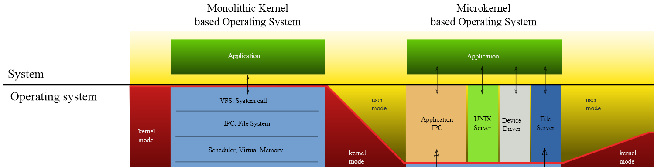
Mechanisms and Policies (3)

Slide 47
Mechanisms and Policies (4)
In a microkernel-based OS, its function-blocks are almost policy free;
  consider the history of UNIX. At first, it had a time-sharing scheduler.
Policy decisions are important for all resource allocation.
  Whenever it is necessary to decide whether or not to allocate a resource, a policy decision must be made.
    Whenever the question is how rather than what, it is a mechanism that must be determined.

Slide 48
Implementation
Early operating systems were written in assembly language.
  Now, although some operating systems are still written in assembly language, most are written in a higher-level language such as C or C++.
Actually, an OS can be written in more than one language.
  The lowest levels of the kernel might be assembly language.
  Higher-level routines might be in C, and system programs might be in C or C++, in interpreted scripting languages like PERL or Python, or in shell scripts.

Slide 49
Operating-System Structure
The OS design structures can be classified into five forms:
  Simple Structure
  Layered Approach
  Micro-kernels
  Modules
  Hybrid Systems

Slide 50
Simple Structure (1)
In simple OS structure, an OS does not have a well-defined structure.
  MS-DOS is an example of such a system.
  It was written to provide the most functionality in the least space, so it was not carefully divided into modules. Figure 2.11 shows a simple OS structure.
  In MS-DOS, the interfaces and levels of functionality are not well separated (monolithic in nature).
  Application programs are able to access the basic I/O routines to write directly to the display and disk drives.
    Such freedom leaves MS-DOS vulnerable to errant (or malicious) programs, causing entire system crashes when user programs fail.

Slide 51
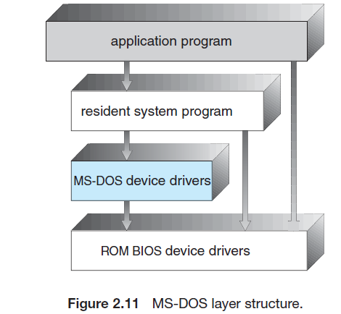
Simple Structure (2)

Slide 52
Simple Structure (3)
  Another example of simple structuring is the original UNIX system.
    Like MS-DOS, UNIX initially was limited by hardware functionality.
    It consists of two separable parts:
      the kernel and the system programs.
  We can view the traditional UNIX OS (monolithic design) as being layered to some extent, as shown in Figure 2.12.
    Everything below the system-call interface and above the physical hardware is the kernel.
    The kernel provides the file system, CPU scheduling, memory management, and other OS functions through system calls.
  It had a distinct performance advantage, there is very little overhead in the system call interface or in communication within the kernel.

Slide 53
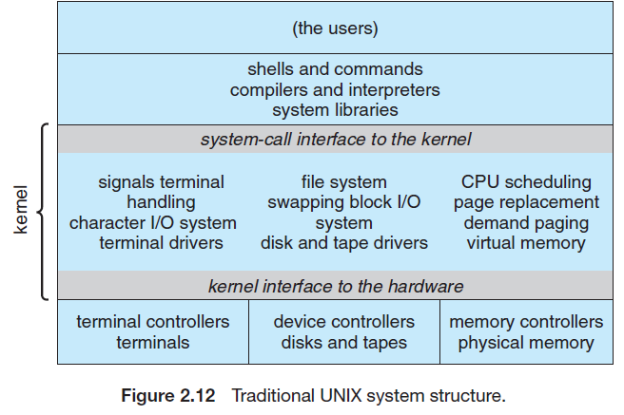
Simple Structure (4)

Slide 54
Layered Approach (1)
In layered approach, an OS can be made modular in many ways:
  One method is the layered approach, in which the OS is broken into a number of layers (called levels).
  The bottom layer (layer 0) is the hardware; the highest (layer N) is the user interface (Figure 2.13).
A typical OS layer—say, layer M —consists of data structures and a set of routines that can be invoked by higher-level layers.
  The main advantage of the layered approach is simplicity of construction and debugging.
  Disadvantage: Each layer adds overhead to the system call.

Slide 55
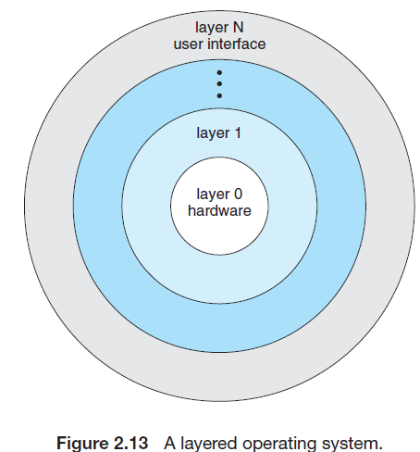
Layered Approach (2)

Slide 56
Micro-kernels (1)
In the mid-1980s, researchers at Carnegie Mellon University developed an OS called Mach that modularized the kernel using the microkernel approach.
  This method structures the OS by removing all nonessential components from the kernel and implementing them as system and user-level programs.
  The result is a smaller kernel.
    There is little consensus regarding which services should remain in the kernel and which should be implemented in user space.
  Figure 2.14 illustrates the architecture of a typical microkernel.

Slide 57
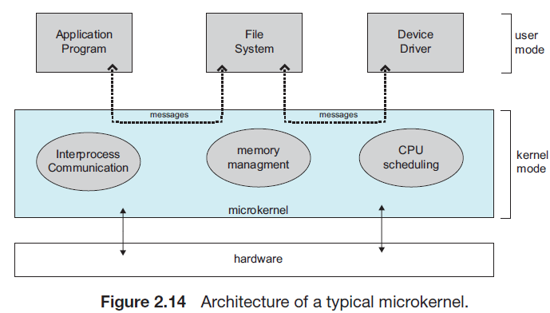
Micro-kernels (2)

Slide 58
Micro-kernels (3)
The main function of the microkernel is to provide communication between the client program and the various services that are also running in user space.
  Communication is provided through message passing.
    For example, if the client program wishes to access a file, it must interact with the file server.
    The client program and service never interact directly.
    Rather, they communicate indirectly by exchanging messages with the microkernel.
  One benefit of the microkernel approach is that it makes extending the OS easier. All new services are added to user space and consequently do not require modification of the kernel.
  The microkernel also provides more security and reliability, since most services are running as user rather than kernel processes.

Slide 59
Micro-kernels (4)
Unfortunately, the performance of micro-kernels can suffer due to increased system-function overhead.
  Consider the history of Windows NT:
    The first release had a layered microkernel organization.
    This version’s performance was low compared with that of Windows 95.
    Windows NT 4.0 partially corrected the performance problem by moving layers from user space to kernel space and integrating them more closely.
  By the time Windows XP was designed, Windows architecture had become more monolithic than microkernel.

Slide 60
Modules (1)
Perhaps the best current methodology for OS design involves using loadable kernel modules:
  Means, the kernel has a set of core components and links in additional services via modules, either at boot time or run time.
    This type of design is common in modern implementations of UNIX, such as Solaris, Linux, and Mac OS X, and Windows.
  The idea of the modular OS design is for the kernel to provide core services while other services are implemented dynamically, as the kernel is running.

Slide 61
Modules (2)
  Linking services dynamically is preferable to adding new features directly to the kernel,
    Thus, it is possible to build a CPU scheduling and memory management algorithms directly into the kernel.
  The overall result from a modular OS resembles a layered system in that each kernel section has defined, protected interfaces;
  It is more flexible than a layered system, because any module can call any other module.
  This approach is similar to the microkernel approach in that the primary module has only core functions and it involves the knowledge of how to load and communicate with other modules;
    but it is more efficient, because modules do not need to invoke message passing in order to communicate other modules.

Slide 62
Modules (3)
The Solaris OS structure is shown in Figure 2.15, is organized around a core kernel with seven types of loadable kernel modules:
    Scheduling classes
    File systems
    Loadable system calls
    Executable formats
    STREAMS modules
    Miscellaneous
    Device and bus drivers
  Linux also uses loadable kernel modules, primarily for supporting device drivers and file systems.

Slide 63
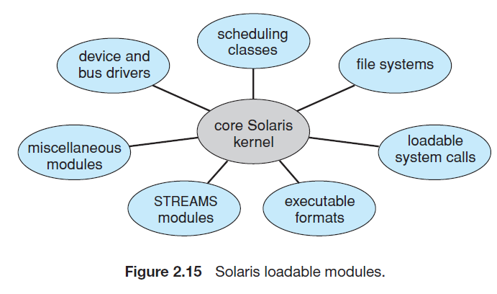
Modules (4)

Slide 64
Hybrid Systems (1)
In practice, a modern OS structure is a hybrid system that address performance, security, and usability issues.
  For example, both Linux and Solaris are monolithic, because the OS is in a single address space to provide very efficient performance.
  Windows is largely monolithic in nature, but it has features of microkernel systems, includes providing support for separate subsystems (known as OS personalities) that run as user-mode processes.
    Windows systems also provide support for dynamically loadable kernel modules.

Slide 65
Hybrid Systems (2)
Three famous hybrid OS are:
  Apple Mac OS X
  iOS and
  Android.

Slide 66
iOS
Apple mobile OS for iPhone, iPad
  Structured on Mac OS X, added functionality
  Does not run OS X applications natively
    Also runs on different CPU architecture (ARM vs. Intel)
  Cocoa Touch Objective-C API for developing apps
  Media services layer for graphics, audio, video
  Core services provides cloud computing, databases
  Core operating system, based on Mac OS X kernel
Figure 2.17 iOS Architecture

Slide 67
Android
The Android OS was designed by the Open Handset Alliance (led primarily by Google) and was developed for Android smartphones and tablet computers.
  Whereas iOS is designed to run only on Apple mobile devices and is a close-sourced one
  Android OS runs on a variety of mobile platforms and is open-sourced, partly explaining its rapid rise in popularity.
  The structure of Android appears in Figure 2.18.

Slide 68
Android (1)
Linux is used primarily for process, memory, and device-driver support for hardware and has been expanded to include power management.
The Android runtime environment includes a core set of libraries as well as the Dalvik virtual machine.
Software designers for Android devices develop applications in the Java.
However, rather than using the standard Java API, Google has designed a separate Android API for Java development.

Slide 69
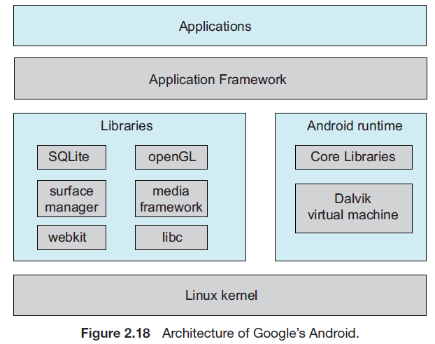
Android (2)

Slide 70
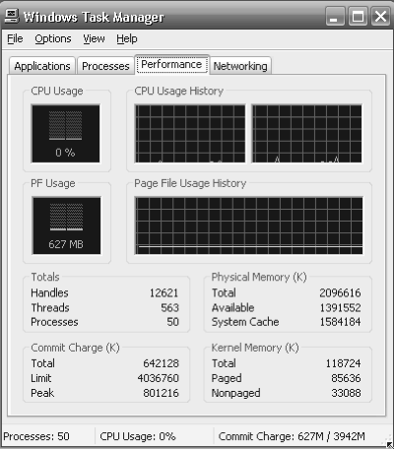
Performance Tuning
Improve performance by removing bottlenecks
OS must provide means of computing and displaying measures of system behavior
For example, “top” program or Windows Task Manager

Slide 71
Exercises (1)
What is the purpose of system calls?
What are the five major activities of an operating system with regard to
process management?
What are the three major activities of an operating system with regard to memory management?
What are the three major activities of an operating system with regard to secondary-storage management?
What is the purpose of the command interpreter? Why is it usually separate from the kernel?

Slide 72
Exercises (2)
What system calls have to be executed by a command interpreter or shell in order to start a new process?
What is the purpose of system programs?
What is the main advantage of the layered approach to system design?
What are the disadvantages of the layered approach?
List five services provided by an operating system, and explain how each creates convenience for users. In which cases would it be impossible for user-level programs to provide these services? Explain your answer.
Why do some systems store the operating system in firmware, while others store it on disk?
How could a system be designed to allow a choice of operating systems from which to boot? What would the bootstrap program need to do?

Slide 73
Exercises (3)
The services and functions provided by an operating system can be divided into two main categories. Briefly describe the two categories, and discuss how they differ.
Describe three general methods for passing parameters to the operating system.
What are the five major activities of an operating system with regard to file management?
What are the two models of interprocess communication? What are the strengths and weaknesses of the two approaches?
Why is the separation of mechanism and policy desirable?
What is the main advantage of the microkernel approach to system design? How do user programs and system services interact in a microkernel architecture? What are the disadvantages of using the microkernel approach?
What are the advantages of using loadable kernel modules?

Slide 74
End of Chapter 2

