Slide 1
Genetic Algorithm II

Slide 2
Contents
Overview
Why it does, what it does?
Genetic Programming
Interactive Genetic Algorithm
Human Based Genetic Algorithm

Slide 3
Genetic Algorithms
A GeneticAlgorithm (GA) is a search technique used in computing to find exact or approximate solutions to optimization and search problems
GA uses techniques inspired by evolutionary biology such as inheritance, mutation, selection and crossover

Slide 4
Genetic Algorithms
A Genetic Algorithm (GA) is a probabilistic search algorithm that iteratively transforms a set (called a population) of mathematical objects (typically fixed-length binary character strings)
  each population with an associated fitness value, into a new population of offspring objects using the Darwinian principle of natural selection and
  using operations that are patterned after naturally occurring genetic operations, such as crossover and mutation

Slide 5
GA – Quick Review
Developed: USA in the 1970’s
  By: J. Holland, K. DeJong, D. Goldberg
Typically applied to:
  discrete optimization problems
Attributed features:
  not too fast
  good heuristic for combinatorial problems
Special features:
  Traditionally emphasizes combining information from good
  parents (crossover)
  many variants, e.g. reproduction models, operators

Slide 6
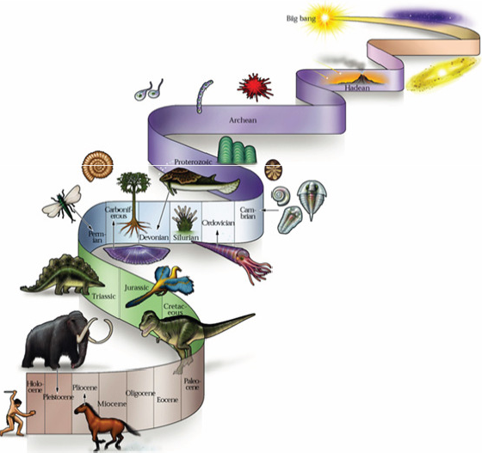
How do GAs Work?
The structure is relatively simple to comprehend, but the dynamic behavior is complex

Slide 7
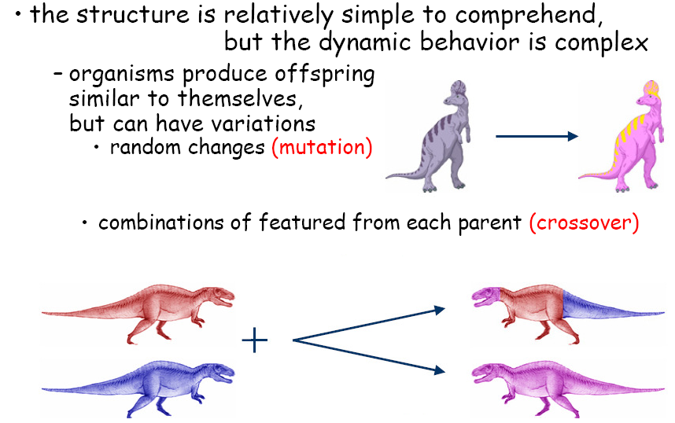
How do GAs Work?

Slide 8
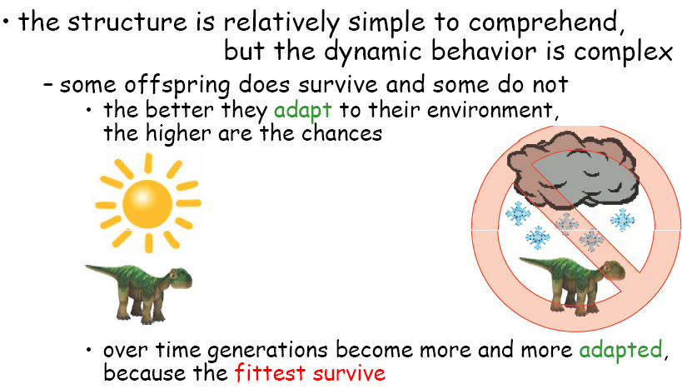
How do GAs Work?

Slide 9
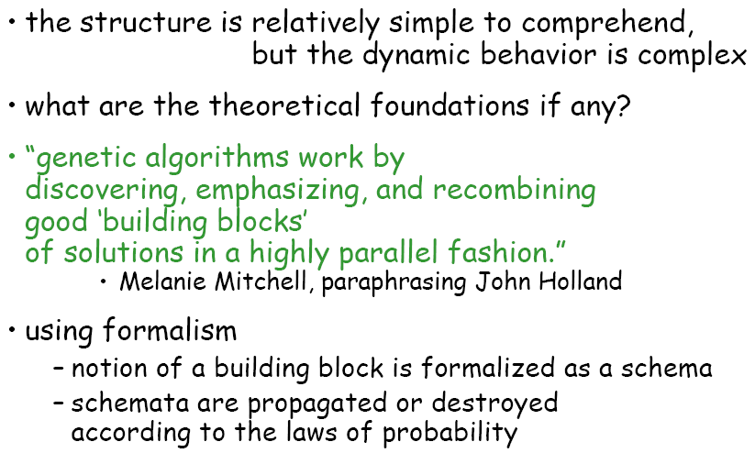
How do GAs Work?

Slide 10
Operators of a GA
Selection replicates the most successful solutions found in a population at a rate proportional to their relative quality
  Select the best one from the population set!
Recombination decomposes two distinct solutions and then randomly mixes their parts to form novel solutions
Mutation randomly perturbs (disturbs) a candidate solution

Slide 11
A Simple GA
Produce an initial population of individuals
evaluate the fitness of all individuals
while termination condition not met do
select fittest individuals for reproduction
recombine between individuals
mutate individuals
evaluate the fitness of the modified individuals
generate a new population
End while

Slide 12
Components of a GA
A problem definition as input, and
  Encoding principles (gene, chromosome)
  Initialization procedure (creation)
  Selection of parents (reproduction)
  Genetic operators (mutation, recombination)
  Evaluation function (environment)
  Termination condition

Slide 13
GA -Requirements
A typical GA requires:
Genetic Representation:
  A way of representing solutions/individuals in evolutionary computation methods
Fitness Function:
  A particular type of objective function that quantifies the optimality of a solution

Slide 14
GA -Requirements
A GA operates through a simple cycle of stages:
    i) Creation of a “Population” of strings,
    ii) Evaluation of each string,
    iii) Selection of best strings and
    iv) Genetic manipulation to create new population of strings.

Slide 15
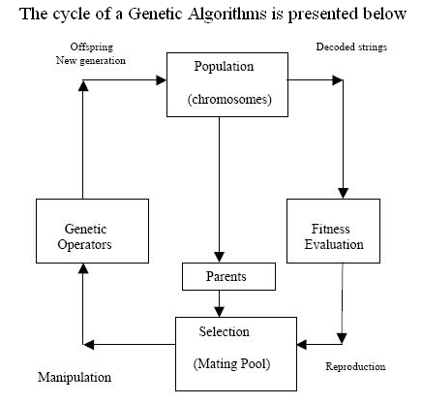
Genetic Algorithms Operators

Slide 16
Fundamental Idea
“Select the best, discard the rest”

Slide 17
Initialization
Start with a population of randomly generated individuals, or use
- a previously saved population
- a set of solutions provided by a human expert
- a set of solutions provided by another heuristic algorithm

Slide 18
Encoding
Binary Encoding
  In binaryencoding every chromosome is a string of bits, 0 or 1
  Chromosome A:101100101100101011100101
  Chromosome B:111111100000110000011111
  Binary encoding is the most common, mainly because first works about GA used this type of encoding

Slide 19
Encoding
Permutation Encoding
  In permutation encoding, every chromosome is a string of numbers, which represents number in a sequence
  Chromosome A: 1 5 3 2 6 4 7 9 8
  Chromosome B: 8 5 6 7 2 3 1 4 9
  Permutation encoding can be used in ordering problems, such as travelling salesman problem or task ordering problem

Slide 20
Encoding
Real-Valued Encoding
  In real value encoding, every chromosome is a string of some values. Values can be anything connected to problem, form numbers, real numbers or chars to some complicated objects
    Chromosome A: 1.2324 5.3243 0.4556 2.3293 2.4545
    Chromosome B: 2.3245 2.3253 4.4656 5.2193 0.8721
  Direct value encoding can be used in problems, where some complicated value, such as real numbers, are used. Use of binary encoding for this type of problems would be very difficult [NeuralNetwork]

Slide 21
Encoding
Tree Encoding
  In tree encoding every chromosome is a tree of some objects, such as functions or commands in programming languages
  Tree encoding is used mainly for evolving programs or expressions, for geneticprogramming
  Tree encoding is natural for encoding evolving programs.
    The programming language LISP is convenient for tree representation,because the set-based LISP structures are naturally tree-like, so the crossover and mutation can be done relatively easily

Slide 22
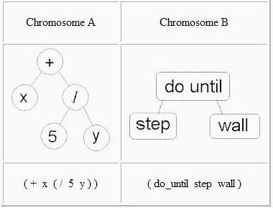
Encoding
Tree encoding
  Open ended search space
  Possibility of uncontrolled
  tree growth
  Difficult to understand and
  control large trees

Slide 23
Encoding
Choosing an encoding method must rely on the following key ideas
  Use a data structure as close as possible to the natural representation
  Write appropriate genetic operators as needed
  If possible, ensure that all genotypes correspond to feasible solutions
  If possible, ensure that genetic operators preserve feasibility

Slide 24
Encoding
Which Encoding Method do you choose ?? ??
“Use whatever encoding is the most natural for your problem, and then devise (generate) a GA that can use that encoding”– Lawrence Davis 1991

Slide 25
Crossover
Crossover (recombination) enables the evolutionary process to move toward promising regions of the search space
  Matches good parents’ sub-solutions to construct better offspring

Slide 26
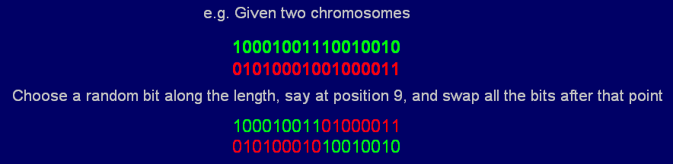
Crossover
Crossover Rate
  Chance that two chromosomes will swap elements
  Various crossover operators
  Typical rate is ~ 0.7

Slide 27
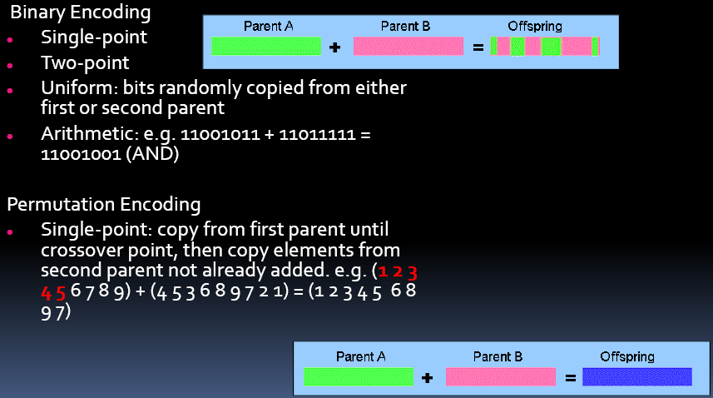
Crossover Operators

Slide 28
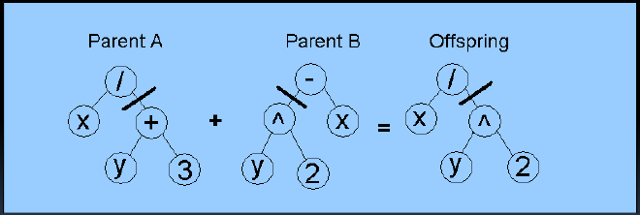
Crossover Operators
Tree encoding crossover

Slide 29
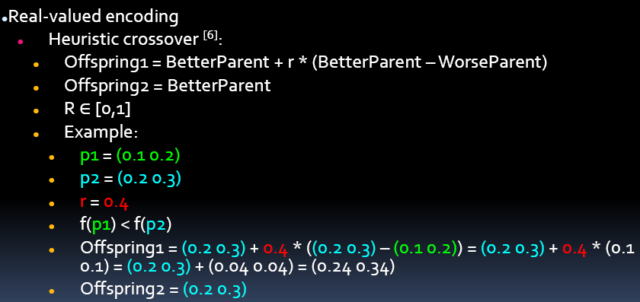
Crossover Operators

Slide 30
Mutation
Purpose: to simulate the effect of errors that happen with low probability during duplication (crossover)
Results:
  - Movement in the search space
  - Restoration of lost information to the population

Slide 31
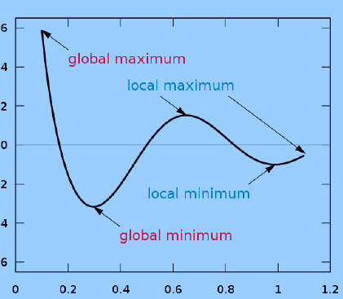
Mutation
Mutation rate
  Chance that mutation operation will be performed on a given element
  Usually fairly low ≈ 0.001 – 0.025
  depending on application
  To avoid local minima

Slide 32
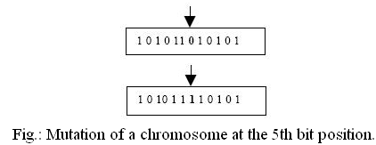
Mutation

Slide 33
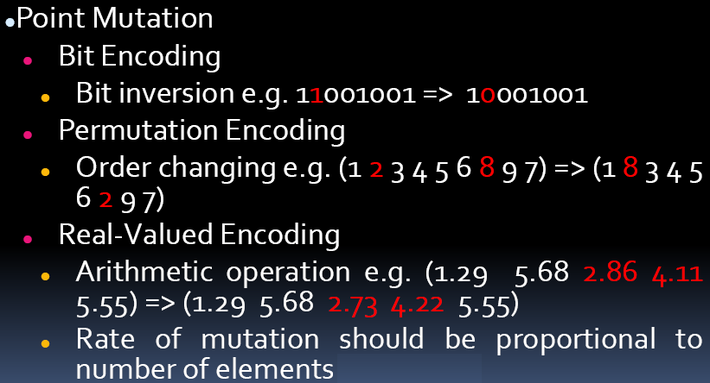
Mutation Operators

Slide 34
Evaluation (fitness function)
Solution is only as good as the evaluation function; choosing a good one is often the hardest part
Similar-encoded solutions should have a similar fitness

Slide 35
Termination condition
A pre-determined number of generations or time has elapsed
When a satisfactory solution has been achieved
No improvement in solution quality has taken place for a pre-determined number of generations

Slide 36
GA Example1
The GA cycle is illustrated in this example for maximizing a function f(x) = x² in the interval 0 ≤ x ≤ 31
In this example the fitness function is f(x) itself
  The larger is the functional value, the better is the fitness of the string
In this example, we start with 4 initial chromosomes
The fitness value of the strings and the percentage fitness of the total are estimated in Table A
  Since fitness of the second string is large, select 2 copies of the second string and one each for the first and fourth string in the crossover pool

Slide 37
GA Example1
The selection of the partners in the crossover pool is also done randomly
  Here in table B, we selected partner of string 1 to be the 2nd string and partner of 4th string to be the 2nd string
The crossover points for the first-second and second-fourth strings have been selected and are shown in table B
The second generation of the population without mutation in the first generation is presented in table C

Slide 38
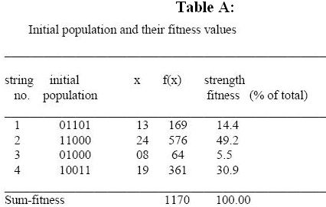
GA Example1

Slide 39
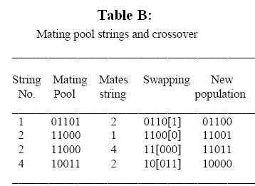
GA Example1

Slide 40
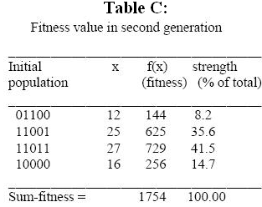
GA Example1

Slide 41
GA Example2
Let us consider a Diophantine equation (Diophantine equation is an indeterminate polynomial equation that allows the variables to be integers only ) : a + 2b + 3c + 4d = 30, where a, b, c and d are positive integer variables
Using a GA, all that is needed is a little time to reach a solution (a?, b ?, c ?, d ?)
  Of course you could ask, why not just use a brute force method (plug in every possible value for (a, b, c, d) given the constraints 1 ≥ (a,b,c,d) ≤ 30)?

Slide 42
GA Example2
The architecture of GA systems allow for a solution to be reached quicker since “better” solutions have a better chance of surviving and procreating, as opposed to randomly throwing out solutions and seeing which ones work

Slide 43
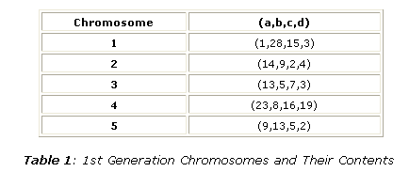
GA Example2
First we will choose 5 random initial solution sets (chromosomes), with constraints 1 ≥ (a, b, c, d) ≤ 30 (Note that we can choose smaller constraints for (a, b, c, d) but for the sake of simplicity we shall use 30)

Slide 44
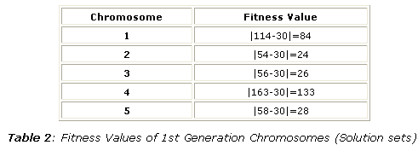
GA Example2
To calculate the fitness values, plug each solution set into the expression a + 2b + 3c + 4d = 30. Then, calculate the absolute value of the difference of each expression with 30, this will be the fitness value (Table 2):

Slide 45
GA Example2
Since values that are lower are closer to the desired answer (30), these values are more desirable
  In this case, higher fitness values are not desirable
In order to create a system where chromosomes with more desirable fitness values are more likely to be chosen as parents, we must first calculate the percentages that each chromosome has of being picked
  One solution is to take the sum of the multiplicative inverses of the fitness values (0.135266), and calculate the percentages from there (Table 3)

Slide 46
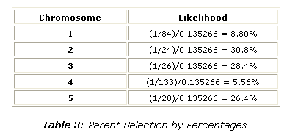
GA Example2

Slide 47
GA Example2
In order to pick our 5 pairs of parents (each of which will have 1 offspring, and thus 5 new solutions sets total), imagine that we had a 10000 sided die,
  and on 880 of those sides chromosome 1 was labeled, and on 3080 of those sides, chromosome 2 was labeled, and on 2640 of those sides, chromosome 3 was labeled, and on 556 of those sides, chromosome 4 was labeled, and on 2640 of those sides, chromosome 5 was labeled

Slide 48
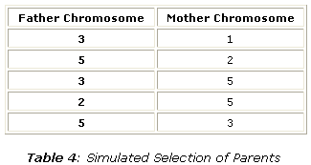
GA Example2
To choose our first pair we roll the die twice, and take those chromosomes to be our first two parents. Continuing in this fashion we have the following parents:

Slide 49
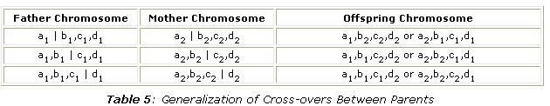
GA Example2
The offspring of each of these parents contains the genetic information of both father and mother. This can be possible by crossover.
Let us say a mother has the solution set (a1,b1,c1,d1) and a father has the solution set (a2,b2,c2,d2), then there can be six possible crossovers (| = dividing line)

Slide 50
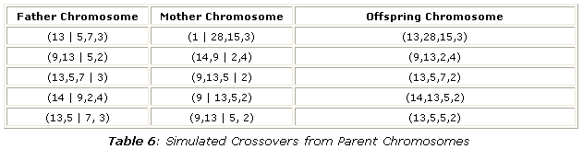
GA Example2
There are many other ways in which parents can trade genetic information to create an offspring, crossing over is just one way. Where the dividing line would be located is completely arbitrary, and so is whether or not the father or mother will contribute to the left or right of the dividing line. Now let's apply this to our offspring:

Slide 51
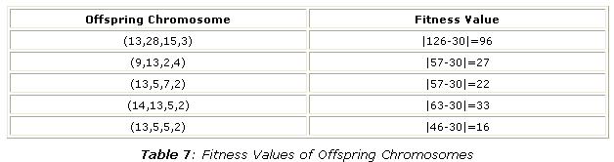
GA Example2
Now we can calculate the fitness values for the new generation of offsprings.

Slide 52
GA Example2
The average fitness value for the offspring chromosomes were 38.8, while the average fitness value for the parent chromosomes were 59.4
Of course, the next generation (the offspring)are supposed to mutate, that is, for example we can change one of the values in the ordered quadruple of each chromosome to some random integer between 1 and 30
Progressing at this rate, one chromosome should eventually reach a fitness level of 0 eventually, that is when a solution is found

Slide 53
GA Example2
If you tried and simulated this yourself, depending on the mutations you may actually get a fitness average that is higher, but on the long-run, the fitness levels will decrease
For systems where the population is larger (say 50, instead of 5), the fitness levels should more steadily and stable approach the desired level.

Slide 54
Holland’s Schema Theorem
A schema is a template that identifies a subset of strings with similarities at certain string positions
Consider binary strings of length 6
The schema (1**0*1) describes the set of all strings of length 6 with 1’s at positions 1and 6 and a 0 at position 4

Slide 55
Holland’s Schema Theorem
Order:Number of fixed positions in the template
Defining Length δ(H):The distance between the first and last specific positions
Fitness of a schema:is the average fitness of all strings matching the schema
The order of 1**0*1is 3 and its defining length is 5

Slide 56
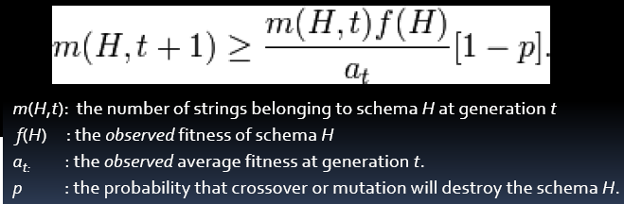
Holland’s Schema Theorem
The schema theorem statesthat short, low-order,schemata with above-average fitness, increase exponentially in successive generations.Expressed as an equation:
      Holland, Adaptation in Natural and Artificial Systems,TheMITPress; Reprint edition 1992 (originally published in 1975)

Slide 57
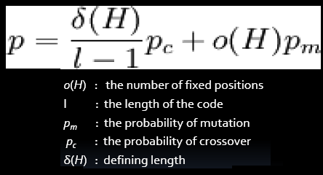
Holland’s Schema Theorem
The probability of disruption: the probability that crossover or mutation will destroy the schema H
  So a schema with a shorter defining length δ(H) is less likely to be disrupted

Slide 58
Building Block Hypothesis
Building Block Hypothesis Consists of:
  A description of an abstract adaptive mechanism that performs adaptation by recombining "buildingblocks", i.e. low order, low defining-length schemata with above average fitness
  A hypothesis that a genetic algorithm performs adaptation by implicitly and efficiently implementing this abstract adaptive mechanism

Slide 59
Building Block Hypothesis
“Short, low order,and highly fit schemata are sampled, recombined [crossedover], and resampled to form strings of potentially higher fitness. In a way, by working with the separticular schemata [the building blocks ], we have reduced the complexity of our problem; instead of building high-performance strings by trying every conceivable combination, we construct better and better strings from the best partial solutions of past samplings“
      Goldberg 1989

Slide 60
References
    C. Darwin. On the Origin of Species by Means of Natural Selection; or, the Preservation of flavored Races in the Struggle for Life. John Murray, London, 1859.
    W. D. Hillis. Co-Evolving Parasites Improve Simulated Evolution as an Optimization Procedure. Artificial Life 2, vol 10, Addison-Wesley, 1991.
    J. H. Holland. Adaptation in Natural and Artificial Systems. The University of Michigan Press, Ann Arbor, Michigan, 1975.
    Z. Michalewicz. Genetic Algorithms + Data Structures = Evolution Programs. Springer-Verlag, Berlin, third edition, 1996.
    M. Sipper. Machine Nature: The Coming Age of Bio-Inspired Computing. McGraw-Hill, New-York, first edition, 2002.
    M. Tomassini. Evolutionary algorithms. In E. Sanchez and M. Tomassini, editors, Towards Evolvable Hardware, volume 1062 of Lecture Notes in Computer Science, pages 19-47. Springer-Verlag, Berlin, 1996.

Slide 61
References
http://en.wikipedia.org/wiki/Genetic_algorithm
http://en.wikipedia.org/wiki/Genetic_algorithm
http://en.wikipedia.org/wiki/Holland_schema_theorem
http://en.wikipedia.org/wiki/Genetic_programming
http://en.wikipedia.org/wiki/HBGA
http://www.obitko.com/tutorials/genetic-algorithms/encoding.php
http://www.nd.com/products/genetic/crossover.htm
http://www.cs.sunysb.edu/~cse634/spring2009/Genetic_Algorithms.pdf

