Slide 1
Chapter 8 Reasoning Under Uncertainty –Part I
Main Textbook: Artificial Intelligence Foundations of Computational Agents, 2nd Edition, David L. Poole and Alan K Mackworth, Cambridge University Press, 2018.
Reference Textbook: Artificial Intelligence: A Guide to Intelligence Systems, Michael Negnevitsky, 3rd Edition, 2011, Addison Wesley, ISBN 978-1408225745

Slide 2
Introduction
Agents in real environments are inevitably forced to make decisions based on incomplete information.
Even when an agent senses the world to find out more information, it rarely finds out the exact state of the world
For example, a doctor does not know exactly what is going on inside a patient, a teacher does not know exactly what a student understands, etc.
This chapter considers reasoning with uncertainty that arises whenever an agent is not omniscient
This chapter describes how probability can be used to represent the world by making appropriate independence assumptions, and shows how to reason with such representations.

Slide 3
Probability
Reasoning with uncertainty has been studied in the fields of probability theory and decision theory.
When an agent makes decisions and is uncertain about the outcomes of its actions, it is gambling on the outcomes.
We have learnt that probability as the theory of tossing coins and rolling dice.
In general, probability is a calculus for belief designed for making decisions
Probability theory is the study of how knowledge affects belief is measured in terms of a number between 0 and 1
The probability of belief α is 0 means that α is believed to be definitely false, and the probability of α is 1 means that α is believed to be definitely true.

Slide 4
Probability
Probability is a measure of belief and the belief need to be updated when a new evidence is observed.
If an agent’s probability of belief α is greater than 0 and less than 1, this does not mean that α is true to some degree
but rather that the agent is ignorant of whether α is true or false.
The view of probability as a measure of belief is known as Bayesian probability or subjective probability.
Uncertainty in the world is epistemological – pertaining to an agent’s beliefs of the world, rather than ontological – how the world is.

Slide 5
Semantics of Probability
Probability theory is built on the foundation of worlds and variables
Variables could be described in terms of worlds; a variable is a function from worlds into the domain of the variable.
Variables will be written starting with an uppercase letter.
Each variable has a domain which is the set of values that the variable can take
A Boolean variable is a variable with domain {true, false}.
A discrete variable has a domain that is a finite set. For example, a world could consist of the symptoms, diseases and test results.
We might be able to answer questions about the probability that a patient with a particular combination of symptoms may come into the hospital again in the nearby future.

Slide 6
Semantics of Probability
We first define a probability over finite sets of worlds with finitely many variables and use this to define the probability of propositions.
A probability measure is a function P from worlds into the non-negative real numbers such that,
where Ω is the set of all possible worlds.
The use of 1 as the probability of the set of all of the worlds is just by convention.
The probability of proposition α, written P(α), is the sum of the probabilities of possible worlds in which α is true.

Slide 7
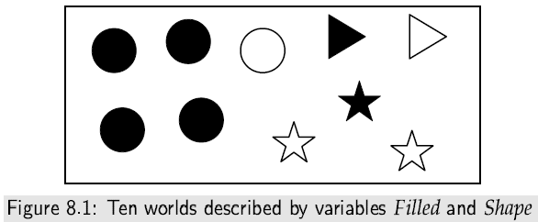
Semantics of Probability

Slide 8
Semantics of Probability
If X is a random variable, a probability distribution, P(X), over X is a function from the domain of X into the real numbers such that, given a value x ∈ domain(X), P(x) is the probability of the proposition X = x.
A probability distribution over a set of variables is a function from the values of those variables into a probability
For example, P(X, Y) is a probability distribution over X and Y such that P(X=x,Y=y), where x ∈ domain(X) and y ∈ domain(Y), has the value P(X=x ∧ Y=y), where X=x ∧ Y=y is a proposition and P is the function on propositions defined above.
If (X₁ . . . X_{n}) are random variables, probability distribution over all worlds, P(X₁, . . . , X_{n}) is called the joint probability distribution.

Slide 9
Axioms for Probability
An axiomatic definition specifies axioms.
Suppose P is a function from propositions into real numbers that satisfies the following three axioms of probability:
Axiom1: 0 ≤ P(α) for any proposition α. That is, the belief in any proposition cannot be negative.
Axiom2: P(τ) = 1 if τ is a tautology. That is, if τ is true in all possible worlds, its probability is 1.
Axiom3: P(α ∨ β) = P(α) + P(β) if α and β are contradictory propositions; In other words, if two propositions cannot both be true (they are mutually exclusive), the probability of their disjunction is the sum of their probabilities.
These axioms form a sound and complete axiomatization of the meaning of probability.

Slide 10
Axioms for Probability
Proposition 8.1: If there are a finite number of discrete random variables, Axioms 1, 2, and 3 are sound and complete with respect to the semantics.
Proposition 8.2:The following hold for all propositions α and β
(a) Negation of a proposition: P(￢α) = 1 − P(α).
(b) If α ↔ β, then P(α) = P(β). That is, logically equivalent propositions have the same probability.
(c) Reasoning by cases: P(α) = P(α ∧ β) + P(α ∧ ￢β).
(d) If V is a random variable with domain D, then, for all propositions α,
(e) Disjunction for non-exclusive propositions: P(α ∨ β) = P(α) + P(β) −P(α ∧ β).

Slide 11
Axioms for Probability
Proof. (a): The propositions α ∨ ￢α and ￢(α ∧ ￢α) are tautologies. Therefore, 1 = P(α ∨ ￢α) = P(α) +P(￢α). Rearranging gives the desired result.
Proof. (b): If α ↔ β, then α ∨ ￢β is a tautology, so P(α ∨ ￢β) = 1. α and ￢β are contradictory statements, so Axiom3 gives P(α ∨ ￢β) = P(α) + P(￢β). Using part (a), P(￢β) = 1 − P(β). Thus, P(α) + 1 − P(β) = 1, and so P(α) = P(β).
Proof. (c): The proposition α ↔ ((α ∧ β) ∨ (α ∧ ￢β)) and ￢((α ∧ β) ∧ (α ∧ ￢β)) are tautologies. Thus, P(α) = P((α ∧ β) ∨ (α ∧ ￢β)) = P(α ∧ β) +P(α ∧ ￢β).
Proof. (d): The proof is analogous to the proof of proposition (c).
Proof. (e): (α ∨ β)↔ ((α ∧ ￢β) ∨ β) is a tautology. Thus, P(α ∨ β) = P((α ∧ ￢β) ∨ β) = P(α ∧ ￢β) +P(β). Proposition (c) shows P(α ∧ ￢β) = P(α)− P(α ∧ β). Thus, P(α ∨ β) = P(α) + P(β) −P(α ∧ β).

Slide 12
Conditional Probability
Probability is a measure of belief.
The measure of belief in proposition h given proposition e is called the conditional probability of h given e, written P(h|e).
The proposition e representing the conjunction of all of the agent’s observations of the world is called evidence.
Given evidence e, the conditional probability P(h|e) is the agent’s posterior probability of h.
The probability P(h) is the prior probability of h and is the same as P(h|true) because it is the probability before the agent has observed anything.
The evidence used for the posterior probability is everything the agent observes about a particular situation.

Slide 13
Conditional Probability
Example 8.3:
For the diagnostic assistant, the prior probability distribution over possible diseases is used before the diagnostic agent finds out about the particular patient.
Evidence is obtained through discussions with the patient, observing symptoms, and the results of lab tests.
Essentially any information that the diagnostic assistant finds out about the patient is evidence.
The assistant updates its probability to reflect the new evidence in order to make informed decisions.

Slide 14
Semantics of Conditional Probability
Evidence e, where e is a proposition, will rule out all possible worlds that are incompatible with e.
Like the definition of logical consequence, the given proposition e selects the possible worlds in which e is true.
As in the definition of probability, we first define the conditional probability over worlds, and then use this to define a probability over propositions.
Evidence e induces a new probability P(w|e) of world w given e. Any world where e is false has conditional probability 0, and the remaining worlds are normalized so that the probabilities of the worlds sum to 1:
c x P(w) if e is true in world w
P(w|e) = 0 if e is false in world w
where c is a constant (depends on e) that ensures the posterior probability of all worlds sums to 1.

Slide 15
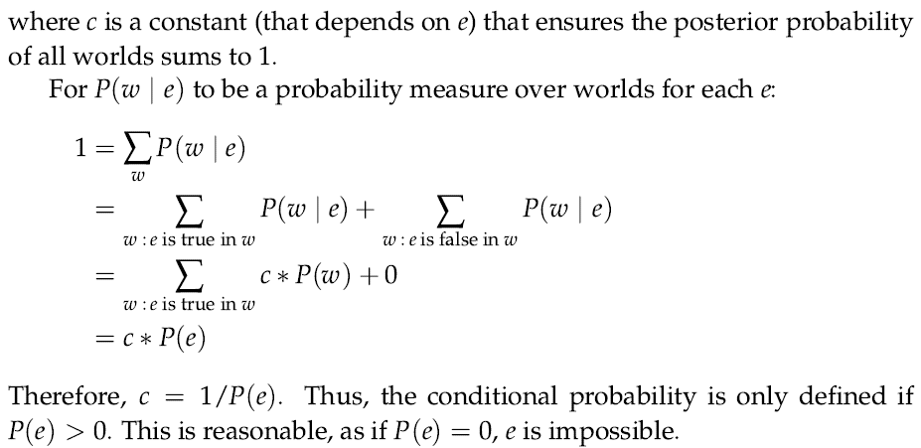
Semantics of Conditional Probability

Slide 16
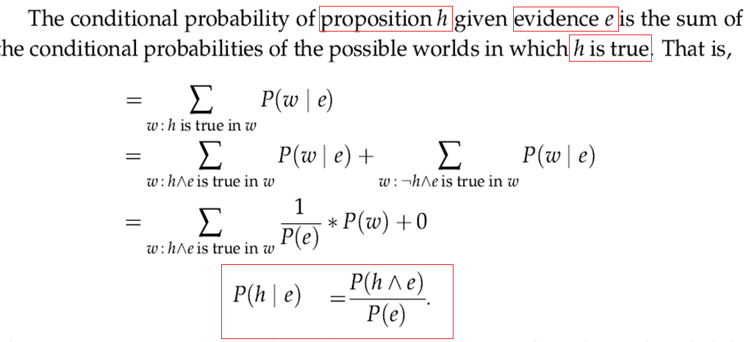
Semantics of Conditional Probability

Slide 17
Semantics of Conditional Probability

Slide 18
Semantics of Conditional Probability
A conditional probability distribution, written P(X|Y) where X and Y are variables or sets of variables, is a function of the variables: given a value x ∈ domain(X) for X and a value y ∈ domain(Y) for Y, it gives the value P(X = x|Y = y), where the latter is the conditional probability of the propositions.
The definition of conditional probability allows the decomposition of a conjunction into a product of conditional probabilities:

Slide 19
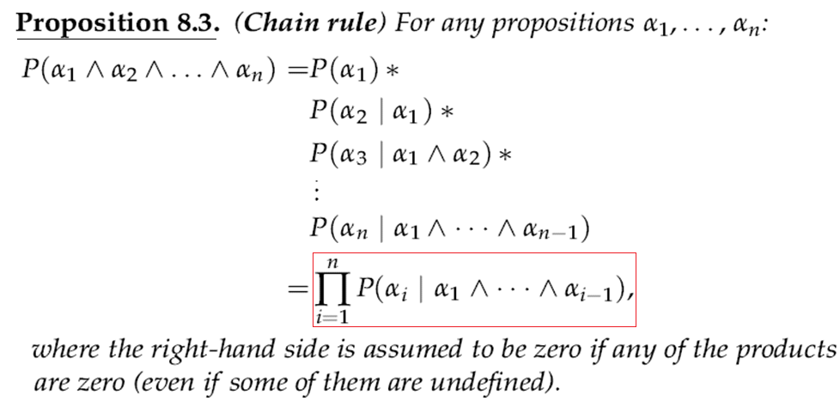
Semantics of Conditional Probability

Slide 20
Axioms of probability: Summary
1. 0 ≤ P(A) ≤ 1 ; for every A ⊆ S (S is the given finite sample space)
Boundary: P(φ) = 0 and P(S) = 1
Monotonic: if A ⊆ B ⊆ S, then p(A) ≤ p(B)
4. Inclusion–exclusion:
If A and B are mutually inclusive, P(A \/ B) = P(A)+P(B)−P(A /\ B)
If A and B are mutually exclusive, then P(A \/ B) = P(A) + P(B)
5. Intersection: P(A /\ B) = P(A)* P(B|A), where A and B are true
6. Negation: P(~A) = 1 − P(A), this is a generalization of the fact
that A is true if and only if ~A is false and vice versa
7. Equivalence: If A ≡ B, then P(A) = P(B)
(Assume A and B are two propositions)

Slide 21
Bayes’ Rule
Let A and B are two events in the world, suppose that A and B are not mutually exclusive (they occur conditionally):
The probability that event A will occur if event B occurs is called the conditional probability
Conditional probability is denoted as p(A|B), interpreted as ‘conditional probability of event A occurring given that event B has occurred’
p(A|B) = the no. of times A and B occur (1)
the no. of times B occur
The no. of times A and B can occur, or the probability that both A and B will occur is called the joint probability of A and B is represented as p(A ∩ B)
p(A|B) = p(A ∩ B) (2)
p(B)
p(B|A) = p(B ∩ A) (3)
p(A)

Slide 22
Bayes’ Rule
From (2) and (3) we get
p(A ∩ B) = p(A|B) x p(B) and p(B ∩ A) = p(B|A) x p(A) (4)
Joint probability is commutative, thus
p(A ∩ B) = p(B ∩ A), therefore
p(A|B) x p(B) = p(B|A) x p(A) (5)
Eq. (5) yields the following equation:
p(A|B) = p(B|A) x p(A) (6)
p(B)
The Eq. (6) is known as Bayes’ rule
Where:
p(A|B) is the conditional probability that event A occurs given that event B has occurred
p(B|A) is the conditional probability of event B occurring given that event A has occurred
p(A) is the prior probability of event A
p(B) is the prior probability of event B

Slide 23
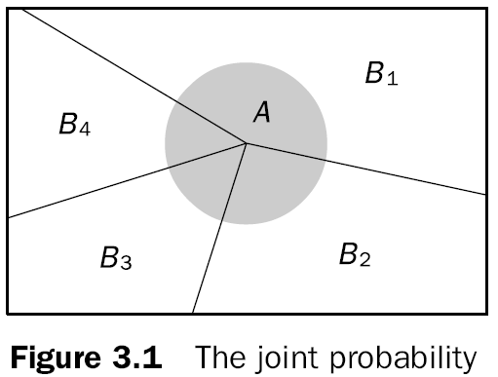
Bayes’ Rule: Proof
Assume that the event A is dependent upon event B (the joint probability of events A and B is shown in Figure 3.1)
The event A depends on a number of events B₁, B₂,…., B_{n}

Slide 24
Bayes’ Rule: Proof
From (4) based on Figure 3.1
p(A ∩ B₁) = p(A|B₁) x p(B₁)
p(A ∩ B₂) = p(A|B₂) x p(B₂)
: :
p(A ∩ B_{n}) = p(A|B_{n}) x p(B_{n})
We combined the above sequences to get p(A) and is given as:
(7)
Equation (7) is called law of total probability.
From figure 3.1, if the occurrence of event A depends on only two mutually exclusive events, B and ¬B, then (7) becomes
p(A) = p(A|B) x p(B) + p(A| ¬B) x p(¬B) (8)

Slide 25
Bayes’ Rule: Proof
Similarly, if the occurrence of B depends on events, A and ¬ A, then
p(B) = p(B|A) x p(A) + p(B| ¬A) x p(¬A) (9)
Substitute (9) into Baye’s rule (6) to yield
p(A|B) = p(B|A) x p(A) (10)
p(B|A) x p(A) + p(B| ¬A) x p(¬A)
Eq. (10) provides the background for the application of probability theory to mange uncertainty.

Slide 26
Bayes’ Rule
Let S be the set of all objects in the Figure shown above. Let Black be the set of all black objects, White be the set of all white objects, Square be the set of all square objects, A be the set of all objects containing an A, and B be the set of all objects containing an B. We then have that
P(A|White) = 2/4 = ½, P(Black) = 9/13, P(A|Black) = 3/9 = 1/3, P(White) = 4/13, P(A|Square) = 3/8, P(A|Square ∩ Black) = 2/6 = 1/3, P(A|Square ∩ White) = ½
From the above values, P(A) can be Calculated based on Eq. (8):
P(A) = P(A|Black) × P(Black) + P(A|White) × P(White)
= (1/3 × 9/13) + (1/2 × 4/13)
= 5/13

Slide 27
Bayes’ Rule
An agent using probability to update its belief when it observes a new evidence
The new evidence is conjoined to the old evidence to form a complete evidence.
Bayes’ rule specifies how an agent should update its belief based on a new evidence:
Suppose an agent has a current belief in proposition h (called hypothesis) based on evidence k, can be given by P(h|k), and can subsequently observes with a new evidence e: P(h|(e ∧ k)).
Bayes’ rule tells us how to update the agent’s belief in hypothesis h as new evidence arrives.

Slide 28
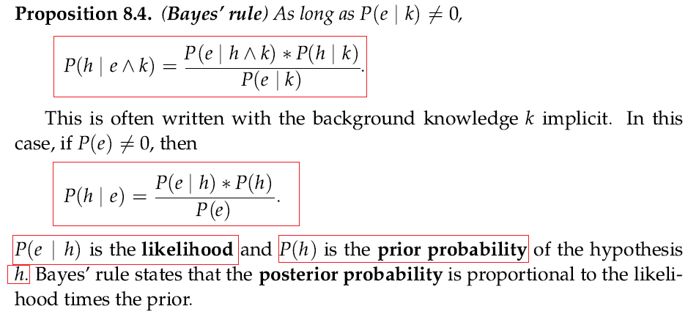
Bayes’ Rule

Slide 29
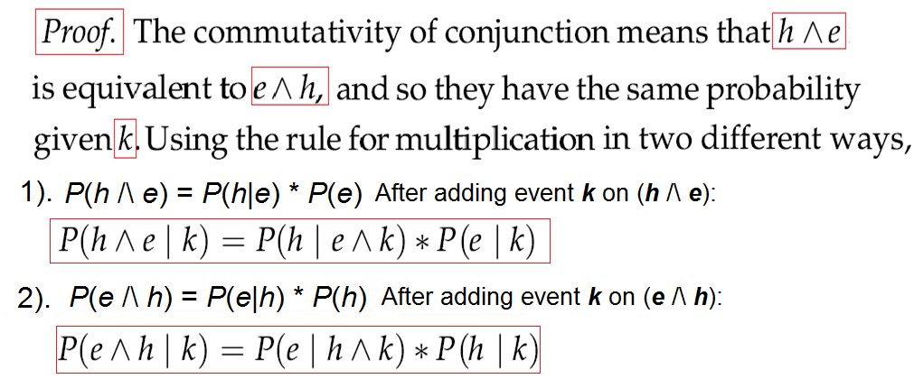
Bayes’ Rule

Slide 30
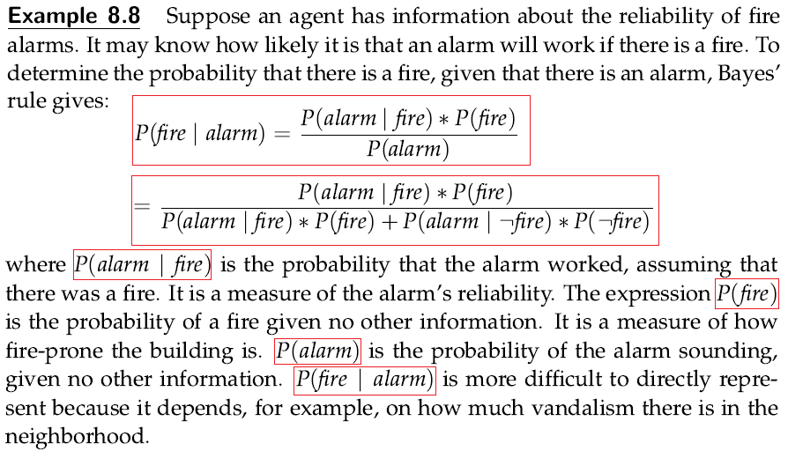
Bayes’ Rule

Slide 31
Bayes’ Rule
Suppose that the rules in a Knowledge Base (KB) are represented in the following form:
IF Evidence E is True
THEN Hypothesis H is True { with a probability of p}
What if event E has occurred but do not know whether event H has occurred? Can we compute the probability that event H has occurred as well?
p(H|E) = p(E|H) x p(H) (11)
p(E|H) x p(H) + p(E| ¬H) x p(¬H)
Where p(H|E) is the probability of the hypothesis H in the presence of evidence E

Slide 32
Bayes’ Rule
p(H|E) = p(E|H) x p(H)
p(E|H) x p(H) + p(E| ¬H) x p(¬H)
p(H) is the prior probability of hypothesis H being true
p(E|H) is the probability that hypothesis H being true will result E
p(¬H) is the prior probability of hypothesis H being false
p(E| ¬H) is the probability of finding evidence E even when hypothesis H is false
In a knowledge based system, the probabilities required to solve a problem are provided by experts
An expert determines the prior probabilities p(H) and p(¬H) and observing evidence E if H is true, p(E|H) and if hypothesis H is false, p(E| ¬H)
The system computes p(H|E) for H in the light of evidence E
p(H|E) is the posterior probability of H upon evidence E

Slide 33
Bayes’ Rule
Generalize the Eq.(11) with multiple hypotheses H₁, H₂,…H_{m} and multiple evidences E₁, E₂,…,E_{n} (but the hypotheses and evidences must be mutually exclusive)
Single evidence E and multiple hypotheses H₁, H₂,…H_{m} follow:
(12)
Multiple evidences E₁, E₂,…,E_{n} and multiple hypothesis H₁, H₂,…H_{m} follow:
(13)

Slide 34
Bayes’ Rule
An application of Eq. (13) requires to obtain the conditional probabilities of all possible combinations of evidences for all hypothesis;
(14)
How does an ES compute all posterior probabilities and finally rank potentially true hypothesis?
Suppose an ES, given three conditionally independent evidences E₁, E₂, and E₃ creates three mutually exclusive hypothesis H₁, H₂,and H₃ and provides prior probabilities for these hypothesis- p(H₁), p(H₂) and p(H₃) respectively
Table 3.2 illustrates the prior and conditional probabilities provided by the expert

Slide 35
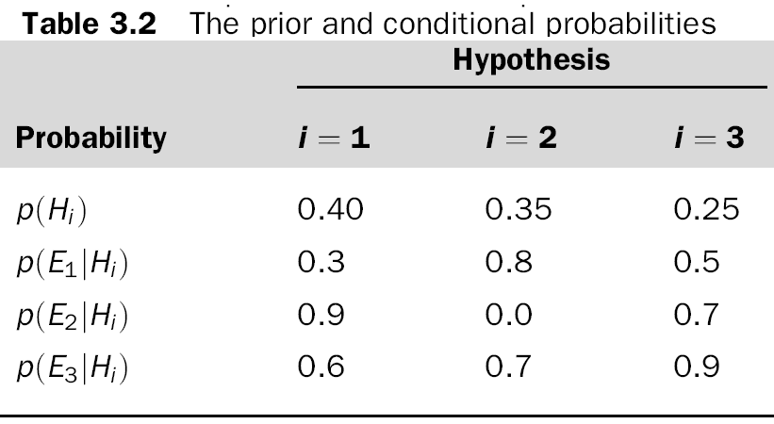
Bayes’ Rule

Slide 36
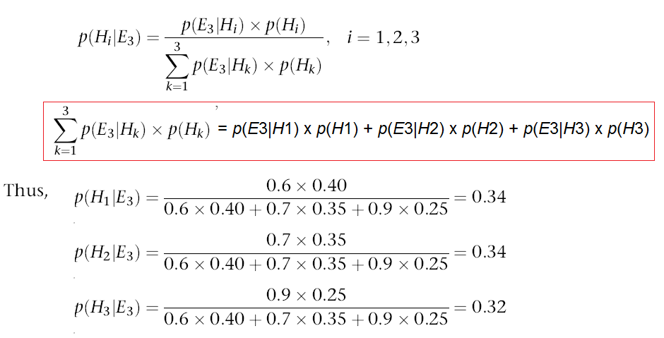
Bayes’ Rule
Assume that we first observe evidence E₃, based on Eq.(14):

Slide 37
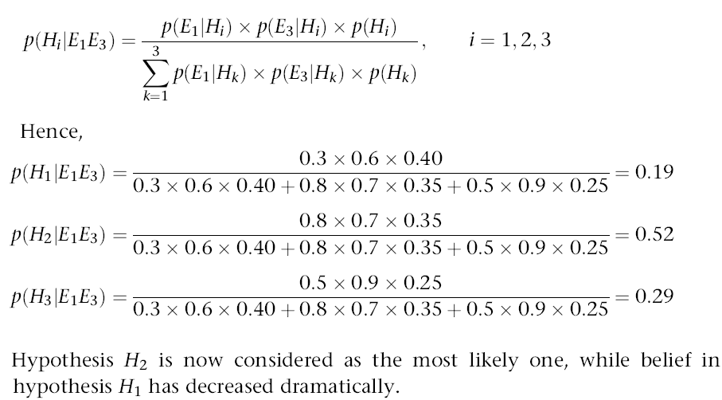
Bayes’ Rule
Suppose now that we observe evidence E₁ along with E₃, the posterior probabilities are calculated as:

Slide 38
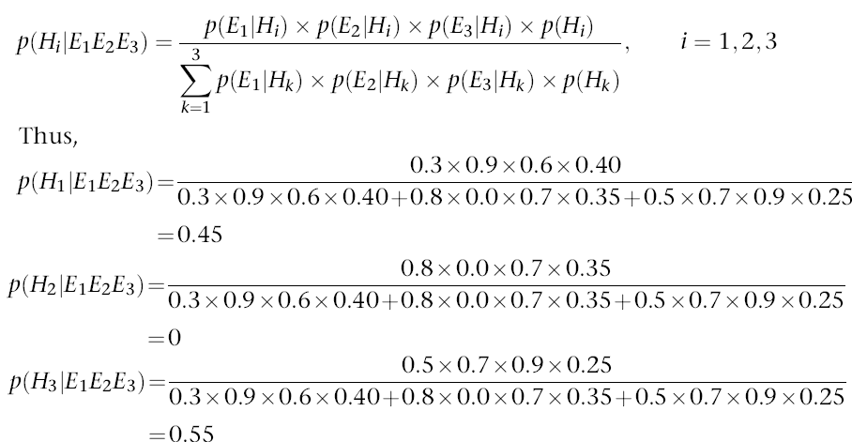
Bayes’ Rule
Along with E₁ and E₃ observing evidence E₂ as well, the ES calculates the final posterior probabilities for all hypotheses:

Slide 39
Bayes’ Rule
Although the initial ranking provided by the expert was H₁, H₂, and H₃, only hypothesis H₁ and H₃ remain under consideration after all evidences (E₁, E₂ and E₃) were observed.
Hypothesis H₂ can now be completely abandoned.
Note: The hypothesis H₃ is considered more likely than hypothesis H₁.

Slide 40
Exercises
1. Prove p(A ∨ B) = p(A) + p(B) − p(A ∧ B) {where A and B are not mutually exclusive events}.
2. Prove that p(A → B) = p(~A) + p(B) – p(~A ∧ B) { where A and B are not mutually exclusive events}.
3. Show, P(A| B ∧ A) = 1
4. Consider an incandescent bulb manufacturing unit. Here machines M1, M2 and M3 make 20%, 30% and 50% of the total bulbs. Of their output, let's assume that 2%, 3% and 5% are defective. A bulb is drawn at random and is found defective. What is the probability that the bulb is made by machine M1 or M2 or M3.

Slide 44
Exercises
Suppose there is a disease randomly found in one-half of one percent of the general population. A certain clinical blood test is 99% effective in detecting the presence of this disease; i.e., it will yield an accurate Positive result in 99% of the cases where the disease is actually present. But it also yields false Positive results in 5% of the cases where the disease is not present. Show the probabilities;
a) The probability that the disease will be present in any particular person.
b) The probability that the disease will not be present in any particular person.
c) The probability that the test will yield a Positive result if the disease is present.
d) The probability that the test will yield a Negative result if the disease is present.
e) The probability that the test will yield a Positive result if the disease is not present.
f) The probability that the test will yield a Negative result if the disease is not present.
g) The probability that the disease is present if the test result is Positive (i.e., the probability that a Positive test result will be a true positive).
h) The probability that the disease is not present if the test result is Positive (i.e., the probability that a Positive test result will be a False Positive).
i) The probability that the disease is absent if the test result is Negative (i.e., the probability that a Negative test result will be a true negative).

Slide 45
The Joint Probability Distribution
Probability distribution gives values for all possible assignments:
For example, weather is one of <sunny, rain, cloudy, snow>
P(weather) = <0.72, 0.1, 0.08, 0.1> (normalized, i.e., sums to 1).
Joint probability distribution for a set of variables gives values for each possible assignment to all the variables
What is the probability of having either a cavity or a Toothache?
P(Cavity ∨ Toothache) ?
= P(Cavity ∧ Toothache) + P(Cavity ∧ ¬ Toothache) + P(¬Cavity ∧ Toothache)
= 0.04 + 0.06 + 0.01
= 0.11
Then, find P(Cavity) ? P(Toothache)? P(Cavity|Toothache)? P(~Cavity|Toothache)

Slide 46
Information
The information theory discusses how to represent information using bits.
For x ∈ domain(X), it is possible to build a code that, to identify x uses − log₂ P(x) bits. The expected number of bits to transmit a value for X is then
This is the information content or entropy of random variable X.
Note: H is a function of the variable X, not a function of the values of the variable.
Thus, for a variable X, the entropy H(X) is a number.

Slide 47
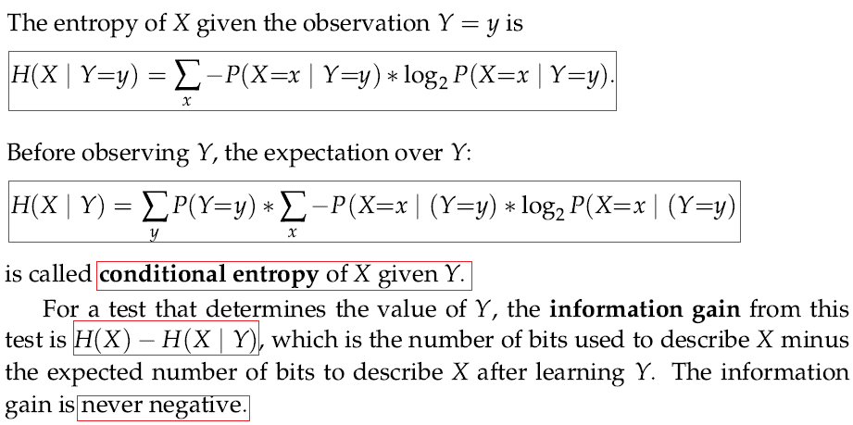
Information

Slide 48
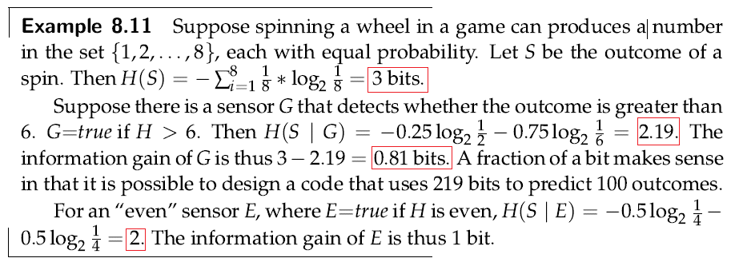
Information

Slide 49
Information
The notion of information is used for a number of tasks:
In diagnosis, an agent could choose a test that provides the most information.
In decision tree learning, information theory provides a useful criterion for choosing which property to split on: split on the property that provides the greatest information gain.
In Bayesian learning, information theory provides a basis for deciding which is the best model given some data.

Slide 50
Independence
The axioms of probability are very weak and provide few constraints on allowable conditional probabilities.
A useful way to limit the amount of information required is to assume that each variable only directly depends on a few other variables.
This uses assumptions of conditional independence.
As long as the value of P(h|e) is not 0 or 1, the value of P(h|e) does not constrain the value of P(h|f∧e).
This latter probability could have any value in the range [0, 1]. It is 1 when f implies h, and it is 0 if f implies ￢h.
Certain knowledge in P(h|e) = P(h|f∧e) specifies f is irrelevant (f is 1) to the probability of h given that e is observed.

Slide 51
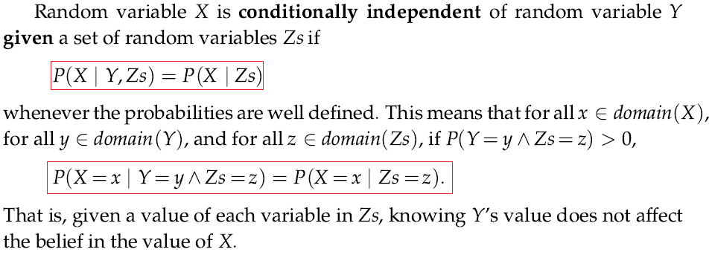
Independence

Slide 52
Belief Networks
A belief network is a directed model of conditional dependence among a set of random variables.
The conditional independence in a belief network takes in an ordering of the variables, and results in a directed graph.
To define a belief network on a set of random variables, {X₁, . . . ,X_{n}}, first select a total ordering of the variables, say, X₁, . . . , X_{n}
The chain rule shows (see proposition 8.3) how to decompose a conjunction into conditional probabilities:
Define the parents of random variable X_{i} , written parents(X_{i}), to be a minimal set of predecessors of X_{i} in the total ordering such that the other predecessors of X_{i} are conditionally independent of X_{i} given parents(X_{i}).

Slide 53
Chain Rule

Slide 54
Belief Networks
Thus X_{i} probabilistically depends on each of its parents, but is independent of its other predecessors.
That is, parents(X_{i}) ⊆ {X₁, . . . , X_{i-1}} such that (X_{i} | X₁, . . . , X_{i-1}) = P(X_{i} | parents(X_{i})). Putting the chain rule and the definition of parents together gives:
The probability over all of the variables, P(X₁,X₂, . . . ,X_{n}), is called the joint probability distribution.
A belief network defines a factorization of the joint probability distribution into a product of conditional probabilities:
A belief network, also called a Bayesian network, is an acyclic directed graph (DAG), where the nodes are random variables.
a set of conditional probability distributions giving P(X | parents(X)) for each variable X.

Slide 55
Belief Networks
Example 8.13 Consider the four variables with the ordering:{Intelligent, Works_hard, Answers, Grade}. Consider the variables in order. Intelligent does not have any parents, thus parents(Intelligent) = {}. Similarly Works_hard is independent of Intelligent, and it has no parents. The corresponding belief network is given in Figure 8.2. The variable Answers has two parents, Intelligent and Works_hard, so parents(Answers) = {Intelligent, Works_hard}.
Grade is independent of Intelligent and Works_hard and has a parent:
parents(Grade) = {Answers}.
This graph defines the decomposition of the joint distribution:
P(Intelligent, Works_hard, Answers, Grade) = P(Intelligent) ∗ P(Works_ hard) ∗ P(Answers|Intelligent ∧ Works_hard) ∗ P(Grade|Answers)
The domains of the variables are simple, for example the domain of Answers may be {insightful, clear, superficial, vacuous}

Slide 56
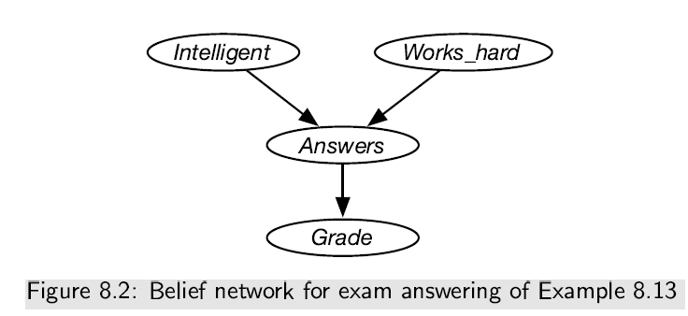
Belief Networks
A belief network specifies a joint probability distribution from which arbitrary conditional probabilities can be derived.

Slide 57
Observations and Queries
Example 8.14: Before there are any observations, the distribution over intelligence is P(Intelligent), which is provided as part of the network.
To determine the distribution over grades, P(Grade), requires inference.
If a grade of A is observed, the posterior distribution of Intelligent is given by: P(Intelligent|Grade=A); intelligent in the presence of grade A
If it was observed that Works_hard is false, the posterior distribution of Intelligent is:
P(Intelligent|Grade=A ∧ Works_hard = false).
Although Intelligent and Works_hard are independent as per the given observations, they are dependent given the grade.
This might explain why some people claim they did not work hard to get a good grade; it increases the probability that they are intelligent.

Slide 58
Constructing Belief Networks
To represent a domain in a belief network, the designer of a network must consider the following questions:
What are the relevant variables? what the agent may observe in the domain. what information the agent is interested in knowing the posterior probability of. What the other hidden variables or latent variables that will not be observed or queried but make the model simpler.
What values should these variables take? For each variable, the designer should specify what it means to take each value in its domain.
What is the relationship between the variables? This should be expressed by adding arcs in the graph to define the parent relation.
How does the distribution of a variable depend on its parents? This is expressed in terms of the conditional probability distributions.

Slide 59
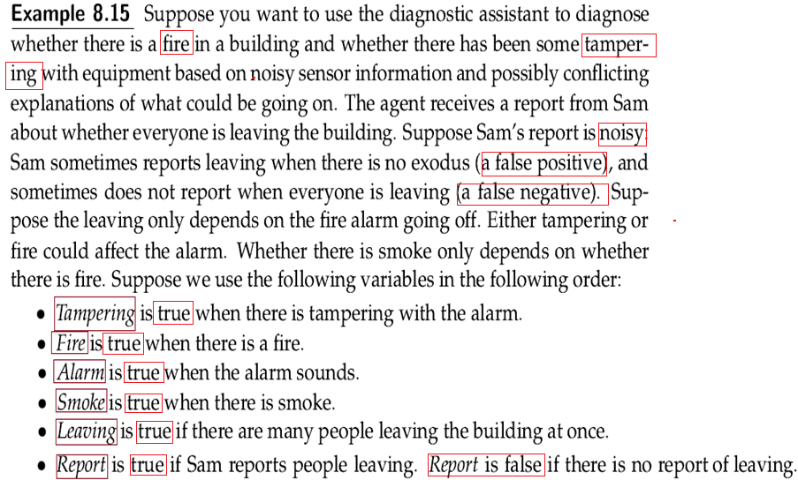

Slide 60
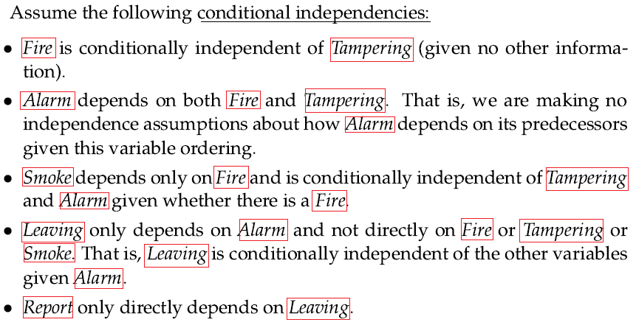

Slide 61
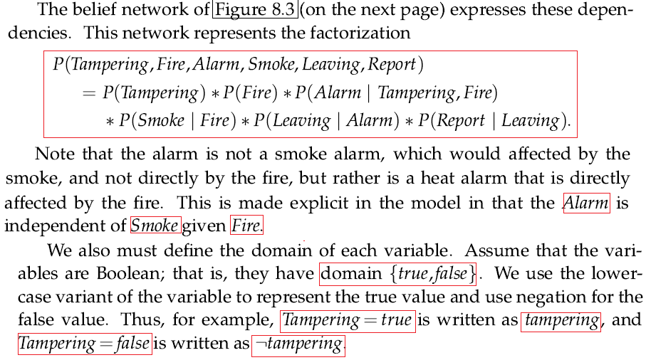

Slide 62
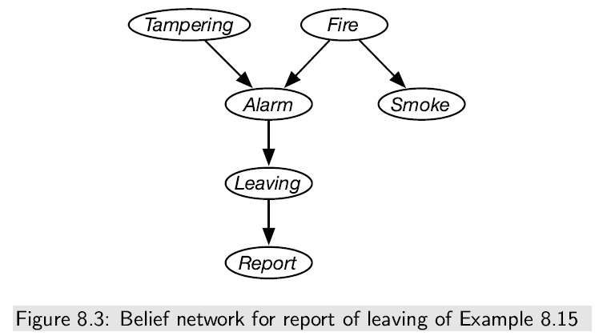
Constructing Belief Networks

Slide 63
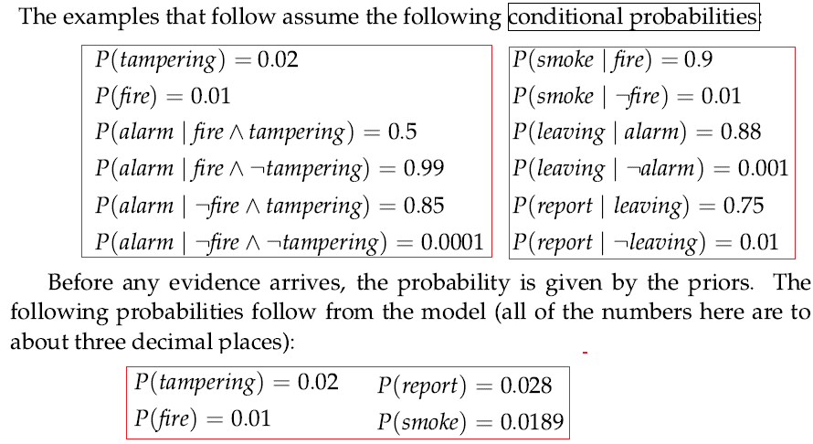

Slide 64
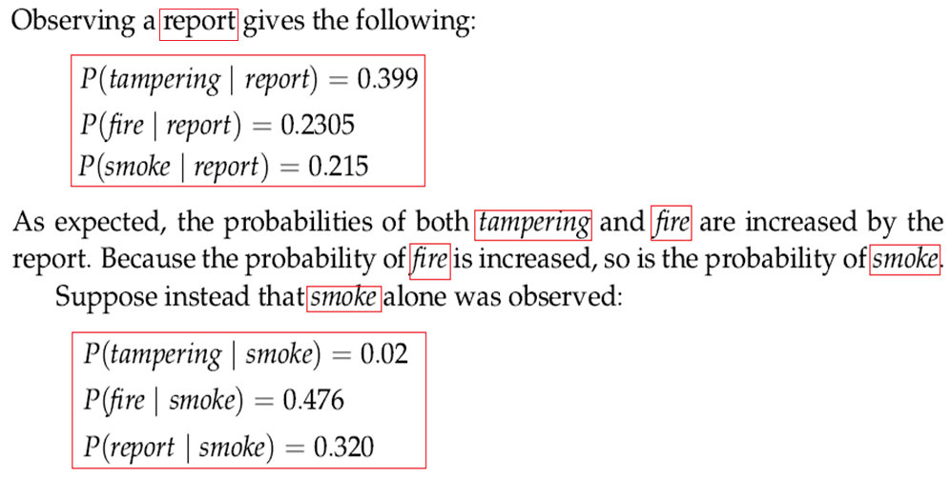

Slide 65
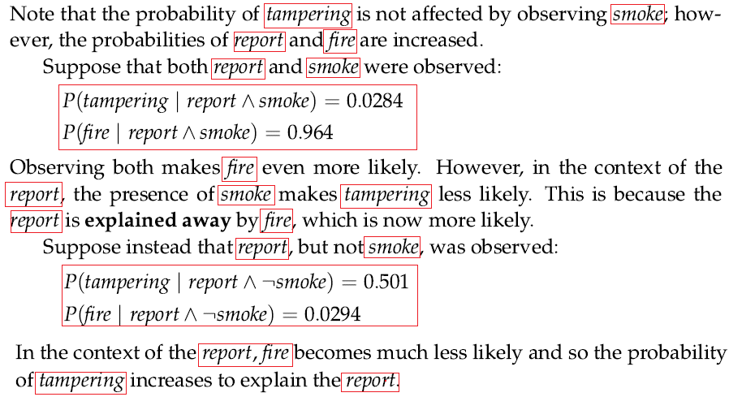

Slide 66
Constructing Belief Networks
Consider the following situation
You have a new burglar alarm installed at home. It is fairly reliable at detecting a burglary, but also responds to minor earthquakes. You have two neighbors, John and Marry, who have promised to call you at work when they hear the alarm. John always calls when he hears the alarm, but some times confuses the telephone ringing with the alarm and calls then. Marry on the other hand, likes rather loud music and sometimes misses the alarm. Given evidence of who has or has not called, we would like to estimate the probability of a burglary.
In the case of burglary network, burglary and earthquakes directly effect the probability of the alarm, but John and Marry call depends only on the alarm, that is the network represents that they do not perceive any burglaries directly, and they do not feel the minor earthquakes.
Notice that the network does not have nodes corresponding to Marry currently listening to loud music or to the telephone ringing and confusing John. The probabilities actually summarize a potentially infinite set of possible circumstances in which the alarm might fail or John or Marry might fail to call , etc.

Slide 67
Constructing Belief Networks
“I'm at work, neighbor John calls to say my alarm is ringing, but neighbor Mary doesn't call “. Sometimes it's set off by minor earthquakes. Is there a burglar?
Variables: Burglary(B), Earthquake(E), Alarm(A), JohnCalls(J), MaryCalls(M)
Network topology reflects "causal" knowledge:
A burglar can set the alarm off
An earthquake can set the alarm off
The alarm can cause Mary to call
The alarm can cause John to call

Slide 68
Constructing Belief Networks
The topology shows that
Burglary and Earthquake
Directly affect the probability
Of the alarm. But JohnCall and
MaryCall depend on the
Alarm.
In the CPT(conditional probability table), letters B, E, A, J and M stand for Burglary,
Earthquake, Alarm, JohnCalls and MaryCalls respectively

Slide 69
Constructing Belief Networks
Once we have specified the topology, we need to specify the CPT for each node. For example, the CPT for the random variable Alarm might look like this:
B E P(A|B, E)
T F
T T 0.95 0.05
T F 0.94 0.06
F T 0.29 0.71
F F 0.001 0.999

Slide 70
Constructing Belief Networks
There are two ways to understand the semantics of Bayesian networks,
To see network as a representation of JPD (joint probability distribution)
To view network as an encoding of a collection of conditional independence statements
A generic entry in the joint is the probability of a conjunction of particular assignments to each variable, such as
P(X_{i}= x₁∧x₂ ∧ …x_{n}) = ∏_{i=1-n} P(X_{i}| Parents(X_{i}))
Calculate the probability of the event that the alarm has sounded but neither a burglary nor an earthquake has occurred, and both John and Mary call done:
P(J ∧ M ∧ A ∧ ~B ∧ ~E) = P(J|A ) * P( M|A)* P( A | ~B ∧ ~E)* P(~B) P( ~E)
= 0.90 x 0.70 x 0.001 x 0.999 x 0.998 = 0.00062

Slide 71
Constructing Belief Networks
Example 8.16 Consider the problem of diagnosing why someone is sneezing and perhaps has a fever. Sneezing could be because of influenza or because of hay fever. They are not independent, but are correlated due to the season. Suppose hay fever depends on the season because it depends on the amount of pollen, which in turn depends on the season. The agent does not get to observe sneezing directly, but rather observed just the “Achoo” sound. Suppose fever depends directly on influenza. These dependency considerations lead to the belief network of Figure 8.4.

Slide 72
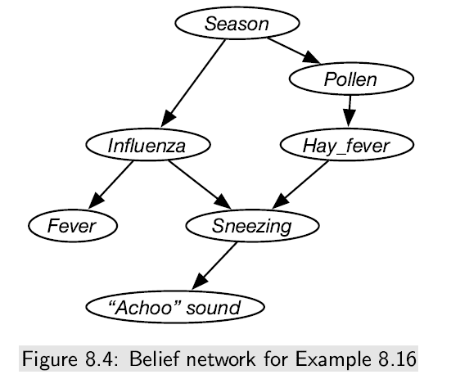
Constructing Belief Networks

Slide 73
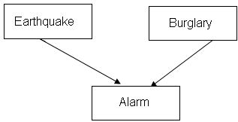
Exercise 1
Consider the following three variables Bayesian network:

Slide 74
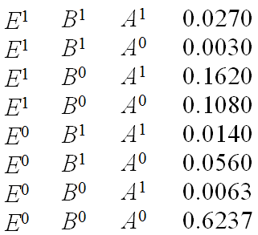
Exercise 1 cont
The joint distribution over the three variables; Earthquake (E), Burglary (B) and Alarm (A) are shown below:

Slide 75
Exercise 1 cont
Based on the network, compute P(A¹|E¹)
Based on the network, compute P( A¹| E⁰, B¹)
Based on the network, compute P( A⁰| E¹, B¹)
By direct computation of the joint probability distribution, show P(E¹|A¹,B¹) < P(E¹|A¹).

Slide 76
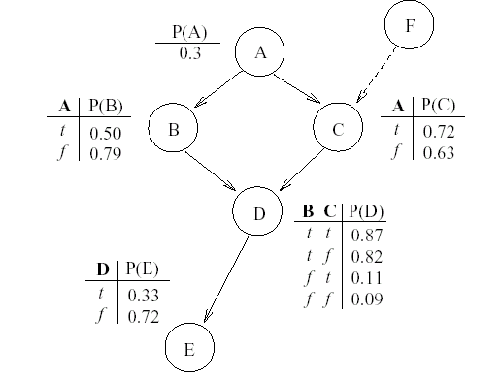
Exercise 2
Given the following network , answer the following questions about conditional independence (node F is a newly added node for question e)

Slide 77
Exercise 2 cont
Are A and E conditionally independent given D?
Are A and E conditionally independent given B?
c. Are B and C conditionally independent given A?
d. Are B and C conditionally independent given A and E?
e. If we add new node F to the network, are B and F conditionally independent given C?

Slide 78
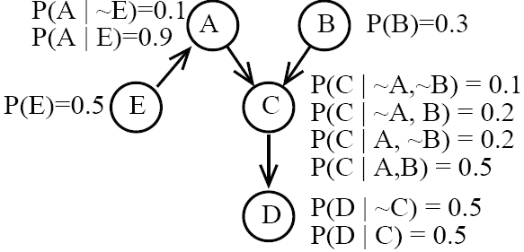
Exercise 3
Consider the following Bayesian Network shown below containing four Boolean random variables.
Calculate the following:
1) P( A ∧ C ∧ D ∧ ~B ∧ ~E)
2) P(~D|C∧ E)
3) P(B|D)
4) Show an expression for how to compute P(D) in terms of values in the full joint distribution

Slide 79
Probabilistic Inference
Next Section

