Slide 1
Data Visualization With Python

Slide 2
What Will You Learn in this two hours time ?
What is Data and why is it so important to make it visualize ?
Why data need to be managed and how to do it ?
The role of data visualization in Data Science.
A brief introduction about numpy , Pandas, and Matplotlib and their relationship with our daily life.
Follow with me and let’s observe the world of Data together,

Slide 3
What is Data ?
Information in raw or unorganized form (Eg. Alphabets, Numbers, or Symbols) that refer to, or represent, conditions, ideas, or objects. Data is limitless and present everywhere in the universe.
The blogs from facebook, the news from televisions, the videos from YouTube, all of them are data.
To be short, the information that can be sent to a far distance can be taken as the Data.

Slide 4
Why Is the Data So important to make it visualize
Whenever you browse the internet or use social media like Facebook, they might some of your data or cookies. Those are the raw datas. Big companies like Google, Facebook and Amazon, collect those raw datas from the users and use tools to visualize it.
So, the question is,
Why Do We need to Visualize them ??

Slide 5
The main reasons
To have an overall picture in our mind
To predict the future
To understand the events objectively

Slide 6
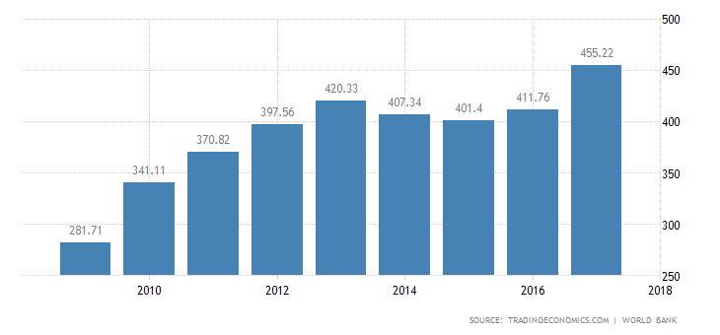
1. To have an overall picture in our mind
As we use tools to visualize the datas, the result is normally with graphs. Those graphs are seen by the executives to make a decision more clearly than looking at raw data each by each.
From the picture beside, we can clearly notice that , the GPA of Thailand went downward at the year of 2009. Then , we can find out the reason to decline and avoid for it in the future.

Slide 7
2. To predict the future
A government can also make various types of decisions with the help of graph, Eg. Increasing tax rate or not, avoiding the serious cause of economy to the country.
A certain type of company use the graphs to make the decisions for their company and set the plans of long term and short terms.

Slide 8
3. To Understand the Events Objectively
Without having the overall picture of the datas you are holding, it is hard to see the main objective of the situation.
Looking at a graph or “Visualized Data”, can bring the right decisions and save more time.

Slide 9
Let’s Visualize some Data !
Today lecture , we will try to use the tools , Pandas and Matplotlib to make the data visualization.
Moreover, we will also download the csv file(a raw data) from the google.
CSV (comma-separated value) file is a simple file format that used to store the data with comma separated after each values.
Notes:
We’ve learned that those visualized data are just making the raw data to become a readable and understandable

Slide 10
MatplotLib
Python 2D plotting library in order to produce the high quality figures in a large variety of formats, graphs, charts, plots, scatter plots, etc.
It’s straightforward to use, and easy to understanding
Later on lesson, I will try to use the matplotlib to dive deep inside the world of Data Visualization.
Might be lots of fun, hope you enjoy it

Slide 11
Importing the library
Firstly input these two lines in the Jupyter note book file. Then ,we can start our journey !

Slide 12
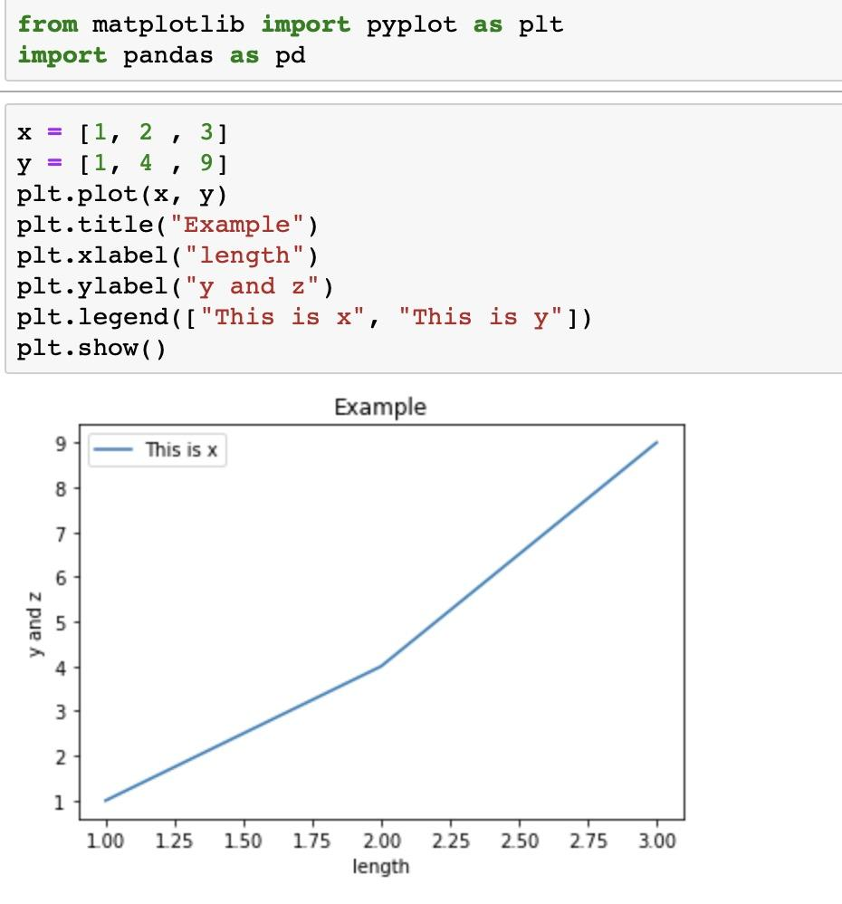
Simple example
Need 2 variables to store the data,
Put these two variables into .plot( x - axis, y- axis)
And then putting the label

Slide 13
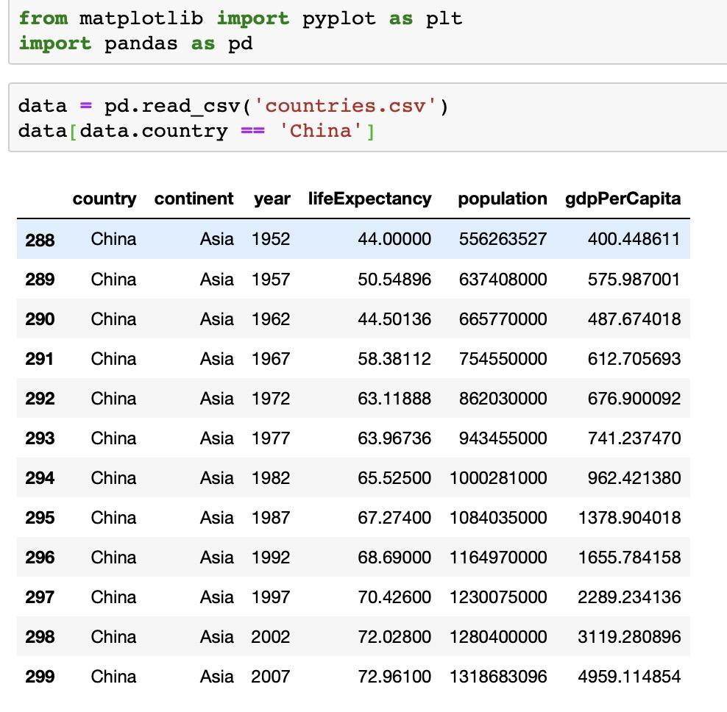
Read the CSV file
Read CSV file with pandas
Store it into a variable
From that , we take the data that is related with the China.
Notes:
Comma-separated value file, is available on the google

Slide 14
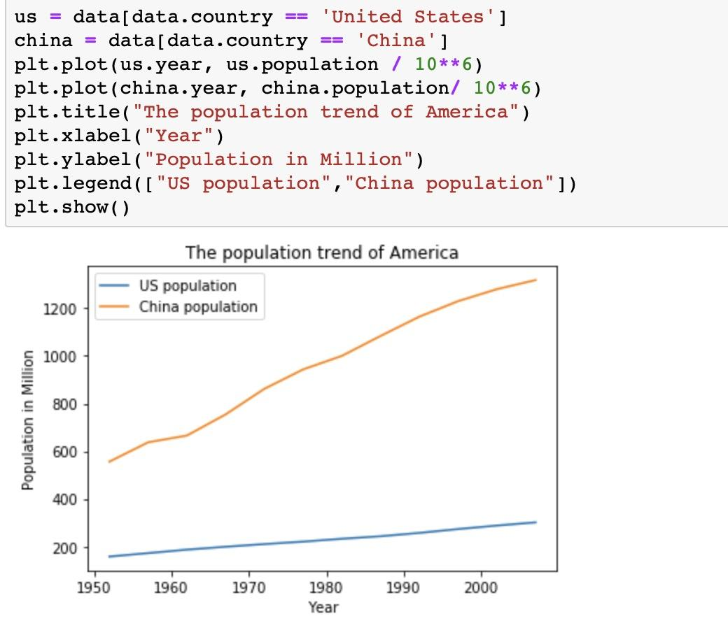
Compare the population of America with China

Slide 15
Additional Feature
The size of the figure is adjustable, it can be adjusted with
plt.figure(figsize = (width in inches, height in inches) )
The form of the line can also change in to many different forms

