Slide 1
Underlying Technologies for Cloud Computing

Slide 2
Underlying Technologies for Cloud Computing
A set of primary technology components that collectively enable key features and characteristics associated with contemporary cloud computing:
Broadband Networks and Internet Architecture
Data Center Technology
Virtualization Technology
Web Technology
Multitenant Technology
Service Technology

Slide 3
Why Broadband Networks and Internet?
All clouds must be connected together somehow.
Internetworks (or Internet) allow for the remote provisioning of IT resources.
Internet support ubiquitous access.
Architecture components?

Slide 4
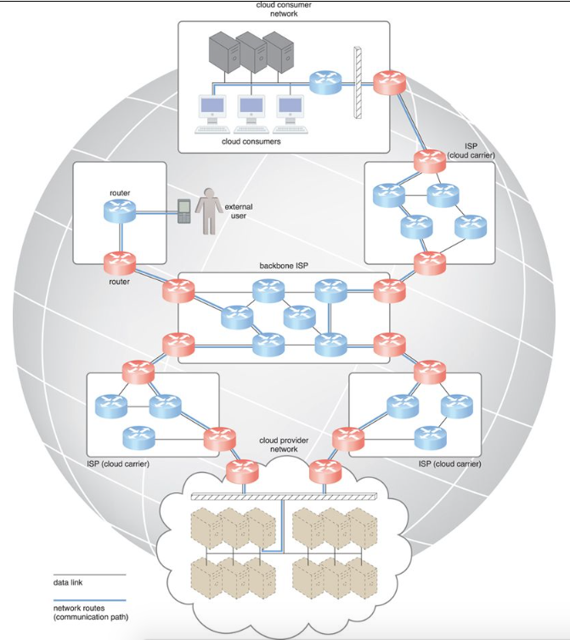
Messages travel over dynamic network routes in this ISP internetworking configuration.
Internet Principles
decentralized provisioning and management model.
dynamic and aggregation of ISPs.
No one govern the Internet.

Slide 5
Worldwide connectivity is enabled through a hierarchical topology composed of Tiers 1, 2, and 3.
Two fundamental components used to construct the internetworking architecture are connectionless packet switching (datagram networks) and router-based interconnectivity.

Slide 6
Connectionless Packet Switching (Datagram Networks)
End-to-end (sender-receiver pair) data flows are divided into packets of a limited size.
Received and processed through network switches and routers, then queued and forwarded from one intermediary node to the next.
Important addresses for switching?

Slide 7
Router-based Interconnectivity
Routers process and forward each packet individually while maintaining the network topology information.
What is network topology information?
Routers manage network traffic and gauge the most efficient hop (in terms of number of hops or link cost) for packet delivery.
?

Slide 8
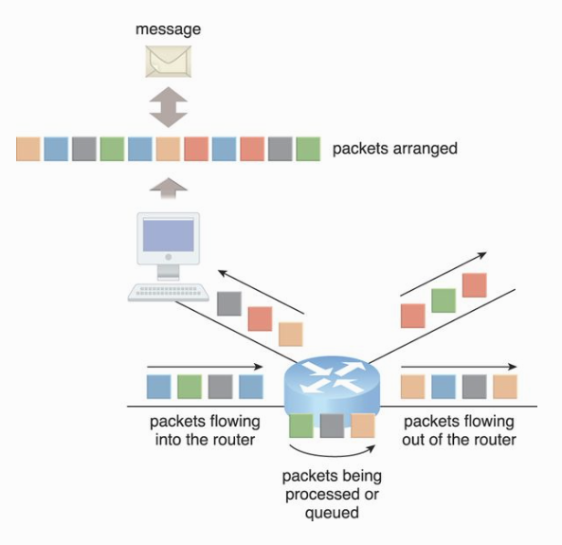
The communication path that connects a cloud consumer with its cloud provider may involve multiple ISP networks.

Slide 9
ISPs Internet’s internetworking Layer
Physical Layer
IP packets are transmitted through underlying physical networks that connect adjacent nodes, such as Ethernet, ATM network, and the 3G mobile HSDPA.
Data link layer that controls data transfer between neighboring nodes, and a physical layer that transmits data bits through both wired and wireless media.
Transport Layer
Transport Control Protocol (TCP)
User Datagram Protocol (UDP)

Slide 10
ISPs Internet’s internetworking Layer (2)
Application Layer
Protocols such as HTTP, SMTP for e-mail, BitTorrent for P2P, and SIP for IP telephony use transport layer protocols to standardize and enable specific data packet transferring methods over the Internet.
Many other protocols also fulfill application-centric requirements and use either TCP/IP or UDP as their primary method of data transferring across the Internet and LANs.

Slide 11
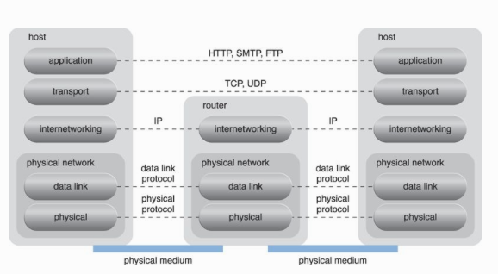

Slide 12
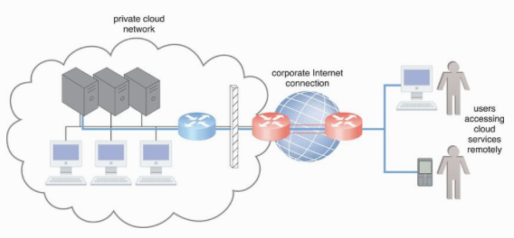
Technical Business Consideration
Connectivity issues
On-premise services has no connectivity issues if accessed from corporate Internet networks.
Users can directly access the network traffic to and from the Internet.
Have complete control over and can safeguard their corporate networks using firewalls and monitoring software.

Slide 13
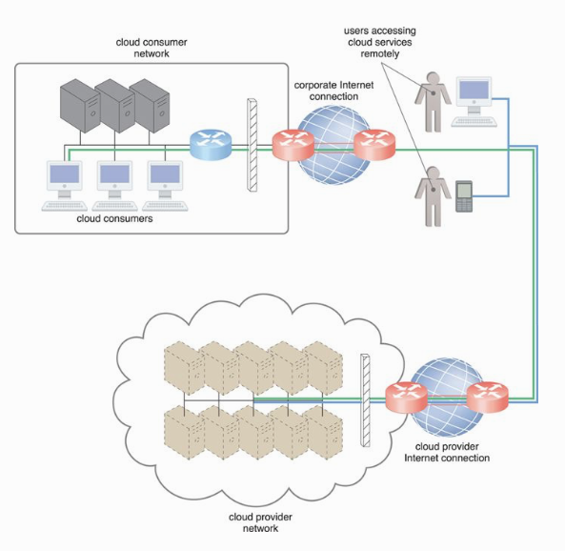
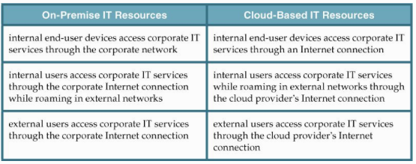

Slide 14
Technical Business Consideration (2)
Network bandwidth and latency issues
End-to-end bandwidth is determined by the transmission capacity of the shared data links.
Latency is the amount of time it takes a packet to travel from one data node to another.
Factors that increase latency?
Bandwidth is critical for applications that require substantial amounts of data to be transferred to and from the cloud.
Latency is critical for applications with a business requirement of swift response times.
?

Slide 15
Technical Business Consideration (3)
Cloud carrier and cloud provider selection
The service levels of Internet connections between cloud consumers and cloud providers are determined by their ISPs (multiple ISPs involved)
QoS management across multiple ISPs is difficult to achieve in practice.
Multiple cloud carriers may be needed in order to achieve the necessary level of connectivity and reliability for their cloud applications (between cloud consumers and cloud providers), resulting in additional costs.
Cloud adoption can therefore be easier for applications with more relaxed latency and bandwidth requirements.

Slide 16
Data Center Technology
A group of IT resourced located in close proximity offering:
power sharing,
higher efficiency in shared IT resource usage, and
improved accessibility for IT personnel.
Modern data centers exist as specialized IT infrastructure used to house centralized IT resources, such as servers, databases, networking and telecommunication devices, and software systems.

Slide 17
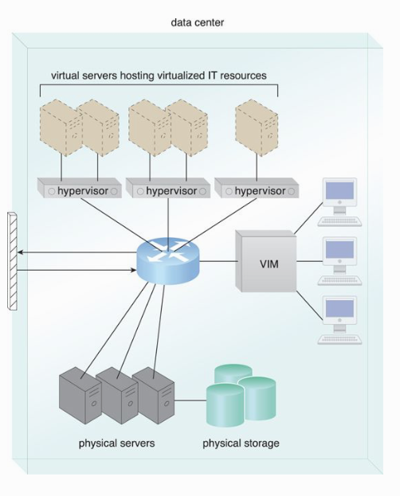
Data Center Components
Virtualization
A platform that abstracts the physical computing and networking IT resources as virtualized components that are easier to allocate, operate, release, monitor, and control.
Standardized and modularity
Aggregation of multiple identical building blocks of facility infrastructure and equipment to support scalability, growth, and speedy hardware replacements.
Automation
To automate tasks like provisioning, configuration, patching, and monitoring without supervision.
Remote operation and Management
Remote control

Slide 18
Data Center Components (2)
High availability
Designed to operate with increasingly higher levels of redundancy to sustain availability through redundant power supplies, UPSs, hardware, etc.
Security-aware design, operation and management
Thorough and comprehensive physical and logical accesses for data centers
Facility
Custom-designed locations that are outfitted with specialized computing, storage, and network equipment.

Slide 19
Data Center Components (3)
Computing hardware
Rack-mounted, blade server, etc.
x86-32bits, x86-64, and RISC architecture (multiple cores).
Redundant and hot-swappable components, such as hard disks, power supplies, network interfaces, and storage controller cards.

Slide 20
An example from HPE solution.

Slide 21
Data Center Components (4)
Storage
NAS, SAN, Cloud-based storage, etc.
Underlying technologies
Disk arrays, I/O caching, hot-swappable HDD, storage virtualization, fast data replication technology

Slide 22
Data Center Components (5)
Network hardware
Carrier and external networks interconnection
Web-tier load balancing and acceleration
Examples include XML pre-processors, encryption/decryption appliances, and layer 7 switching devices that perform content-aware routing.
LAN fabric (LAN networks)
Gigabit Ethernet.
SAN fabric
Fiber optic connection. Fibre Channel (FC), Fibre Channel over Ethernet (FCoE), etc.

Slide 23
Virtualization Technology
A process of converting a physical IT resource into a virtual IT resource. Most types of IT resources can be virtualized, including:
Servers – A physical server can be abstracted into a virtual server.
Storage – A physical storage device can be abstracted into a virtual storage device or a virtual disk.
Network – Physical routers and switches can be abstracted into logical network fabrics, such as VLANs.
Power – A physical UPS and power distribution units can be abstracted into what are commonly referred to as virtual UPSs.
Steps?
Allocation of physical IT resources,
Installation of host OS,
Installation of guest OS.
Virtualization software is sometimes referred to as a virtual machine manager or a virtual machine monitor (VMM), but most commonly known as a hypervisor.

Slide 24
Its Characteristics
Hardware Independency
A conversion process that translates unique IT hardware into emulated and standardized software-based copies.
Server consolidation
Multiple virtual servers to be simultaneously created in the same virtualization host.
Resource replication
Virtual server as virtual disk image.
Simple file operations, such as copy, move, and paste, can be used to replicate, migrate, and back up the virtual server.
Agility, rapidly scale out and up.
Ability to roll back.
Support business continuity with efficient backup (e.g., disk snapshot)

Slide 25
Operating System-based Virtualization
Operating system-based virtualization can rectify hardware compatibility issues even if the hardware driver is not available to the virtualization software.

Slide 26
Operating System-based Virtualization (2)
Operating system-based virtualization can introduce demands and issues related to performance overhead such as:
The host operating system consumes CPU, memory, and other hardware IT resources.
Hardware-related calls from guest operating systems need to traverse several layers to and from the hardware.
Licenses are usually required for host operating systems, in addition to individual licenses for each of their guest operating systems.

Slide 27
Hardware-based Virtualization
An installation of virtualization software directly on the physical host hardware.
Virtual servers to interact with hardware without requiring intermediary action from the host operating system, resulting in better efficiency.
A hypervisor has a simple user-interface that requires a negligible amount of storage space, existing as a thin layer of software that handles hardware management functions to establish a virtualization management layer.

Slide 28
Considerations in Virtualization Technology
Performance Overhead – Virtualization may not be ideal for complex systems that have high workloads with little use for resource sharing and replication.
Special Hardware Compatibility – Many hardware vendors that distribute specialized hardware may not have device driver versions that are compatible with virtualization software.
Portability – The programmatic and management interfaces that establish administration environments for a virtualization program to operate with various virtualization solutions can introduce portability gaps due to incompatibilities.

Slide 29
Web Technology Terminology
Web resources vs. IT resources
Web resources – artifacts accessible via WWW.
IT resources - a physical or virtual IT-related artifact that can be software or hardware-based.
Basic web technologies
URL, HTTP, XML
Web application
Distributed applications that use web-based technologies.

Slide 30
Common Architectural Abstraction of Web Application

Slide 31
Multitenant Technology
A technology that enables multiple users (tenants) to access the same application logic simultaneously (a dedicated instance of software).
Multitenant applications ensure that tenants do not have access to data and configuration information that is not their own.
Tenants can individually customize features of the application, such as:
Interfaces (look and feel)
Business process – customize rules, logics and workflows.
Data model – freely include, exclude, rename fields.
Access control

Slide 32
Common Characteristics of Multitenant Applications
Usage Isolation – The usage behavior of one tenant does not affect the application availability and performance of other tenants.
Data Security – Tenants cannot access data that belongs to other tenants.
Recovery – Backup and restore procedures are separately executed for the data of each tenant.
Application Upgrades – Tenants are not negatively affected by the synchronous upgrading of shared software artifacts.
Scalability – The application can scale to accommodate increases in usage by existing tenants and/or increases in the number of tenants.
Metered Usage – Tenants are charged only for the application processing and features that are actually consumed.
Data Tier Isolation – Tenants can have individual databases, tables, and/or schemas isolated from other tenants.

Slide 33
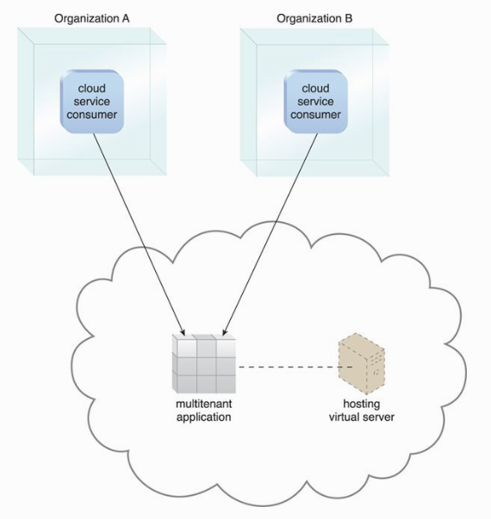
A multitenant application that is being concurrently used by two different tenants with a typical SaaS implementation.

Slide 34
Multitenancy vs. Virtualization
Multitenancy is sometimes mistaken for virtualization because the concept of multiple tenants is similar to the concept of virtualized instances.
The differences lie in what is multiplied within a physical server acting as a host:
With virtualization: Multiple virtual copies of the server environment can be hosted by a single physical server. Each copy can be provided to different users, can be configured independently, and can contain its own operating systems and applications.
With multitenancy: A physical or virtual server hosting an application is designed to allow usage by multiple different users. Each user feels as though they have exclusive usage of the application.

Slide 35
Service Technology
The field of service technology is a keystone foundation of cloud computing that formed the basis of the “as-a-service” cloud delivery models, e.g. IaaS, PaaS, SaaS.
Key technology – Web Services. Core technologies behind web services include, but not limited to:
Web Service Description Language (WSDL) - defines the application programming interface (API) of a Web service, including its individual operations (functions) and each operation’s input and output messages.
XML Schema Definition Language (XML Schema) - defines the data structure of the XML-based input and output messages exchanged by Web services.
Simple Object Access Protocol (SOAP) - defines a common messaging format used for request and response messages exchanged by Web services.
Universal Description, Discovery, and Integration (UDDI) – regulates service registries in which WSDL definitions can be published as part of a service catalog for discovery purposes.
These four technologies formed the first generation of web services technology.

Slide 36
Services Technology
Second-generation Web service technologies (commonly referred to as WS-*) has been developed to address various additional functional areas, such as
security,
reliability,
transactions,
routing, and
business process automation.

Slide 37
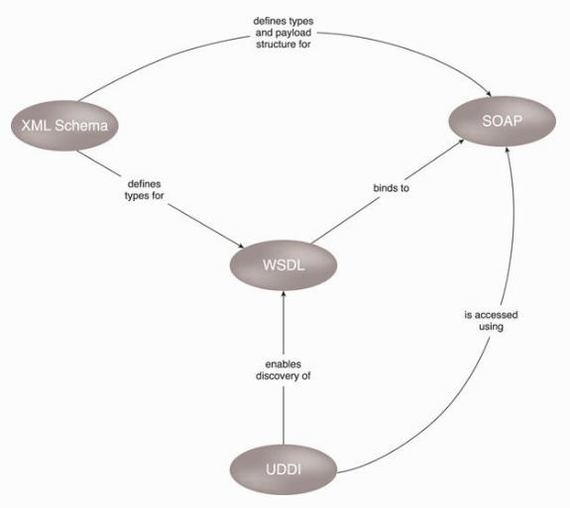

Slide 38
Service Agents
Service agents are event-driven programs designed to intercept messages at runtime.
There are active and passive service agents.
Active service agents perform an action upon intercepting, reading and making changes of the contents of a message.
Passive service agents, on the other hand, do not change message contents. Agents read the message and may then capture certain parts of its contents, usually for monitoring, logging, or reporting purposes.
Cloud-based environments rely heavily on the use of system-level and custom service agents to perform much of the runtime monitoring and measuring required to ensure that features, such as elastic scaling and pay-for-use billing, can be carried out instantaneously.

