Slide 1
Fundamental Cloud Security

Slide 2
Basic Concepts
Information security is a complex ensemble of
techniques,
technologies, regulations, and
Behaviors
that collaboratively protect the integrity of and access to computer systems and data.
IT security measures aim to defend against threats and interference that arise from both malicious intent and unintentional user error.

Slide 3
Basic Concepts (2)
C
I
A

Slide 4
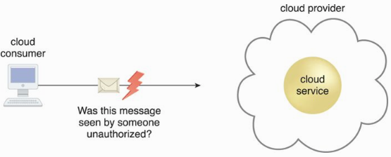
Confidentiality
The characteristic of something being made accessible only to authorized parties.

Slide 5
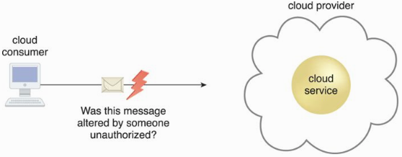
Integrity
The characteristic of not having been altered by an unauthorized party.

Slide 6
Authenticity
The characteristic of something having been provided by an authorized source. This also encompasses non-repudiation.
Non-repudiation?
The inability of a party to deny or challenge the authentication of an interaction.

Slide 7
Other Relevant Terms
Availability - being accessible and usable during a specified time period.
Threat - a potential security violation that can challenge defenses in an attempt to breach privacy and/or cause harm.
Vulnerabilities - a weakness that can be exploited either because it is protected by insufficient security controls.
Risk - the possibility of loss or harm arising from performing an activity.

Slide 8
Other Relevant Terms (2)
Security Controls - countermeasures used to prevent or respond to security threats and to reduce or avoid risk.
Security Mechanisms - components comprising a defensive framework that protects IT resources, information, and services.
Security Policies - a set of security rules and regulations that enforce security controls and mechanisms.

Slide 9
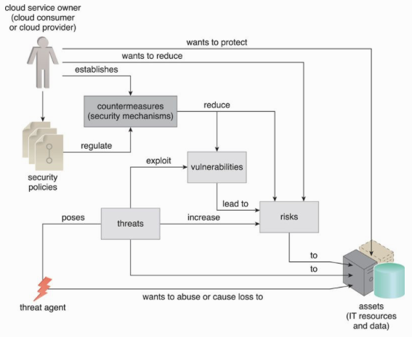

Slide 10
The Ingredients of an Attack
Motive + Means + Opportunity = ATTACK!

Slide 11
Common Threat Agents
A treat agent?
an entity that poses a threat because it is capable of carrying out an attack.
Originated from?
either internally or externally, from humans or software programs.
Relationship?

Slide 12
Types of Threat Agents/Attackers
Anonymous Attackers - a non-trusted cloud service consumer without permissions in the cloud (typically external software programs).
Malicious Service Agent - a service agent (or a program pretending to be a service agent) with compromised or malicious logic.
Trusted Attacker - attacks from within a cloud’s trust boundaries by abusing legitimate credentials.
Malicious Insider - threat agents acting on behalf of or in relation to the cloud provider. They are typically current or former employees or third parties with access to the cloud provider’s premises.

Slide 13
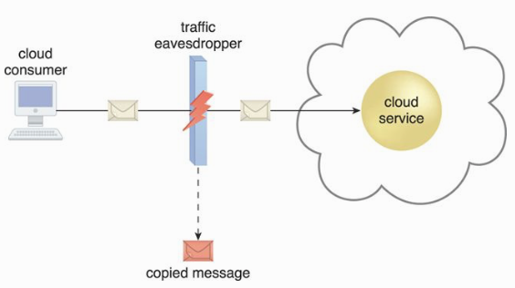
Cloud Security Threats
Traffic Eavesdropping – data is passively intercepted by malicious service agents.
Gather information to directly compromise confidentiality, e.g., username and password.

Slide 14
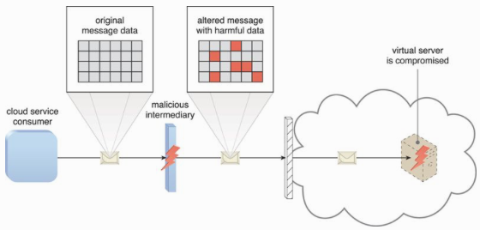
Malicious Intermediary
This attack arises when messages are intercepted and altered by a malicious service agent.

Slide 15
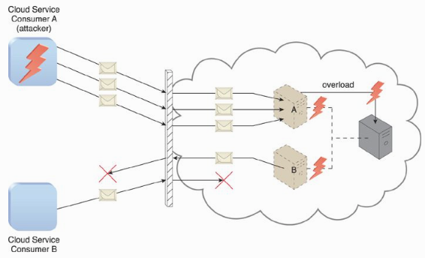
Denial of Service
To overload IT resources to the point where they cannot function properly.
Workload increased (CPU, memory loads)
Network traffic increased
Successful DoS attacks produce server degradation and/or failure.

Slide 16
Distributed DoS (DDoS)
DoS is easy to detect (trace back) and mitigate.

Slide 17
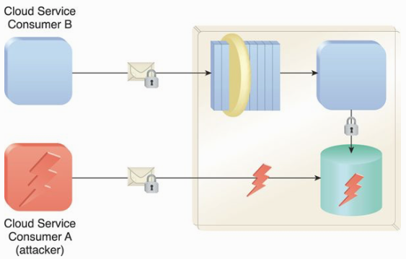
Insufficient Authorization
Attackers gain direct access to IT resources through poorly managed cloud API.

Slide 18
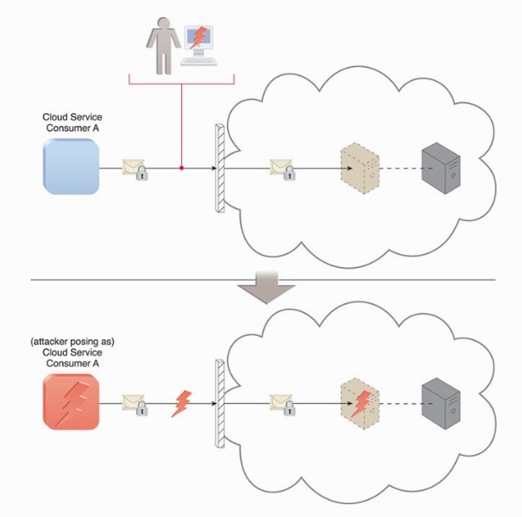
Weak Authentication
Cloud consumer A uses a weak password enabling an attacker to easily crack it.

Slide 19
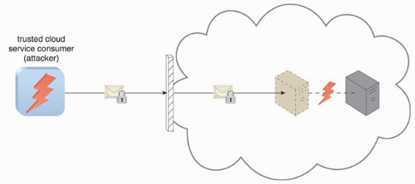
Virtualization Attack
This attack exploits vulnerabilities in the virtualization platform to jeopardize its confidentiality, integrity, and/or availability.
Accesses a virtual server to compromise its underlying physical server.

Slide 20
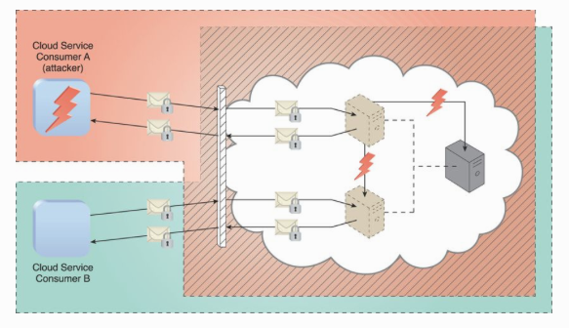
Overlapping Trusted Boundaries
Physical IT resources shared by multiple cloud consumers, resulting in overlapping trusted boundaries.
Malicious cloud consumers target shared IT resources with the intention of compromising cloud consumers or other IT resources that share the same trust boundary.

Slide 21
Another Considerations
Flawed Implementation
Security Policy Disparity
Contracts
Risk Management

Slide 22
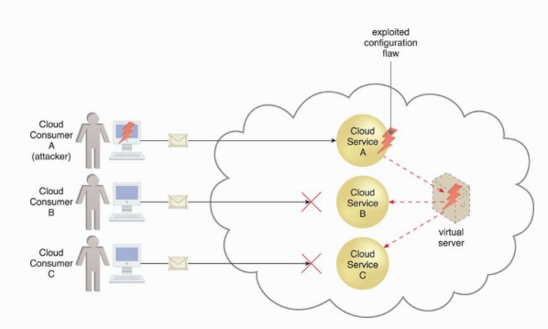
Flawed Implementation
Substandard design, implementation, or configuration of cloud service deployments may lead to undesirable consequences.
Attackers can exploit these vulnerabilities to impair the integrity, confidentiality, and/or availability of cloud provider IT resources.

Slide 23
Security Policy Disparity
Our own implemented security mechanisms are different from that provided by cloud providers.
Assessments are needed to ensure our IT resources being migrated to a cloud are sufficiently protected.
Cloud consumers may not be granted sufficient administrative control (of course we are not the owner of the cloud infra).
Some public clouds, additional third parties, such as security brokers and certificate authorities, may introduce their own distinct set of security policies and practices (make things more complicated).

Slide 24
Contracts
Examine contract and SLA.
Use clear language that indicates the amount of liability assumed by the cloud provider and/or the level of indemnity the cloud provider may ask for.
Contractual obligations is where the lines are drawn between cloud consumer and cloud provider assets. In case of security breach, who to be blamed (us or cloud provider).

Slide 25
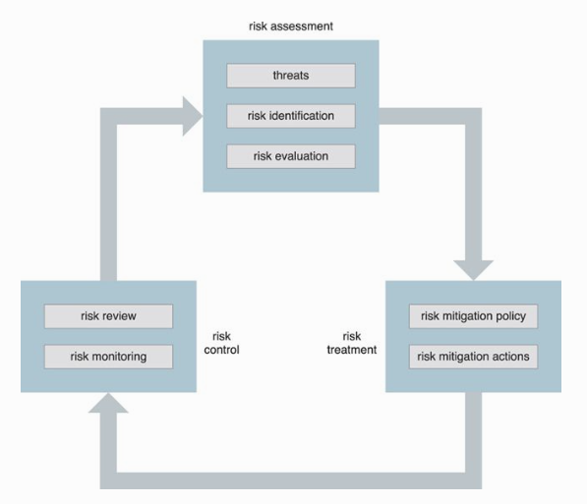
Risk Management
When assessing the potential impacts and challenges pertaining to cloud adoption, cloud consumers are encouraged to perform a formal risk assessment as part of a risk management strategy. Process comprises
Risk assessment – to identify potential vulnerabilities and shortcomings.
Risk treatment – mitigation policies and plans to treat risks.
Risk control – risk monitoring
Risk management is an on-going process.

Slide 26
Cloud Security Mechanisms

Slide 27
Security Mechanisms
Encryption
Hashing
Digital Signature
Public Key Infrastructure (PKI)
Identity and Access Management (IAM)
Single Sign-On (SSO)
Cloud-based Security Groups
Hardened Virtual Server Images

Slide 28
Encryption
A digital coding system dedicated to preserving the confidentiality and integrity (in some algorithms only) of data.

Slide 29
Brute Force Search

Slide 30
Symmetric Encryption
Single key for both encryption/decryption processes.
Non-repudiation is not possible if more than two parties share the same key.

Slide 31
Asymmetric Encryption
Also known as public key encryption.
A pair of keys, public and private keys, are utilized.
Use cases
Public key encryption – confidentiality.
Public key signing – non-repudiation.

Slide 32
Hashing
Hashing mechanism is used to achieve data integrity.
Hashing technology can be used to derive a hashing code or message digest from a message.

Slide 33
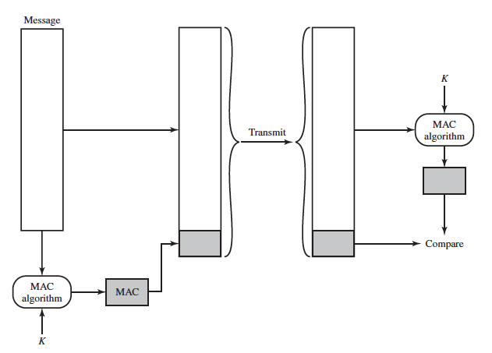
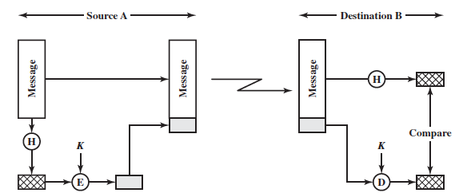
Message Digest vs. Hashing Code

Slide 34
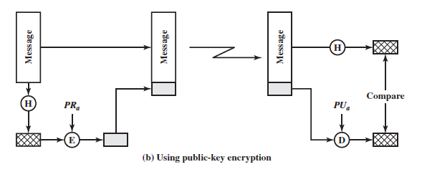
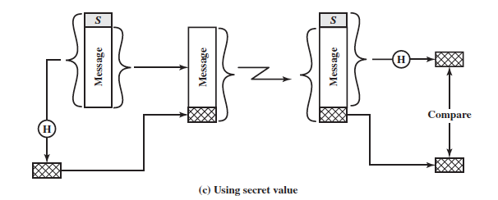
Alternative Hashing Approaches

Slide 35
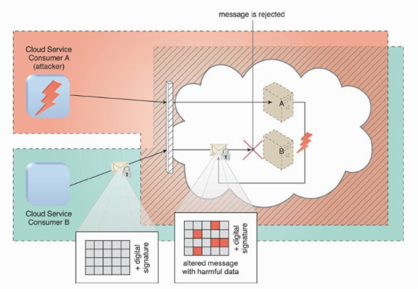
Digital Signature
Means of providing data authenticity and integrity through authentication and non-repudiation.
Asymmetric encryption and hashing mechanisms are involved in the process.

Slide 36
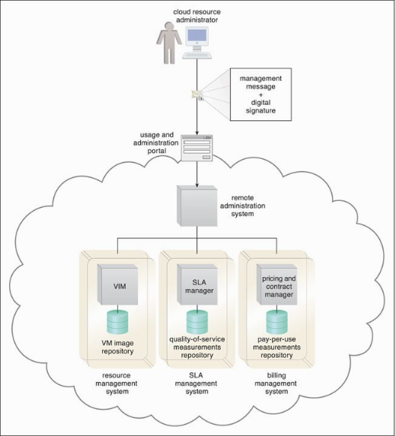

Slide 37
Public Key Infrastructure (PKI)
Management the issuance of asymmetric keys.
PKIs rely on the use of digital certificates, which are digitally signed data structures that bind public keys to certificate owner identities, as well as to related information, such as validity periods.
Digital certificates are usually digitally signed by a third-party certificate authority (CA).

Slide 38
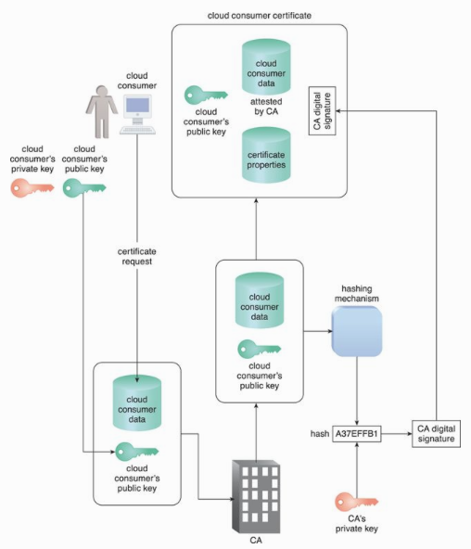

Slide 39
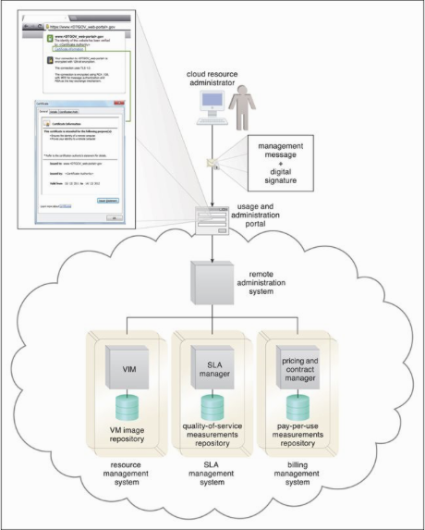

Slide 40
Identity and Access Management (IAM)
Encompasses the components and policies necessary to control and track user identities and access privileges for IT resources
Authentication – username/password, biometric, digital signatures, your blood, etc.
Authorization – correct granularity for access controls and the relationships between identities, access control rights, and IT resource availability.
User management – create, modify, delete, group management.
Credential management - establishes identities and access control rules for defined user accounts.

Slide 42
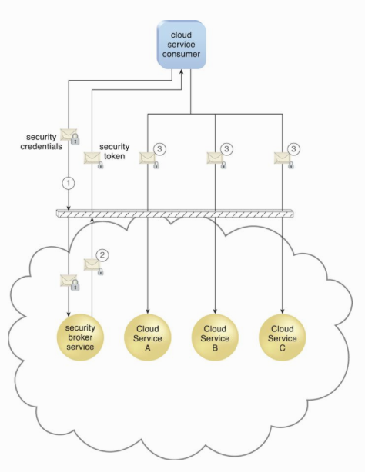
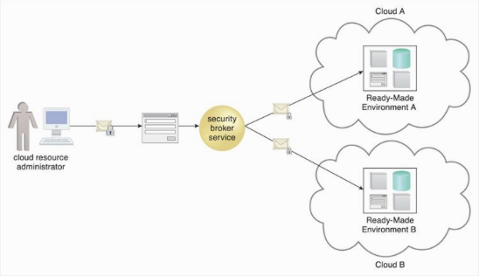
Single Sign-On (SSO)
Authenticated once, access all services.
Authenticated by a security broker.
Credentials remain valid for the duration of a session.

Slide 44
SSO Advantages
SSO reduces password fatigue.
SSO reduces password exposure.
SSO simplifies user and password management.
SSO opens up new possibilities.
How about disadvantages?
SSO gives you the keys to the castle.
SSO does not work when your identity provider is down.
SSO takes a little bit of investment to set up.

Slide 45
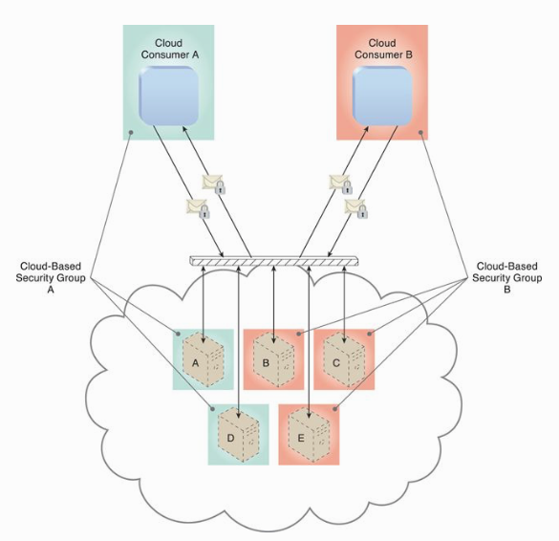
Cloud-Based Security Groups
Segment IT resources hence different security mechanisms can be provided to different segments.
Network – multiple segments each with different security policies and mechanisms.
Virtual servers –multiple types such as public/private groups, development/production groups.

Slide 46
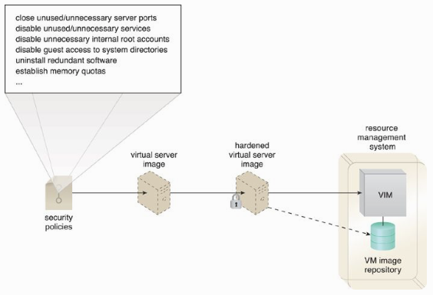
Hardened Virtual Server Images
The process of stripping unnecessary software from a system to limit potential vulnerabilities that can be exploited by attackers.
Remove redundant programs.
Close unnecessary server ports.
Disable unused services, root accounts, guest accounts, etc.

