Slide 1
Introduction to Cloud Computing

Slide 2
Introduction to Cloud Computing
What is a cloud computing?
A model for enable ubiquitous, convenient, on-demand network access to a shared pool of configurable computing resources (e.g., network servers, storage, applications and services) that can be rapidly provisioned and released with minimal management effort or service provider interaction.

Slide 3
Origin and Influences
Envisioned as computing utilities for all (similar to water or electricity utilities)
Business drivers:
Capacity planning - the process of determining and fulfilling future demands of an organization’s IT resources, products, and services.
Lead strategy
Lag strategy
Match strategy
Cost reduction – infrastructure-related operating overhead includes
Technical personnel, upgrades/patches cost, security and access control measures, administrative/account staffs → on-going ownership of technology.
Organizational agility - ability to adapt and evolve to successfully face change caused by both internal and external factors.

Slide 4
Basic Terminology
Cloud - a distinct IT environment that is designed for the purpose of remotely provisioning scalable and measured IT resources.
IT resources - a physical or virtual IT-related artifact that can be either software-based, such as a virtual server or a custom software program, or hardware-based, such as a physical server or a network device.

Slide 5
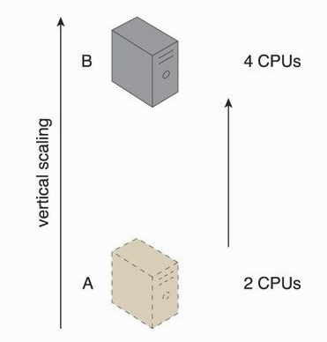
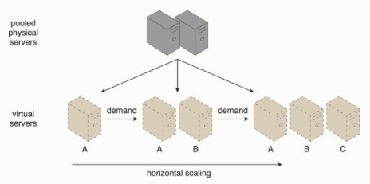
Basic Terminology (2)
On-premise - an IT resource that is hosted in a conventional IT enterprise within an organizational boundary.
Cloud consumers/providers
Scaling - the ability of the IT resource to handle increased or decreased usage demands.
Horizontal – scaling out and in
Vertical – scaling up and down

Slide 7
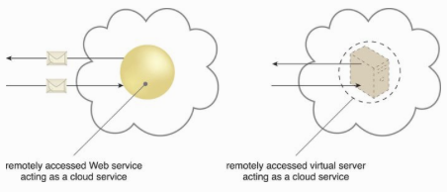
Basic Terminology (3)
Cloud service - any IT resource that is made remotely accessible via a cloud.
Cloud service consumer - a temporary runtime role assumed by a software program when it accesses a cloud service.

Slide 8
Benefits
Reduced investments and proportional costs
On demand access to pay-as-you-go
The perception of having unlimited computing resources
Ability to add/remove IT resources
Abstract of IT infrastructure
Increased scalability
Increased availability and reliability

Slide 9
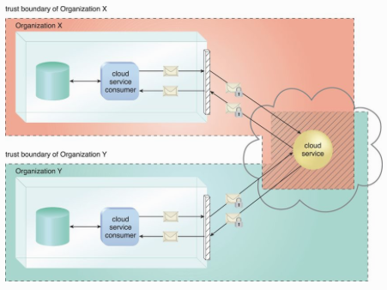
Risks and Challenges
Increased security vulnerabilities

Slide 10
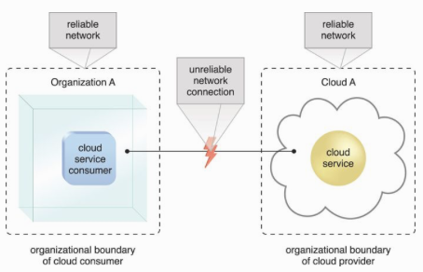
Risks and Challenges (2)
Reduced Operational Governance Control
An unreliable cloud provider may not maintain the guarantees it makes in the SLAs.
Longer geographic distances between the cloud consumer and cloud provider can require additional network hops that introduce fluctuating latency and potential bandwidth constraints.

Slide 11
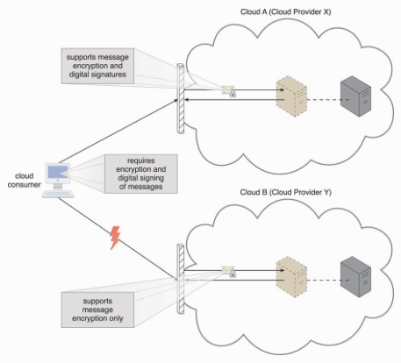
Risks and Challenges (3)
Limited portability between cloud providers

Slide 12
Cloud Computing Elements
Five essential characteristics
Broad network access, rapid elasticity, measured service, on-demand and resource pooling.
Three service models
Software as a service (SaaS), Platform as a service (Paas), Infrastructure as a service (Iaas).
Four deployment models
Public, private, community and hybrid

Slide 13
Cloud Computing Elements

Slide 14
Cloud Characteristics
On-demand usage
Ubiquitous access
Multitenancy (and resource pooling)
Elasticity
Measured usage
Resiliency

Slide 15
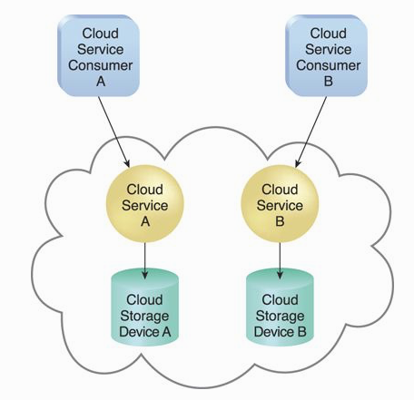
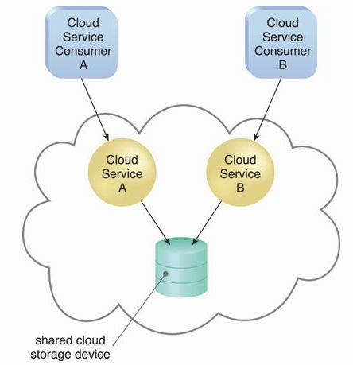
Single tenant
Multitenant

Slide 16
Resiliency
“A form of failover that distributes redundant implementations of IT resources across physical locations.”

Slide 17
Cloud Computing Reference Architecture

Slide 18
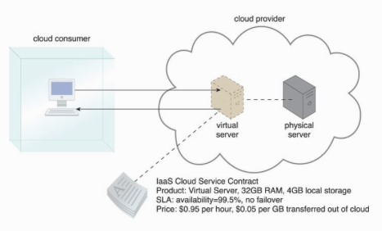
IaaS
A self-contained IT environment comprised of infrastructure-centric IT resources that can be accessed and managed via cloud service-based interfaces and tools.

Slide 19
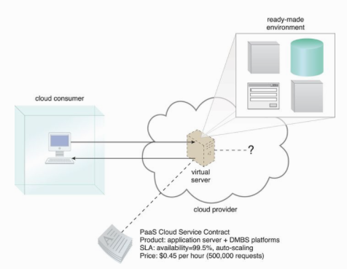
PaaS
A pre-defined “ready-to-use” environment typically comprised of already deployed and configured IT resources.
The cloud consumer wants to extend on-premise environments into the cloud for scalability and economic purposes.
The cloud consumer uses the ready-made environment to entirely substitute an on-premise environment.
The cloud consumer wants to become a cloud provider and deploys its own cloud services to be made available to other cloud consumers.
E.g., Google App Engine offers a Java and Python-based environment.

Slide 20
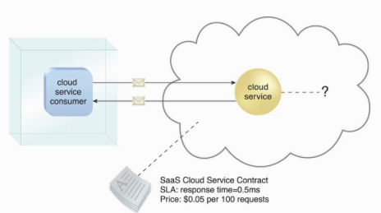
SaaS
A software program positioned as a shared cloud service and made available as a “product” or generic utility represents the typical profile of a SaaS offering.

Slide 21
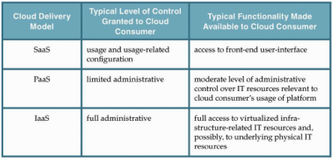

Slide 22
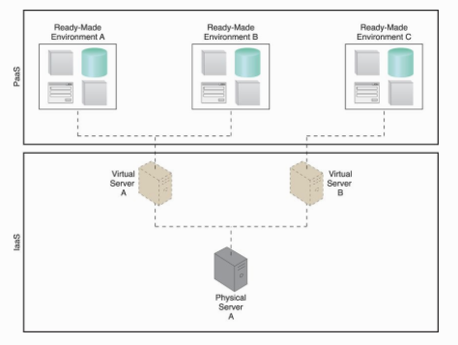
Combining Delivery Model: IaaS + PaaS

Slide 23
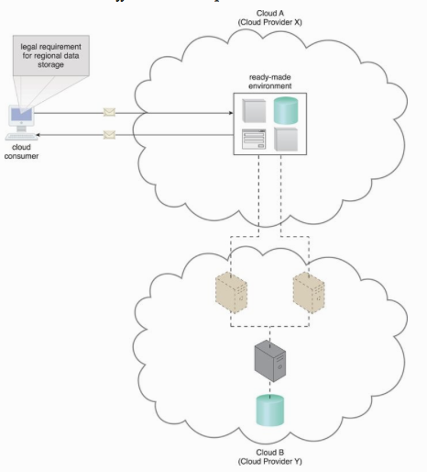

Slide 24
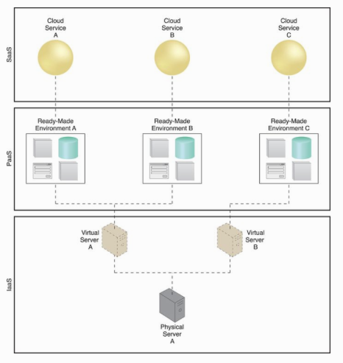
IaaS + PaaS + SaaS

Slide 25
Cloud Security Risk and Countermeasures
Abuse or nefarious use of cloud computing
Free trail period -> attackers may use this period to get into the cloud to conduct various attacks.
Countermeasures – stricter initial registration and validation processes, enhanced credit card fraud monitoring and coordination, comprehensive observation of customer network traffic, check public’s black lists

Slide 26
Cloud Security Risk and Countermeasures (2)
Insecure interfaces and APIs
A set of software interfaces or APIs available to customers enabling them to manage and interact with cloud services (from authentication, access control to encryption and monitoring).
The design of interfaces and APIs must be secure. Why?
Countermeasures – CP interfaces model analyzing, strong authentication/access controls/encryptions implemented, understand APIs dependency chains

Slide 27
Cloud Security Risk (3)
Malicious insider ( unprecedented level of trust onto CP, e.g., CP system administrators)
HR requirements as part of legal contract
Shared technology issues (how to isolate multi-tenant sharing the same resources)
Security best practice implementation
Data loss or leakage
Strong API access control, encryption, etc.
Account or service hijacking (due to stolen credentials)
Strong two-factor authentication (OTP, etc.)
Unknown risk profile

Slide 28
Example: Encrypted Database to Prevent Data Loss or Leakage

Slide 29
Cloud Security as a Service
The Cloud Security Alliance defines security as a service (SecaaS) the provision security applications and services via the cloud either cloud-based infra and software or from cloud to the customer’s premise system.
SecaaS categories of service
Identity and access management, data loss prevention, web security, email security, security assessments, intrusion management, security information and event management, encryption, business continuity and disaster recovery and network security.

