Slide 1
Cloud computing mechanisms
Cloud infrastructure mechanisms

Slide 2
Cloud Infrastructure Mechanisms
Foundational building blocks of cloud environments, which comprises
Logical Network Perimeter
Virtual Server
Cloud Storage Device
Cloud Usage Monitor
Resource Replication
Read-Made Environment

Slide 3
Logical Network Perimeter
An isolation of network environment establishing a virtual network boundary.
Purposes?
isolate IT resources in a cloud from non-authorized users,
isolate IT resources in a cloud from non-users,
isolate IT resources in a cloud from cloud consumers, and
control the bandwidth that is available to isolated IT resources.

Slide 4
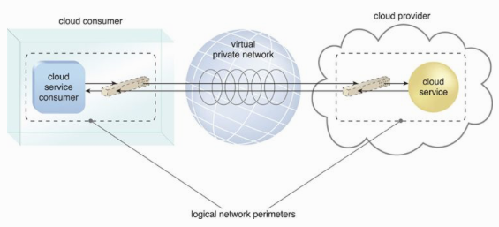
Logical Network Perimeter (2)
Typically established via network devices that supply and control the connectivity of a data center (commonly deployed as virtualized IT environment), which includes
Virtual Firewall – actively filter incoming and outgoing traffic.
Virtual Network – isolates the network environment within the data center.

Slide 5
Case Study (DTGOV)
Routers – connect the Internet and the extranet.
DMZ zone – virtual network hosting the proxy servers.
Management firewalls – isolate the management perimeter, providing management services.
Cold service firewalls – isolate traffic to cloud-based IT resources.
Intra-data center firewalls – filter network traffic to and from other data centers via routers.

Slide 6
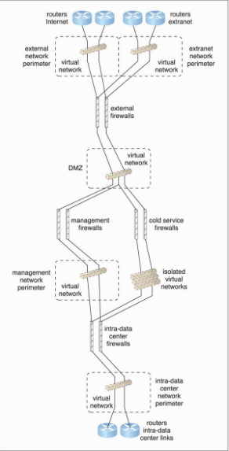
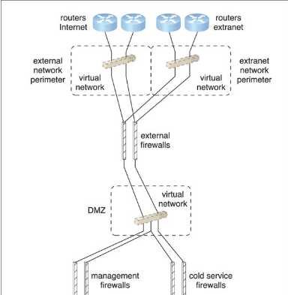

Slide 7
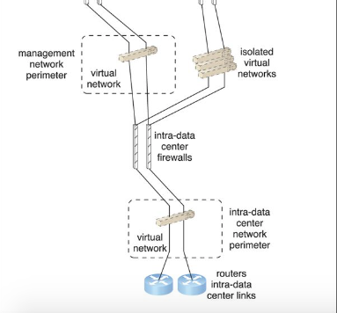

Slide 8
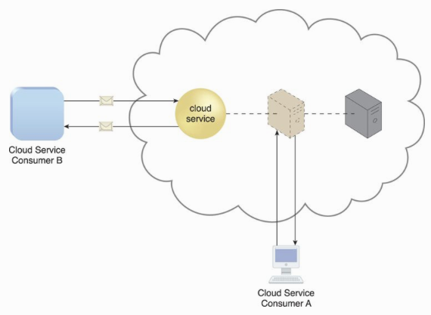
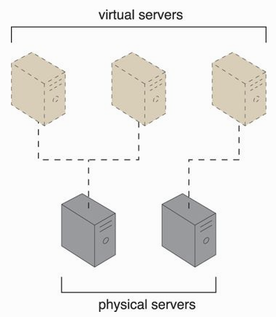
Virtual Servers
A form of virtualization software that emulates a physical server.
Used by a cloud provider for resources sharing.
Virtual server = virtual machine

Slide 9
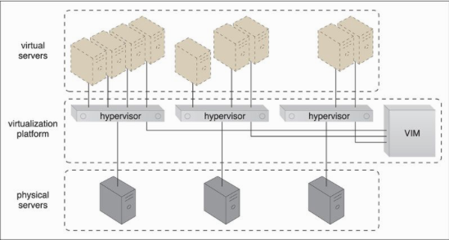
Case Study (DTGOV) Continued.
DTGOV offers several types of pre-made VM images for its customers.
VM images = virtual disk images used by a hypervisor to boot virtual servers.
Template virtual servers.

Slide 10
Case Study (DTGOV) Continued
Template Virtual Servers (may include pre-installed software/applications) examples:
Small Virtual Server Instance – 1 virtual processor core, 4 GB of virtual RAM, 20 GB of storage space in the root file system
Medium Virtual Server Instance – 2 virtual processor cores, 8 GB of virtual RAM, 20 GB of storage space in the root file system
Large Virtual Server Instance – 8 virtual processor cores, 16 GB of virtual RAM, 20 GB of storage space in the root file system
Memory Large Virtual Server Instance – 8 virtual processor cores, 64 GB of virtual RAM, 20 GB of storage space in the root file system
Processor Large Virtual Server Instance – 32 virtual processor cores, 16 GB of virtual RAM, 20 GB of storage space in the root file system
Ultra-Large Virtual Server Instance – 128 virtual processor cores, 512 GB of virtual RAM, 40 GB of storage space in the root file system

Slide 11
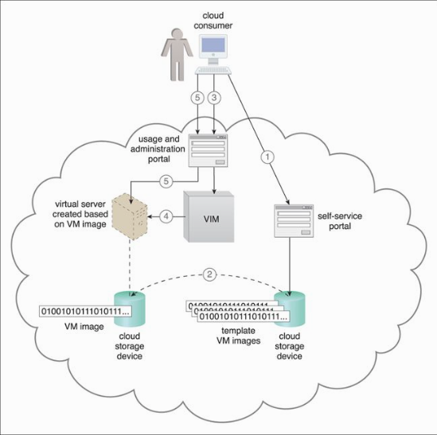
Case Study (DTGOV) Continued
Additional storage capacity can be added to a virtual server by attaching a virtual disk from a cloud storage device.
Cloud consumer can choose the most suitable virtual server template from the list of available configurations.
The allocated VM image is updated whenever the cloud consumer customizes the virtual server.
VIM creates the virtual server instance from the appropriate physical server.

Slide 12
Cloud Storage Devices Mechanism
Storage devices designed specifically for cloud-based environment.
Instances of these storage could be virtualized.
Able to provide fix-increment capacity allocation in support of pay-per-use mechanism.
Primary concern - CIA

Slide 13
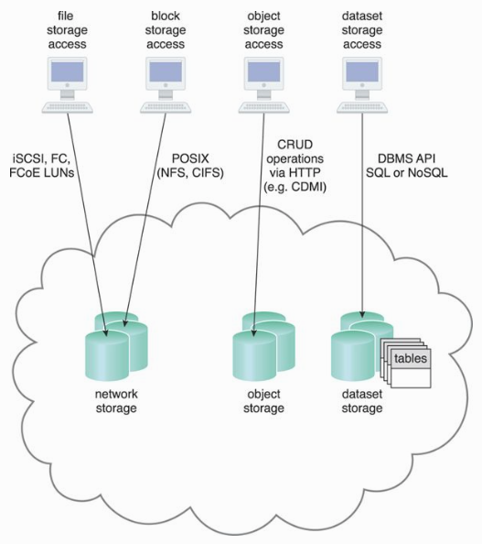
Cloud Storage Levels
Files – Collections of data are grouped into files that are located in folders.
Blocks – The lowest level of storage and the closest to the hardware, a block is the smallest unit of data that is still individually accessible.
Datasets – Sets of data are organized into a table-based, delimited, or record format.
Objects – Data and its associated metadata are organized as Web-based resources.

Slide 14
Technical Interfaces to Storage
Network Storage Interfaces – Most legacy network storage falls under this category, e.g., SCSI for storage blocks, NFS for network storage.
Storage processing levels and thresholds for file allocation are usually determined by the file system itself (tend to be suboptimal)
Object Storage Interfaces - Various types of data can be referenced and stored as Web resources. This is referred to as object storage.
REST protocol, Web service-based cloud services as examples

Slide 15
Technical Interfaces to Storage (2)
Database Storage Interfaces – support a query language in addition to basic storage operations.
Relational Data Storage – relies on table to organize similar data into rows and columns. Use of the industry standard Structured Query Language (SQL). Examples include IBM DB2, Oracle database, Microsoft SQL and MySQL.
Complex relational database designs can imposes higher processing overhead and latency
Non-relational Data Storage – aims at reducing processing overhead of relational databases.
Drawback – tend to not support relational database functions such as transactions or joins.

Slide 17
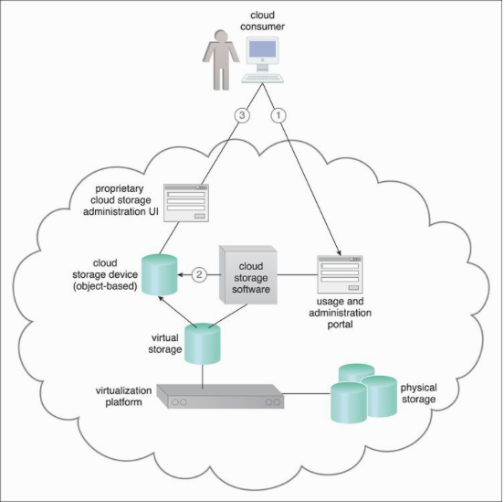
Case Study (DTGOV) Continued

Slide 18
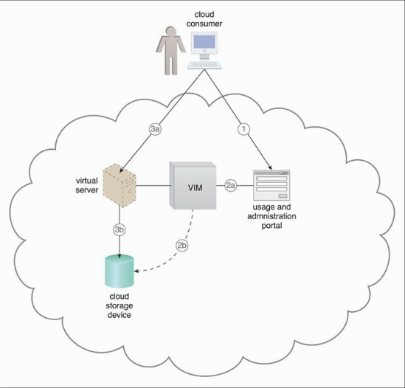

Slide 19
Cloud Usage Monitor Mechanism
A lightweight and autonomous software program responsible for collecting and processing IT resource usage data.
Metrics – amount of data, number of transactions, usage time, etc.
Three common agent-based implementation formats:
Monitoring agent
Resource agent
Polling agent

Slide 20
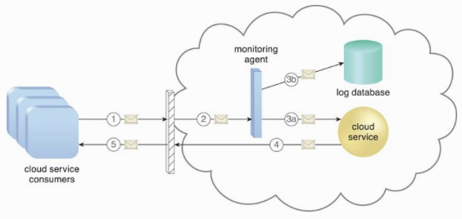
Monitoring Agent
A service agent existing along communication paths, monitoring and analyzing data flows.
Measure network traffic and message metrics.

Slide 21
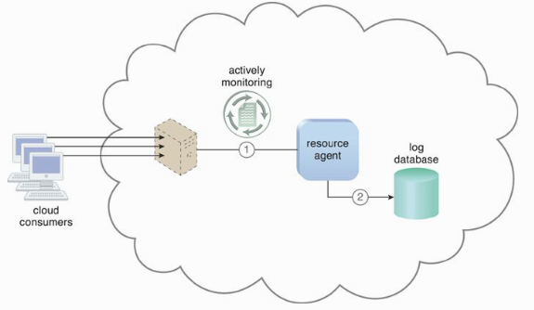
Resource Agent
Even-driven agent monitoring resource usage based on pre-defined, observable at the resource software level such as initiating, suspending, resuming and vertical scaling.

Slide 22
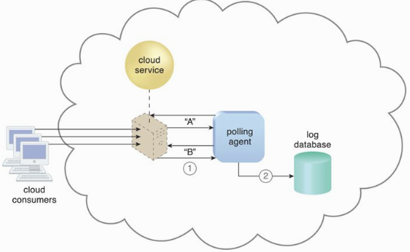
Polling Agent
A processing module that collects cloud service usage data by polling IT resources.
Commonly used to periodically monitor IT resource status, such as uptime and downtime.

Slide 23
Case Study (DTGOV) Continued
Needs to define a model that allows virtual servers of varying performance levels to be leased and billed hourly.
Each resource usage event that is generated by VIM contains the following data:
Event Type (starting, started, scaled, stopping, stopped), VM Type – pre-defined VM configurations, VM ID, Cloud Consumer ID, Timestamp.
Usage measurements – for every VM, a measurement period (in a scale of minute usage).
VM can be started, scaled and stopped multiple times (e.g., started and scaled, or scaled and scaled).

Slide 24
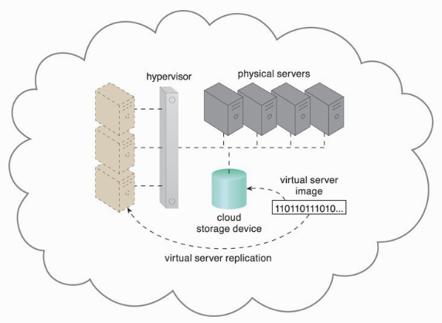
Resource Replication
The creation of multiple instances of the same IT resource.
Replication is typically performed when an IT resource’s availability and performance need to be enhanced.

Slide 25
Case Study (DTGOV) Continued.
A set of high-availability virtual servers that can be automatically relocated to physical servers running in different data centers in response to severe failure conditions.

Slide 26
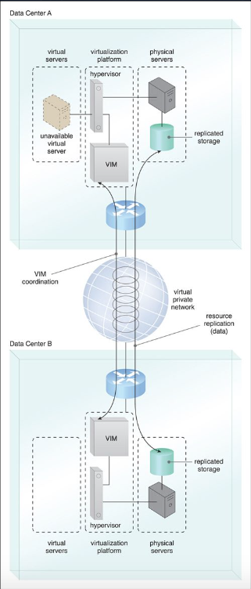
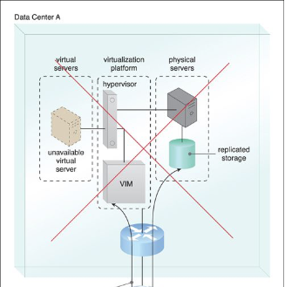
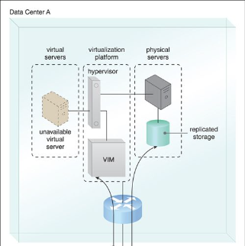
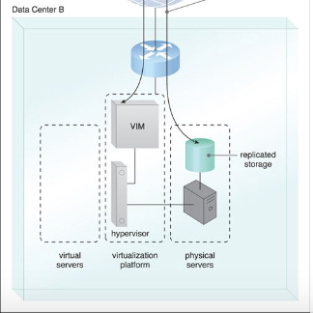
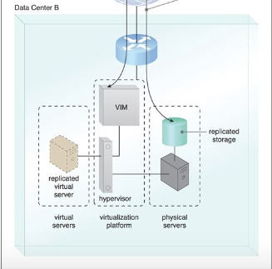

Slide 27
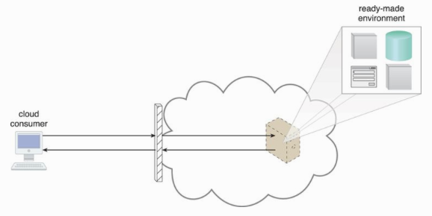
Ready-Made Environment
A defining component of the PaaS cloud delivery model that represents a pre-defined, cloud-based platform comprised of a set of already installed IT resources,
ready to be used and
customized by a cloud consumer.
Typically equipped with Software Development Kit (SDK)

Slide 28
