Slide 1
Specialized Cloud Mechanisms

Slide 2
Specialized mechanisms in support of one or more cloud characteristics.
Automatic Scaling Listener
Load Balancer
Pay-per-use Monitor
Audit Monitor
Failover Systems
Hypervisor
Resource Cluster
Multi-Device Broker
State Management Database
Considered as an extension to Cloud infrastructure.
Combined to offer distinct and custom architecture.

Slide 3
Automatic Scaling Listener
This mechanism is a service agent that monitors and tracks communications between cloud service consumers and cloud services for dynamic scaling purposes.
Typically placed near a firewall (or at hypervisor) tracking workload (processing requests) status.
What does it do in general?

Slide 4
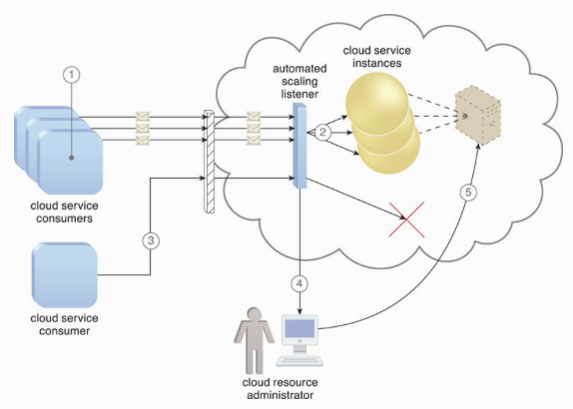
Automatically scaling IT resources out or in based on parameters previously defined by the cloud consumer (commonly referred to as auto-scaling).
Automatic notification of the cloud consumer when workloads exceed current thresholds or fall below allocated resources.
This way, the cloud consumer can choose to adjust its current IT resource allocation.

Slide 5
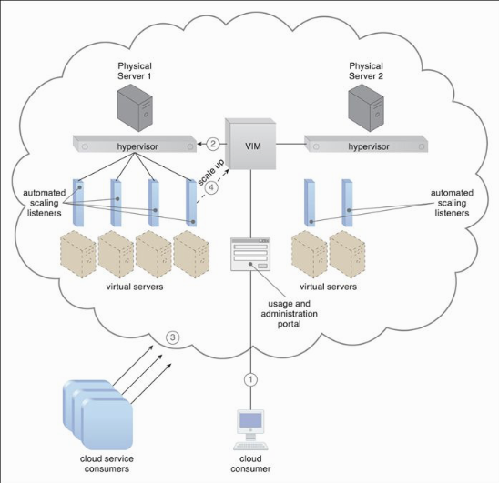
Case Study (DTGOV)
DTGOV’s physical servers vertically scale virtual server instances, starting with the smallest VM configuration
(1 virtual processor core, 4 GB of virtual RAM) to the largest (128 virtual processor cores, 512 GB of virtual RAM).
Scale-Down – VM resides in the same physical server while being scaled down.
Scale-Up – capacity is doubled. VIM may live migrate VM to other servers (a current one is overcommitted.)
Auto-scaling settings controlled by cloud consumers determine the runtime behavior of automated scaling listener agents.

Slide 6
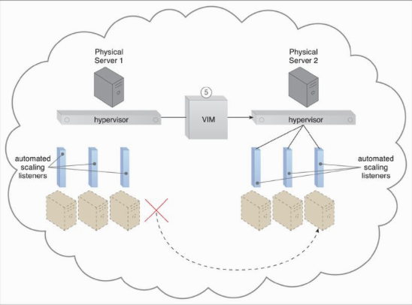
Physical server 1 is overcommitted. VIM live migrates scaled-up VM to the physical server 2.

Slide 7
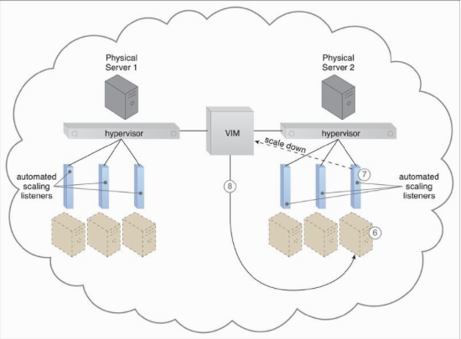
Usage remains 15% below the capacity, scaled-down.

Slide 8
Load Balancer
A common approach to horizontal scaling is to balance a workload across two or more IT resources to increase performance and capacity beyond what a single IT resource can provide.
The load balancer mechanism is a runtime agent with logic fundamentally based on this premise.

Slide 9
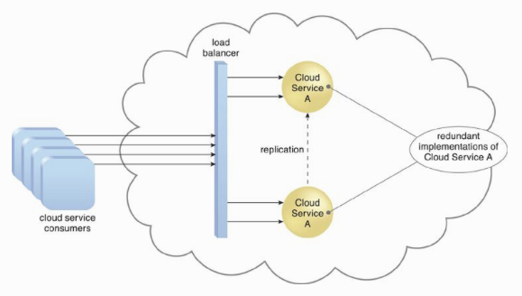
Load Balancer Functionalities
Asymmetric Distribution – larger workloads are issued to IT resources with higher processing capacities.
Workload Prioritization – workloads are scheduled, queued, discarded, and distributed workloads according to their priority levels.
Content-Aware Distribution – requests are distributed to different IT resources as dictated by the request content.

Slide 10
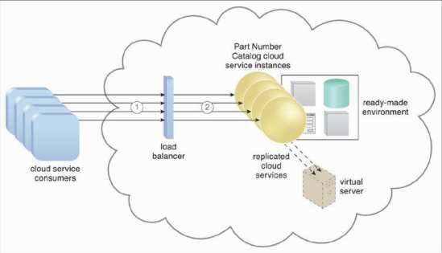
A load balancer is programmed or configured with a set of performance and QoS rules and parameters with the general objectives of optimizing IT resource usage, avoiding overloads, and maximizing throughput.
The load balancer mechanisms can exist as a:
multi-layer network switch
dedicated hardware appliance
dedicated software-based system (common in server operating systems)
service agent (usually controlled by cloud management software)

Slide 11
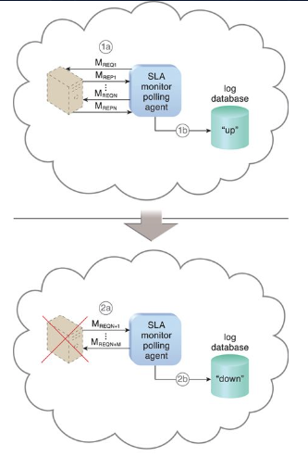
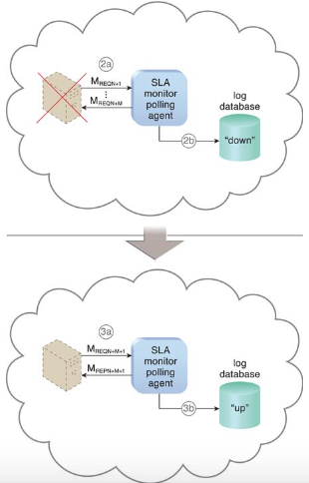
SLA Monitor
To specifically observe the runtime performance of cloud services to ensure that they are fulfilling the contractual QoS requirements that are published in SLAs.

Slide 12
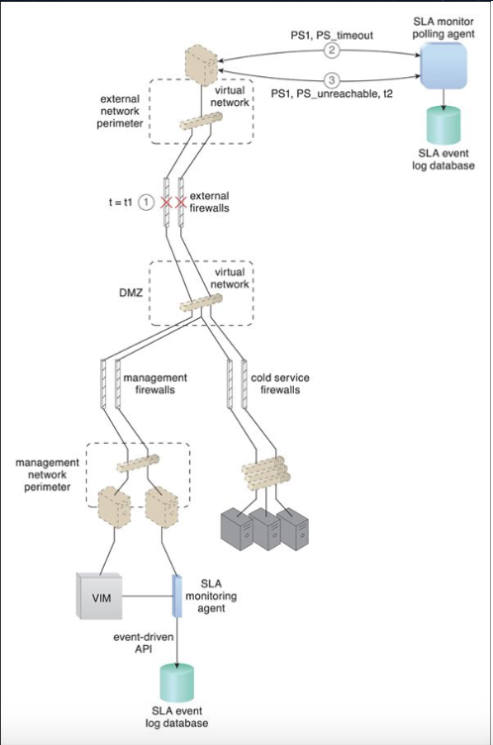
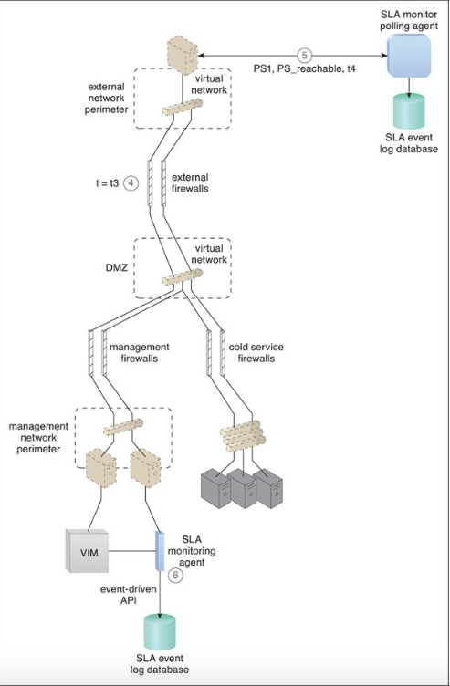

Slide 13
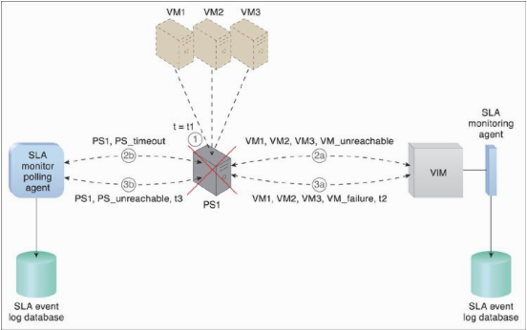
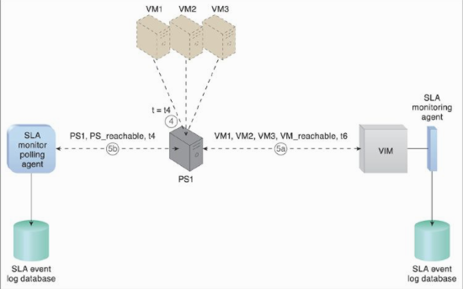

Slide 14
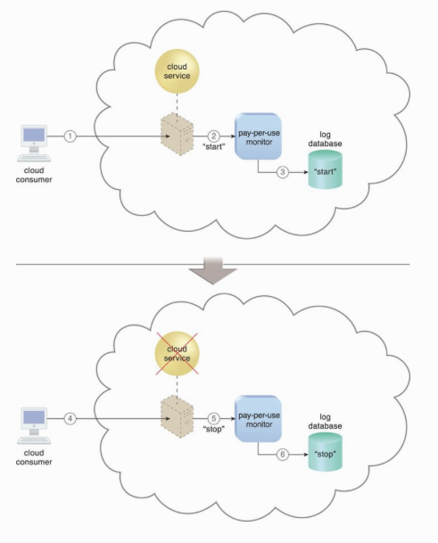
Pay-per-use Monitor
The pay-per-use monitor mechanism measures cloud-based IT resource usage in accordance with predefined pricing parameters and generates usage logs for fee calculations and billing purposes.
Some typical monitoring variables are:
request/response message quantity
transmitted data volume
bandwidth consumption
time duration

Slide 15
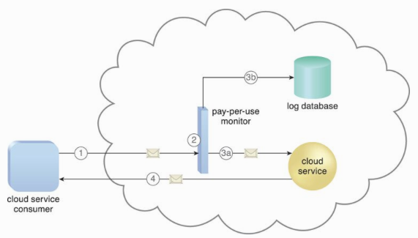
Monitor based on service request.

Slide 16
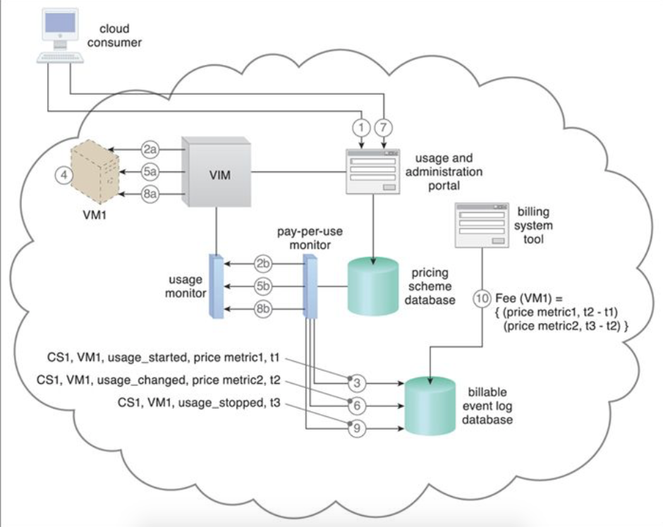

Slide 17
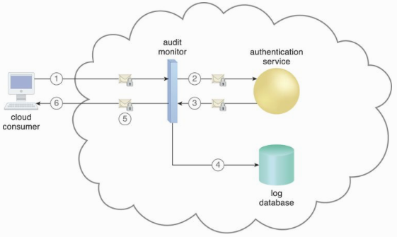
Audit Monitor
The audit monitor mechanism is used to collect audit tracking data for networks and IT resources in support of (or dictated by) regulatory and contractual obligations.
For example, data related to login (whether successful or failed logins, number of attempts, credentials, etc.)

Slide 18
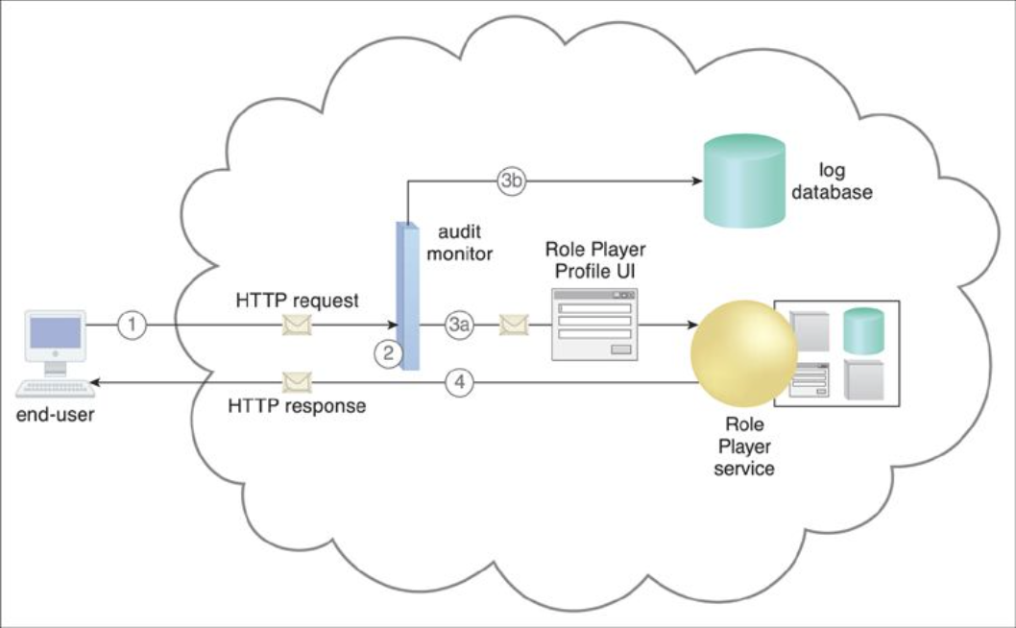

Slide 19
Failover System
A mechanism used to increase reliability and availability.
To establish a clustering technology providing de redundant implementations.
A failover system is configured to automatically switch over to a redundant or standby IT resource instance whenever the currently active IT resource becomes unavailable.

Slide 20
Failover System Configurations
Active-Active
Redundant implementations of the IT resource actively serve the workload synchronously. Load balancing among active instances is required
Active-Passive
A standby or inactive implementation is activated to take over the processing from the IT resource that becomes unavailable, and the corresponding workload is redirected to the instance taking over the operation.

Slide 21
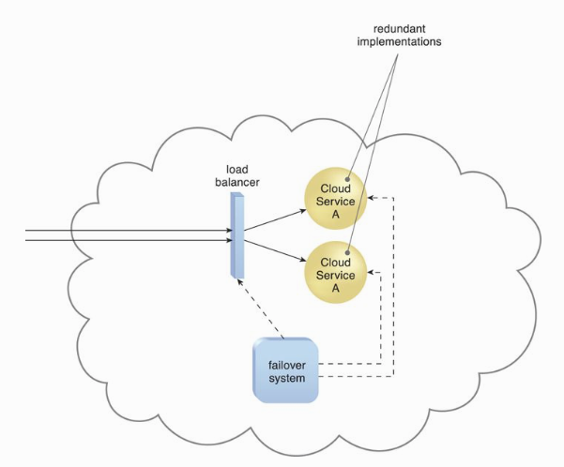
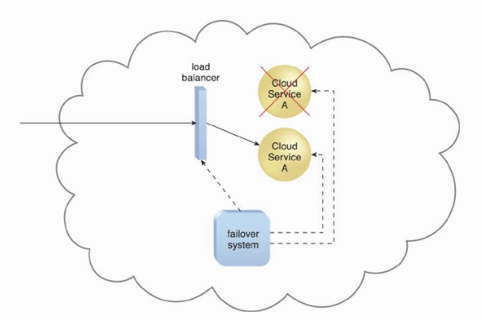
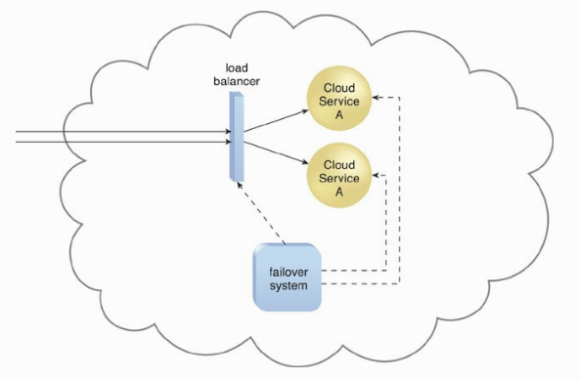

Slide 22
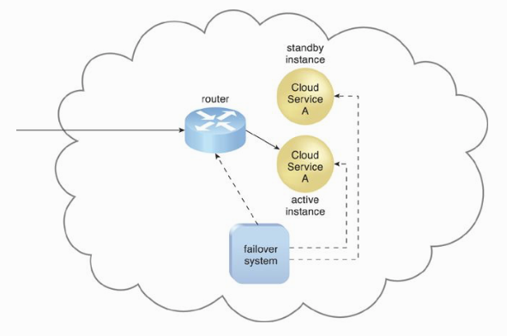
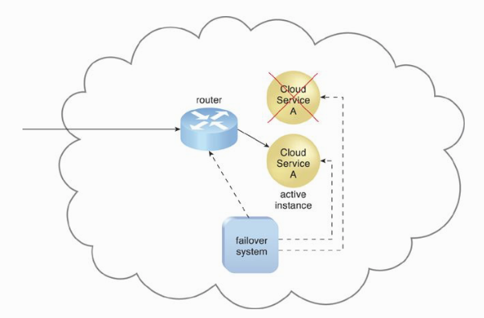

Slide 23
Case Study (DTGOV)
DTGOV creates a resilient virtual server to support the allocation of virtual server instances that are hosting critical applications
which are being replicated in multiple data centers.
The replicated resilient virtual server has an associated active-passive failover system.
Its network traffic flow can be switched between the IT resource instances that are residing at different data centers, if the active instance were to fail.

Slide 24
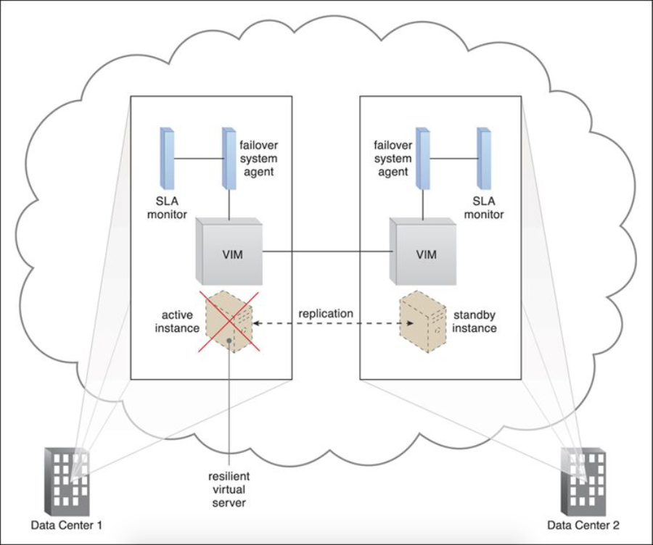
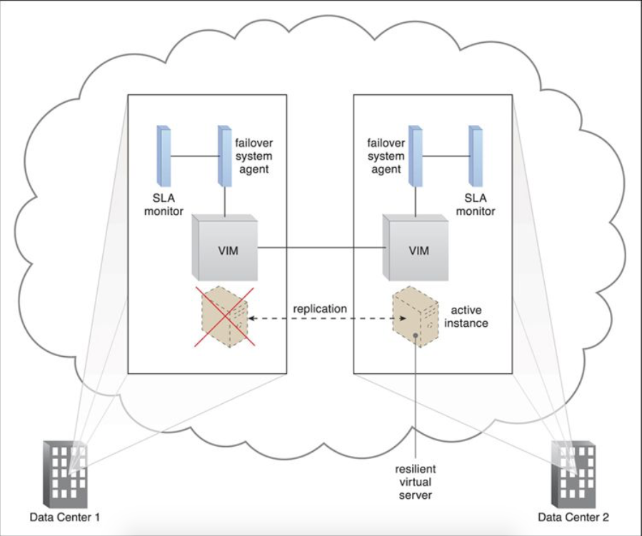
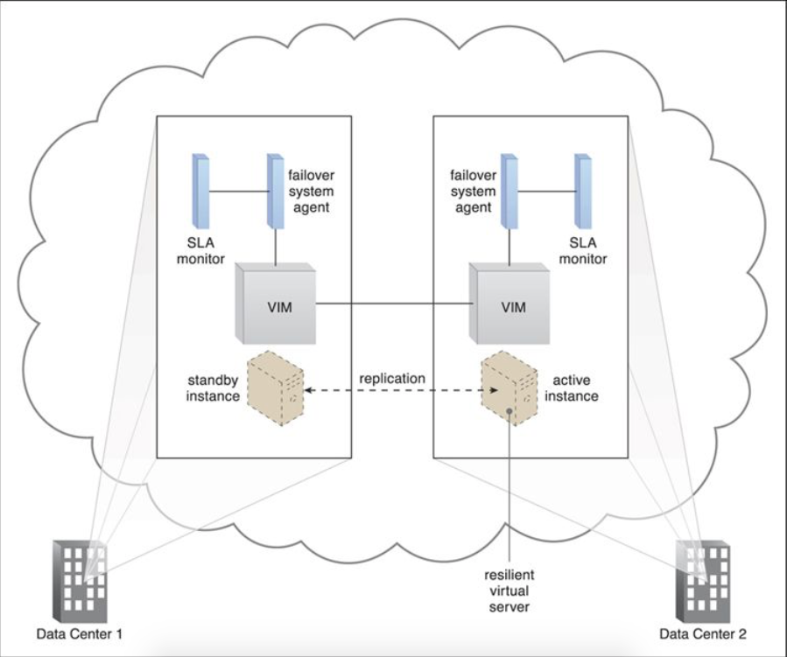
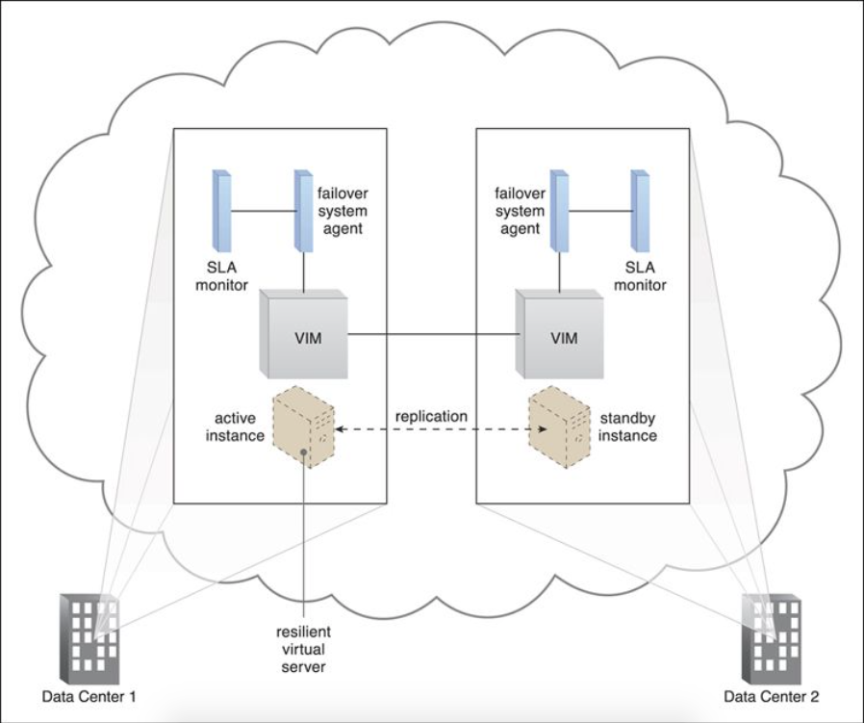

Slide 25
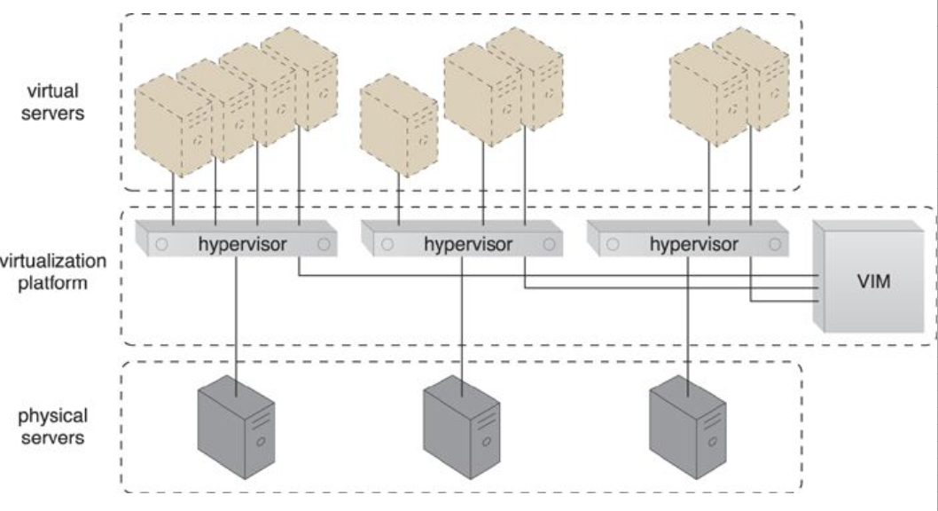
Hypervisor
A fundamental part of virtualization infrastructure that is primarily used to generate virtual server instances of a physical server.
A hypervisor is generally limited to one physical server and can therefore only create virtual images of that server.
A hypervisor has limited virtual server management features, such as increasing the virtual server’s capacity or shutting it down.
The VIM provides a range of features for administering multiple hypervisors across physical servers.

Slide 26
Hypervisor (2)
Hypervisor software can be installed directly in bare-metal servers and provides features for
controlling,
sharing and
scheduling the usage of hardware resources.

Slide 27
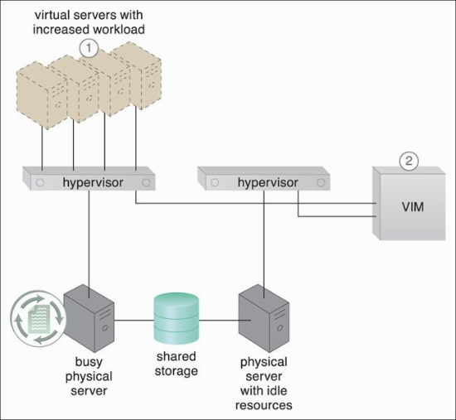
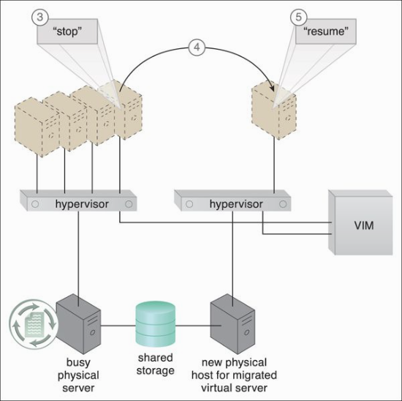
Case Study (DTGOV)
DTGOV has established a virtualization platform in which the same hypervisor software product is running on all physical servers.
The VIM coordinates the hardware resources in each data center so that virtual server instances can be created from the most expedient underlying physical server.
As a result, cloud consumers are able to lease virtual servers with auto-scaling features.
In order to offer flexible configurations, the DTGOV virtualization platform provides live VM migration of virtual servers among physical servers inside the same data center.

Slide 28
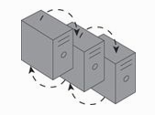
Resource Cluster
Cloud-based IT resources that are geographically diverse can be logically combined into groups to improve their allocation and use.
The resource cluster mechanism is used to group multiple IT resource instances so that they can be operated as a single IT resource.
This increases the combined computing capacity, load balancing, and availability of the clustered IT resources.

Slide 29
Resource Cluster (2)
Resource cluster architectures rely on high-speed dedicated network connections, or cluster nodes, between IT resource instances to communicate about
workload distribution,
task scheduling,
data sharing, and
system synchronization.
A cluster management platform that is running as distributed middleware in all of the cluster nodes is usually responsible for these activities.

Slide 30
Common Resource Cluster Types
Server Cluster – physical and virtual servers clustered to increase performance. Servers are able to live migrate from one to another.
Database Cluster – designed to improve data availability.
Large Dataset Cluster - data partitioning and distribution is implemented so that the target datasets can be efficiently partitioned without compromising data integrity or computing accuracy.

Slide 31
Load balancing and resource replication are implemented through a cluster-enabled hypervisor

Slide 32
Loosely-coupled server cluster

Slide 33
Two Basic Types of Resource Cluster
Load Balanced Cluster – This resource cluster specializes in distributing workloads among cluster nodes to increase IT resource capacity while preserving the centralization of IT resource management.
HA Cluster – A high-availability cluster maintains system availability in the event of multiple node failures, and has redundant implementations of most or all of the clustered IT resources. It implements a failover system mechanism that monitors failure conditions and automatically redirects the workload away from any failed nodes.

Slide 34
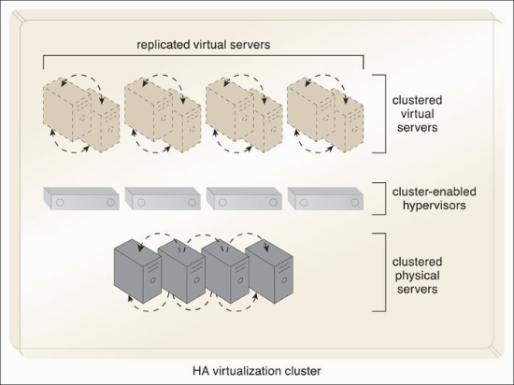
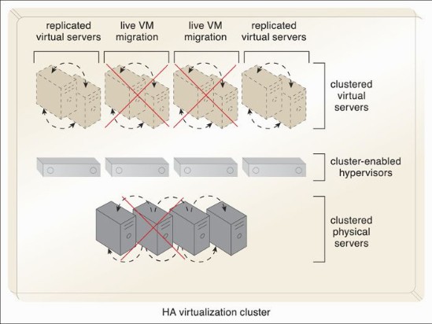
Case Study (DTGOV)

Slide 35
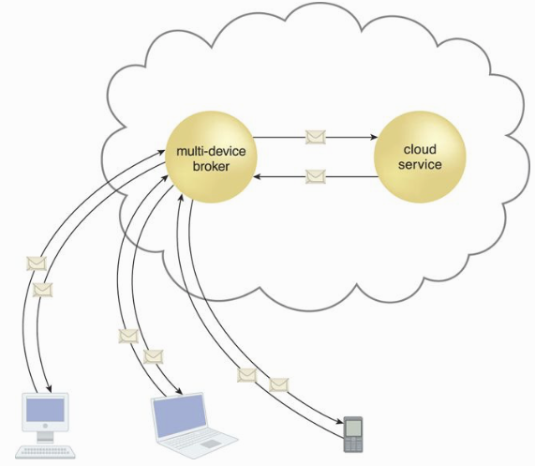
Multi-device Broker
The multi-device broker mechanism is used to facilitate runtime data transformation so as to make a cloud service accessible to a wider range of cloud service consumer programs and devices.

Slide 36
Multi-device brokers commonly exist as gateways or incorporate gateway components, such as:
XML Gateway – transmits and validates XML data
Cloud Storage Gateway – transforms cloud storage protocols and encodes storage devices to facilitate data transfer and storage
Mobile Device Gateway – transforms the communication protocols used by mobile devices into protocols that are compatible with a cloud service
The levels at which transformation logic can be created include:
transport protocols
messaging protocols
storage device protocols
data schemas/data models

Slide 37
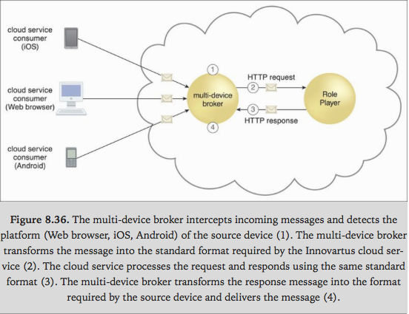

Slide 38
State Management Database
A state management database is a storage device that is used to temporarily persist state data for software programs.
As an alternative to caching state data in memory, software programs can off-load state data to the database in order to reduce the amount of runtime memory they consume
By doing so, the software programs and the surrounding infrastructure are more scalable.
State management databases are commonly used by cloud services, especially those involved in long-running runtime activities.

Slide 39
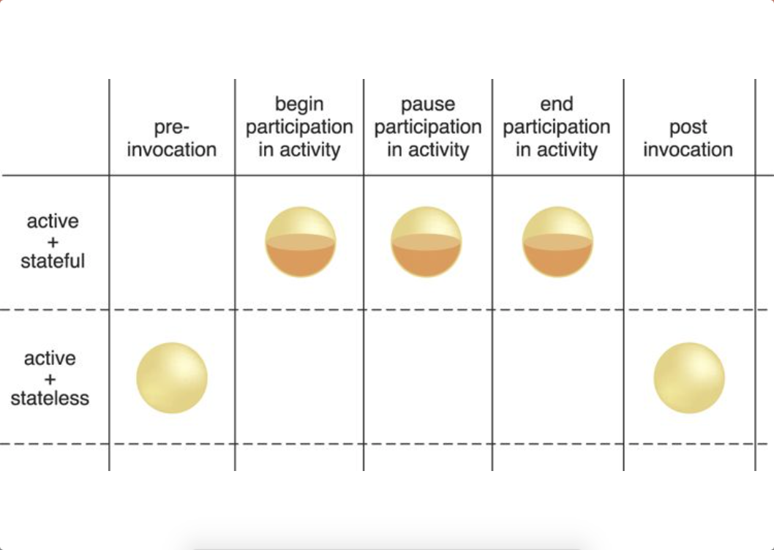
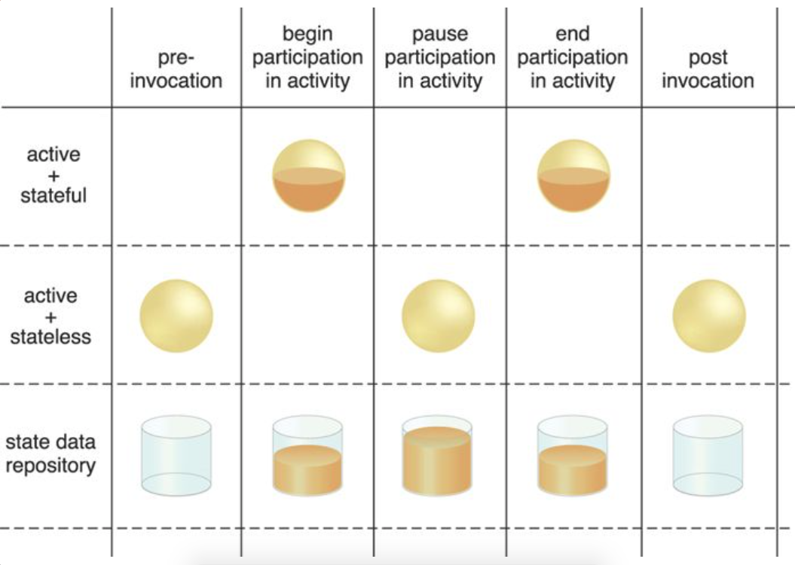

Slide 40
