Slide 1
Cloud Management Mechanisms

Slide 2
Topics
Remote Administration Mechanism
Resource Management Mechanism
SLA Management System
Billing Management System

Slide 3
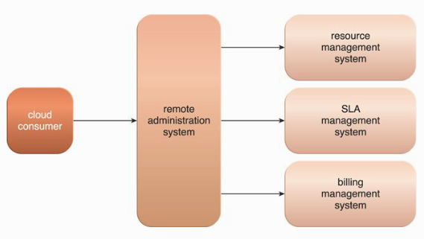
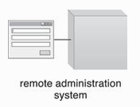
Remote Administration Mechanism
This mechanism provides tools and user-interfaces for external cloud resource administrators to configure and administer cloud-based IT resources.
It establishes a portal for access to administration and management features of various underlying systems, including the resource management, SLA management, and billing management systems.

Slide 4
Remote Administration Mechanism
Tools and APIs provided by Remote Administration Mechanism are typically used by a cloud provider to develop and customize online portal.
Two types:
Usage and Administration Portal
Self-service Portal

Slide 5
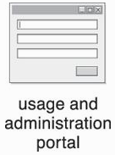
Usage and Administrative Portal
A general purpose portal that centralizes management controls to different cloud-based IT resources and can further provide IT resource usage reports.

Slide 6
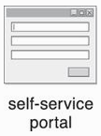
Self-service Portal
A portal that allows cloud consumers to search an up-to-date list of cloud services and IT resources that are available from a cloud provider (usually for lease). The cloud consumer submits its chosen items to the cloud provider for provisioning.

Slide 8
Things Cloud Consumers Can Do
Configuring and setting up cloud services
Provisioning and releasing IT resource for on-demand cloud services
Monitoring cloud service status, usage, and performance
Monitoring QoS and SLA fulfillment
Managing leasing costs and usage fees
Managing user accounts, security credentials, authorization, and access control
Tracking internal and external access to leased services
Planning and assessing IT resource provisioning
Capacity planning.

Slide 9
- Standardized API is preferred. - Easy to migrate - Easy to manage IT resources on multiple clouds

Slide 10
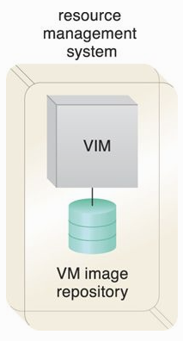
Resource Management System
This mechanism helps coordinate IT resources in response to management actions performed by both cloud consumers and cloud providers.
Core to this system is the virtual infrastructure manager (VIM) that coordinates the server hardware so that virtual server instances can be created from the most expedient underlying physical server.
VIM can create and manage multiple instances of a hypervisor across different physical servers or allocate a virtual server on one physical server to another (or to a resource pool).

Slide 11
Tasks Done Thru Resource Management System
Managing virtual IT resource templates that are used to create pre-built instances, such as virtual server images.
Allocating and releasing virtual IT resources into the available physical infrastructure in response to the starting, pausing, resuming, and termination of virtual IT resources instances.

Slide 12
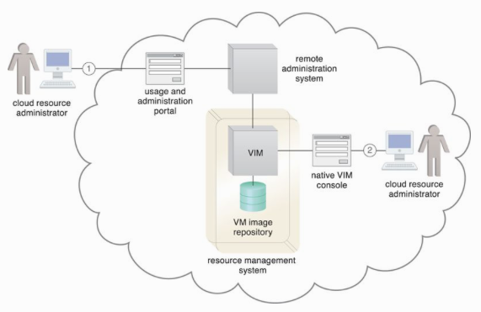
Tasks Done Thru Resource Management System
Coordinating IT resources in relation to the involvement of other mechanisms, such as resource replication, load balancer, and failover system.
Enforcing usage and security policies throughout the lifecycle of cloud service instances
Monitoring operational conditions of IT resources.

Slide 13
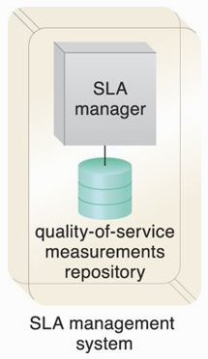
SLA Management System
This mechanism represents a range of commercially available cloud management products that provide features pertaining to the administration, collection, storage, reporting, and runtime notification of SLA data.
An SLA management system deployment will generally include a repository used to store and retrieve collected SLA data based on pre-defined metrics and reporting parameters.

Slide 14
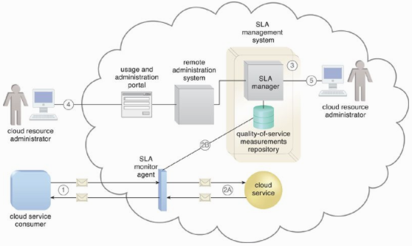

Slide 15
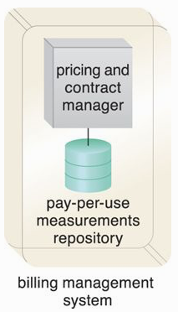
Billing Management System
This system is dedicated to the collection and processing of usage data as it pertains to cloud provider accounting and cloud consumer billing.
Specifically, the billing management system relies on pay-per-use monitors to gather runtime usage data that is stored in a repository that the system components then draw from for
billing,
reporting, and
invoicing purposes.

Slide 16
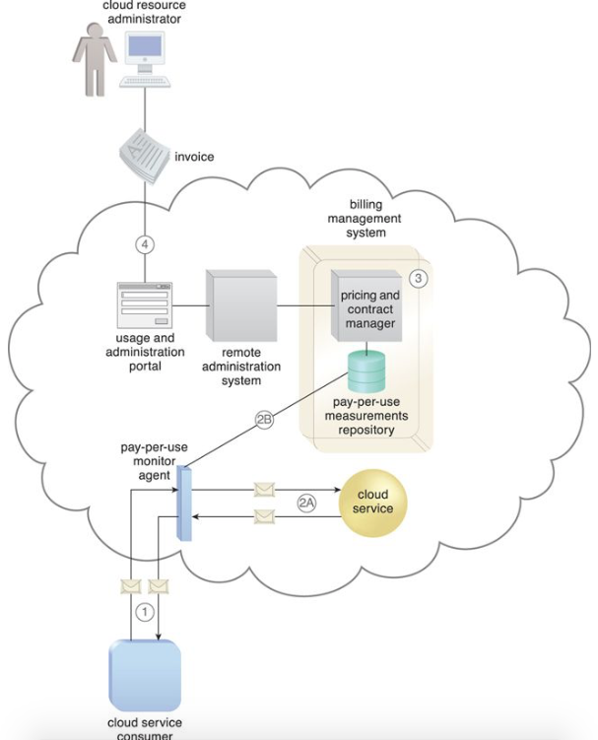

Slide 17
Thank you

