Slide 1
Cloud Computing Architecture
Fundamental Cloud Architectures

Slide 2
Fundamental Cloud Architectures
Workload Distribution Architecture
Resource Pooling Architecture
Dynamic Scalability Architecture
Elastic Resource Capacity Architecture
Service Load Balancing Architecture
Cloud Bursting Architecture
Elastic Disk Provisioning Architecture
Redundant Storage Architecture

Slide 3
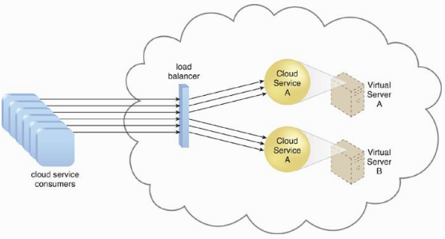
Workload Distribution Architecture
IT resources can be horizontally scaled, adding of one or more identical IT resources and a load balancer that provides runtime logic capable of evenly distributing the workload among the available IT resources.
Additional mechanisms:
Audit monitor
Cloud usage monitor
Hypervisor
Logical network perimeter
Resource cluster
Resource replication

Slide 4
Resource Pooling Architecture
The use of one or more resource pools, in which identical IT resources are grouped, maintained and synchronized.
Common examples of resource pools:
Physical server pools
Virtual server pools
Storage pools
Network pools – a pool of virtual firewalls devices, physical network switches.
CPU pools
Memory pools
Last but not least, swimming pools

Slide 5
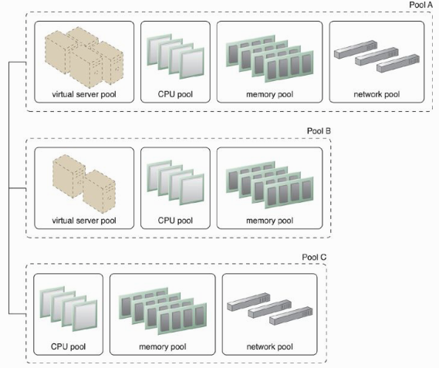
Complex resource pools – Hierarchical structure

Slide 6
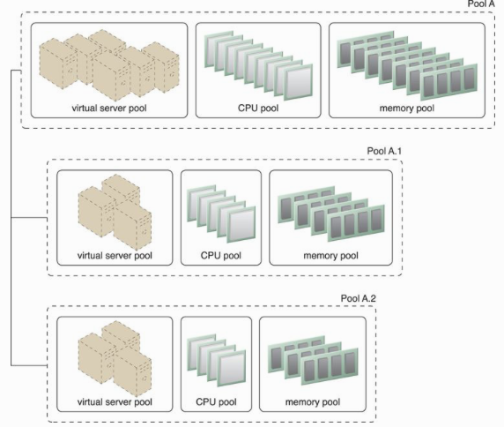
Nested pool – groups of same type of IT resources.
Typically assigned to different departments or groups in the same cloud consumer organization.

Slide 7
Resource Pooling Architecture
Additional mechanisms to this architecture:
Audit monitor
Cloud usage monitor
Hypervisor
Logical network perimeter
Pay-per-use monitor
Remote administration system
Remote management system
Resource replication

Slide 8
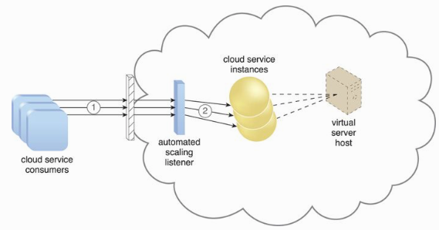
Dynamic Scalability Architecture
An architectural model based on a system of predefined scaling conditions that trigger the dynamic allocation of IT resources from resource pools.

Slide 9
Dynamic Scaling Mechanisms
Dynamic Horizontal Scaling – IT resource instances are scaled out and in to handle fluctuating workloads.
Dynamic Vertical Scaling – IT resource instances are scaled up and down when there is a need to adjust the processing capacity of a single IT resource. For example, a virtual server that is being overloaded can have its memory dynamically increased or it may have a processing core added.
Dynamic Relocation – The IT resource is relocated to a host with more capacity. For example, a database may need to be moved from a tape-based SAN storage device with 4 GB per second I/O capacity to another disk-based SAN storage device with 8 GB per second I/O capacity.

Slide 10
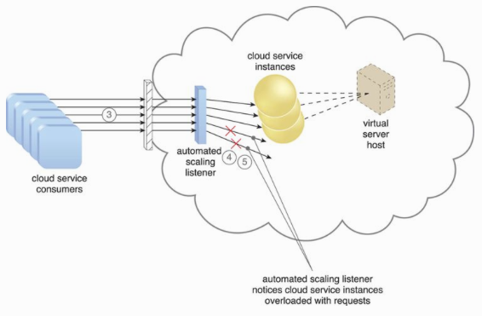

Slide 11
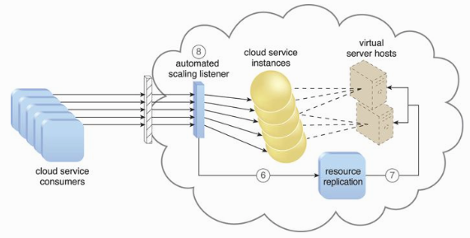
Additional mechanisms to this architecture:
Cloud usage monitor
Pay-per-use monitor
Resource replication
Hypervisor

Slide 12
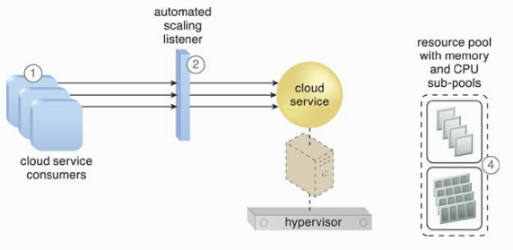
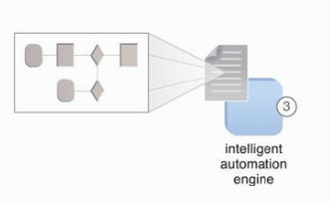
Elastic Resource Capacity Architecture
The dynamic provisioning of virtual servers, using a system that allocates and reclaims CPUs and RAM in immediate response to the fluctuating processing requirements of hosted IT resources.

Slide 13
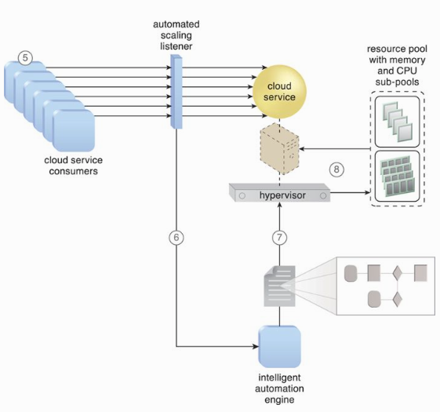
Additional mechanisms to this architecture:
Cloud usage monitor
Pay-per-use monitor
Resource replication
Hypervisor

Slide 14
Service Load Balancing Architecture
A specialized variation of the workload distribution architecture that is geared specifically for scaling cloud service implementations. Redundant deployments of cloud services are created, with a load balancing system added to dynamically distribute workloads.
The load balancer can be either independent of the cloud services or built-in part of the application or server’s environment.

Slide 15
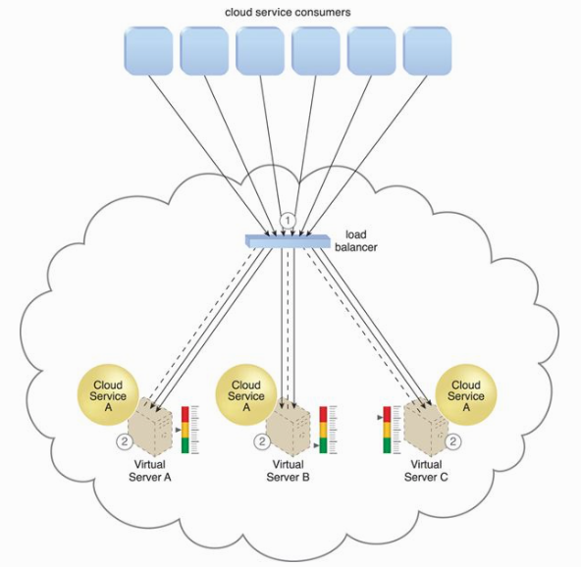

Slide 16
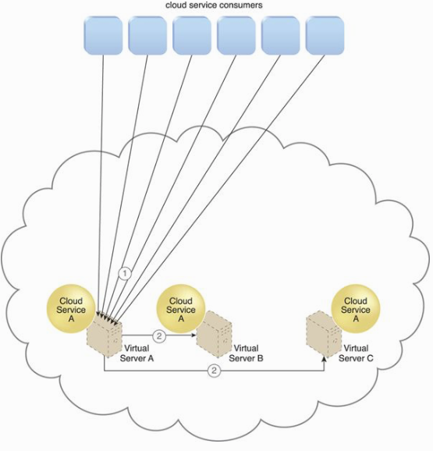

Slide 17
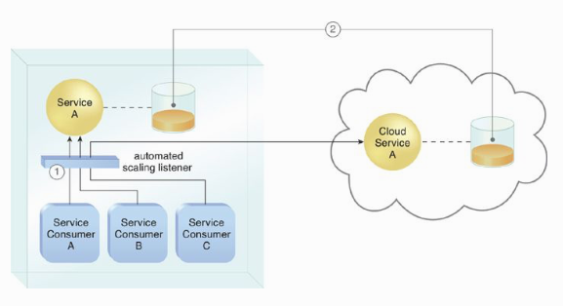
Cloud Bursting Architecture
A form of dynamic scaling that scales or “bursts out” on-premise IT resources into a cloud whenever predefined capacity thresholds have been reached.
The option of using cloud-based IT resources only to meet higher usage demands.
The automated scaling listener determines when to redirect requests to cloud-based IT resources, and resource replication is used to maintain synchronicity between on-premise and cloud-based IT resources.

Slide 18
Elastic Disk Provisioning Architecture
Cloud consumers are commonly charged for cloud-based storage space based on fixed-disk storage allocation, meaning the charges are predetermined by disk capacity and not aligned with actual data storage consumption.
Thin-provisioning – consumers charged based on real usage.

Slide 19
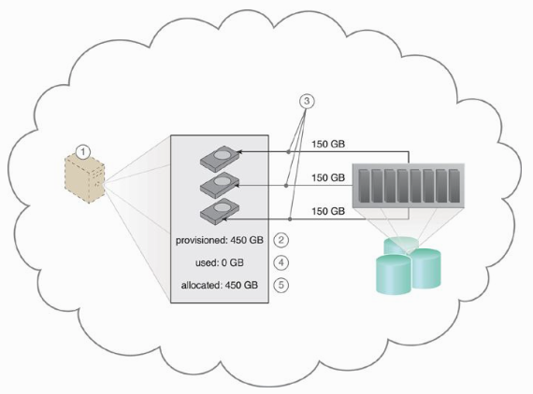

Slide 20
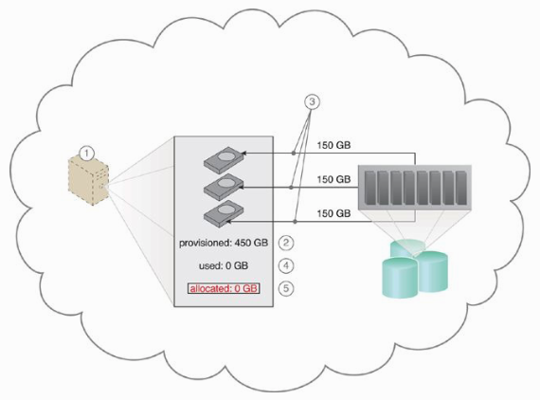

Slide 21
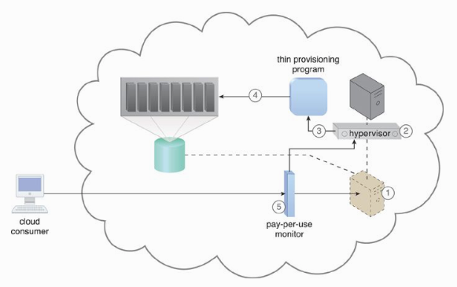

Slide 22
Redundant Storage Architecture
Failure storages can cause a severe impact to cloud services, cloud consumers’ satisfaction, cloud providers’ financial and reputation, etc.
The redundant storage architecture introduces a secondary duplicate cloud storage device as part of a failover system that synchronizes its data with the data in the primary cloud storage device.

Slide 23
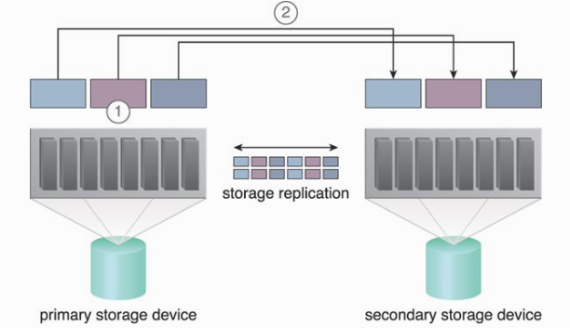

Slide 24
Case Study

Slide 25
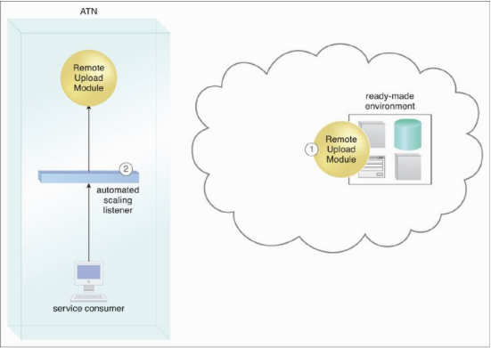

Slide 26
