Slide 1
Cloud Computing Architectures
Advanced Cloud Architectures

Slide 2
Advanced Cloud Architectures
Hypervisor Clustering Architecture
Load Balanced Virtual Server Instances Architecture
Non-Disruptive Service Relocation Architecture
Zero Downtime Architecture
Cloud Balancing Architecture
Resource Reservation Architecture
Dynamic Failure Detection and Recovery Architecture
Bare-Metal Provisioning Architecture
Rapid Provisioning Architecture
Storage Workload Management Architecture

Slide 3
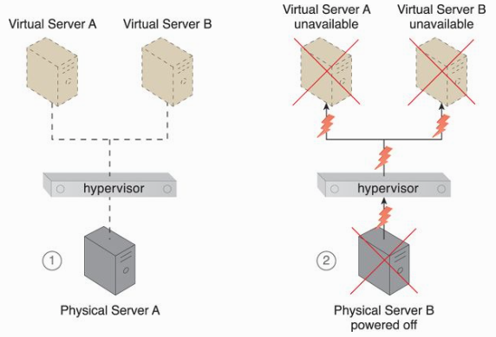
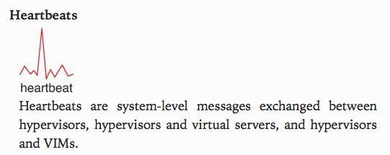
Hypervisor Clustering Architecture
Recall that hypervisors are responsible for creating and hosting multiple VMs. Any failure conditions can impact VMs.

Slide 4
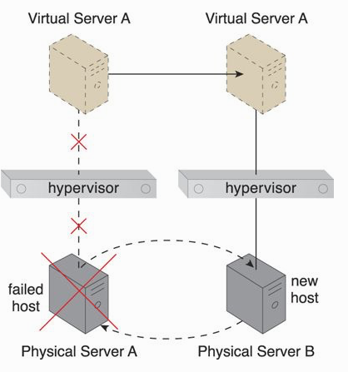
Hypervisor Clustering Architecture (2)
A high-availability cluster of hypervisors across multiple physical servers.
Live Migration

Slide 5
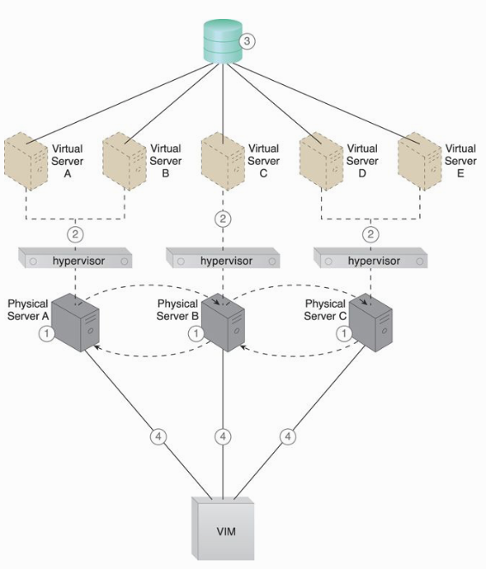

Slide 6
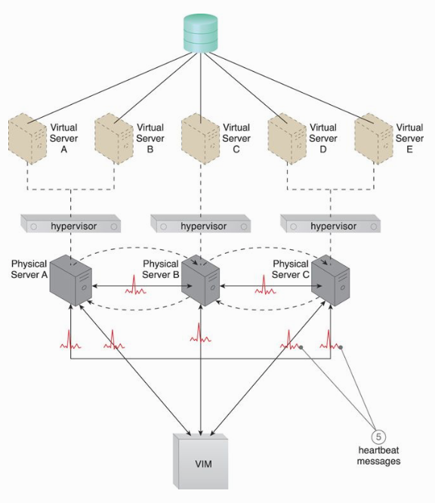

Slide 7
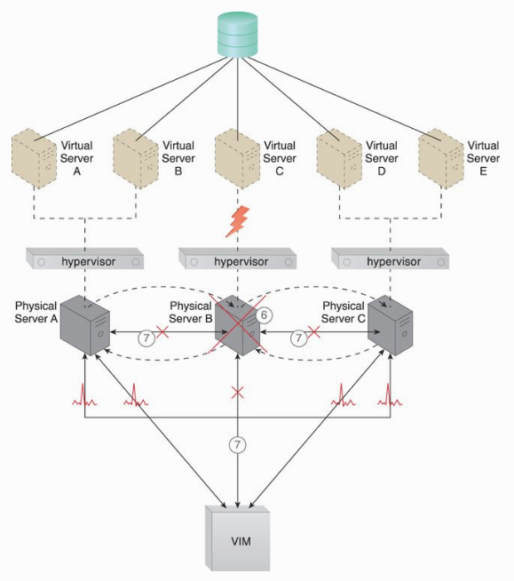

Slide 8
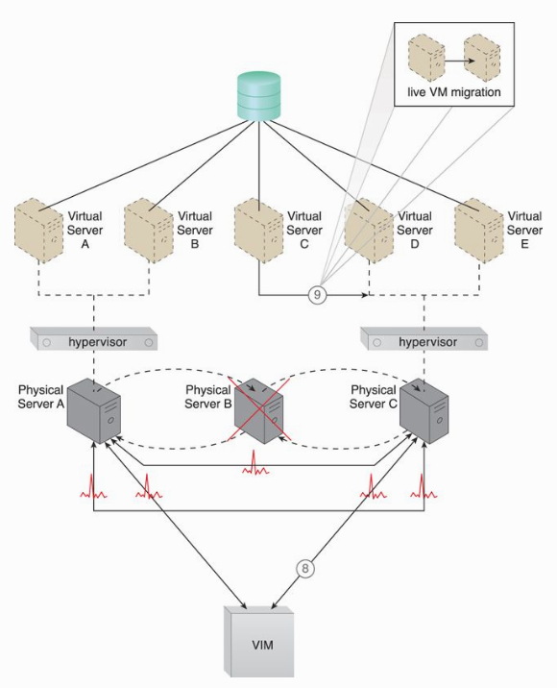

Slide 9
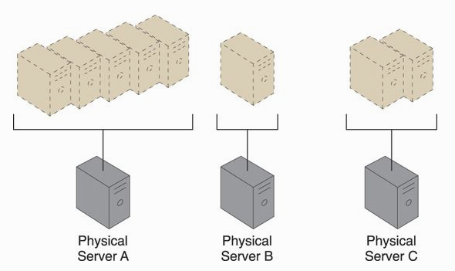
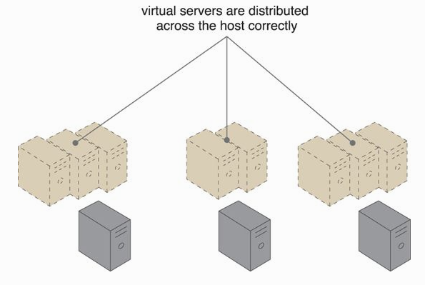
Load Balanced Virtual Server Instances Architecture
Uneven virtual server instances on physical servers become challenging as this easily causes under-utilized and/or over-utilized servers conditions.

Slide 10
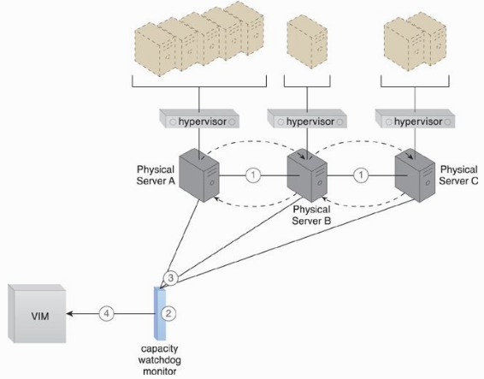

Slide 11
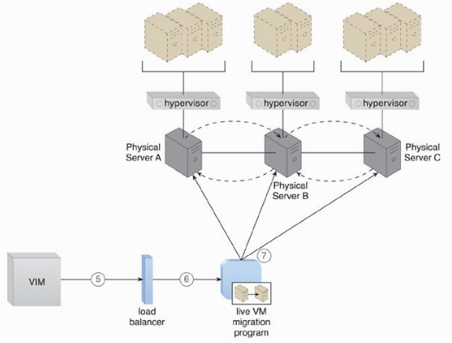

Slide 12
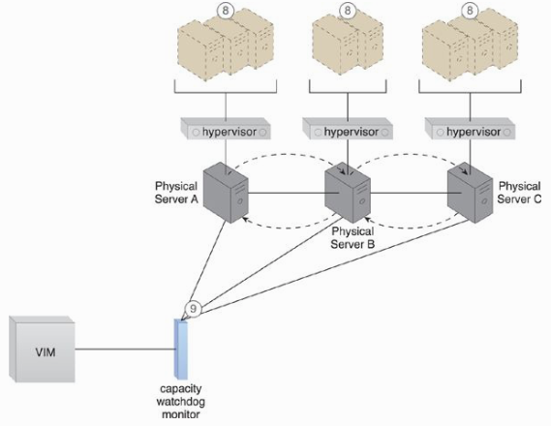

Slide 13
Load Balanced Virtual Server Instances Architecture (2)
Additional mechanisms to this architecture
Automated scaling listener
Load balancer
Logical network perimeter
Resource replication

Slide 14
Non-Disruptive Service Location Architecture
Reasons lead to unavailable services in the cloud computing:
Runtime usage demands exceed its processing capacity.
Maintenance update (a temporary outage).
Permanent migration to a new physical server host.
This architecture establishes a system by which a predefined event triggers the duplication or migration of a cloud service implementation at runtime, thereby avoiding any disruption.
Key aspect – new cloud service is able to handle requests before the original cloud service is deactivated/removed.
Common approach – live VM migration.

Slide 15
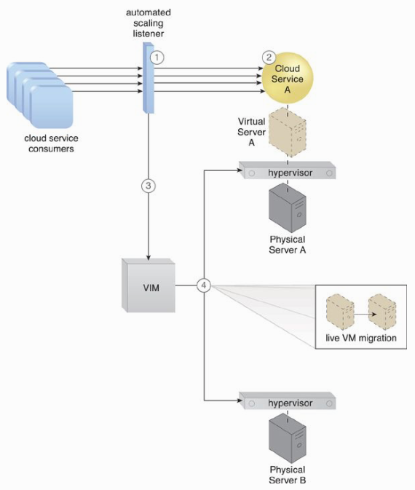

Slide 16
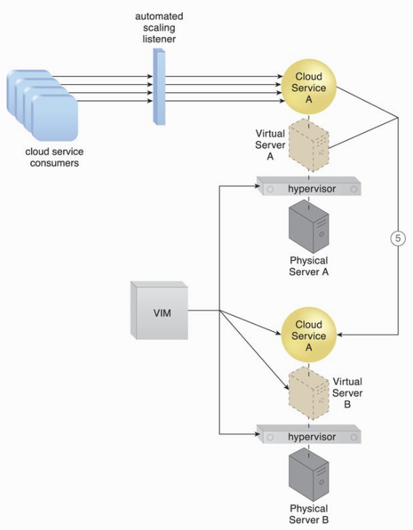

Slide 17
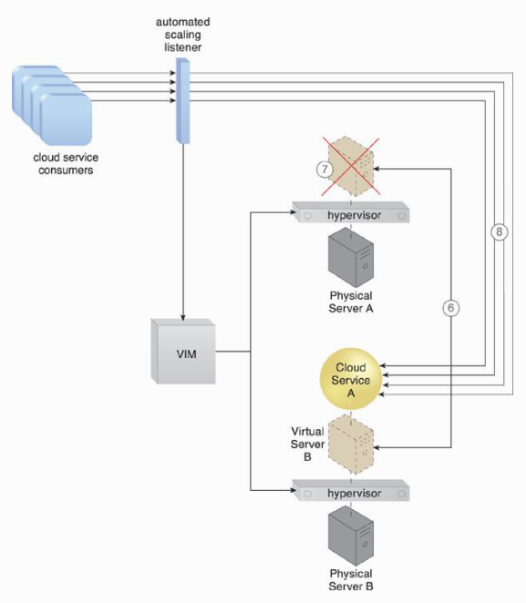

Slide 18
Two ways of Virtual Server Migration
A copy of the virtual server disks is created on the destination host, if the virtual server disks are stored on a local storage device or non-shared remote storage devices attached to the source host.
Copying the virtual server disks is unnecessary if the virtual server’s files are stored on a remote storage device that is shared between origin and destination hosts.

Slide 19
Non-Disruptive Service Location Architecture
Additional mechanisms:
Cloud usage monitor
Pay-per-use monitor
Resource replication
SLA management system
SLA monitor

Slide 20
Zero Downtime Architecture
A physical server naturally acts as a single point of failure (that is why we have a clustering technology).
Failure or compromised servers affect cloud service availability. The issuance of zero downtime is quite challenging.
This architecture establishes a sophisticated failover system that allows virtual servers to be dynamically moved to different physical server hosts, in the event that their original physical server host fails.

Slide 21
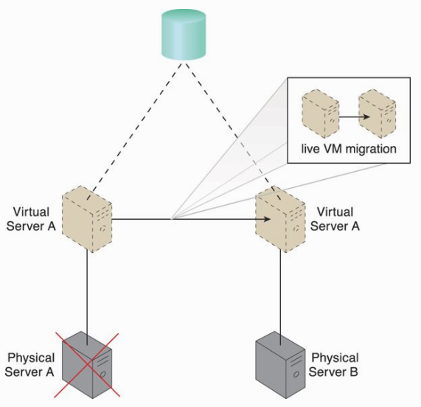

Slide 22
Zero Downtime Architecture (2)
Additional Mechanisms:
Audit monitor – check if a host is relocated to a prohibited location.
Cloud usage monitor
Hypervisor
Logical network perimeter
Resource cluster
Resource replication

Slide 23
Cloud Balancing Architecture
This established a specialized load-balancing model in which IT resources can be load-balanced cross multiple clouds.
Improve the performance and scalability of IT resources.
Increase the availability and reliability of IT resources.
Improve load-balancing and IT resource optimization.
Cloud balancing – based on the combination of the automated scaling listener and failover system mechanisms.

Slide 24
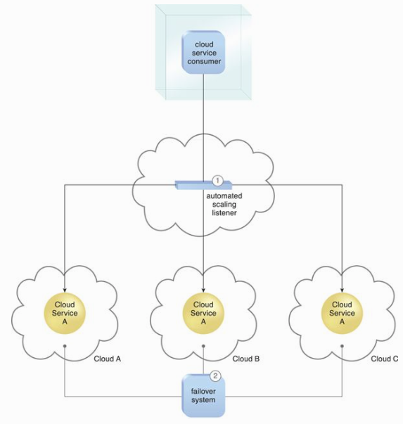

Slide 25
Resource Reservation Architecture
Depending on the cloud design (shared usage and available levels of capacity), resource constraint issue may exist.
Two or more consumers may be allocated with insufficient IT resources, as a result, one or more cloud consumers experience degraded performance.
Resource borrowing (nested and sibling resource pools) does not return the borrowed IT resources due to prolonged usage. One who owns primary pool experiences degraded performance.

Slide 26
Resource Reservation Architecture (2)
Depending on the cloud design (shared usage and available levels of capacity), resource constraint issue may exist.
Two or more consumers may be allocated with insufficient IT resources, as a result, one or more cloud consumers experience degraded performance.
Resource borrowing (nested and sibling resource pools) does not return the borrowed IT resources due to prolonged usage. One who owns parent pool experiences degraded performance.

Slide 27
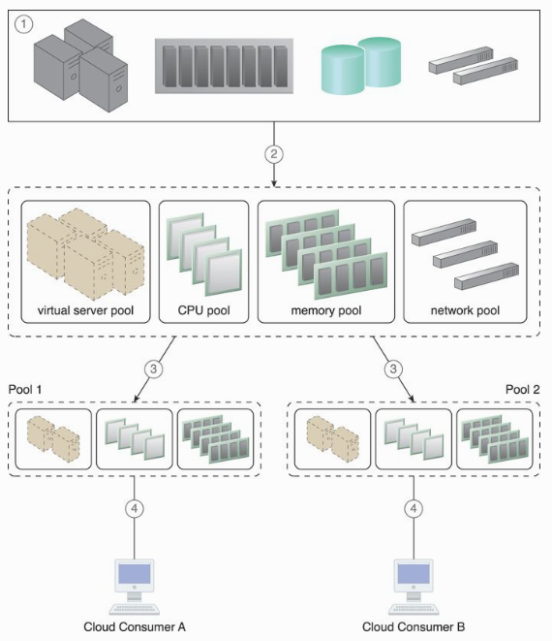

Slide 28
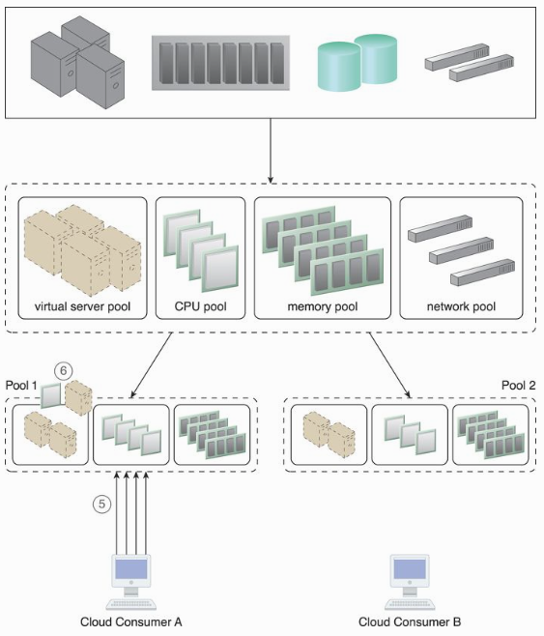

Slide 29
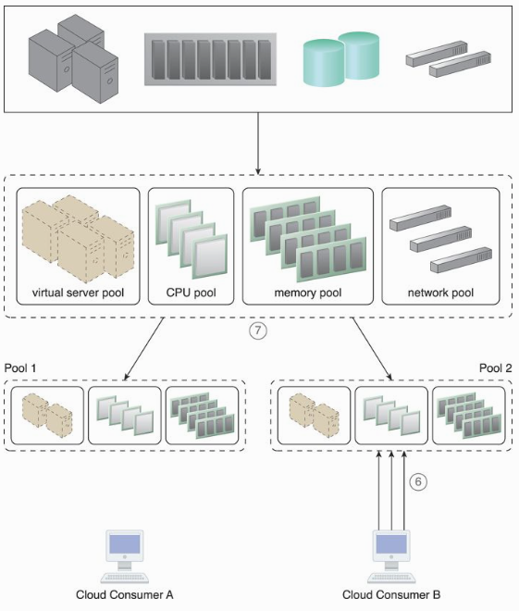

Slide 30
Dynamic Failure Detection and Recovery Architecture
This architecture establishes a resilient watchdog system to monitor and respond to a wide range of pre-defined failure scenarios.
It notifies and escalates the failure conditions that it cannot automatically resolve itself.
Specialized agent called the Intelligent Watchdog Monitor.

Slide 31
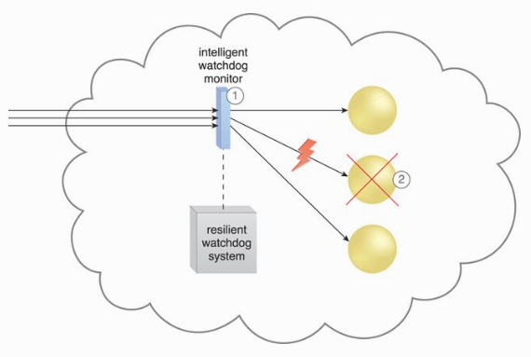

Slide 32
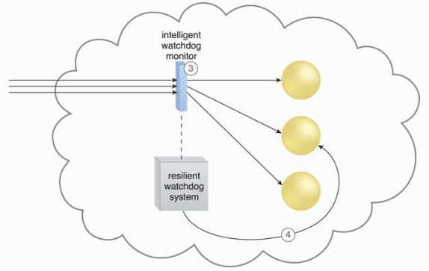

Slide 33
Resilient Watchdog Functionalities
Watching
Deciding upon an event
Acting upon an event
Reporting
Escalating

Slide 34
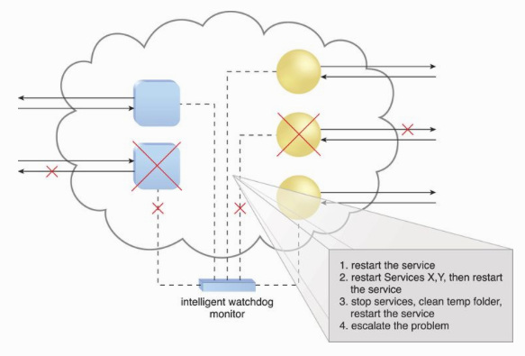

Slide 35
Actions taken by the Watchdog
Running a batch file
Sending a console message
Send a text message
Send an email message
Sending an SNMP trap
Logging a ticket

Slide 36
Dynamic Failure Detection and Recovery Architecture
Additional Mechanisms:
Audit monitor – to track whether data recovery is carried out in compliance with legal or policy requirements.
Failover system
SLA management system
SLA monitor

Slide 37
Bare-Metal Provisioning Architecture
Remote provisioning on bare-metal servers is unavailable due to uninstalled OS.
This architecture establishes a system that utilizes this feature with specialized service agents, which are used to discover and effectively provision entire operating systems remotely.
Installation of remote management support in the servers’ ROM.

Slide 38
Bare-Metal Provisioning Architecture (2)
Remote management software (in ROM) enables connections to physical server consoles but
Manual deployments on multiple servers – vulnerable to human and config. errors.
Time-intensive and significant runtime IT resource processing.

Slide 39
Bare-Metal Provisioning System
Discovery Agent
Deployment Agent
Discovery Section
Management Loader
Deployment component

Slide 40
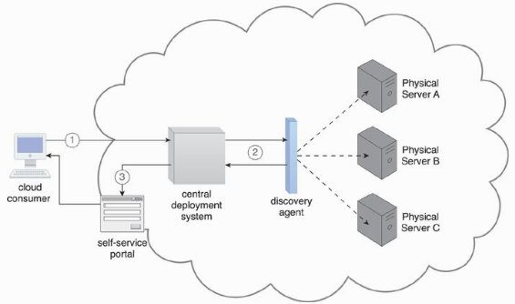

Slide 41
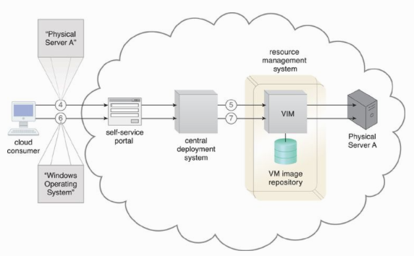

Slide 42
Storage Workload Management Architecture
Over-utilized cloud storage devices increase the workload on the storage controller, hence causing a range of performance challenges.
Under-utilized cloud storage devices are wasteful.

Slide 43
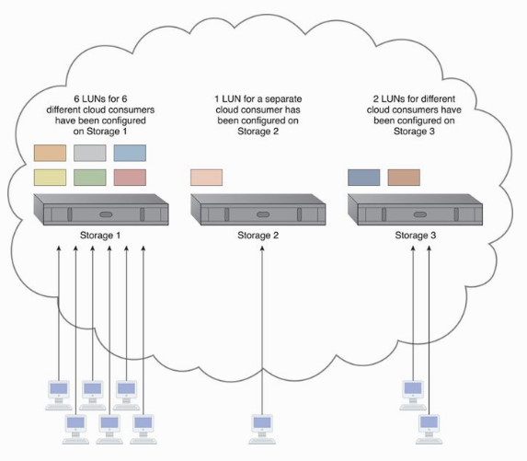

Slide 44
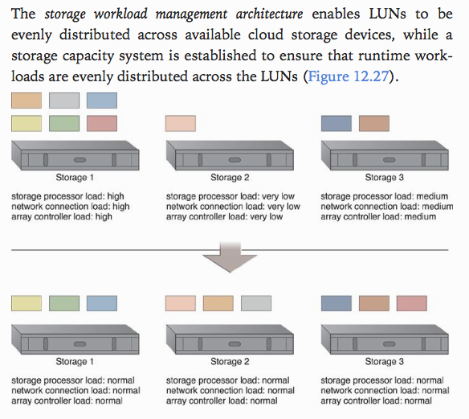

Slide 45
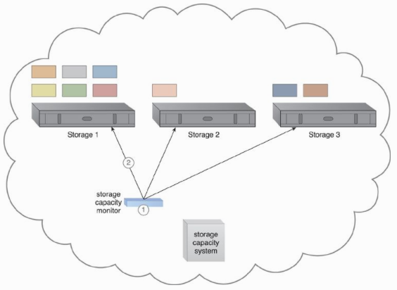

Slide 46
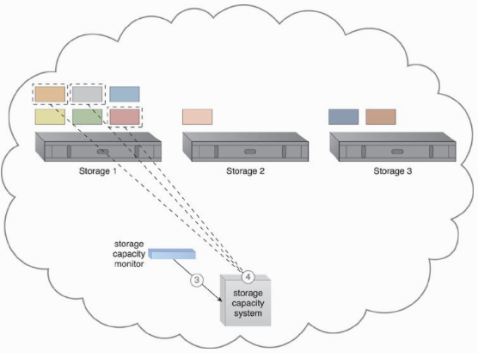

Slide 47
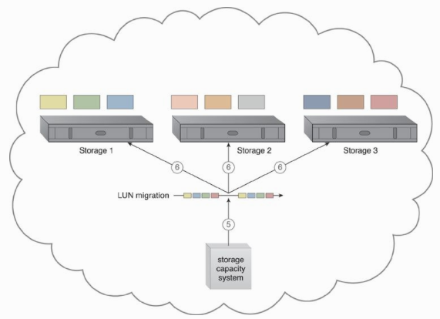

Slide 48
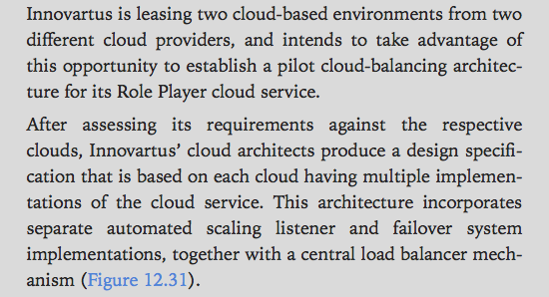

Slide 49
