Slide 1
Specialized Cloud Architectures

Slide 2
Specialized Cloud Architectures
Direct I/O Access Architecture
Direct LUN Access Architecture
Dynamic Data Normalization Architecture
Elastic Network Capacity Architecture
Cross-Storage Device Vertical Tiering Architecture
Intra-Storage Device Vertical Data Tiering Architecture
Load Balanced Virtual Switches Architecture
Multipath Resource Access Architecture
Persistent Virtual Network Configuration Architecture
Redundant Physical Connection for Virtual Servers Architecture
Storage Maintenance Window Architecture

Slide 3
Direct I/O Access Architecture
In virtualization environment, access to I/O cards are usually provided via a hypervisor-based layer.
Sometimes direct access to these I/O cards deem necessary.
This architecture enables VM to circumvent (bypass) the hypervisor and directly access to physical I/O cards.
Host CPU must support this type of access with the appropriate drivers installed.
Benefit: Increased workload can be handled (I/O access emulation increases latency).

Slide 4
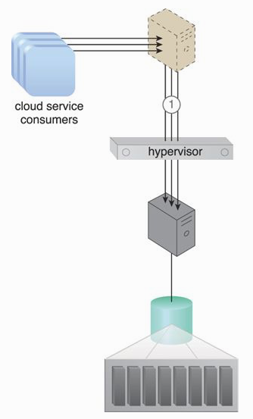
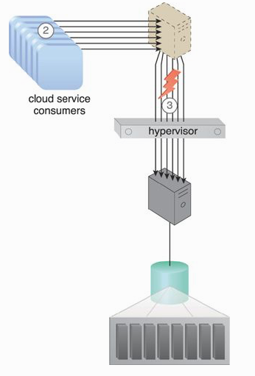

Slide 5
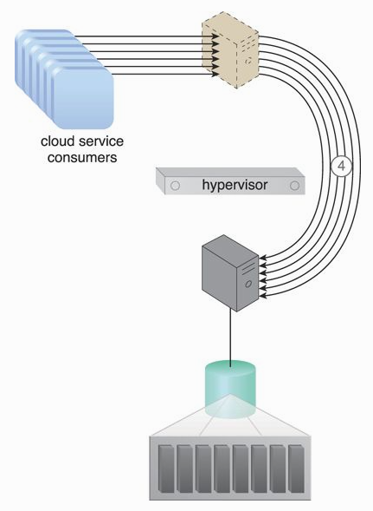
Other mechanisms:
Cloud usage monitor
Logical network perimeter
Pay-per-use monitor
Resource replication (replace virtual
I/O with physical I/O

Slide 6
Direct LUN Access Architecture
Storage LUN are mapped via a host bus adapter (HBA) on the hypervisor. As a result, the storage LUN is emulated as file-based storage to virtual servers.
Sometimes virtual servers need to directly access block-based storage (storage LUNs).
For example, access via emulated adapter is insufficient when a cluster is implemented and a LUN is used a shared cluster storage device between two virtual servers.
Benefit: Enable a cluster of virtual servers to access to a shared LUN directly (as a shared volumn).

Slide 7
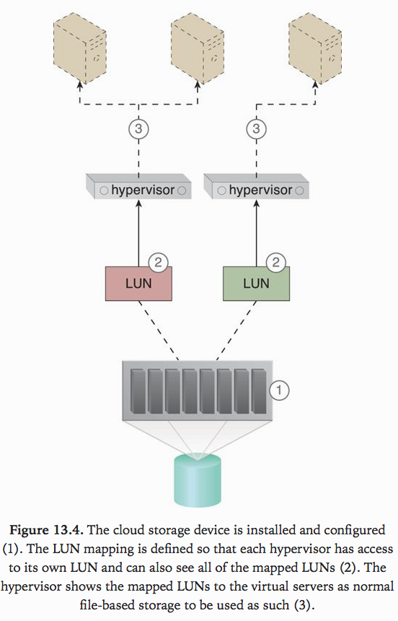

Slide 8
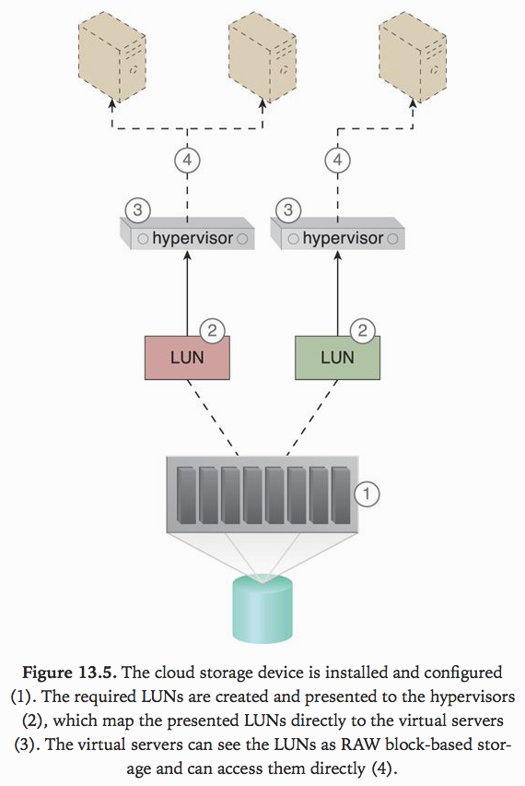

Slide 9
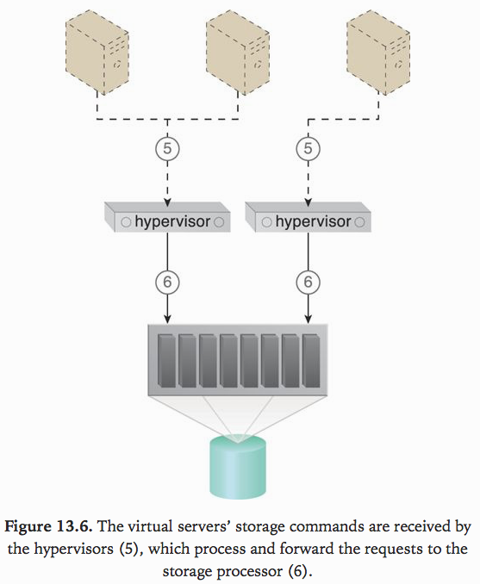
Other mechanisms:
Cloud usage monitor
Pay-per-use monitor
Resource replication (block-based storage instead of file-based storage)

Slide 10
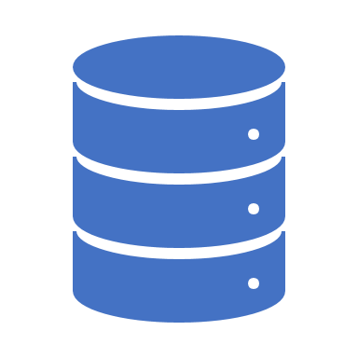
Dynamic Data Normalization Architecture
Issues of having redundant data in cloud-based environment:
  Increased time required to store and catalog files
  Increased required storage and backup space
  Increased costs due to increased data volume
  Increased time required for replication to secondary storage
  Increased time required to backup data
Data normalization architecture establishes a de-duplication system.

Slide 11
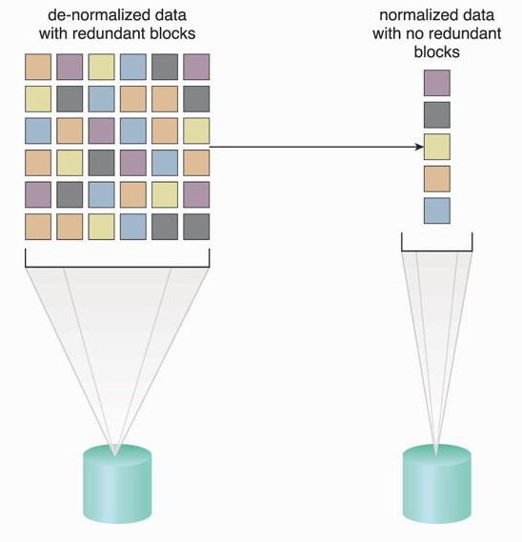

Slide 12
De-Duplication System
Hash codes (every piece of data) are generated and maintained.
Data is received, examined and hashed.
Newly generated hash is compared.
If duplicated block, a pointer is generated and saved.
If not, new blocks are saved.

Slide 13
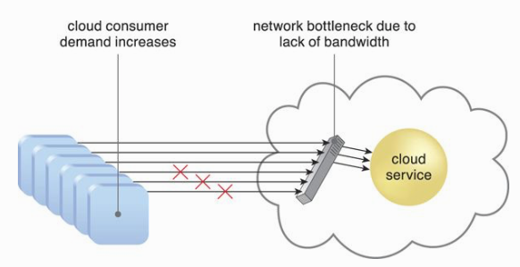
Elastic Network Capacity Architecture
Although IT resources may be scaled on-demand, performance and scalability may be inhibited (held back) by limited network bandwidth.
This architecture dynamically allocates additional bandwidth when cloud consumer demand increases (to avoid network bottlenecks).
Additional bandwidth and/or network ports are allocated when required.

Slide 14
Other Mechanisms
Automated scaling listener
Intelligent automation engine – run scripts to modify number of allocated ports
Cloud usage monitor
Logical network perimeter
Pay-per-use monitor
Resource replication – add additional network ports

Slide 15
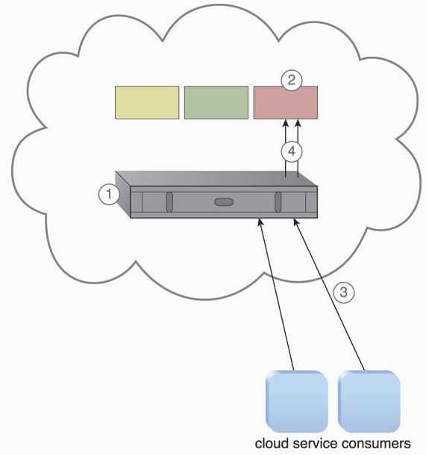
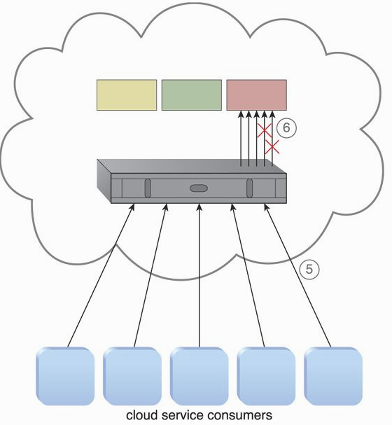
Cross-Storage Device Vertical Tiering Architecture
Cloud storage sometimes cannot handle increasing performance requirements (IOPS), and needs to scale-up.
Vertical scaling – inefficient and time-consuming, resources may be wasteful when not needed.

Slide 16
Cross-Storage Device Vertical Tiering Architecture (2)
This architecture establishes a system that survives bandwidth and data processing power scaling by vertically scaling between storage devices that have different capacity.
LUNs can automatically scale up and down across multiple devices (e.g., between traditional hard drives and SSDs).
Automated scaling listener monitors the requests and signals the storage management program to move LUN to a higher capacity (both bandwidth and processing power) when the requests increase.

Slide 17
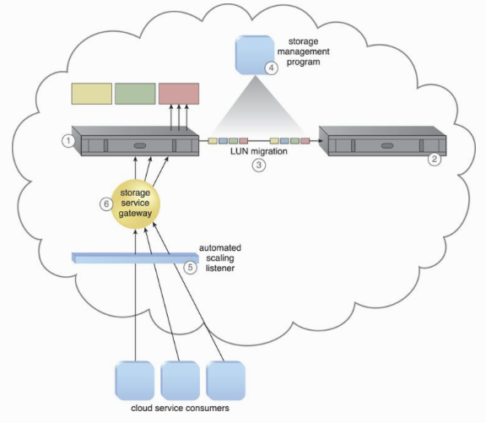

Slide 18
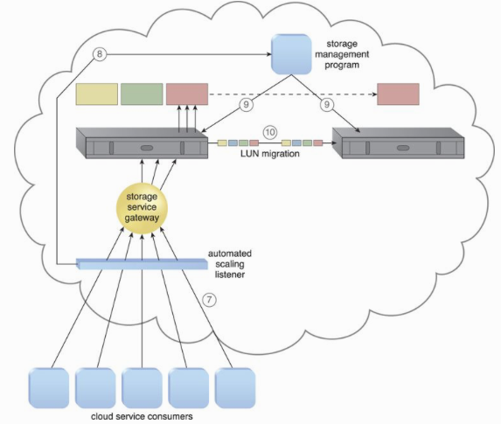

Slide 19
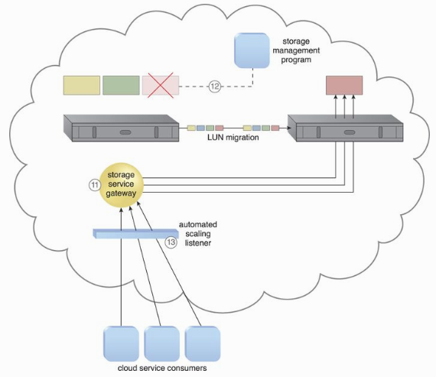
Other mechanisms:
Audit monitor
Pay-per-use
Cloud usage

Slide 20
Intra-Storage Device Vertical Data Tiering Architecture
In certain scenarios, cloud consumers may have distinct data storage requirements (security, privacy, legal requirements) restricting the data physical’s location to a single cloud storage device.
This limitation may pose severe scalability limitations (cascade to any cloud services or apps that are dependent upon the use of the cloud storage.
This architecture establishes a system to support vertical scaling within a single cloud storage device.
Intra-device scaling system optimizes the availability of different disk types with different capacities.

Slide 21
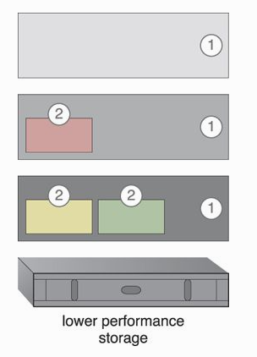
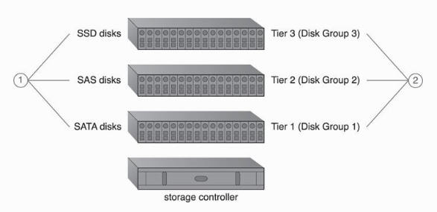

Slide 22
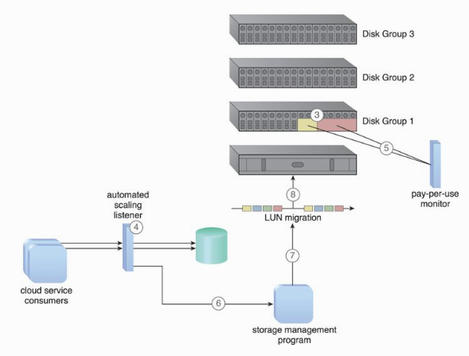

Slide 23
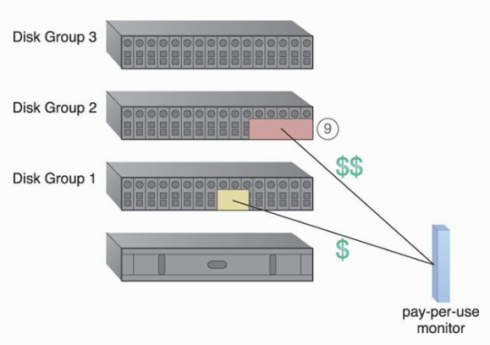

Slide 24
Load Balanced Virtual Switches Architecture
Virtual servers are connected to the outside world via virtual switches, which send and receive traffic with the same uplink.
Bandwidth bottlenecks form when the network traffic on the uplink’s port increases to a point that it causes transmission delays, performance issues, packet loss, and lag time.
The load balanced virtual switches architecture establishes a load balancing system where multiple uplinks are provided to balance network traffic workloads across multiple uplinks or redundant paths, which can help avoid slow transfers and data loss.

Slide 25
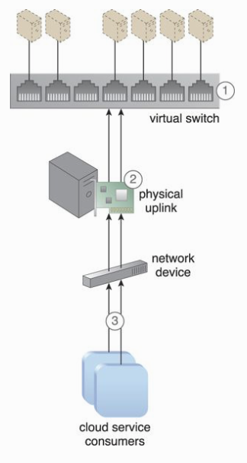
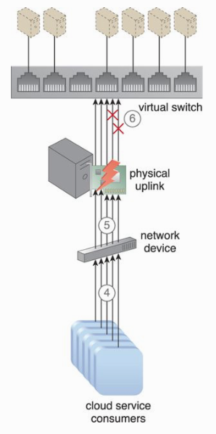

Slide 26
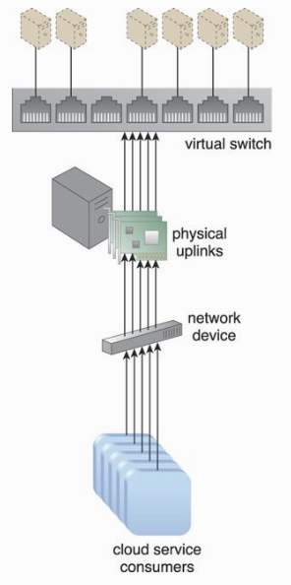
Other mechanisms:
  Cloud usage monitor
  Load balancer
  Logical network perimeter
  Resource replication – additional uplinks
  Hypervisor
  Virtual server

Slide 27
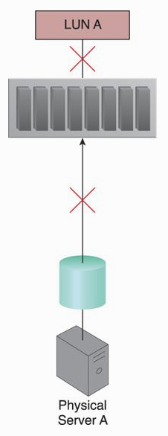
Multipath Resource Access Architecture
Certain IT resources can only be accessed using an assigned path (or hyperlink) that leads to their exact location.
Path can be lost or incorrectly defined – IT resource unavailability.
This architecture establishes a multipathing system with alternative paths to IT resources, so that cloud consumers have the means to programmatically or manually overcome path failures.

Slide 28
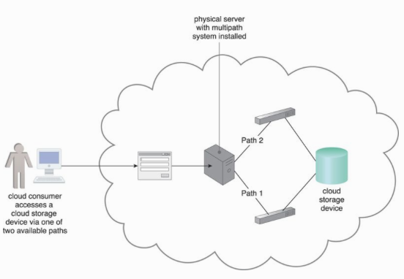

Slide 29
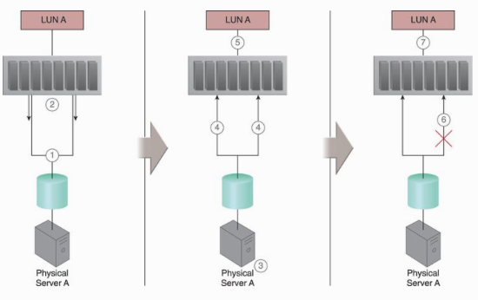

Slide 30

Other mechanisms involved in this architecture:
  Cloud storage device
  Hypervisor
  Virtual server
  Logical network perimeter
  Resource replication

Slide 31
Persistent Virtual Network Configuration Architecture
Network configurations and port assignments for virtual servers are generated during the creation of the virtual switch on the host physical server and the hypervisor hosting the virtual server.
These configurations and assignments reside in the virtual server’s immediate hosting environment, meaning a virtual server that is moved or migrated to another host will lose network connectivity because destination hosting environments do not have the required port assignments and network configuration information.

Slide 32
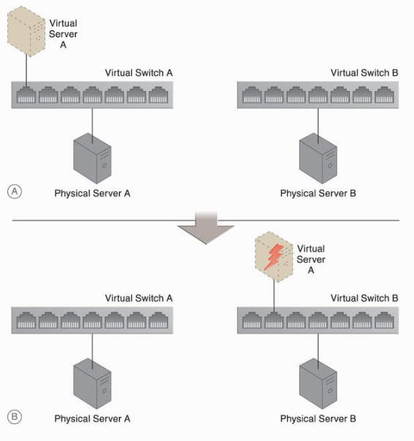

Slide 33
Persistent Virtual Network Configuration Architecture (2)
In this architecture, network configuration information is stored in a centralized location and replicated to physical server hosts. This allows the destination host to access the configuration information when a virtual server is moved from one host to another.
The system established with this architecture includes a centralized virtual switch, VIM, and configuration replication technology. The centralized virtual switch is shared by physical servers and configured via the VIM, which initiates replication of the configuration settings to the physical servers.

Slide 34
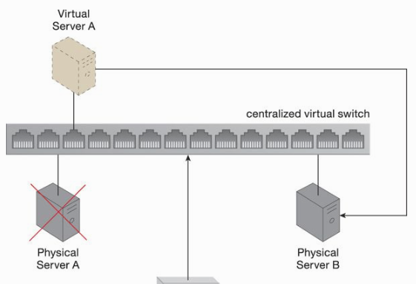

Slide 35
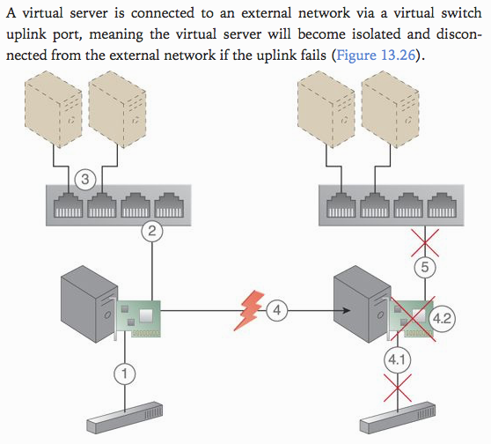
Redundant Physical Connection for Virtual Servers Architecture

Slide 36
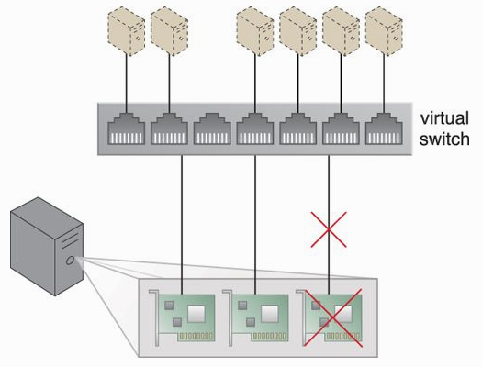

Slide 37
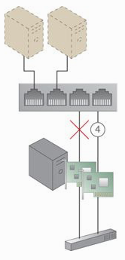
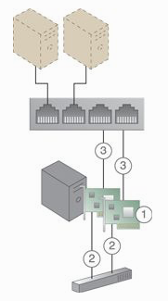
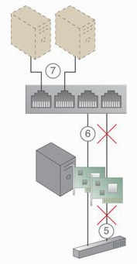

Slide 38
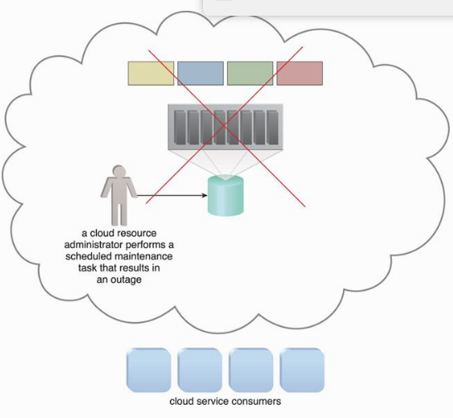
Storage Maintenance Window Architecture
Cloud storage devices that are subject to maintenance and administrative tasks sometimes need to be temporarily shut down, meaning cloud service consumers and IT resources consequently lose access to these devices and their stored data.
The storage maintenance window architecture enables cloud service consumers to be automatically and transparently redirected to the secondary cloud storage device, without becoming aware that their primary storage device has been taken offline.

Slide 39
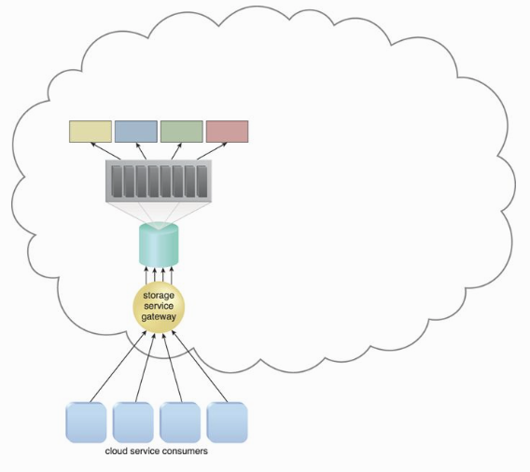

Slide 40
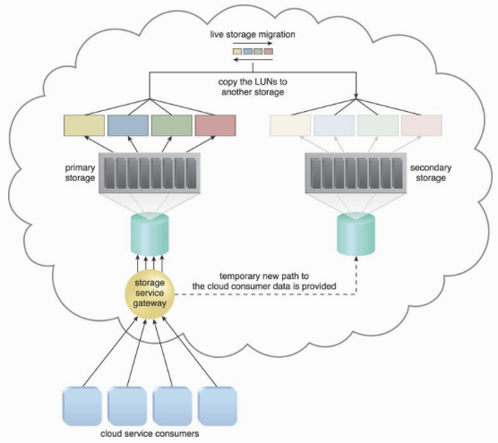

Slide 41
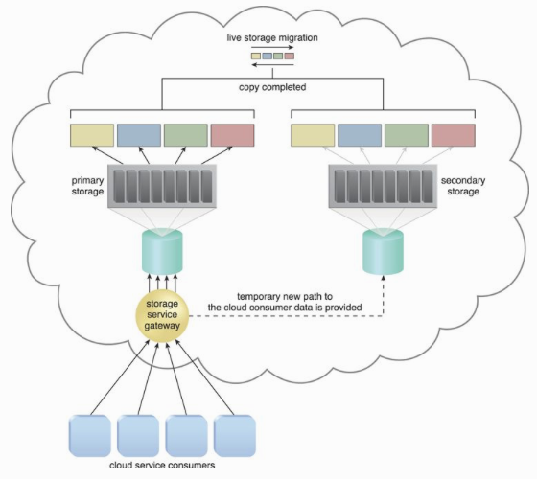

Slide 42
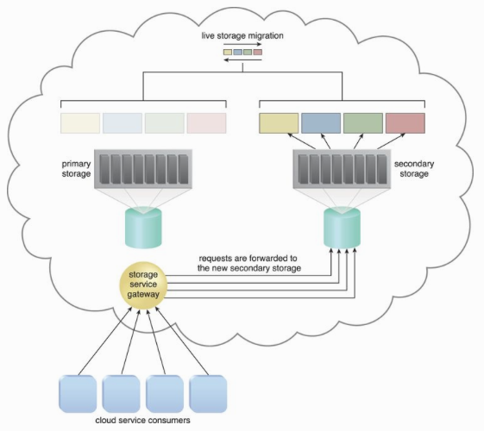

Slide 43
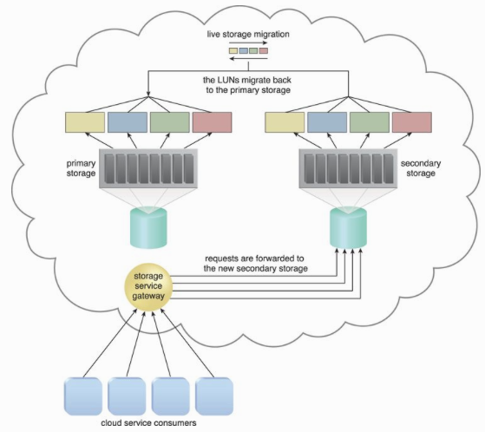

Slide 44
