Slide 1
Working With Cloud - 2

Slide 2
Cost Metrics and Pricing Models

Slide 3
Business Cost Metrics
Up-front costs (CAPEX) are associated with the initial investments that organizations need to make in order to fund the IT resources they intend to use.
Up-front costs for the purchase and deployment of on-premise IT resources tend to be high.
“Up-front costs for the leasing of cloud-based IT resources tend to be low.
On-going costs (OPEX) represent the expenses required by an organization to run and maintain IT resources it uses.
On-going costs for the operation of on-premise IT resources can vary. Examples include licensing fees, electricity, insurance, and labor.
On-going costs for the operation of cloud-based IT resources can also vary, but often exceed the on-going costs of on-premise IT resources (especially over a longer period of time). Examples include virtual hardware leasing fees, bandwidth usage fees, licensing fees, and labor.

Slide 4
Business Cost Metrics (2)
Additional costs - to supplement and extend a financial analysis beyond the calculation and comparison of standard up-front and on-going business cost metrics, several other more specialized business cost metrics can be taken into account. Examples include
Cost of capital – cost incurred during raising funds.
Sunk costs – prior investment in IT resources (Sunk vs. Up-front)
Integration costs – to ensure compatibility in a new cloud environment (or new IT premise in foreign environment).
Locked-in cost – cost incurred by port (move) IT resources from one cloud to another.

Slide 5
Case Study Example (Section 15.1)
10 mins
What are the final decisions for TCO of
3 years
5 years
7 years

Slide 6
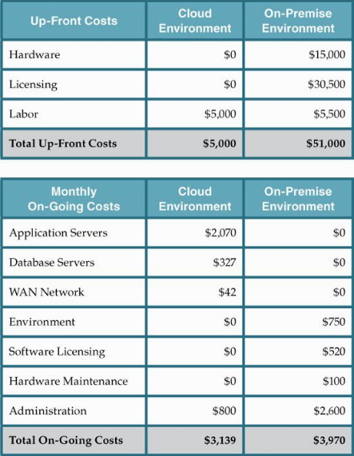

Slide 7
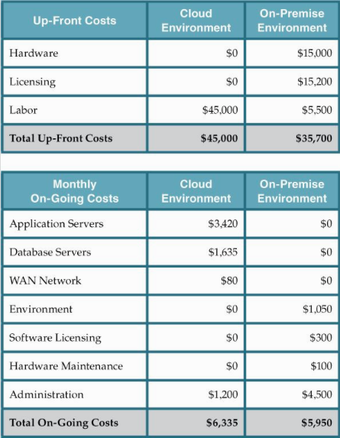

Slide 8
Cloud Usage Cost Metrics
A set of usage cost metrics for calculating costs associated with cloud-based IT resource usage measurements:
Network Usage – inbound and outbound network traffic, as well as intra-cloud network traffic.
Server Usage – virtual server allocation (and resource reservation)
Cloud Storage Device – storage capacity allocation.
Cloud Service – subscription duration, number of nominated users, number of transaction.

Slide 9
Network Usage
The amount of data that is transferred over a network connection, network usage is typically calculated using separately measured inbound network usage traffic and outbound network usage traffic metrics in relation to cloud services or other IT resources.
Inbound/Outbound Network Usage Metric
Description – inbound/outbound network traffic
Measurement – Σ, inbound network traffic in bytes
Frequency – continuous and cumulative over a predefined period
Cloud Delivery Model – IaaS, PaaS, SaaS
Example – up to 1 GB free, $0.001/GB up to 10 TB a month

Slide 10
Network Usage (2)
Network usage metrics can be applied to WAN traffic between IT resources of one cloud that are located in different geographical regions in order to calculate costs for synchronization, data replication, and related forms of processing. Conversely, LAN usage and other network traffic among IT resources that reside at the same data center are typically not tracked.
Intra-Cloud WAN Usage Metric
Description – network traffic between geographically diverse IT resources of the same cloud.
Measurement – Σ, intra-cloud WAN traffic in bytes.
Frequency – continuous and cumulative over a predefined period.
Cloud Delivery Model – IaaS, PaaS, SaaS.
Example – up to 500 MB free daily and $0.01/GB thereafter, $0.005/GB after 1 TB per month.

Slide 11
Server Usage
The allocation of virtual servers is measured using common pay-per-use metrics in IaaS and PaaS environments that are quantified by the number of virtual servers and ready-made environments.
This form of server usage measurement is divided into on-demand virtual machine instance allocation and reserved virtual machine instance allocation metrics.
The former metric measures pay-per-usage fees on a short-term basis, while the latter metric calculates up-front reservation fees for using virtual servers over extended periods. The up-front reservation fee is usually used in conjunction with the discounted pay-per-usage fees.

Slide 12
Server Usage (2)
On-Demand Virtual Machine Instance Allocation Metric
Description – uptime of a virtual server instance
Measurement – Σ, virtual server start date to stop date
Frequency – continuous and cumulative over a predefined period
Cloud Delivery Model – IaaS, PaaS
Example – $0.10/hour small instance, $0.20/hour medium instance, $0.90/hour large instance
Reserved Virtual Machine Instance Allocation Metric
Description – up-front cost for reserving a virtual server instance.
Measurement – Σ, virtual server reservation start date to expiry date
Frequency – daily, monthly, yearly
Cloud Delivery Model – IaaS, PaaS
Example – $55.10/small instance, $99.90/medium instance, $249.90/large instance.

Slide 13
Server Usage (3)
Another common cost metric – performance.
Cloud providers of IaaS and PaaS environments tend to provision virtual servers with a range of performance attributes.
What are these attributes?

Slide 14
Cloud Storage Device Usage
Cloud storage is generally charged by the amount of space allocated within a predefined period, as measured by the on-demand storage allocation metric.
Similar to IaaS-based cost metrics, on-demand storage allocation fees are usually based on short time increments (such as on an hourly basis).
Another common cost metric for cloud storage is I/O data transferred, which measures the amount of transferred input and output data.

Slide 15
Cloud Storage Device Usage (2)
On-Demand Storage Space Allocation Metric
Description – duration and size of on-demand storage space allocation in bytes.
Measurement – Σ, date of storage release / reallocation to date of storage allocation (resets upon change in storage size).
Frequency – continuous
Cloud Delivery Model – IaaS, PaaS, SaaS
Example – $0.01/GB per hour (typically expressed as GB/month)
I/O Data Transferred Metric
Description – amount of transferred I/O data
Measurement – Σ, I/O data in bytes
Frequency – continuous
Cloud Delivery Model – IaaS, PaaS
Example – $0.10/TB

Slide 16
Cloud Service Usage
Cloud service usage in SaaS environments is typically measured using the following three metrics:
Application Subscription Duration Metric
Description – duration of cloud service usage subscription
Measurement – Σ, subscription start date to expiry date
Frequency – daily, monthly, yearly
Cloud Delivery Model – SaaS
Example – $69.90 per month

Slide 17
Cloud Service Usage (2)
Number of Nominated Users Metric
Description – number of registered users with legitimate access
Measurement – number of users
Frequency – monthly, yearly
Cloud Delivery Model – SaaS
Example – $0.90/additional user per month
Number of Transactions Users Metric
Description – number of transactions served by the cloud service
Measurement – number of transactions (request-response message exchanges)
Frequency – continuous
Cloud Delivery Model – PaaS, SaaS
Example – $0.05 per 1,000 transactions

Slide 18
Cost Management Considerations
Cost management is often centered around the lifecycle phases of cloud services, as follows:
Cloud Service Design and Development – During this stage, the vanilla pricing models and cost templates are typically defined by the organization delivering the cloud service.
Cloud Service Deployment – Prior to and during the deployment of a cloud service, the backend architecture for usage measurement and billing-related data collection is determined and implemented, including the positioning of pay-per-use monitor and billing management system mechanisms.
Cloud Service Contracting – This phase consists of negotiations between the cloud consumer and cloud provider with the goal of reaching a mutual agreement on rates based on usage cost metrics.

Slide 19
Cost Management Considerations (2)
Cloud Service Offering – This stage entails the concrete offering of a cloud service’s pricing models through cost templates, and any available customization options.
Cloud Service Provisioning – Cloud service usage and instance creation thresholds may be imposed by the cloud provider or set by the cloud consumer. Either way, these and other provisioning options can impact usage costs and other fees.
Cloud Service Operation – This is the phase during which active usage of the cloud service produces usage cost metric data.
Cloud Service Decommissioning – When a cloud service is temporarily or permanently deactivated, statistical cost data may be archived.

Slide 20
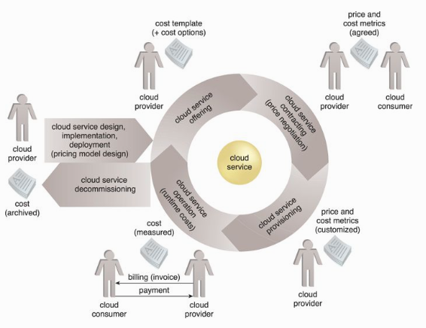

Slide 21
Pricing Models
The pricing models used by cloud providers are defined using templates that specify unit costs for fine-grained resource usage according to usage cost metrics. Various factors can influence a pricing model, such as:
market competition and regulatory requirements.
overhead incurred during the design, development, deployment, and operation of cloud services and other IT resources.
opportunities to reduce expenses via IT resource sharing and data center optimization.

Slide 22
Pricing Models (2)
A pricing model can contain multiple price templates, whose formulation is determined by variables like:
Cost Metrics and Associated Prices – These are costs that are dependent on the type of IT resource allocation (such as on-demand versus reserved allocation).
Fixed and Variable Rates Definitions – Fixed rates are based on resource allocation and define the usage quotas included in the fixed price, while variable rates are aligned with actual resource usage.
Volume Discounts – More IT resources are consumed as the degree of IT resource scaling progressively increases, thereby possibly qualifying a cloud consumer for higher discounts.
Cost and Price Customization Options – This variable is associated with payment options and schedules. For example, cloud consumers may be able to choose monthly, semi-annual, or annual payment installments.

Slide 23
Pricing Models (3)
Price templates are important for cloud consumers that are appraising cloud providers and negotiating rates, since they can vary depending on the adopted cloud delivery model.
For example:
IaaS – Pricing is usually based on IT resource allocation and usage, which includes the amount of transferred network data, number of virtual servers, and allocated storage capacity.
PaaS – Similar to IaaS, this model typically defines pricing for network data transferred, virtual servers, and storage. Prices are variable depending on factors such as software configurations, development tools, and licensing fees.
SaaS – Because this model is solely concerned with application software usage, pricing is determined by the number of application modules in the subscription, the number of nominated cloud service consumers, and the number of transactions.

Slide 24
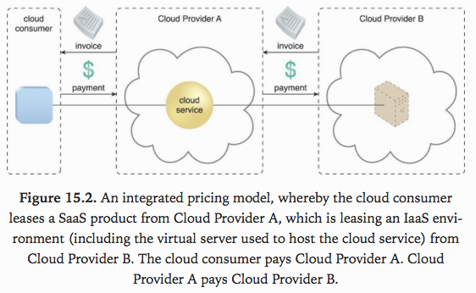

Slide 25
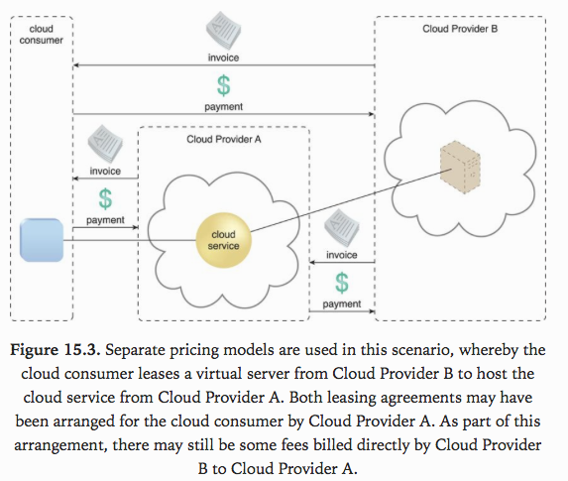

Slide 26
Additional Considerations
Negotiation – Cloud provider pricing is often open to negotiation, especially for customers willing to commit to higher volumes or longer terms.
Payment Options – There are two common payment options available to cloud consumers: pre-payment and post-payment.
Cost Archiving – By tracking historical billing information both cloud providers and cloud consumers can generate insightful reports that help identify usage and financial trends.

