Slide 1
Working With Cloud - 3

Slide 2
Service Quality Metrics and SLA Models

Slide 3
Introduction
Service-level agreements (SLAs) are a focal point of negotiations, contract terms, legal obligations, and runtime metrics and measurements.
SLAs formalize the guarantees put forth by cloud providers, and correspondingly influence or determine the pricing models and payment terms.
SLAs set cloud consumer expectations and are integral to how organizations build business automation around the utilization of cloud-based IT resources.
The guarantees made by a cloud provider to a cloud consumer are often carried forward, in that the same guarantees are made by the cloud consumer organization to its clients, business partners, or whomever will be relying on the services and solutions hosted by the cloud provider.

Slide 4
Service Quality Metrics
SLAs use service quality metrics to express measurable QoS characteristics, for example:
Availability – up-time, outages, service duration.
Reliability – minimum time between failures, guaranteed rate of successful responses.
Performance – capacity, response time, and delivery time guarantees.
Scalability – capacity fluctuation and responsiveness guarantees.
Resiliency – mean-time to switchover and recovery.

Slide 5
Service Quality Metrics (2)
Each service quality metric is ideally defined using the following characteristics:
Quantifiable – The unit of measure is clearly set, absolute, and appropriate so that the metric can be based on quantitative measurements.
Repeatable – The methods of measuring the metric need to yield identical results when repeated under identical conditions.
Comparable – The units of measure used by a metric need to be standardized and comparable. For example, a service quality metric cannot measure smaller quantities of data in bits and larger quantities in bytes.
Easily Obtainable – The metric needs to be based on a non-proprietary, common form of measurement that can be easily obtained and understood by cloud consumers.

Slide 6
Service Availability Metrics – Availability Rate Metric
The overall availability of an IT resource is usually expressed as a percentage of up-time. For example, an IT resource that is always available will have an up-time of 100%.
Description – percentage of service up-time
Measurement – total up-time / total time
Frequency – weekly, monthly, yearly
Cloud Delivery Model – IaaS, PaaS, SaaS
Example – minimum 99.5% up-time

Slide 7
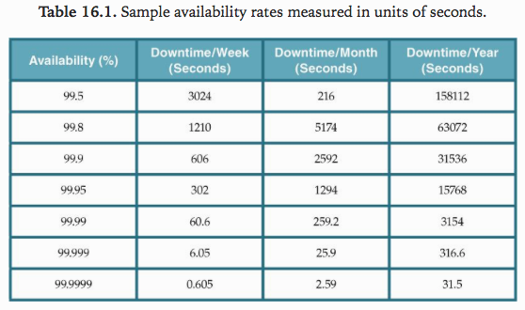

Slide 8
Service Availability Metrics – Outage Duration Metric
This service quality metric is used to define both maximum and average continuous outage service-level targets.
Description – duration of a single outage
Measurement – date/time of outage end – date/time of outage start
Frequency – per event
Cloud Delivery Model – IaaS, PaaS, SaaS
Example – 1 hour maximum, 15 minute average”

Slide 9
Service Reliability Metrics - MTBF
Reliability focuses on how often the service performs as expected, which requires the service to remain in an operational and available state. Mean-Time Between Failures (MTBF) Metric include:
Description – expected time between consecutive service failures
Measurement – Σ, normal operational period duration / number of failures
Frequency – monthly, yearly
Cloud Delivery Model – IaaS, PaaS
Example – 90 day average”

Slide 10
Service Reliability Metrics – Reliability Rate Metric
Overall reliability is more complicated to measure and is usually defined by a reliability rate that represents the percentage of successful service outcomes. This metric measures the effects of non-fatal errors and failures that occur during up-time periods. For example, an IT resource’s reliability is 100% if it has performed as expected every time it is invoked, but only 80% if it fails to perform every fifth time.
Description – percentage of successful service outcomes under pre-defined conditions
Measurement – total number of successful responses / total number of requests
Frequency – weekly, monthly, yearly
Cloud Delivery Model – SaaS
Example – minimum 99.5%”

Slide 11
Service Performance Metrics
Network capacity metric – Mbps/Gbps
Storage device capacity metric – Gbytes/Terabytes/etc.
Server capacity metric – CPU, RAM, storage
Web app capacity metric – requests per mins (SaaS)
Instance starting time metric – time to initialize new instance (IaaS, SaaS)
Response time metric – million seconds (SaaS)
Completion time metric – time required to complete a sync. task

Slide 12
Service Scalability Metrics
Service scalability metrics are related to IT resource elasticity capacity, which is related to the maximum capacity that an IT resource can achieve, as well as measurements of its ability to adapt to workload fluctuations.
For example, a server can be scaled up to a maximum of 128 CPU cores and 512 GB of RAM, or scaled out to a maximum of 16 load-balanced replicated instances.
Metrics include
Storage scalability (horizontal) metric – in respond to increased workload
Server scalability (horizontal) metric – in respond to increased workload
Server scalability (vertical) metric – in respond to workload fluctuations

Slide 13
Service Resiliency Metrics
The ability of an IT resource to recover from operational disturbances is often measured using service resiliency metrics.
When resiliency is described within or in relation to SLA resiliency guarantees, it is often based on redundant implementations and resource replication over different physical locations, as well as various disaster recovery systems.
Resiliency metrics can be applied in three different phases to address the challenges and events that can threaten the regular level of a service:
Design Phase – Metrics that measure how prepared systems and services are to cope with challenges.
Operational Phase – Metrics that measure the difference in service levels before, during, and after a downtime event or service outage, which are further qualified by availability, reliability, performance, and scalability metrics.
Recovery Phase – Metrics that measure the rate at which an IT resource recovers from downtime, such as the meantime for a system to log an outage and switchover to a new virtual server.

Slide 14
Service Resiliency Metrics (2)
Mean-Time to Switchover (MTSO) Metric
Description – the time expected to complete a switchover from a severe failure to a replicated instance in a different geographical area
Measurement – (date/time of switchover completion – date/time of failure) / total number of failures
Frequency – monthly, yearly
Cloud Delivery Model – IaaS, PaaS, SaaS
Example – 10 minute average
Mean-Time System Recovery (MTSR) Metric
Description – time expected for a resilient system to perform a complete recovery from a severe failure
Measurement – (date/time of recovery – date/time of failure) / total number of failures
Frequency – monthly, yearly
Cloud Delivery Model – IaaS, PaaS, SaaS
Example – 120 minute average

Slide 15
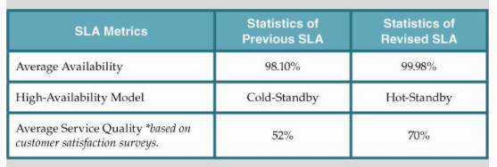

Slide 16
SLA Guidelines – best practices and recommendations
Mapping business cases to SLAs
Working with cloud and on-premise SLAs
Understanding the scope of an SLA
Understanding the scope of SLA monitoring
Documenting guarantees at appropriate granularity
Defining penalties for non-compliance

Slide 17
SLA Guidelines – best practices and recommendations
Incorporating non-measurable requirements – e.g. security and privacy requirements
Disclosure of compliance verification and management
Inclusion of specific metric formulas
Considering independent SLA monitoring
Archiving SLA data
Disclosing cross-cloud dependencies

