Slide 1
Network Foundation Protection
Chapter 10 - 13

Slide 2
Importance of NFP
Many pieces make up a network, and a single not-working-properly component can cause a failure of a network.
Cisco Network Foundation Protection (NFP) framework focuses on three basic planes;
Management plane – protocols and traffic between network admin and devices, e.g., Telnet, SSH.
Control plane – protocols and traffic between devices, e.g., routing protocols
Data plane – user data or transit traffic
Some interdependence exists between the three planes.

Slide 3
Implementing NFP

Slide 4
Implementing NFP (2)

Slide 5
Management Traffic and Management Plane
In general, a new router or switch is configured via a console port using a blue rollover cable. This can be called the management plane.
The management plane includes
Configuration of a system
Who may access a system
Messages from a management protocol such as SNMP.
Beyond a blue rollover cable?

Slide 6
Best Practices for Securing the Management Plane
Enforce password policy.
Login password retry lockout.
Use AAA services (centralized ACS server).
Implement role-based access control (RBAC) – different group, different role (or view).
Keep accurate time across all network devices (secure Network Time Protocol (NTP)).
Use encrypted and authenticated versions of SNMP.
Control which IP addresses are allowed to manage devices.
Lock down syslog (encrypted syslog)
Out-of-band network management.
Disable unnecessary services, e.g., BOOTP, DHCP, DNS, CDP.
Secure system files – make it difficult to delete.

Slide 7
Options for AAA Implementation
Cisco Secure ACS Solution Engine – a dedicated server.
Cisco Secure ACS for Windows Server.
Current flavors of ACS functionality – ACS through a virtual machine.
Cisco ISE – a single physical or logical device or appliance.
Self-contained AAA – a router with AAA functionality.
The AAA method list on pages 285 – 286.

Slide 8
The AAA Method List

Slide 9
Role-Based Access Control
Controls which commands are available to specific roles
Different views of router configurations created for different users providing:
Security: Defines the set of CLI commands that is accessible by a particular user by controlling user access to configure specific ports, logical interfaces, and slots on a router
Availability: Prevents unintentional execution of CLI commands by unauthorized personnel
Operational Efficiency: Users only see the CLI commands applicable to the ports and CLI to which they have access

Slide 10
Role-Based Views
Root View
To configure any view for the system, the administrator must be in the root view. Root view has all of the access privileges as a user who has level 15 privileges.
CLI View
A specific set of commands can be bundled into a “CLI view”. Each view must be assigned all commands associated with that view and there is no inheritance of commands from other views. Additionally, commands may be reused within several views.
Superview
Allow a network administrator to assign users and groups of users multiple CLI views at once instead of having to assign a single CLI view per user with all commands associated to that one CLI view.

Slide 11
Role-Based Views

Slide 12
Creating and Managing a View
Enable aaa with the global configuration command aaa new-model. Exit, and enter the root view with the command enable view command.
Create a view using the parser view view-name command.
Assign a secret password to the view using the secret encrypted-password command.
Assign commands to the selected view using the parser-mode {include | include-exclusive | exclude} [all] [interface interface-name | command] command in view configuration mode.
Exit the view configuration mode by typing the command exit.

Slide 13
SNMP Components and Versions

Slide 14
SNMP Versions

Slide 15
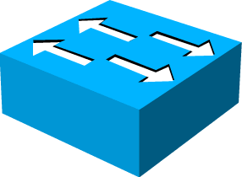
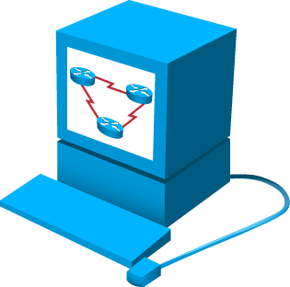
SNMPv3
Transmissions from manager to agent may be authenticated to guarantee the identity of the sender and the integrity and timeliness of a message.
NMS
Managed Node
Managed Node
Encrypted Tunnel
Messages may be encrypted to ensure privacy
Managed Node
Agent may enforce access control to restrict each principal to certain actions on certain portions of its data.
NMS
Managed Node

Slide 16
Securing the Cisco Image and Config. Files
The Cisco resilience configuration feature intends to prevent IOS and config. files to be deleted by a remote user.

Slide 17
What is the Control Plane?
Control plane packets are network device-generated or received packets that are used for the creation and operation of the network itself.
Some examples include OSPF, ICMP, etc.
In many cases, we can disable the reception or transmission of certain types of packets to minimize CPU load.

Slide 18
Best Practices for Securing the Control Plane

Slide 21
Best Practices for Securing the Control Plane (2)

Slide 24
Best Practices for Securing the Data Plane

