Slide 1
Virtual Private Network
Implementation

Slide 2
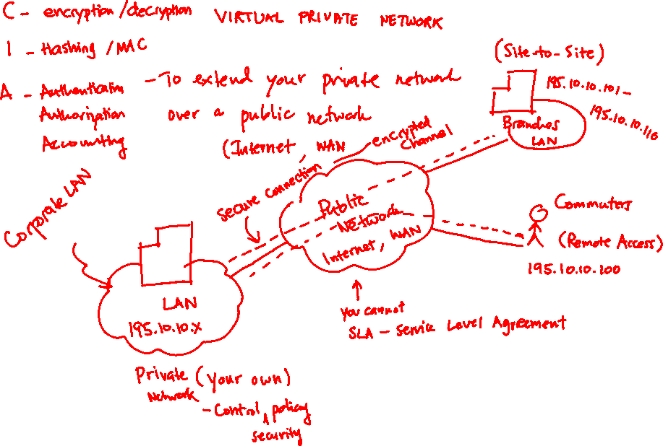

Slide 3




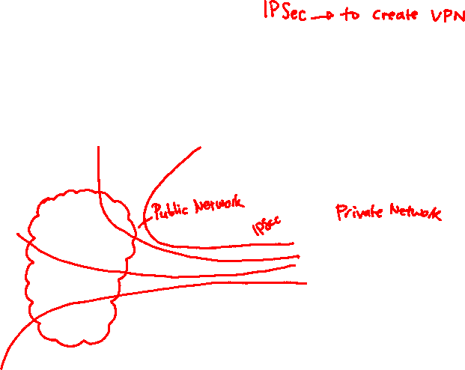
What is a VPN?
Business Partner
with a Cisco Router
Mobile Worker
with a Cisco
VPN Client
CSA
VPN
Internet
SOHO with a Cisco DSL Router
Firewall
Corporate Network
VPN
WAN
  Virtual: Information within a private network is transported over a public network.
  Private: The traffic is encrypted to keep the data confidential.
VPN
Regional branch with
a VPN enabled
Cisco ISR router

Slide 4
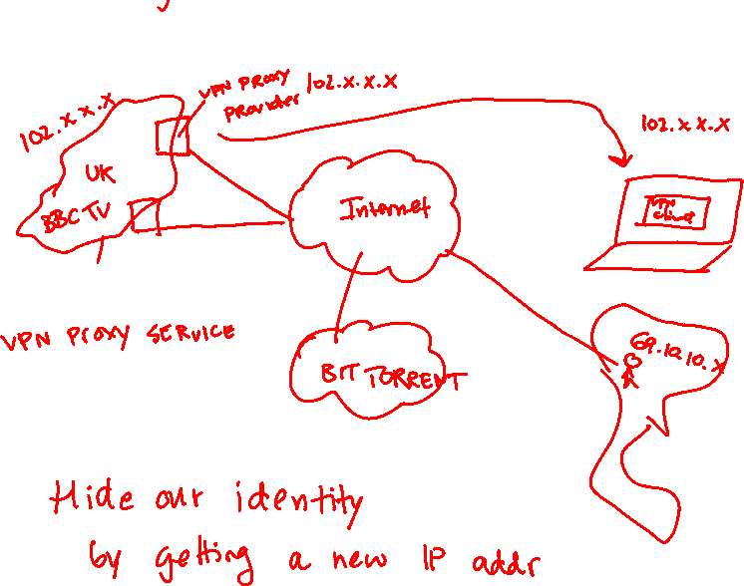


Slide 5

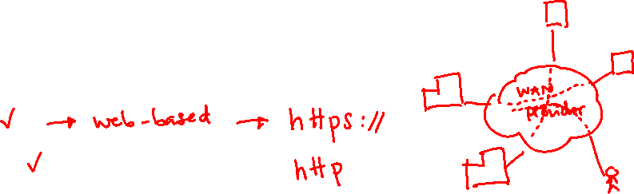
VPN Types – based on technologies
IPSec
IPSec
VPN
Internet
SOHO with a Cisco DSL Router
Multiprotocol Label Switching (MPLS) – no encryption by default
SSL
IPSec

Slide 6

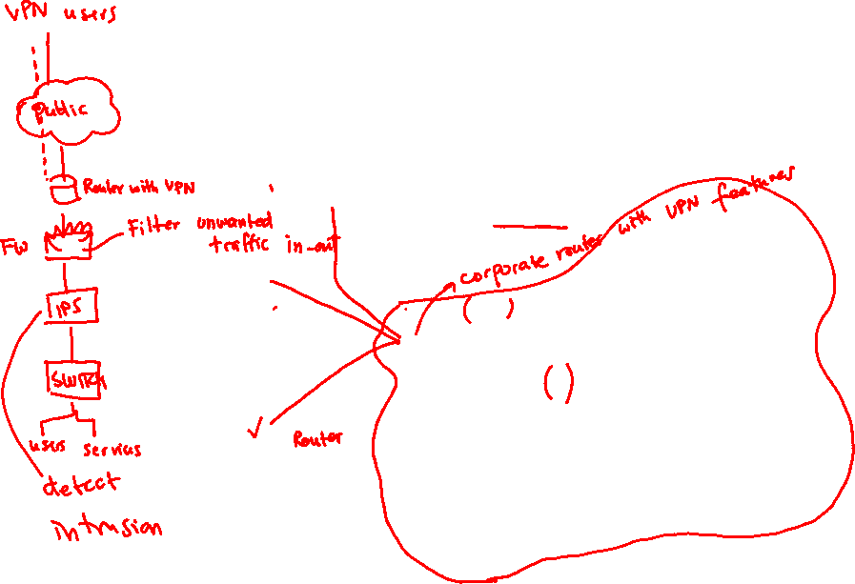
Types of VPN Networks – based on access methods
Business Partner
with a Cisco Router
Remote-access
VPNs
Mobile Worker
with a Cisco
VPN Client
CSA
MARS
VPN
Internet
SOHO with a Cisco DSL Router
Firewall
Site-to-Site
VPNs
VPN
IPS
WAN
VPN
Iron Port
CSA
Regional branch with
a VPN enabled
Cisco ISR router
CSA
CSA
CSA
CSA
CSA
Web
Server
Email Server
DNS

Slide 7

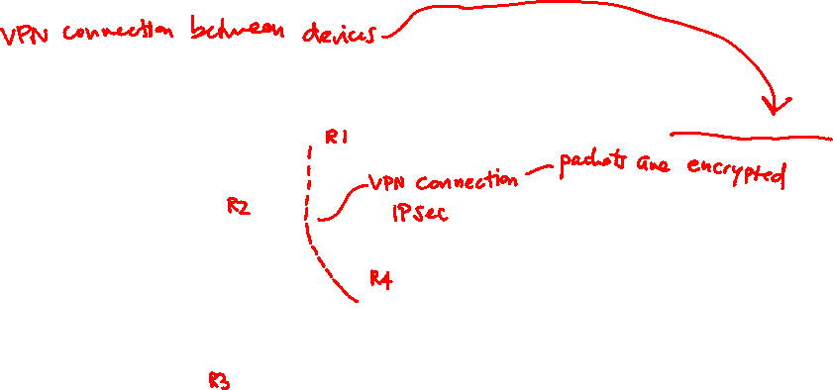
Site-to-Site VPN
Business Partner
with a Cisco Router
Hosts send and receive normal
TCP/IP traffic through a VPN gateway
CSA
MARS
VPN
Internet
SOHO with a Cisco DSL Router
Firewall
Site-to-Site
VPNs
VPN
IPS
WAN
VPN
Iron Port
CSA
Regional branch with
a VPN enabled
Cisco ISR router
CSA
CSA
CSA
CSA
CSA
Web
Server
Email Server
DNS

Slide 8
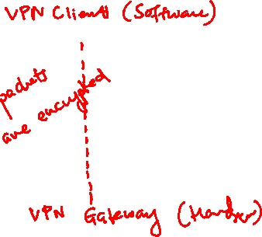
Remote-Access VPNs
Remote-access
VPNs
Mobile Worker
with a Cisco
VPN Client
CSA
MARS
Internet
Firewall
VPN
IPS
Iron Port
CSA
CSA
CSA
CSA
CSA
CSA
Web
Server
Email Server
DNS

Slide 9
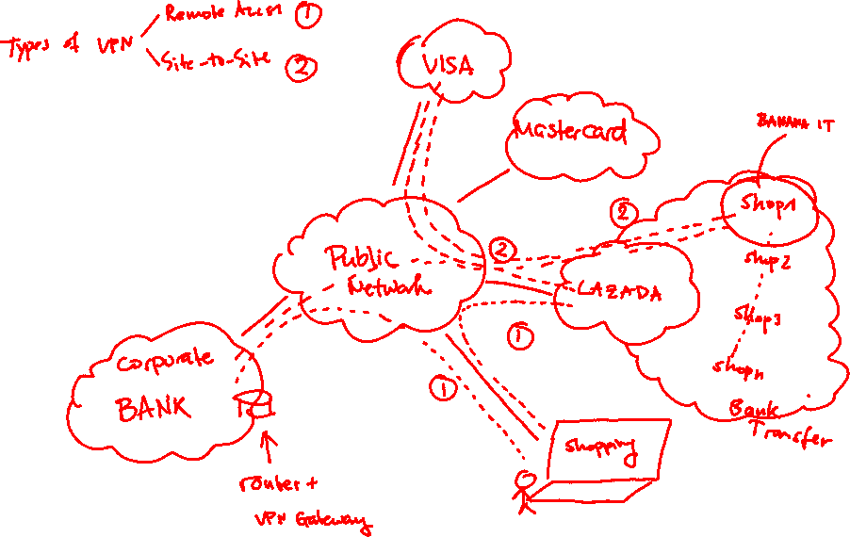

Slide 10
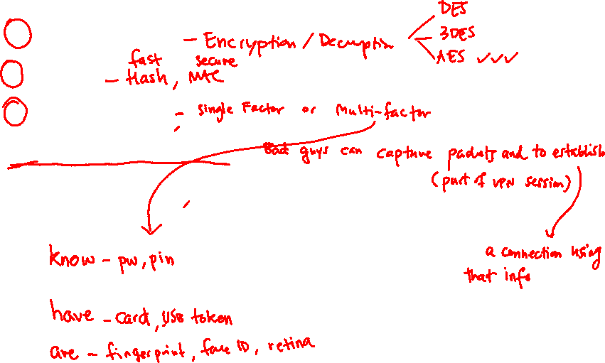
VPN Benefits
Confidentiality
Integrity
Authentication
Antireplay protection

Slide 11
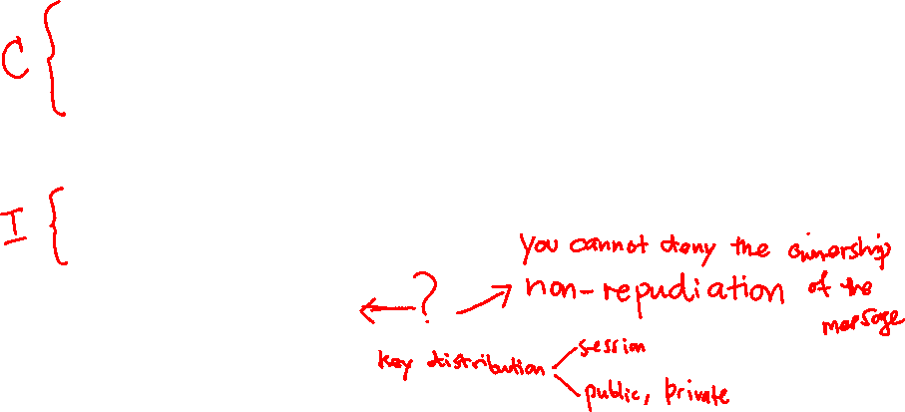
Core Elements to VPN
Ciphers – Block (DES, 3DES, AES, etc.) and Stream (RC4)
Algorithms – Symmetric (DES, 3DES, AES, etc.) and Asymmetric (RSA, DH)
Hash – MD5, SHA-1, SHA-2
HMAC – Hash + key
Digital Signatures
Key Management

Slide 12

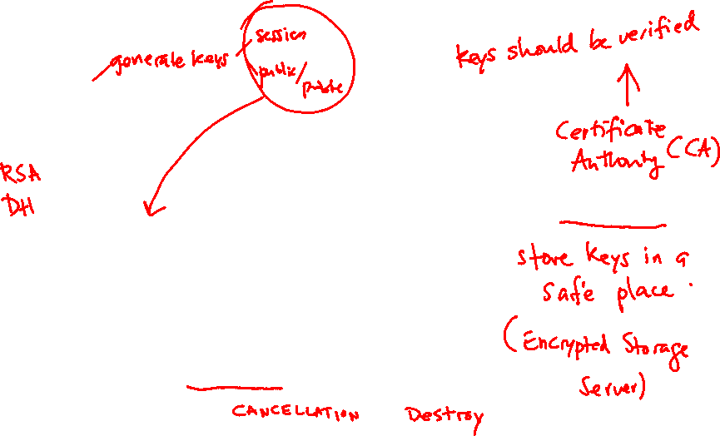
Key Management
Key Generation
Key Verification
Key Management
Key Storage
Key Exchange
Key Revocation and Destruction

Slide 13
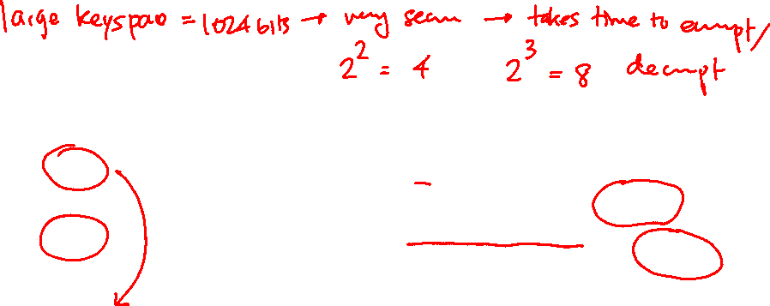
Keyspace
DES Key | Keyspace | # of Possible Keys
56-bit | 2⁵⁶ ¹¹¹¹¹¹¹¹ ¹¹¹¹¹¹¹¹ ¹¹¹¹¹¹¹¹ 11111111 11111111 11111111 11111111 | 72,000,000,000,000,000
57-bit | 2⁵⁷ ¹¹¹¹¹¹¹¹ ¹¹¹¹¹¹¹¹ ¹¹¹¹¹¹¹¹ 11111111 11111111 11111111 11111111 1 | 144,000,000,000,000,000
58-bit | 2⁵⁸ ¹¹¹¹¹¹¹¹ ¹¹¹¹¹¹¹¹ ¹¹¹¹¹¹¹¹ 11111111 11111111 11111111 11111111 11 | 288,000,000,000,000,000
59-bit | 2⁵⁹ ¹¹¹¹¹¹¹¹ ¹¹¹¹¹¹¹¹ ¹¹¹¹¹¹¹¹ 11111111 11111111 11111111 11111111 111 | 576,000,000,000,000,000
60-bit | 2⁶⁰ ¹¹¹¹¹¹¹¹ ¹¹¹¹¹¹¹¹ ¹¹¹¹¹¹¹¹ 11111111 11111111 11111111 11111111 1111 | 1,152,000,000,000,000,000
Twice as
much time
Four time as
much time
With 60-bit DES
an attacker would
require sixteen
more time than
56-bit DES
For each bit added to the DES key, the attacker would require twice the amount of time to search the keyspace.
Longer keys are more secure but are also more resource intensive and can affect throughput.

Slide 14
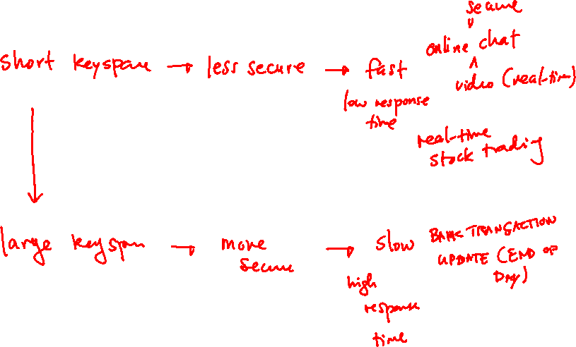

Slide 15
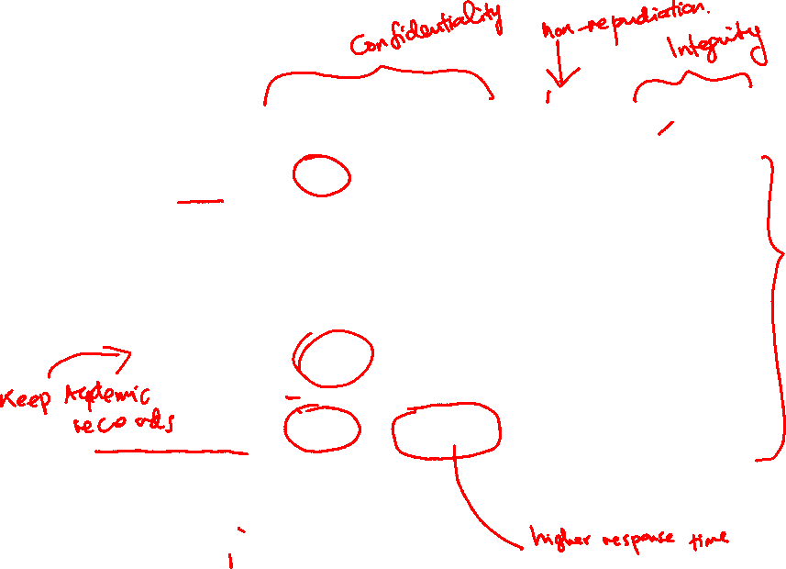
Types of Keys
Symmetric Key
Asymmetric Key
Digital Signature
Hash
Protection up to 3 years
80
1248
160
160
Protection up to 10 years
96
1776
192
192
Protection up to 20 years
112
2432
224
224
Protection up to 30 years
128
3248
256
256
Protection against quantum computers
256
15424
512
512
Calculations are based on the fact that computing power will continue to grow at its present rate and the ability to perform brute-force attacks will grow at the same rate.
Note the comparatively short symmetric key lengths illustrating that symmetric algorithms are the strongest type of algorithm.

Slide 16

Key Properties
Shorter keys = faster processing, but less secure
Longer keys = slower processing, but more secure
Notes:
More Information: Refer to the National Institute of Standards and Technology (NIST) website at http://www.keylength.com/en/4/ to see updated key length recommendations

Slide 17

IPSec vs. SSL
IPSec – collection of protocols and algorithms
  ESP and AH: The two primary methods for implementing IPsec. The acronyms stand for Encapsulating Security Payload (ESP), which can do all the features of IPsec, and Authentication Header (AH), which can do many parts of the IPsec objectives, except for the important one of encryption of the data.
  Encryption algorithms for confidentiality: DES, 3DES, AES.
  Hashing algorithms for integrity: MD5, SHA.
  Authentication algorithms: Pre-shared keys (PSK), RSA digital signatures.
  Key management: An example would be Diffie-Hellman (DH), which can be used to dynamically generate symmetrical keys to be used by symmetrical algorithms; PKI, which supports the function of digital certificates issued by trusted CAs; and Internet Key Exchange (IKE), which does a lot of the negotiating and management for us for IPsec to operate.

Slide 18
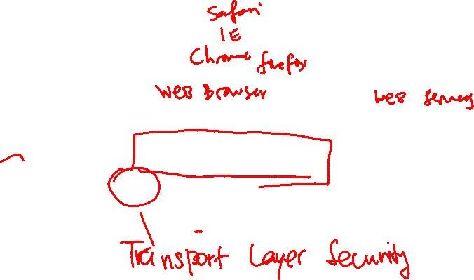
IPSec vs. SSL (2)
SSL
  Proven standard
  Widely deployed to secure web services
  Can be labeled as TLS

Slide 19







IPSec Topology
Main Site
Business Partner
with a Cisco Router
IPsec
Perimeter
Router
Legacy
Concentrator
Legacy
Cisco
PIX
Firewall
POP
Regional Office with a
Cisco PIX Firewall
ASA
Mobile Worker with a
Cisco VPN Client
on a Laptop Computer
SOHO with a Cisco
SDN/DSL Router
Corporate
Works at the network layer, protecting and authenticating IP packets.
  It is a framework of open standards which is algorithm-independent.
  It provides data confidentiality, data integrity, and origin authentication.

Slide 20

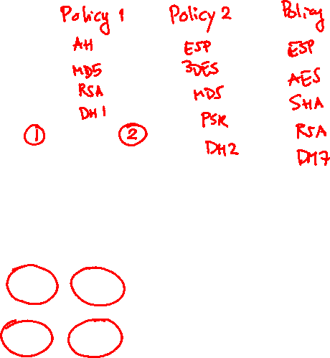
IPSec Framework
Diffie-Hellman
DH7

Slide 21
Confidentiality
Least secure Most secure
Key length:
- 56-bits
Key length:
- 56-bits (3 times)
Key lengths:
128-bits
192 bits
256-bits
Diffie-Hellman
DH7
Key length:
- 160-bits

Slide 22
Integrity
Least secure Most secure
Key length:
- 128-bits
Diffie-Hellman
Key length:
- 160-bits)
DH7

Slide 23
Authentication
Diffie-Hellman
DH7

Slide 24
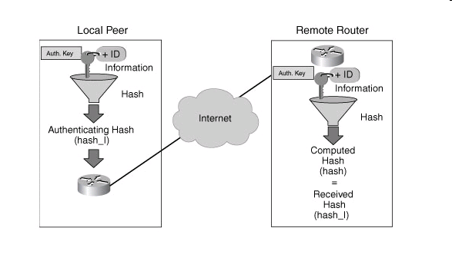
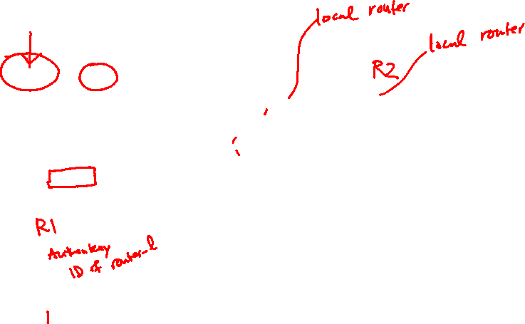
Pre-shared Key (PSK)
[JG1]It?
At the local device, the authentication key and the identity information (device-specific information) are sent through a hash algorithm to form hash_I. One-way authentication is established by sending hash_I to the remote device. If the remote device can independently create the same hash, the local device is authenticated.
The authentication process continues in the opposite direction. The remote device combines its identity information with the preshared-based authentication key and sends it through the hash algorithm to form hash_R. hash_R is sent to the local device. If the local device can independently create the same hash, the remote device is authenticated.
Diffie-Hellman
DH7

Slide 25
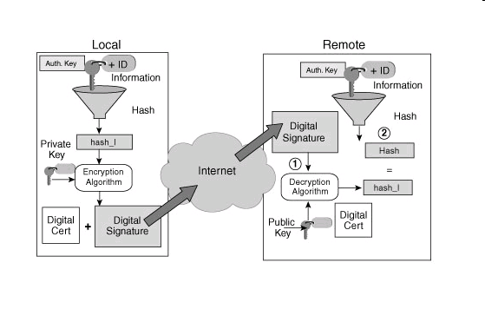
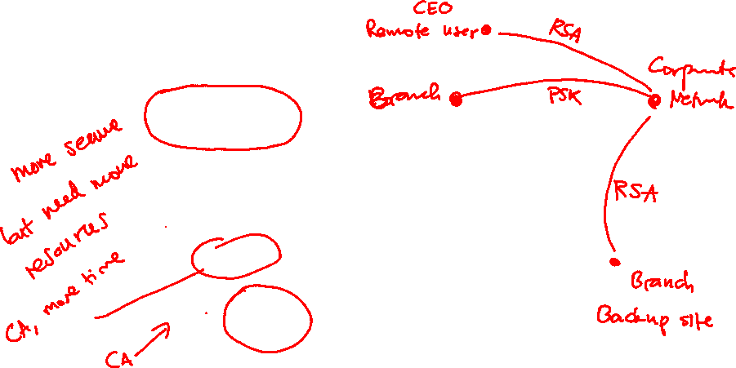
RSA Signatures
At the local device, the authentication key and identity information (device-specific information) are sent through the hash algorithm forming hash_I. hash_I is encrypted using the local device's private encryption key creating a digital signature. The digital signature and a digital certificate are forwarded to the remote device. The public encryption key for decrypting the signature is included in the digital certificate. The remote device verifies the digital signature by decrypting it using the public encryption key. The result is hash_I.
Next, the remote device independently creates hash_I from stored information. If the calculated hash_I equals the decrypted hash_I, the local device is authenticated. After the remote device authenticates the local device, the authentication process begins in the opposite direction and all steps are repeated from the remote device to the local device.

Slide 26
Secure Key Exchange
Diffie-Hellman
DH7

Slide 27

IPSec Framework Protocols
Authentication Header
R1
R2
All data is in plaintext.
AH provides the following:
  Authentication
  Integrity
Encapsulating Security Payload
R1
R2
Data payload is encrypted.
ESP provides the following:
  Encryption
  Authentication
  Integrity

Slide 28



Authentication Header
1. The IP Header and data payload are hashed
IP Header + Data + Key
R2
Hash
IP HDR
AH
Data
Authentication Data
(00ABCDEF)
IP Header + Data + Key
3. The new packet is
transmitted to the
IPSec peer router
Internet
Hash
IP HDR
AH
Data
Recomputed
Hash
(00ABCDEF)
Received
Hash
(00ABCDEF)
=
R1
2. The hash builds a new AH
header which is prepended
to the original packet
4. The peer router hashes the IP
header and data payload, extracts
the transmitted hash and compares

Slide 29
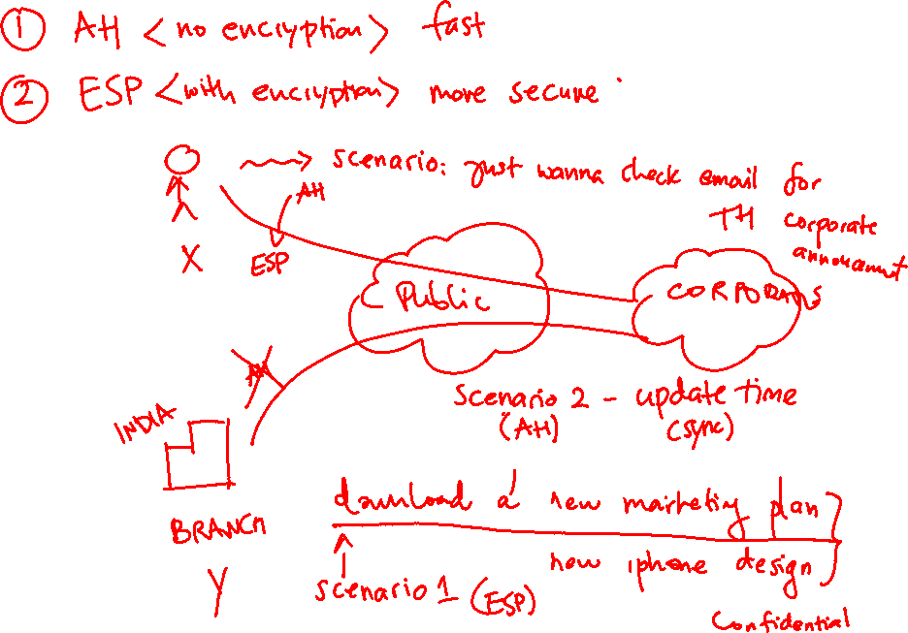

Slide 30

ESP
Diffie-Hellman
DH7

Slide 31



Function of ESP
Internet
Router
Router
IP HDR
Data
IP HDR
Data
New IP HDR
ESP HDR
IP HDR
Data
ESP
Trailer
ESP
Auth
Encrypted
Authenticated
Provides confidentiality with encryption
Provides integrity with authentication

Slide 32
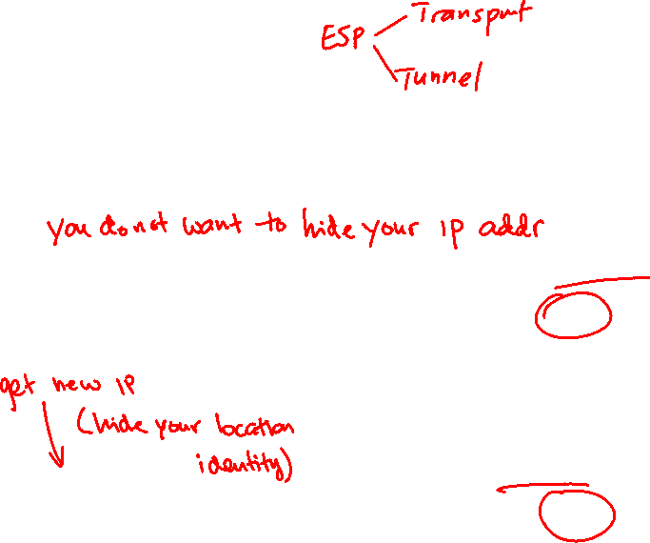
Mode Types
IP HDR
Data
Original data prior to selection of IPSec protocol mode
Transport Mode
Encrypted
IP HDR
ESP HDR
Data
ESP
Trailer
ESP
Auth
Authenticated
Tunnel Mode
Encrypted
New IP HDR
ESP HDR
IP HDR
Data
ESP
Trailer
ESP
Auth
Authenticated

Slide 33
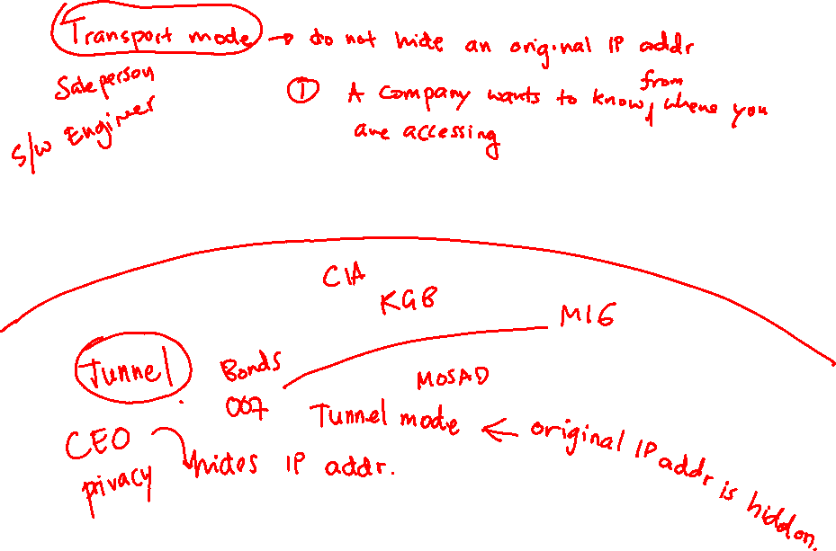

Slide 34

Security Associations
IPSec parameters are configured using IKE

Slide 35

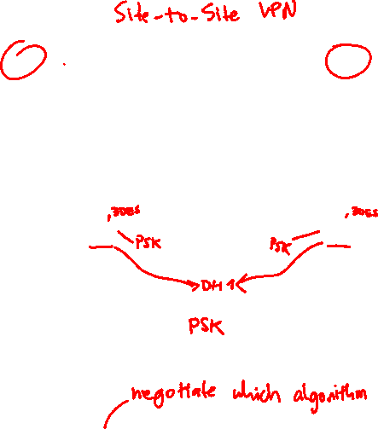
IKE Phases
Host A
R1
R2
Host B
10.0.1.3
10.0.2.3
IKE Phase 1 Exchange
Negotiate IKE policy sets
DH key exchange
Verify the peer identity
Policy 10
DES
MD5
pre-share
DH1
lifetime
Policy 15
DES
MD5
pre-share
DH1
lifetime
Negotiate IKE policy sets
DH key exchange
Verify the peer identity
IKE Phase 2 Exchange
Negotiate IPsec policy
Negotiate IPsec policy

Slide 36
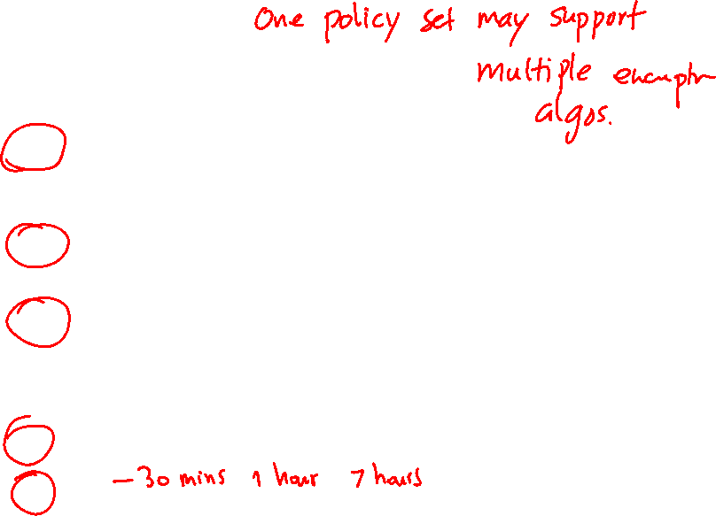
IKE Phase 1
Five items to be agreed upon in Phase 1
  Hash algorithm: This could be message digest 5 algorithm (MD5) or Secure Hash Algorithm (SHA) on most devices.
  Encryption algorithm: This could be DES (bad idea, too weak), 3DES (better) or AES (best) with various key lengths. (Longer is better for keys.)
  Diffie-Hellman (DH) group to use: The DH “group” refers to the modulus size (length of the key) to use for the DH key exchange. Group 1 uses 768 bits, group 2 uses 1024, and group 5 uses 1536.
  Authentication methods (PSK or RSA).
  Lifetime

Slide 37


Slide 38

IKE Phase 1 – First Exchange
R1
R2
Host A
Host B
Negotiate IKE Proposals
10.0.2.3
10.0.1.3
Policy 10
DES
MD5
pre-share
DH1
lifetime
Policy 15
DES
MD5
pre-share
DH1
lifetime
IKE Policy Sets
Policy 20
3DES
SHA
pre-share
DH1
lifetime
Negotiates matching IKE policies to protect IKE exchange

Slide 39


IKE Phase 1 – Second Exchange
Establish DH Key
Private value, X_{A}
Public value, Y_{A}
Private value, X_{B}
Public value, Y_{B}
Alice
Bob
X_{A}
X_{B}
Y_{A} = g mod p
Y_{B} = g mod p
Y_{A}
Y_{B}
X_{A}
X_{B}
(Y_{B} ) mod p = K (Y_{A} ) mod p = K
A DH exchange is performed to establish keying material.

Slide 40


IKE Phase 1 – Third Exchange
Authenticate Peer
Remote Office
Corporate Office
Internet
HR Servers
Peer
Authentication
Peer authentication methods
  PSKs
  RSA signatures
  RSA encrypted nonces
A bidirectional IKE SA is now established.
Phase 1 tunnel is not used to protect user data!!!

Slide 41
IKE Phase 1 – Aggressive Mode
Host A
R1
R2
Host B
10.0.1.3
10.0.2.3
IKE Phase 1 Aggressive Mode Exchange
Send IKE policy set and R1’s DH key
Calculate shared secret, verify peer identify, and confirm with peer
Policy 10
DES
MD5
pre-share
DH1
lifetime
Policy 15
DES
MD5
pre-share
DH1
lifetime
Confirm IKE policy set, calculate shared secret and send R2’s DH key
Authenticate peer and begin Phase 2.
IKE Phase 2 Exchange
Negotiate IPsec policy
Negotiate IPsec policy

Slide 42

IKE Phase 2
Host A
R1
R2
Host B
10.0.1.3
Negotiate IPsec
Security Parameters
10.0.2.3
IKE negotiates matching IPsec policies.
Upon completion, unidirectional IPsec Security Associations (SA) are established for each protocol and algorithm combination.

Slide 43

IPSec VPN Negotiation
10.0.1.3
R1
R2
10.0.2.3
Host A sends interesting traffic to Host B.
R1 and R2 negotiate an IKE Phase 1 session.
IKE SA
IKE Phase 1
IKE SA
R1 and R2 negotiate an IKE Phase 2 session.
IPsec SA
IKE Phase 2
IPsec SA
Information is exchanged via IPsec tunnel.
IPsec Tunnel
The IPsec tunnel is terminated.

Slide 44
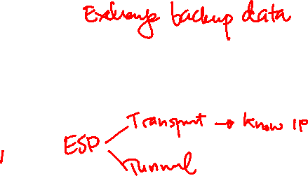
Implementing Site-to-Site VPN
(Chapter 7)

Slide 45

As we consider the VPN options that provide security, we remember that IPsec can perform the following:
  Confidentiality: Using symmetrical encryption algorithms such as 3DES, IDEA, AES, and so on to encrypt clear text into cipher text.
  Data integrity: Using hashing algorithms such as MD5 or SHA and Hashed Message Authentication Code (HMAC) to verify that data has not been manipulated during its transit across the network.
  Authentication: Done by authenticating the VPN peers near the beginning of a VPN session, using PSKs or digital signatures (leveraging digital certificates).
  Hiding the private address space from the Internet: Because IPsec’s Encapsulation Security Protocol (ESP) in tunnel mode encrypts and encapsulates the original packet, and then places a new IP header before forwarding the packet, the Internet sees only the packet as being from the global IP address of one router and destined to the global address of the second router.
IPsec uses two methods for encryption: tunnel and transport mode. If IPsec tunnel mode is used, the IP header and the payload are encrypted. When transport mode is used, only the packet payload is encrypted.

Slide 46
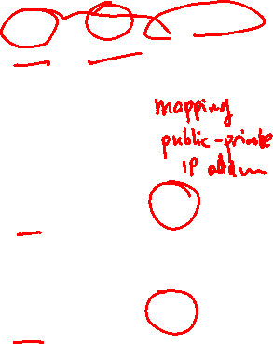
Protocols required for implementation
See chapter 7 for CISCO CLI configuration in both Router and ASA appliances

Slide 47

Summary of IPSec Story
In summary , the VPN peers/gateways negotiate the IKE Phase 1 tunnel using aggressive or main mode, and then use Quick mode to establish the IKE Phase 2 tunnel.
They use the IKE Phase 2 tunnel to encrypt and decrypt user packets. Behind the scenes, the IKE Phase 2 tunnel really creates two one-way tunnels: one from R1 to R2 and one from R2 to R1. The end user does not see the process in any detail, and end users do not know the encryption is even being applied to their packets.
So, we could say we have one IKE Phase 1 bidirectional tunnel used for management between the two VPN peers and two IKE Phase 2 unidirectional tunnels used for encrypting and decrypting end-user packets. These tunnels are often referred to as the security agreements between the two VPN peers.
Many times, these agreements are called security associations (SA). Each SA is assigned a unique number for tracking.
See pages 129, 137 – 139 (CLI) for VPN configuration example.

Slide 48
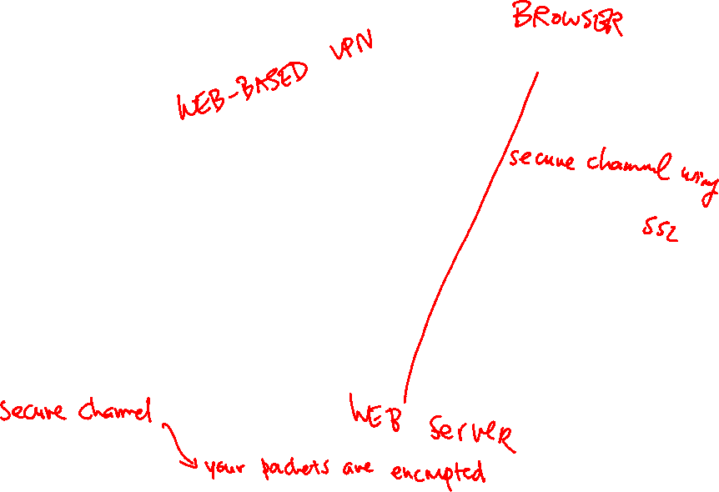
SSL VPN Concepts
Traditionally, for remote access, IPSec VPN client software is installed on a device.
Someone came up with the brilliant idea that using Secure Sockets Layer (SSL), which is built in to nearly every browser and can communicate securely with the server on the other side, could be used to implement tunnels between the end users and corporate servers or even corporate networks.

Slide 49

SSL and IPSec Comparison

Slide 50
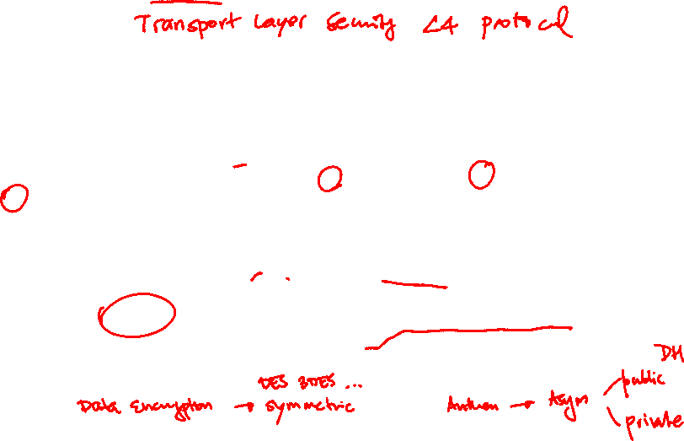
SSL and TLS Protocol Framework
TLS and its predecessor SSL are cryptographic protocols that provide secure transactions on the Internet for things such as e-mail, web browsing, instant messaging, and so on. SSL as a protocol was originally developed by Netscape. Most online transactions that are browser based are secured by SSL or TLS.
Both of these protocols provide confidentiality, integrity, and authentication services. These protocols are considered to be operating at the session layer and higher in the OSI logical model.
They both can use the public key infrastructure (PKI) and digital certificates for authentication of the VPN endpoints and for establishing encryption keys that may be used.
Similar to IPsec, these protocols use symmetric algorithms for bulk encryption, and asymmetric algorithms are used for the authentication and for the exchange of keys.

Slide 51


Slide 52






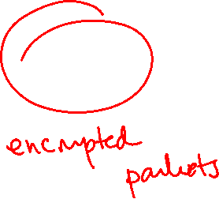
SSL VPNs
  Integrated security and routing
  Browser-based full network SSL VPN access
SSL VPN
Internet
Headquarters
SSL VPN
Tunnel
Workplace
Resources

Slide 53
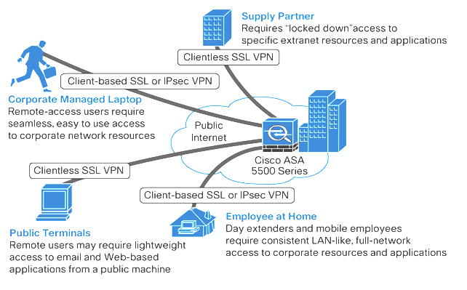
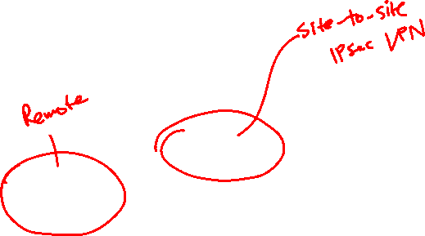
Types of Access

Slide 54
Full Tunnel Client Access Mode

Slide 55
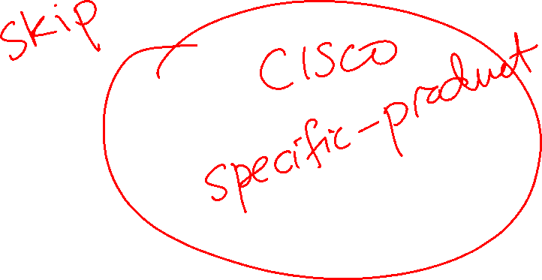

Slide 56



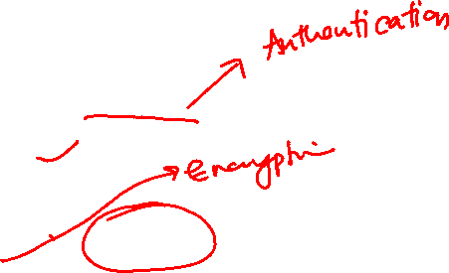
Establishing an SSL Session
User makes a connection to TCP port 443
1
Router replies with a digitally signed public key
2
User using SSL client
SSL VPN enabled ISR router
3
User software creates a shared-secret key
4
Shared-secret key, encrypted with public key of the server, is sent to the router
5
Bulk encryption occurs using the shared-secret key with a symmetric encryption algorithm

Slide 57



SSL VPN Design Considerations
User connectivity
Router feature
Infrastructure planning
Implementation scope

